Slide 1
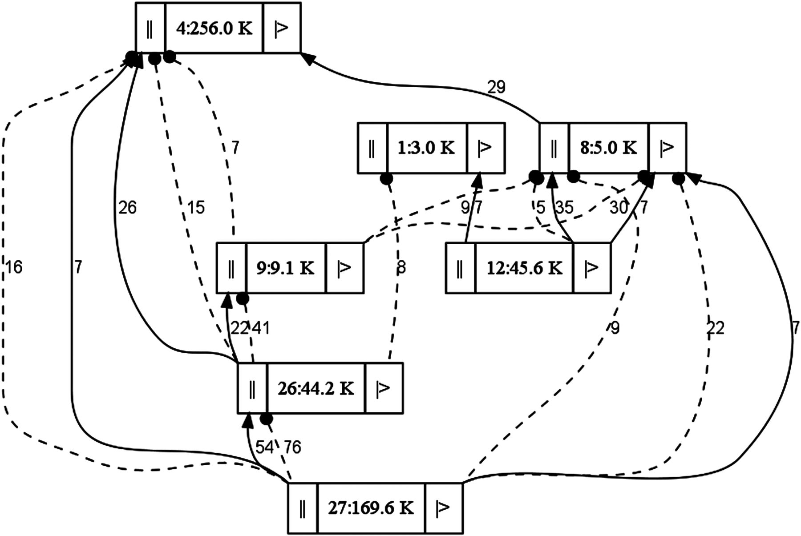
Figure 1. A scheme showing linking scaffold with the help of graph in a preliminary view of the assembly. Assembly ...
Notes:
Figure 1. A scheme showing linking scaffold with the help of graph in a preliminary view of the assembly. Assembly graphs were used as a guide to connect the scaffolds. Each box represent a scaffold, ‘||’ represent the 3′ end, and ‘|>’ represent the 5′ end of each scaffold. Number on each scaffold represents the scaffold number and size of the scaffold. The thick black lines indicate that the scaffolds are attached in correct orientation and spotted line indicate that the scaffolds are attached in reverse orientation in the assembly. Numbers on these lines represents the sequence coverage. The orientation of each scaffold was confirmed through Sanger sequencing.
Unless provided in the caption above, the following copyright applies to the content of this slide: © The Author 2013. Published by Oxford University Press on behalf of Kazusa DNA Research Institute.This is an Open Access article distributed under the terms of the Creative Commons Attribution License (http://creativecommons.org/licenses/by/3.0/), which permits unrestricted reuse, distribution, and reproduction in any medium, provided the original work is properly cited.

Slide 2
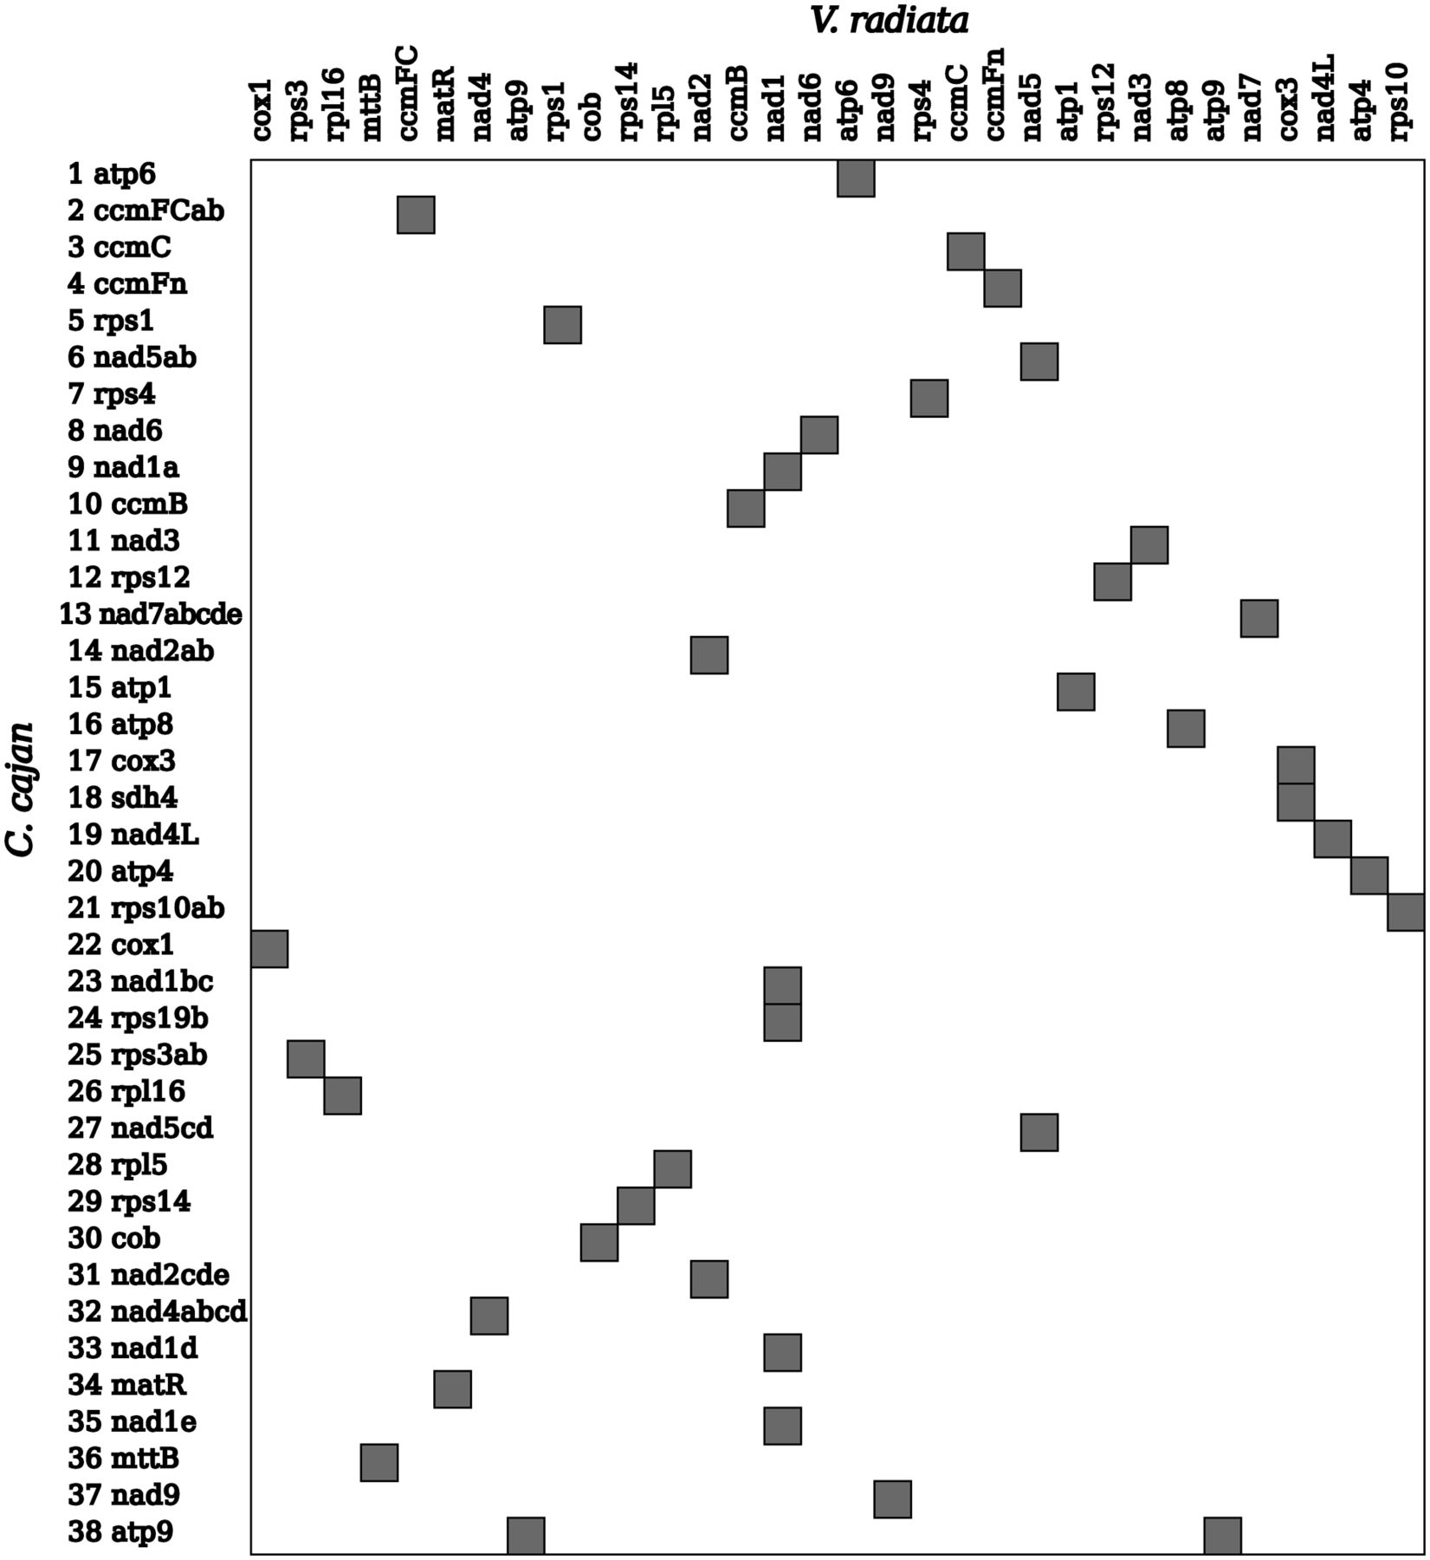
Figure 2. Correlation of gene order between the mitochondrial gene maps of C. cajan and V. radiata. Left-hand side is ...
Notes:
Figure 2. Correlation of gene order between the mitochondrial gene maps of C. cajan and V. radiata. Left-hand side is represented by genes identified in C. cajan and top side is represented by genes of V. radiata. Shaded blocks in the image represent the correlation of gene orders.
Unless provided in the caption above, the following copyright applies to the content of this slide: © The Author 2013. Published by Oxford University Press on behalf of Kazusa DNA Research Institute.This is an Open Access article distributed under the terms of the Creative Commons Attribution License (http://creativecommons.org/licenses/by/3.0/), which permits unrestricted reuse, distribution, and reproduction in any medium, provided the original work is properly cited.

Slide 3
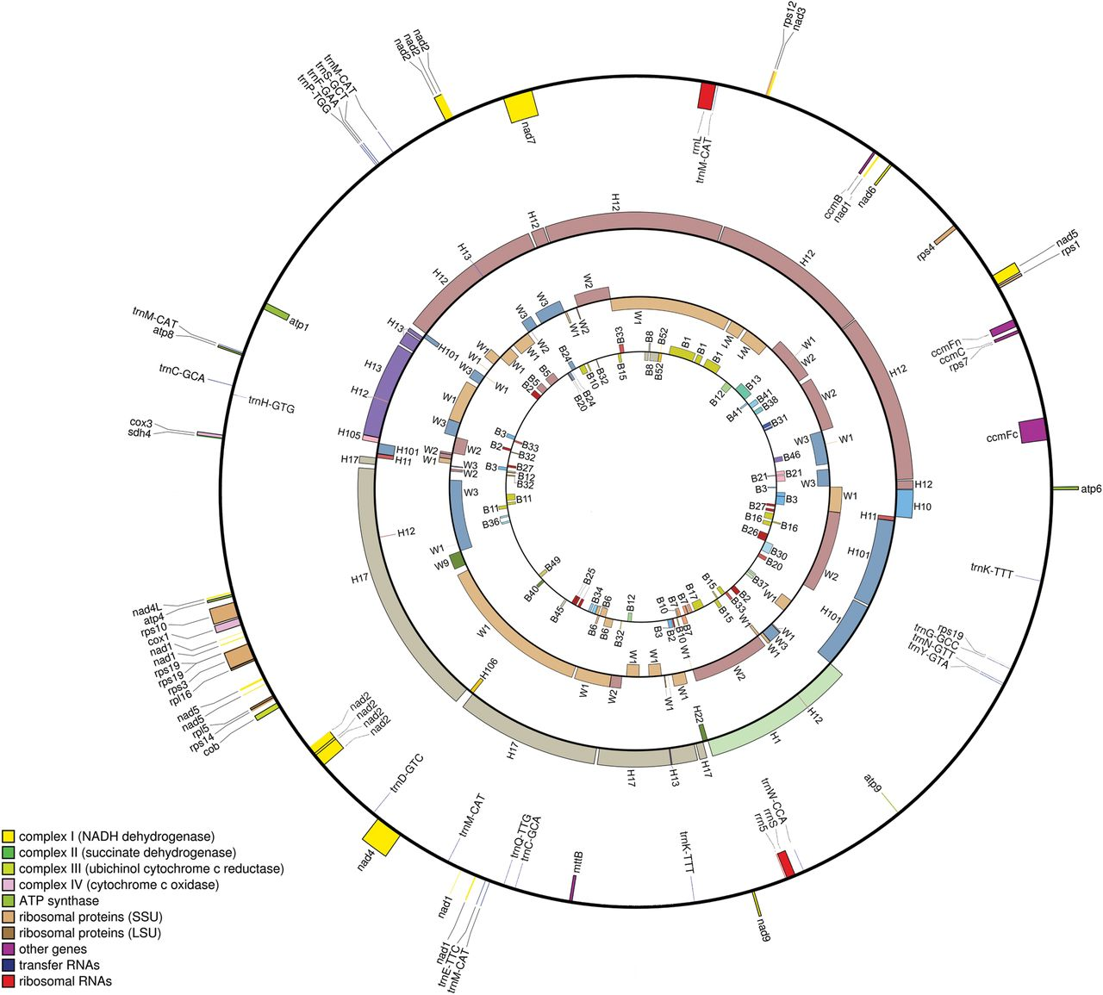
Figure 3. Alignments of Cajanus mitochondrial genomes. The outer circle represents the finalized mitochondrial genome ...
Notes:
Figure 3. Alignments of Cajanus mitochondrial genomes. The outer circle represents the finalized mitochondrial genome assembly and gene annotation of male-sterile line ICPA 2039. Second, third, and fourth circles from the outer circle represent the scaffolds of ICPH 2433, ICPW 29, and ICPB 2039 mapped on ICPA 2039 assembly. Numbers on each circle represent the scaffolds of each line. Hn represent the scaffolds for ICPH 2433, Wn represent the scaffolds for ICPW 29 and Bn represent the scaffolds for ICPB 2039, where n is the scaffold number.
Unless provided in the caption above, the following copyright applies to the content of this slide: © The Author 2013. Published by Oxford University Press on behalf of Kazusa DNA Research Institute.This is an Open Access article distributed under the terms of the Creative Commons Attribution License (http://creativecommons.org/licenses/by/3.0/), which permits unrestricted reuse, distribution, and reproduction in any medium, provided the original work is properly cited.

