Slide 1
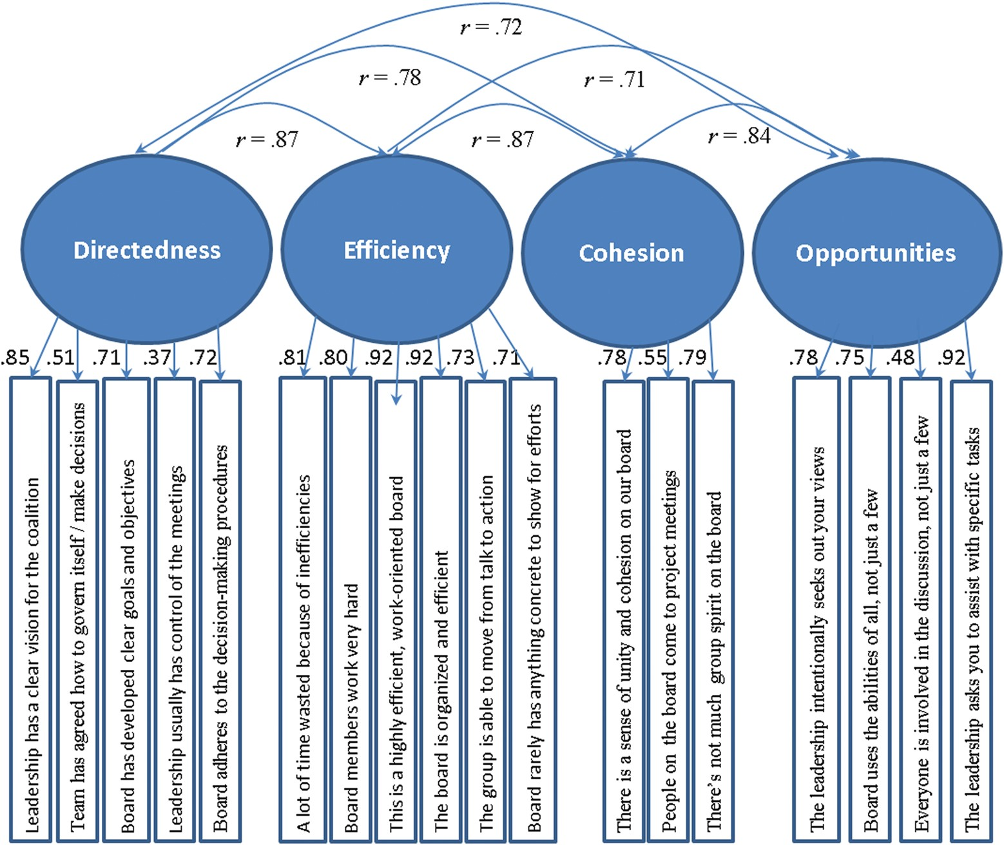
Figure 1: Factor Structure at Midpoint (Wave 3)
Notes:
Figure 1: Factor Structure at Midpoint (Wave 3)
Unless provided in the caption above, the following copyright applies to the content of this slide: © 2013 National Association of Social Workers

