Slide 1
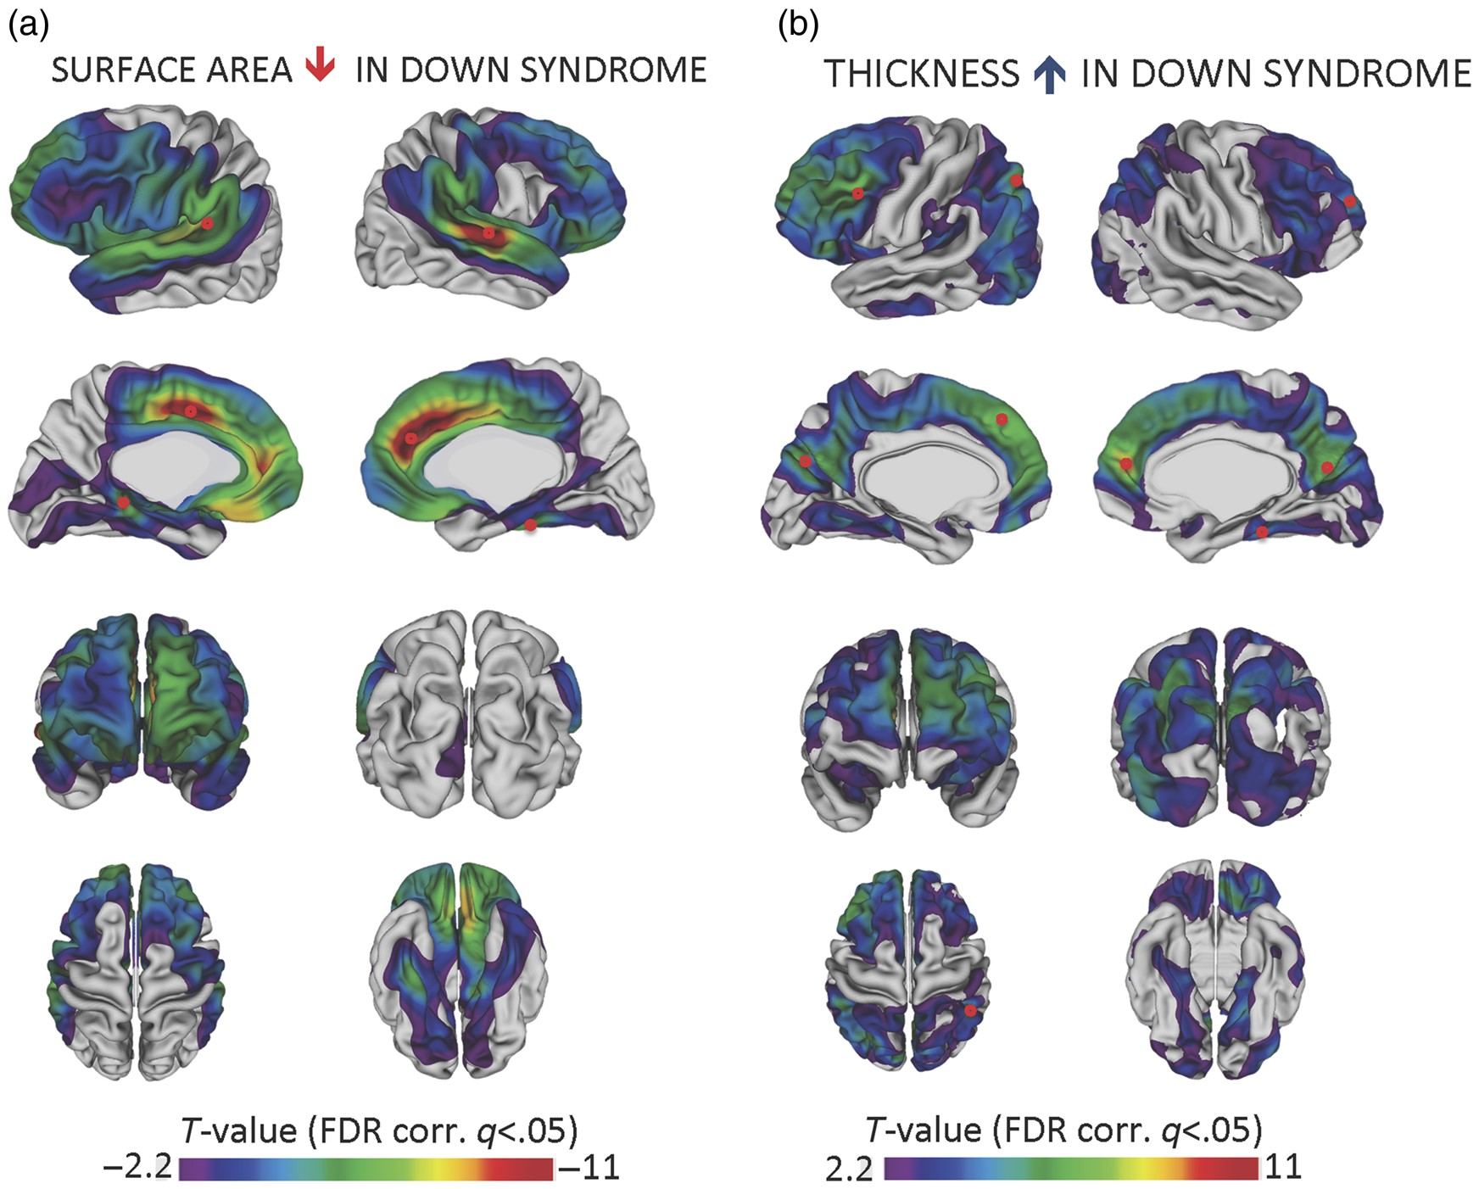
Figure 1. Reductions in cortical surface area and increases in cortical thickness in DS relative to typical controls. A ...
Notes:
Figure 1. Reductions in cortical surface area and increases in cortical thickness in DS relative to typical controls. A series of regression analyses were completed at 40 962 vertices in each hemisphere using the following regression equation: Cortical thickness or surface area (vertexj) ∼ intercept + β1(Sex) + β2 (age centered) + β3 (group). T-statistics associated with the group term that exceeded the FDR-corrected threshold of ±2.2 were projected onto the cortex. Panel (a) displays surface area findings; panel (b) displays cortical thickness findings. Note that the range of T-values for surface area is negative 2.2 to negative 11 while the range for thickness is positive 2.2 to positive 11. This is because DS is associated with largely decreased surface area relative to controls but largely increased cortical thickness. To identify regions in which cortical surface area and thickness were most deviant from controls, the t-scores associated with the group term in the regression equation were ranked and those vertices above the 90th percentile for thickness and below the 10th percentile for surface area were identified. The approximate locations of the peak vertices within these regions are marked with small red circles in panels (a) and (b).
Unless provided in the caption above, the following copyright applies to the content of this slide: Published by Oxford University Press 2015. This work is written by (a) US Government employee(s) and is in the public domain in the US.

