Slide 1
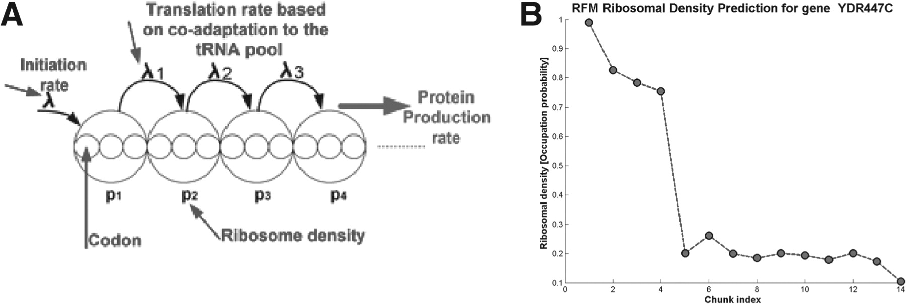
Fig. 1. (A) An illustration of the RFM model. (B) An example ribosomal density profile of the ribosomal protein RP51B ...
Notes:
Fig. 1. (A) An illustration of the RFM model. (B) An example ribosomal density profile of the ribosomal protein RP51B (YDR447C)—an output of RFMapp
Unless provided in the caption above, the following copyright applies to the content of this slide: © The Author 2012. Published by Oxford University Press. All rights reserved. For Permissions, please email: journals.permissions@oup.com

