Slide 1
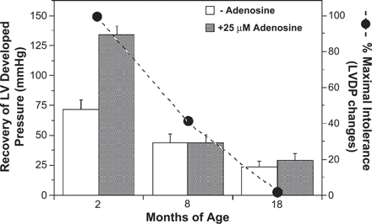
Fig. 1 Aging-related reduction in functional recovery from 20 min global ischemia in young (2 month), mature (8 ...
Notes:
Fig. 1 Aging-related reduction in functional recovery from 20 min global ischemia in young (2 month), mature (8 month) and old (18 month) C57/Bl6 mouse hearts. Recovery of left ventricular pressure was assessed after 60 min reperfusion in untreated and adenosine treated hearts (n=6–9). Also shown is relative development of ischemic “intolerance” (% maximal decline in tolerance observed to 27 months of age –data modified from Refs. [15,103]).
Unless provided in the caption above, the following copyright applies to the content of this slide: Copyright © 2004, European Society of Cardiology

Slide 2
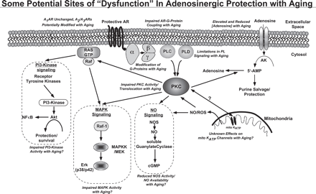
Fig. 2 Schematic of adenosinergic cardioprotective signalling. Possible aging are highlighted in italicized text. ...
Notes:
Fig. 2 Schematic of adenosinergic cardioprotective signalling. Possible aging are highlighted in italicized text. Pathways of protection remain unclear, though evidence supports roles for PKC, mito KATP channels, ROS generation, and MAPKs. There is some support for PI3-kinase signaling. Abbreviations: AK, adenosine kinase; mito KATP, mitochondrial ATP-sensitive K+ channels; PKC, protein kinase C; PL, phospholipase; PLC, phospholipase C; PLD, phospholipase D; ROS, reactive oxygen species.
Unless provided in the caption above, the following copyright applies to the content of this slide: Copyright © 2004, European Society of Cardiology

