Slide 1
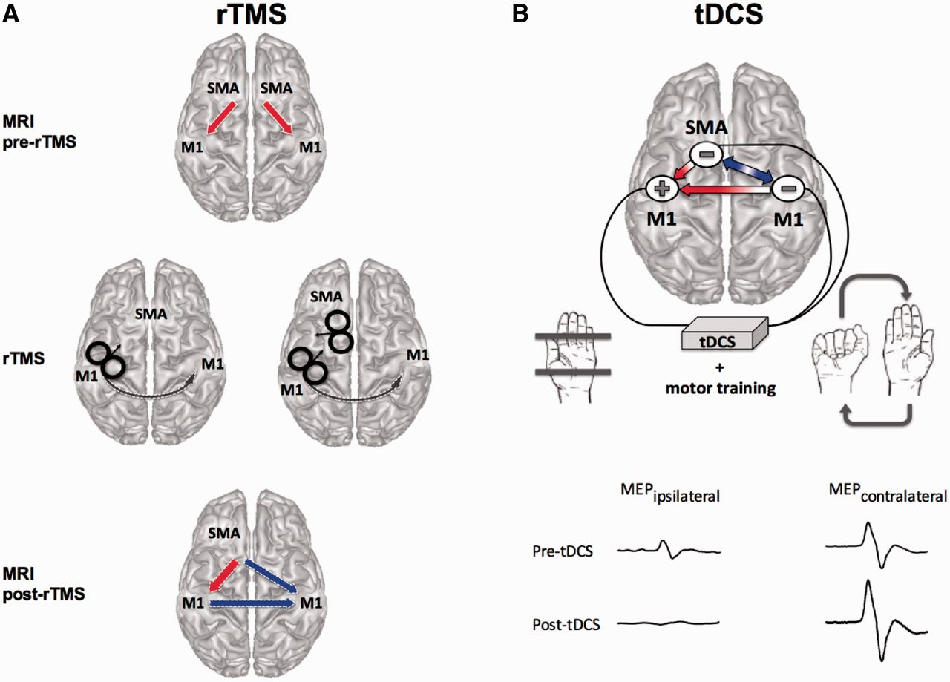
Figure 1 Set-up suggestion using non-invasive brain stimulation for congenital mirror movement rehabilitation. (A) In ...
Notes:
Figure 1 Set-up suggestion using non-invasive brain stimulation for congenital mirror movement rehabilitation. (A) In congenital mirror movements, functional MRI results showed an abnormal bilateral drive from the supplementary motor area (SMA) to the M1 during unimanual movement (red arrows, upper panel; Gallea et al., 2013). Excitatory repetitive TMS (rTMS) can be applied either alone to one M1 or as paired-pulse rTMS of the target M1 and the ipsilateral supplementary motor area (middle panel). This should enhance the inhibitory drive from the stimulated M1 to the contralateral M1 (grey arrow). If a functional MRI connectivity study would be conducted after rTMS, it should show: normal unilateral SMA-M1 coupling (red arrow, lower panel), and decreased drive from SMA and M1 ipsilateral to the stimulation towards the contralateral M1 (blue arrows, lower panel) during attempted unimanual actions. (B) In this three-leads transcranial direct current stimulation (tDCS) set-up using mini-electrodes, the anode is placed over the target M1, while two cathodes are placed over the contralateral M1 and ipsilateral SMA. The tDCS would be applied during unimanual training (voluntary rhythmic movements of the contralateral hand while the ipsilateral hand is constrained). Ideally, such potentiated exercises should (i) rise the excitability of the target M1, (ii) reduce the excitability of contralateral M1, (iii) enhance the excitatory drive from the ipsilateral SMA to the target M1 (small red arrow), (iv) enhance the excitatory drive from the pyramidal neurons in contralateral M1 to the inhibitory interneurons in the target M1 (big red arrow), and (v) reduce the functional coupling between the ipsilateral SMA and contralateral M1 (blue arrow). Such boosted sessions of unimanual training should help to differentially modulate the excitability of each M1 when evaluated by single TMS pulses (lower panel). MEP = motor evoked potential.
Unless provided in the caption above, the following copyright applies to the content of this slide: © The Author (2014). Published by Oxford University Press on behalf of the Guarantors of Brain. All rights reserved. For Permissions, please email: journals.permissions@oup.com

