Slide 1
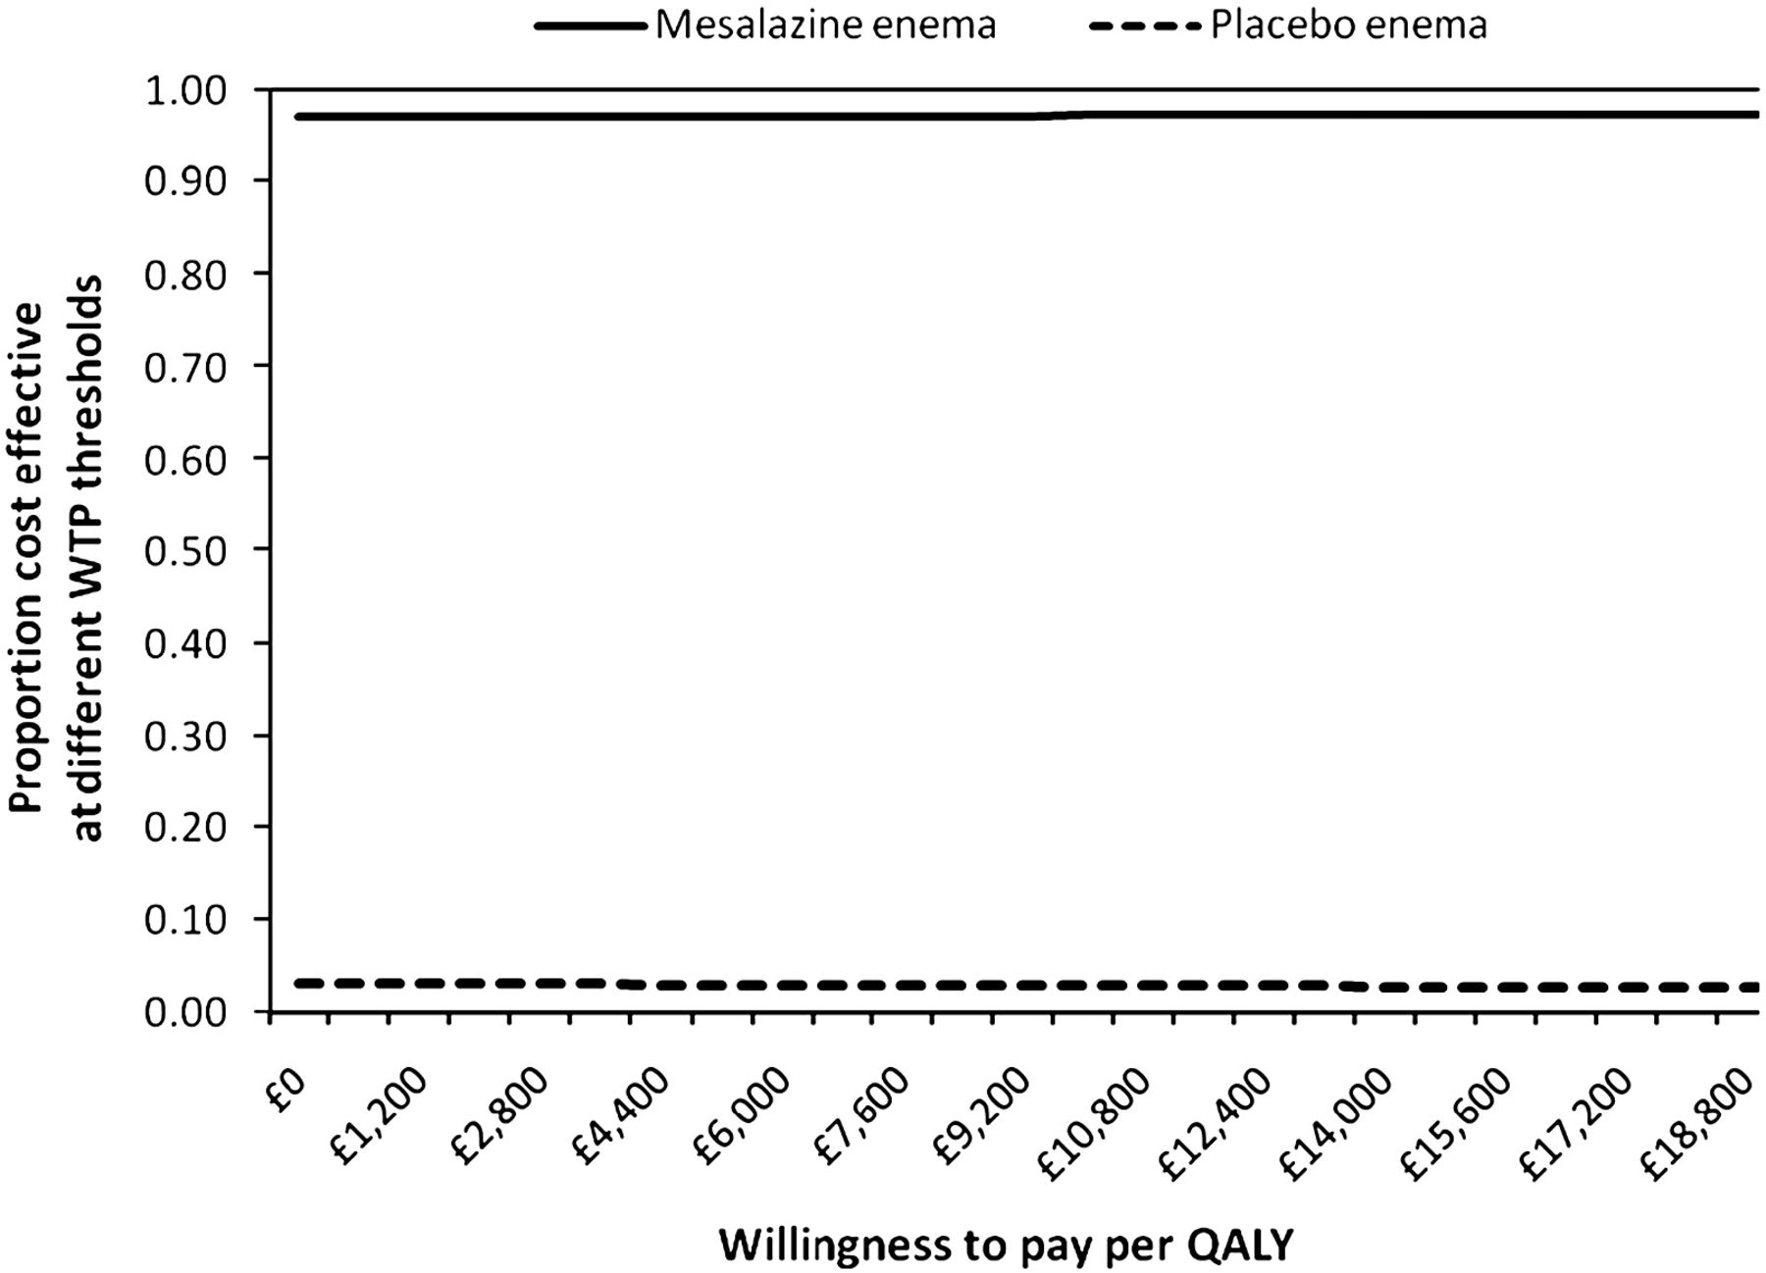
Figure 1 Cost-effectiveness acceptability curve for combined oral and topical mesalazine compared with oral mesalazine ...
Notes:
Figure 1 Cost-effectiveness acceptability curve for combined oral and topical mesalazine compared with oral mesalazine based on willingness-to-pay (WTP) threshold from £0 to £20,000 in base case.
Unless provided in the caption above, the following copyright applies to the content of this slide: © 2009 European Crohn's and Colitis Organisation

