Slide 1
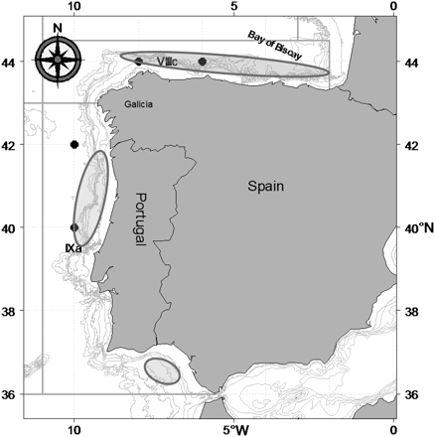
Figure 1. Map of the distribution area of the Iberian sardine stock. Limits of the ICES Subdivisions covered by the ...
Notes:
Figure 1. Map of the distribution area of the Iberian sardine stock. Limits of the ICES Subdivisions covered by the stock (VIIIc and IXa) are shown together with the main spawning locations (shaded areas). The dots indicate the position of the local environmental variables (SST, AT, wind strength, and the northerly and westerly components of wind direction) used in this study.
Unless provided in the caption above, the following copyright applies to the content of this slide: © 2011 International Council for the Exploration of the Sea. Published by Oxford University Press. All rights reserved. For Permissions, please email: journals.permissions@oup.com

Slide 2
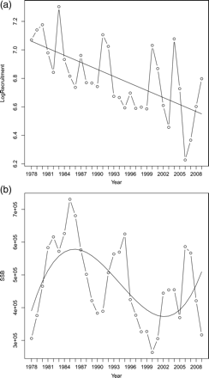
Figure 2. Fitted trends superimposed in the (a) recruitment (log-transformed number of individuals) and (b) SSB (t) ...
Notes:
Figure 2. Fitted trends superimposed in the (a) recruitment (log-transformed number of individuals) and (b) SSB (t) series for the Iberian sardine stock.
Unless provided in the caption above, the following copyright applies to the content of this slide: © 2011 International Council for the Exploration of the Sea. Published by Oxford University Press. All rights reserved. For Permissions, please email: journals.permissions@oup.com

Slide 3
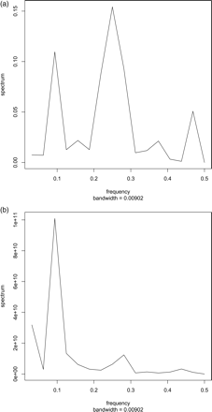
Figure 3. Cycles in detrended (a) recruitment (log-transformed number of individuals) and (b) SSB (t) series for the ...
Notes:
Figure 3. Cycles in detrended (a) recruitment (log-transformed number of individuals) and (b) SSB (t) series for the Iberian sardine stock.
Unless provided in the caption above, the following copyright applies to the content of this slide: © 2011 International Council for the Exploration of the Sea. Published by Oxford University Press. All rights reserved. For Permissions, please email: journals.permissions@oup.com

Slide 4
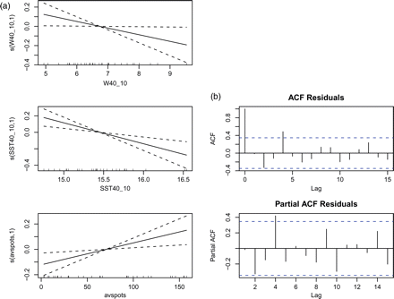
Figure 4. Final GAMs of recruitment (log-transformed number of individuals) in relation to environmental variables (lag ...
Notes:
Figure 4. Final GAMs of recruitment (log-transformed number of individuals) in relation to environmental variables (lag 0): (a) smoothers for significant effects of wind strength (W40_10, in m s−1) and SST (SST40_10, °C) measured in winter at location 40°N 10°W and average annual number of sunspots (avspots), and (b) autocorrelograms (AC and PAC) showing that significant AC (time-lag 4) is present in the residuals.
Unless provided in the caption above, the following copyright applies to the content of this slide: © 2011 International Council for the Exploration of the Sea. Published by Oxford University Press. All rights reserved. For Permissions, please email: journals.permissions@oup.com

Slide 5
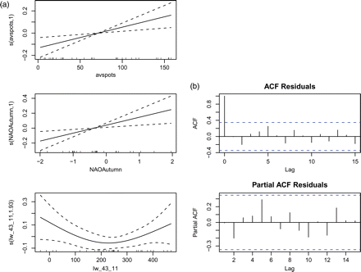
Figure 5. Final GAMs of recruitment (log-transformed number of individuals) in relation to environmental variables (lag ...
Notes:
Figure 5. Final GAMs of recruitment (log-transformed number of individuals) in relation to environmental variables (lag 1): (a) smoothers for significant effects of average annual number of sunspots (avspots), NAOAutumn (averaged over September–November), and the upwelling index (lw_43_11, in m3s−1 km−1) measured at location 43°N 11°W, and (b) autocorrelograms (AC and PAC) showing no significant AC in the residuals.
Unless provided in the caption above, the following copyright applies to the content of this slide: © 2011 International Council for the Exploration of the Sea. Published by Oxford University Press. All rights reserved. For Permissions, please email: journals.permissions@oup.com

Slide 6
Figure 6. ARMA decomposition of the recruitment series (log-transformed) into (a) trend, and (b) noise (residuals) ...
Notes:
Figure 6. ARMA decomposition of the recruitment series (log-transformed) into (a) trend, and (b) noise (residuals) components by fitting an ARMA (4,0) model. The autocorrelograms for (c) AC and (d) PAC show that the residuals of this model are free of AC.
Unless provided in the caption above, the following copyright applies to the content of this slide: © 2011 International Council for the Exploration of the Sea. Published by Oxford University Press. All rights reserved. For Permissions, please email: journals.permissions@oup.com

