Slide 1
Fig. 1 Schematic diagram illustrating the multi-domain PKCγ protein. The C2 region of the C1 domain is shown in the ...
Notes:
Fig. 1 Schematic diagram illustrating the multi-domain PKCγ protein. The C2 region of the C1 domain is shown in the inset below; G118D and C150F are indicated. The binding properties of the C1 and CyS2 domains and the relative positions of the autophosphorylation sites are revealed above the diagram.
Unless provided in the caption above, the following copyright applies to the content of this slide: Brain Vol. 128 No. 2 © Guarantors of Brain 2004; all rights reserved

Slide 2
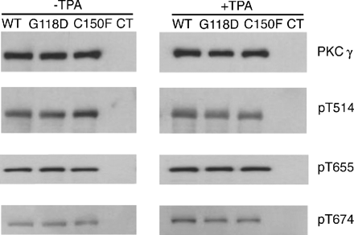
Fig. 2 The autophosphorylation of mutant PKCγ is unaltered from the wild-type pattern. Total PKCγ-GFP levels of the ...
Notes:
Fig. 2 The autophosphorylation of mutant PKCγ is unaltered from the wild-type pattern. Total PKCγ-GFP levels of the wild-type and mutant proteins from transfected COS-7 cells were normalized and detected by western blotting with an anti-PKC (α, β, γ) antibody (top panel). Similar levels of phosphorylation were observed at T514 (second panel), T655 (third panel), and T674 (fourth panel) of GFP-tagged wild-type (WT) and mutant (G118D, C150F) before and after TPA treatment, using phosphospecific antibodies for the western blots. The amount of anti-PKCγ immunoreactivity was equivalent in the transfected samples, and the untransfected cells (CT) showed no immunoreactivity in the 110 kDa size range.
Unless provided in the caption above, the following copyright applies to the content of this slide: Brain Vol. 128 No. 2 © Guarantors of Brain 2004; all rights reserved

Slide 3
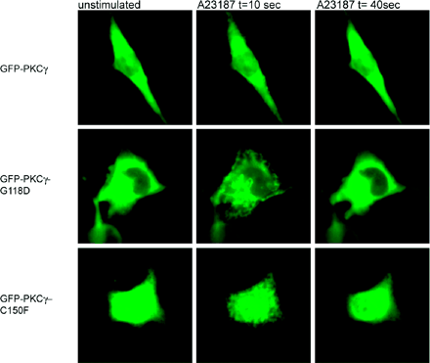
Fig. 3 Ca²⁺ induces a rapid translocation of mutant PKCγ to discreet regions of the plasma membrane. By ...
Notes:
Fig. 3 Ca2+ induces a rapid translocation of mutant PKCγ to discreet regions of the plasma membrane. By 10 s after the addition of the Ca2+ ionophore, A23187, wild-type and mutant PKCγ-GFP translocated to the plasma membrane. The fluorescent signal was enriched in membrane-ruffle like regions of the mutant PKCγ-GFP expressing cells. Less fluorescence was detected in the cytosol of these cells compared with the wild-type PKCγ-GFP expressing cells at the early time point. The wild-type and mutant fusion proteins reverted to the initial distribution by 40 s.
Unless provided in the caption above, the following copyright applies to the content of this slide: Brain Vol. 128 No. 2 © Guarantors of Brain 2004; all rights reserved

Slide 4
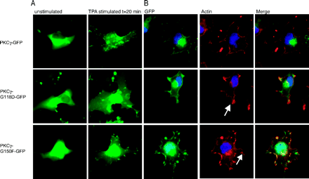
Fig. 4 TPA-induced translocation of GFP-tagged wild-type and mutant PKCγ is similar. (A) The subcellular ...
Notes:
Fig. 4 TPA-induced translocation of GFP-tagged wild-type and mutant PKCγ is similar. (A) The subcellular distribution of wild-type and mutant PKCγ is indistinguishable prior to TPA stimulation (left panel), and only subtle differences in membrane localization are apparent 20 min after stimulation (right panel). (B) There is an apparent increase in the number of transfected cells (GFP positive; left panel) showing actin-rich membrane ruffles detected by Alexa fluor 594-tagged phalloidin (red; middle panel). In cells that had apparent membrane ruffles, co-localization of GFP-tagged kinase and phalloidin-labeled actin filaments (yellow; left panel) was observed.
Unless provided in the caption above, the following copyright applies to the content of this slide: Brain Vol. 128 No. 2 © Guarantors of Brain 2004; all rights reserved

Slide 5
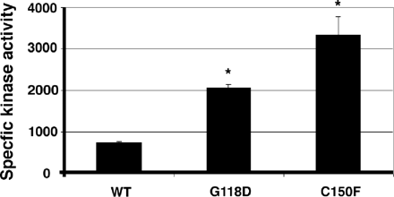
Fig. 5 Mutations in the Cys2 Subdomain increase the phosphotransferase activity of PKCγ in vitro. Anti-GFP ...
Notes:
Fig. 5 Mutations in the Cys2 Subdomain increase the phosphotransferase activity of PKCγ in vitro. Anti-GFP immunoprecipitates from cells expressing wild-type (WT), G118D, and C150F PKCγ were assayed for kinase activity using a PKC-peptide substrate. *Differs from wild-type at P < 0.01 by t-test.
Unless provided in the caption above, the following copyright applies to the content of this slide: Brain Vol. 128 No. 2 © Guarantors of Brain 2004; all rights reserved

