Slide 1
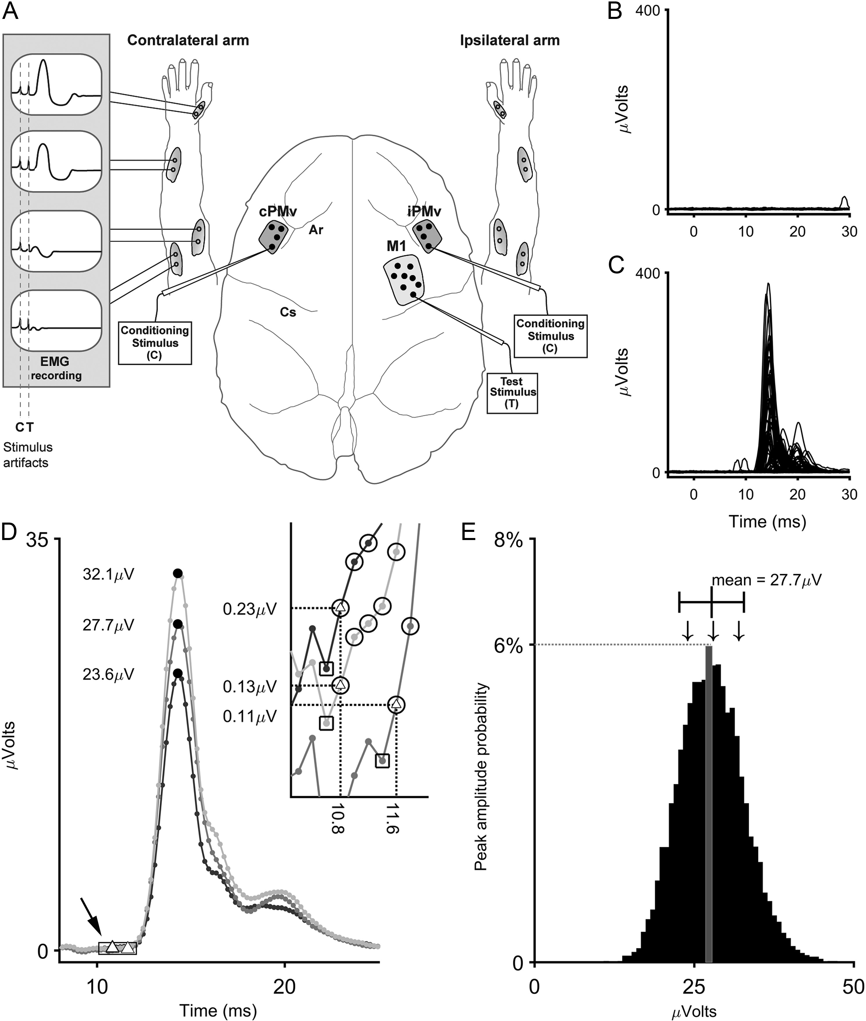
Figure 1. Experimental methods. (A) Schematic representation of the experimental setup. Six (n = 1) or eight muscles ...
Notes:
Figure 1. Experimental methods. (A) Schematic representation of the experimental setup. Six (n = 1) or eight muscles (n = 3) in each arm were implanted in each monkey to record EMG signals. We located M1 (light gray area) and iPMv in one hemisphere and cPMv in the opposite hemisphere (dark gray areas). Dots within the shaded areas show hypothetical stimulation sites in these cortical areas. The two electrodes used for the paired-pulse protocol were then positioned in hand representations of M1 of iPMv or cPMv. Ar: arcuate sulcus; Cs: central sulcus. (B) Example of single trial responses in the FPB with the C-only condition (n = 150) applied in iPMv in a representative protocol. The current intensity of conditioning stimulus (Cstim) was adjusted to be subthreshold. Accordingly, no obvious MEP is observed. (C) Single trial responses in the FPB with the T-only stimulation in M1 (n = 150) in the same protocol. The current intensity for the delivery of the single pulses was set at 125% of the threshold, yielding a clear MEP. (D) From the same protocol, 3 average predicted MEPs calculated with C-only and T-only trials are shown. Each average predicted MEP was generated by averaging 150 randomly drawn predicted traces from the pool of all C-only and T-only combinations (see “Methods” section). For each average predicted MEP, the peak maximum (black dots) and minimum (white triangles) are identified. The inset (top right) is a magnified view of the peak minima obtained using a backward march from the peak (small black arrow). Circles indicate points with a voltage value at 5% higher than the following points on the backward march (see “Methods” section). Squares indicate the first point with a voltage value less than 5% higher than the following point on the backward march. The peak minimum was the previous point (triangle within a black circle). The peak amplitude was defined as the change in potential between the peak minimum and the peak maximum. This process was repeated 10 000 times to produce the probability distribution of predicted peak amplitudes shown in (E). (E) Histogram of the probability distribution of predicted peak amplitudes in the FPB for the same protocol. The histogram presents the probability of occurrence (y axis) of peaks with different magnitudes (x axis). For example, the highlighted bin in gray shows that the probability that the average predicted MEPs would have amplitudes between 27.3 and 28 µV is approximately 6%. The black line and whiskers above the histogram indicate the mean and standard deviation of the distribution. The arrows indicate the location of the peak amplitudes from the 3 example traces in panel D. To quantify the interaction effects in paired-pulse trials (C + T), the conditioned MEP peak amplitude Z-score was compared to this probability distribution.
Unless provided in the caption above, the following copyright applies to the content of this slide: © The Author 2016. Published by Oxford University Press.This is an Open Access article distributed under the terms of the Creative Commons Attribution Non-Commercial License (http://creativecommons.org/licenses/by-nc/4.0/), which permits non-commercial re-use, distribution, and reproduction in any medium, provided the original work is properly cited. For commercial re-use, please contact journals.permissions@oup.com

Slide 2
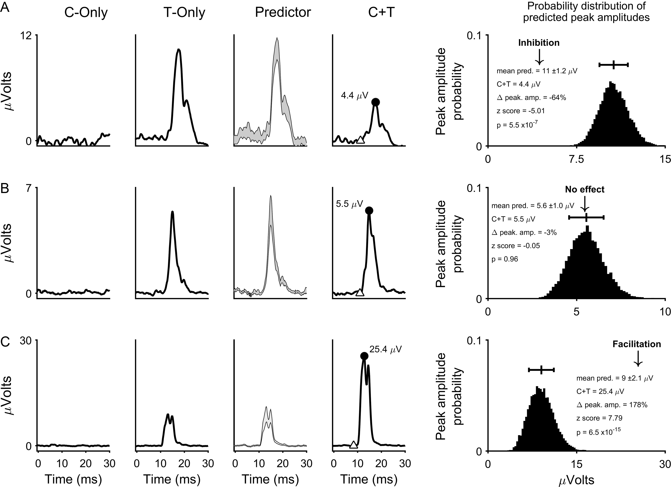
Figure 2. Comparison of the conditioned response with the probability distribution. Each row shows an example of ...
Notes:
Figure 2. Comparison of the conditioned response with the probability distribution. Each row shows an example of comparison between the probability distribution of predicted peak amplitudes and a conditioned response (C + T). EMG traces are aligned (Time = 0 ms) to the end of the Cstim for the C-only trials and to the end of the Tstim for the T-only and the C + T trials. (A) The top row shows an example in which the conditioning of the contralateral PMv (cPMv) decreased the MEP of the FPB (inhibitory effect). The first and second columns show mean traces of 150 trials with C-only and T-only stimulations, respectively. To provide an appreciation of the variability of the predicted responses, the third column shows ±1 standard deviation of the mean of all 10 000 average predicted MEPs. The fourth column shows the mean MEP when the Cstim preceded the Tstim by 15 ms (ISI15). The conditioned MEP peak maximum (black dot) and minimum (white triangle) values were identified to calculate the peak amplitude. In the fifth column, the relative value (Z-score) of the conditioned MEP peak amplitude (arrow) is compared to the probability distribution of predicted peak amplitudes. MEP peak amplitude Z-scores ≤ −1.96 or ≥ 1.96 were considered significantly different from the prediction (p ≤ 0.05). The black line and the whiskers above the histogram of the probability distribution show its mean and standard deviation, respectively. In this example, the conditioned MEP was smaller and its peak amplitude of 4.4 µV is clearly outside the range of the predicted peak amplitudes. This translates into a strongly significant negative Z-score (Z = −5.1; p = 5.5 × 10−7). Thus, with ISI15 the conditioning of cPMv resulted in a significant inhibition of M1 outputs to this muscle. (B) The middle row shows an example in which the conditioning of iPMv 1 ms before the T stimulation in M1 (ISI1) had no effect on the MEP recorded in APB. The conditioned MEP (fourth column) is not markedly different from the mean predicted MEPs (third column). Accordingly, the 5.5 µV value of the peak amplitude of the conditioned MEP (fifth column, arrow) fell within the range of the predicted peak amplitudes and the Z-score was not significant (Z = −0.05; p = 0.96). This result supports that with ISI1, the C stimulation in iPMv did not modulate M1 output to this muscle. (C) The bottom row shows an example in which the conditioning of iPMv 10 ms before the T stimulation (ISI10) increased the MEP recorded in FDS. The conditioned MEP (fourth column) is much greater than the mean predicted MEPs (third column). Its peak amplitude of 25.4 µV is clearly outside the range of the predicted peak amplitudes (fifth column, arrow) with a strongly significant positive Z-score (Z = 7.79; p = 6.5 × 10−15). Thus, with ISI10 the C stimulus in iPMv significantly facilitated M1 output to this muscle.
Unless provided in the caption above, the following copyright applies to the content of this slide: © The Author 2016. Published by Oxford University Press.This is an Open Access article distributed under the terms of the Creative Commons Attribution Non-Commercial License (http://creativecommons.org/licenses/by-nc/4.0/), which permits non-commercial re-use, distribution, and reproduction in any medium, provided the original work is properly cited. For commercial re-use, please contact journals.permissions@oup.com

Slide 3
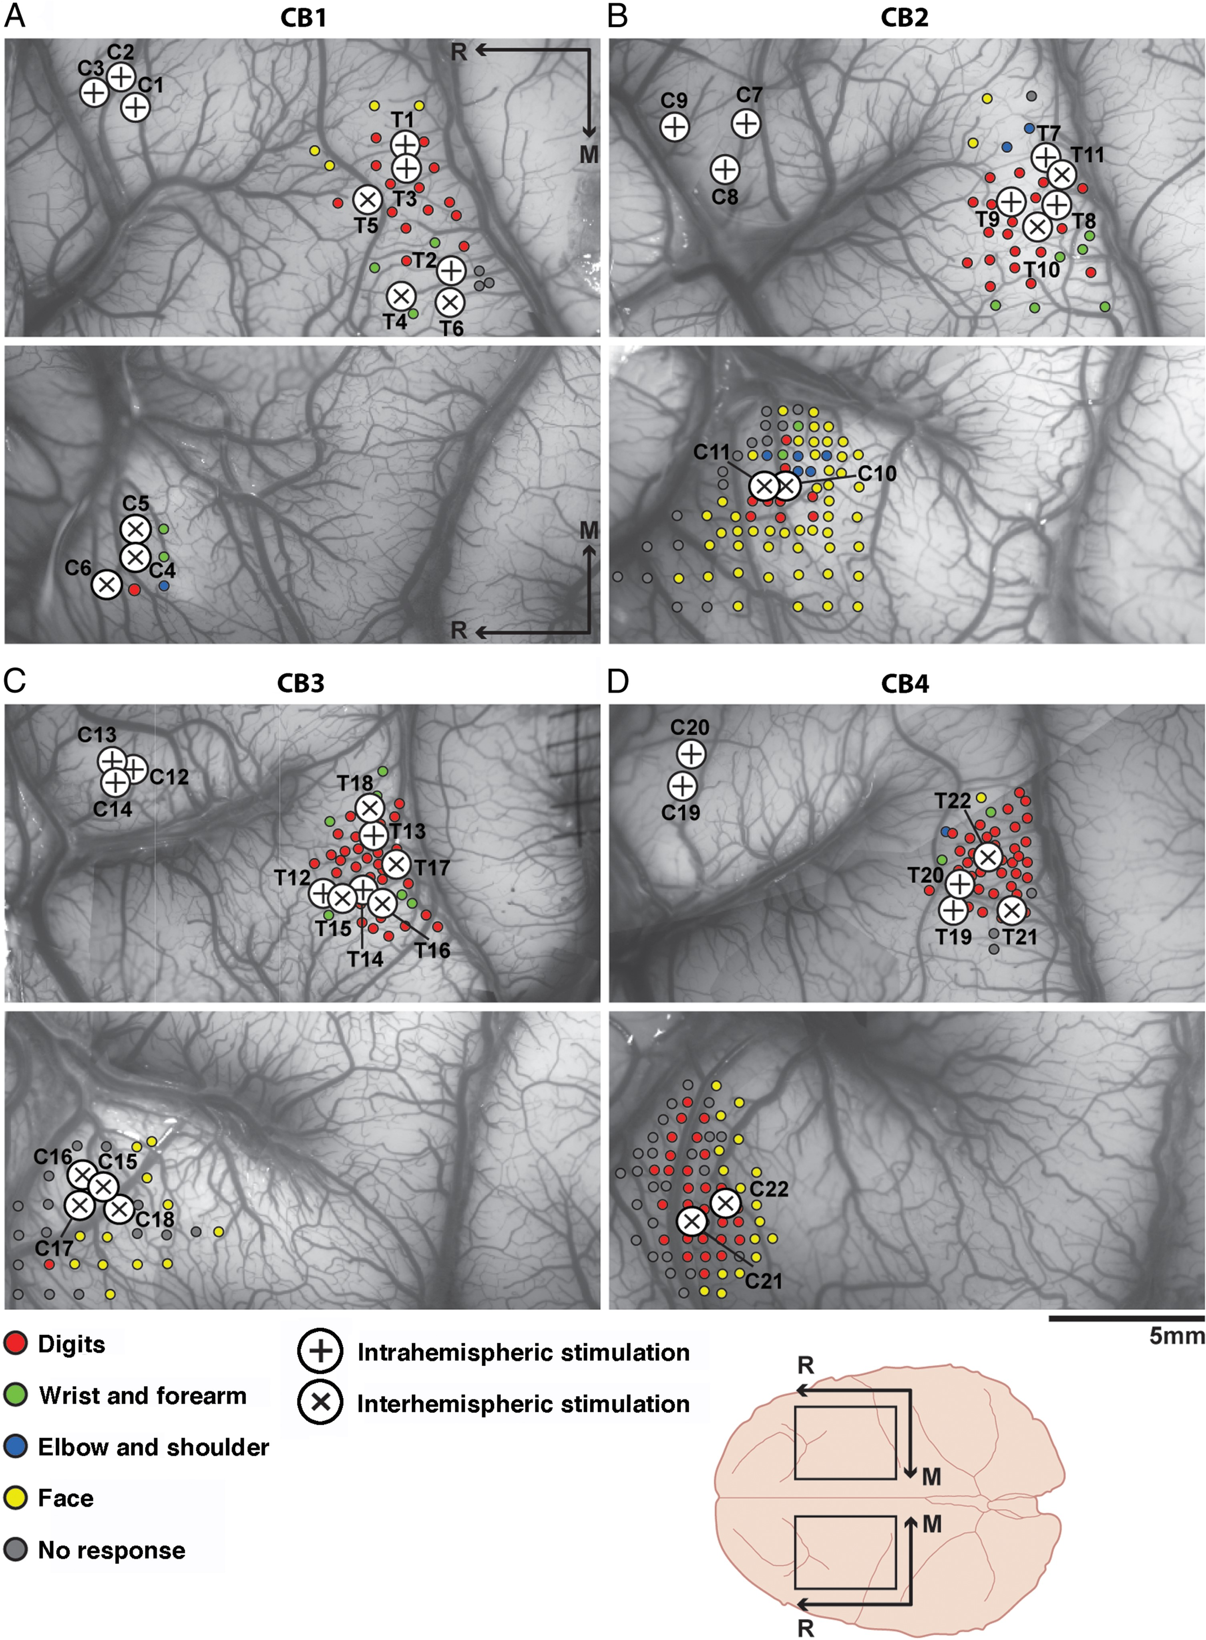
Figure 3. Cortical location of the C_{stim} and T_{stim} electrodes selected for paired-pulse ...
Notes:
Figure 3. Cortical location of the Cstim and Tstim electrodes selected for paired-pulse protocols. (A) Motor mapping data and cortical sites selected for the paired-pulse protocols conducted in CB1. ICMS trains were used to locate the hand representation in M1 and in cPMv (colored dots). The evoked movements in the forearm and hand muscles contralateral to the stimulated hemisphere at threshold current intensity are color-coded according to the legend at the bottom of the figure. Once the hand representations were located, cortical sites evoking EMG responses in at least one of the implanted forearm or intrinsic hand muscles at relatively low current intensity were selected for the paired-pulse protocols. In CB1, 3 protocols were conducted with the C electrode in iPMv (large circles with +) and 3 protocols with the Cstim electrode in cPMv (large circles with ×). The location of the T electrodes in M1 for each protocol is shown with the same symbols. (B) Motor mapping data and cortical sites selected for the paired-pulse protocols conducted in CB2. In this animal, 3 protocols were conducted with the Cstim electrode in iPMv and 2 protocols with the Cstim electrode in cPMv. (C) In CB3, 3 protocols were conducted with the Cstim electrode in iPMv and 4 protocols with the Cstim electrode in cPMv. (D) Finally in CB4, 2 protocols were conducted with the Cstim electrode in iPMv and 2 protocols with the Cstim electrode in cPMv.
Unless provided in the caption above, the following copyright applies to the content of this slide: © The Author 2016. Published by Oxford University Press.This is an Open Access article distributed under the terms of the Creative Commons Attribution Non-Commercial License (http://creativecommons.org/licenses/by-nc/4.0/), which permits non-commercial re-use, distribution, and reproduction in any medium, provided the original work is properly cited. For commercial re-use, please contact journals.permissions@oup.com

Slide 4
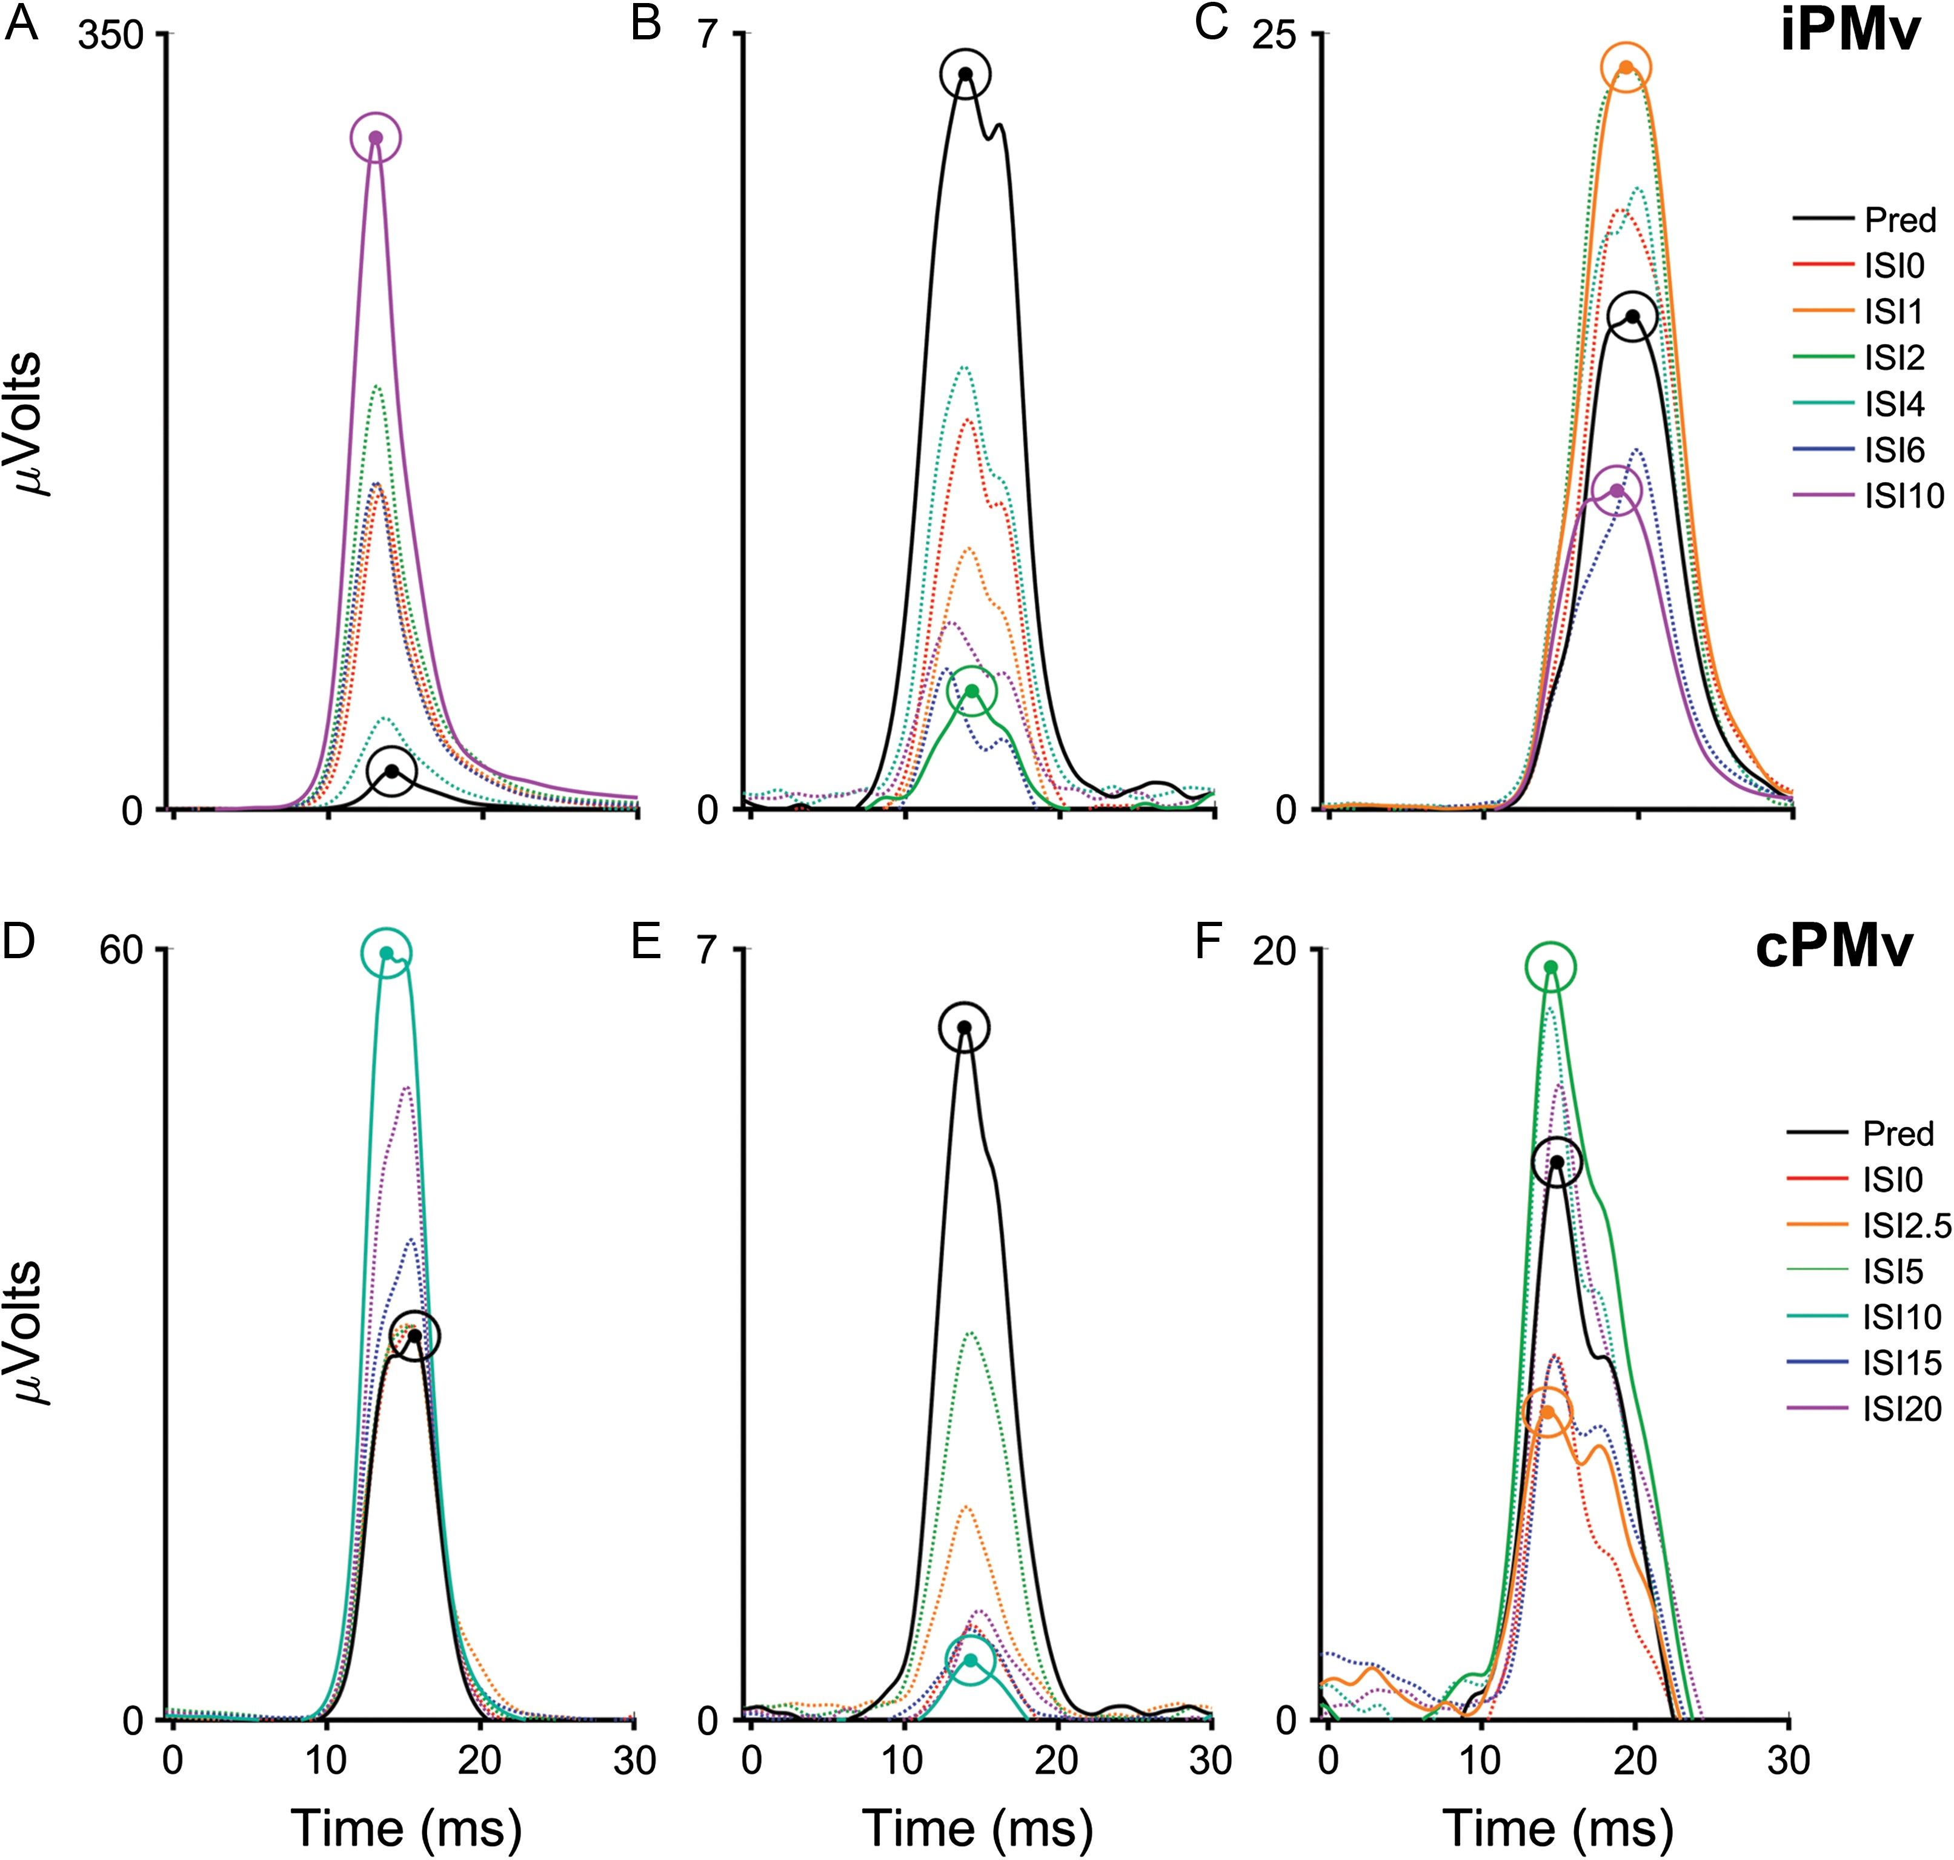
Figure 4. Examples of modulatory effects caused by iPMv and cPMv conditioning. The top row (A–C) shows examples in ...
Notes:
Figure 4. Examples of modulatory effects caused by iPMv and cPMv conditioning. The top row (A–C) shows examples in which the conditioning electrode was in iPMv and the bottom row (D–F) shows examples in which the conditioning electrode was in cPMv. Each panel presents MEPs in one muscle resulting from the different stimulation conditions in a protocol. The black line shows the mean of the 10,000 average predicted MEPs (see Fig. 1D) calculated from the T-only and C-only trial. The colored lines show the average conditioned MEPs (C + T) obtained with the different ISIs, according to the legend on the right. (A) We found cases in which the conditioning of iPMv produced a facilitation of the MEP. This example shows MEPs from the FPB. The traces of conditioned MEPs all have greater peak intensities than the predictor, with ISI10 producing the most powerful facilitation (magenta curve). (B) There were also cases in which the conditioning of iPMv inhibited the MEP. In this example, EMG was recorded from the FDS. The peak amplitude of the MEP after iPMv conditioning is smaller than the predictor with all ISIs. A delay of 2 ms between the Cstim and Tstim (ISI2; green curve) produced the strongest inhibition. (C) Finally, we found cases in which the conditioning of iPMv produced an inhibition of the MEP with some ISIs and a facilitation with others. The figure shows MEPs recorded from the APB. In this case, the MEP was larger than the predictor when iPMv was conditioned with short ISIs (e.g. orange curve: ISI1) and smaller when iPMv was conditioned with long ISIs (e.g. magenta curve: ISI10). (D) Example of an MEP recorded in FPB that was facilitated by the conditioning of cPMv. (E) Example of an MEP from the FDS that was inhibited by the conditioning of cPMv. (F) Example of an MEP in FPB that was facilitated by the conditioning of cPMv with some ISIs and inhibited with others.
Unless provided in the caption above, the following copyright applies to the content of this slide: © The Author 2016. Published by Oxford University Press.This is an Open Access article distributed under the terms of the Creative Commons Attribution Non-Commercial License (http://creativecommons.org/licenses/by-nc/4.0/), which permits non-commercial re-use, distribution, and reproduction in any medium, provided the original work is properly cited. For commercial re-use, please contact journals.permissions@oup.com

Slide 5
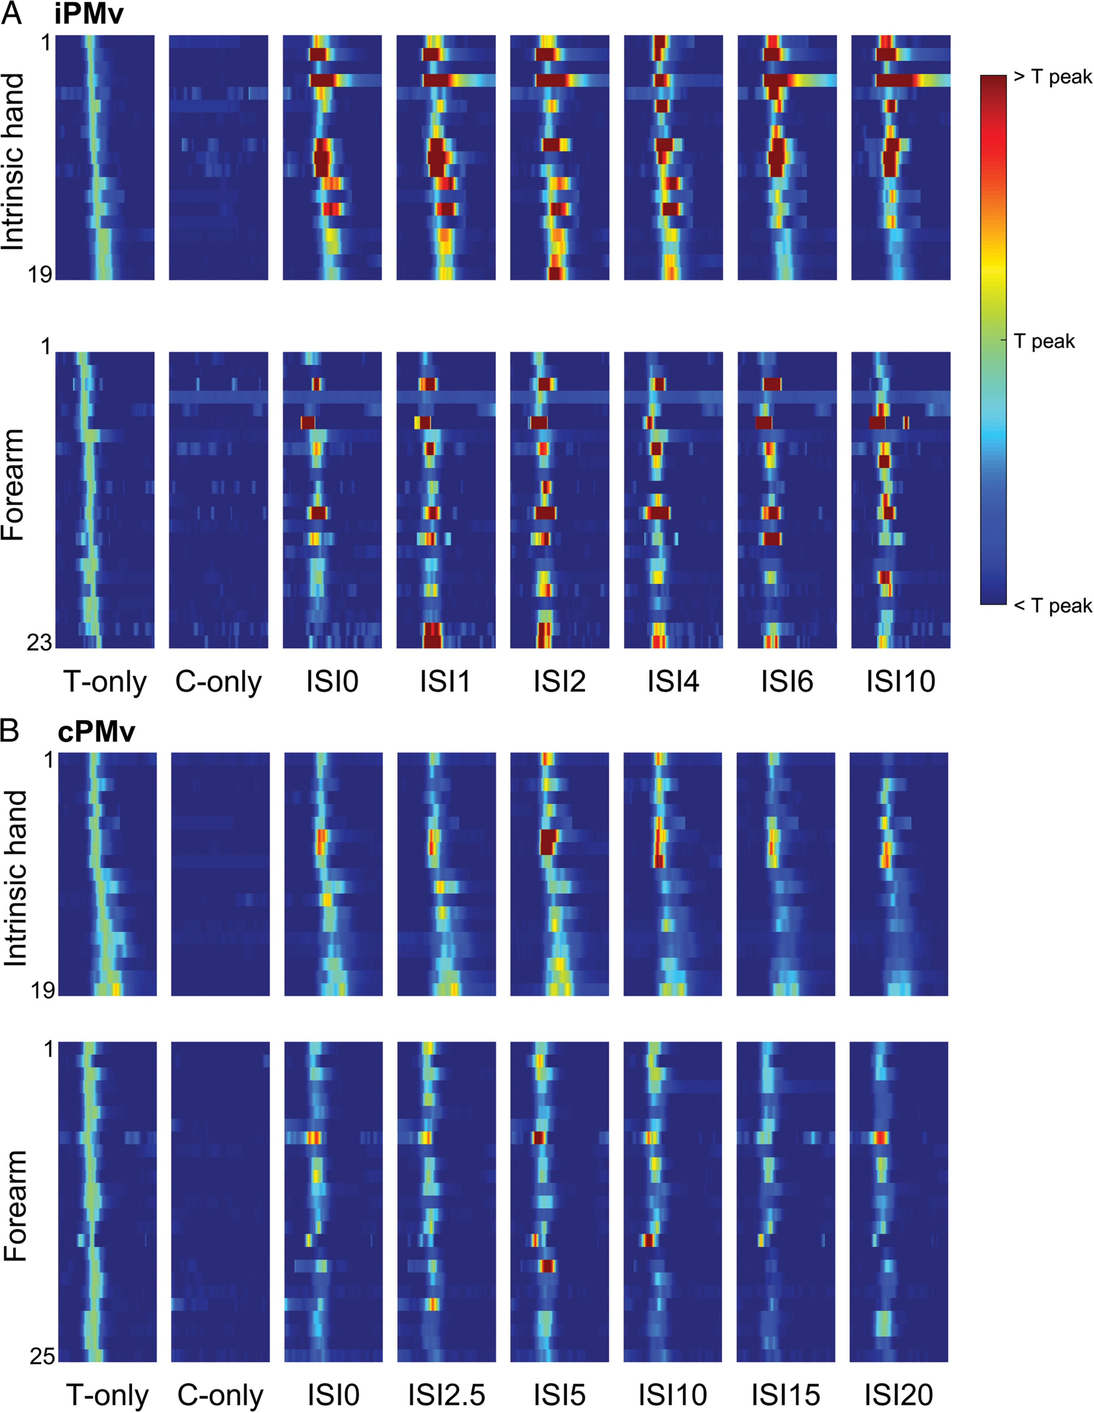
Figure 5. Complete data set of modulatory effects of PMv conditioning on M1 outputs. (A) MEPs conditioned with iPMv ...
Notes:
Figure 5. Complete data set of modulatory effects of PMv conditioning on M1 outputs. (A) MEPs conditioned with iPMv stimulation. The top row shows the 19 MEPs recorded from the intrinsic hand muscles (FPB and APB) and the bottom row the 23 MEPs recorded from the forearm muscles (ECU, EDC, PL, FDS) in the 4 monkeys. The different columns, from left to right, show the responses evoked with the T-only, C-only and the 6 different ISIs. Individual rows within the intensity plot show individual MEPs recorded over a period of 40 ms starting at the end of the stimulus (time = 0). The recordings are ordered based on peak amplitude of the MEP with the T-only trials, and kept for all conditions. The color scale on the right indicates the range of responses normalized to the MEP peak amplitude with the T-only stimulation. Accordingly, in the C + Tstim trials with the different ISIs, traces in the yellow-red range indicate facilitation of the MEP with the conditioning stimulus and traces in the light to dark blue range indicate inhibition. The common dark red colors support that iPMv conditioning induced strong facilitation of the MEPs, more often in intrinsic hand than in forearm muscles. (B) MEPs conditioned with cPMv stimulation. The top row shows the 19 MEPs recorded from the intrinsic hand muscles and the bottom row the 25 MEPs recorded from the forearm muscles. In comparison to conditioning in iPMv, light to dark blue colors are more frequent. This supports that the conditioning of cPMv induced more inhibitory effects in both intrinsic hand and forearm muscles than iPMv.
Unless provided in the caption above, the following copyright applies to the content of this slide: © The Author 2016. Published by Oxford University Press.This is an Open Access article distributed under the terms of the Creative Commons Attribution Non-Commercial License (http://creativecommons.org/licenses/by-nc/4.0/), which permits non-commercial re-use, distribution, and reproduction in any medium, provided the original work is properly cited. For commercial re-use, please contact journals.permissions@oup.com

Slide 6
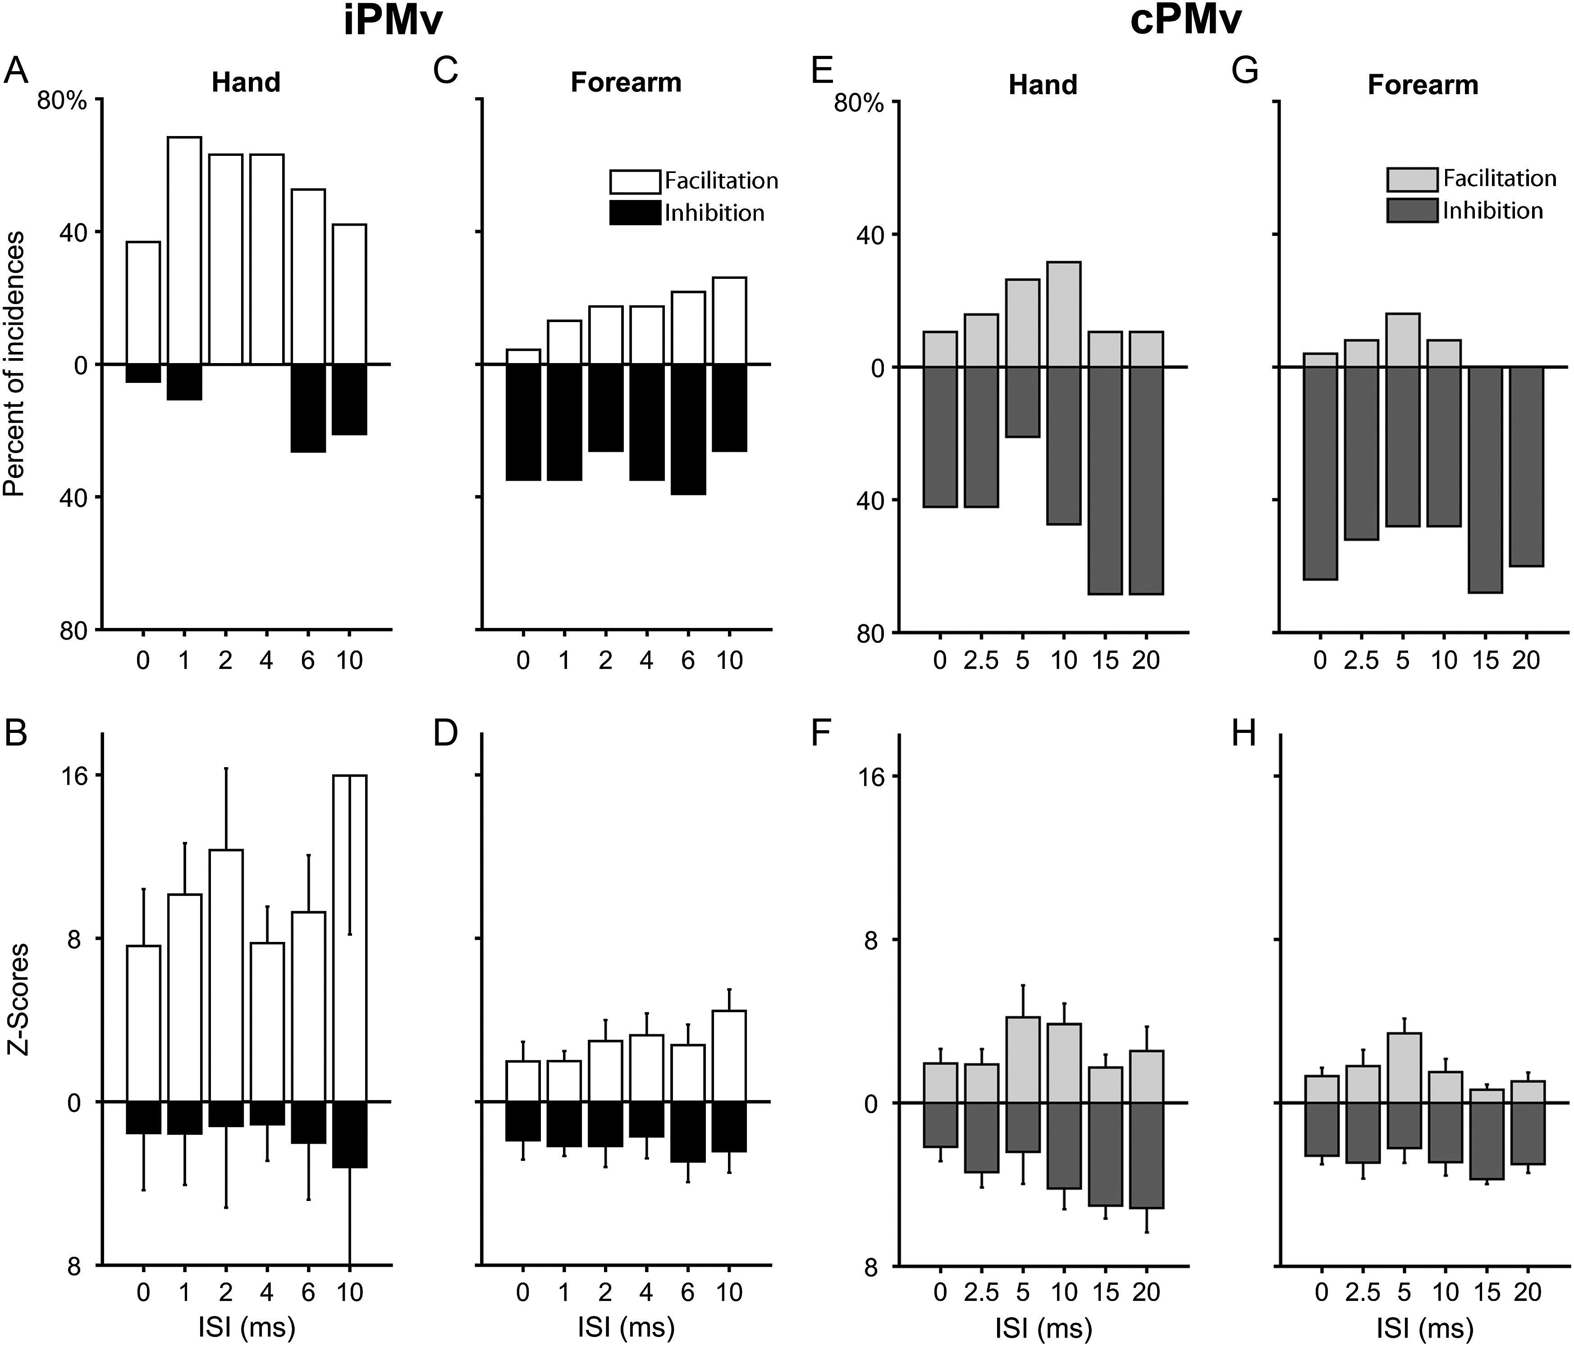
Figure 6. Effects of iPMv and cPMv conditioning on MEPs in intrinsic hand and forearm muscles. (A) Incidence of ...
Notes:
Figure 6. Effects of iPMv and cPMv conditioning on MEPs in intrinsic hand and forearm muscles. (A) Incidence of significant modulation of MEPs in the intrinsic hand muscles produced by iPMv. The histogram shows the proportion of the 19 MEPs that were significantly facilitated (white) or inhibited (black) with each ISI. For example, when both the Cstim and Tstim were applied simultaneously (ISI0), 7 of the 19 MEPs (36.8%) had a significant increase of peak amplitude in comparison to the predicted peaks (conditioning considered facilitatory) and only 1 (5.2%) had a significant decrease of peak amplitude (conditioning considered inhibitory). (B) Magnitude of the modulation of MEPs in intrinsic hand muscles produced by iPMv conditioning. The histogram presents the mean (± SD) of the positive and negative Z-scores with each ISI. Facilitatory effects resulting from iPMv conditioning were also much more powerful than inhibitory effects. Note that although there were no cases of significant inhibition with ISI2 and ISI4, because all 19 MEPs are used for this analysis, there is still a small Z-score value for inhibitory effects with these ISIs. (C) Incidence of significant modulation of MEPs in the forearm muscles produced by iPMv. In contrast to intrinsic hand muscles, iPMv conditioning most often had inhibitory effects on MEPs. (D) Magnitude of the modulation of MEPs in forearm muscles produced by iPMv conditioning. The magnitude of facilitatory effects was much smaller in forearm muscles than in intrinsic hand muscles. (E) Incidence of significant modulation of MEPs in the intrinsic hand muscles produced by cPMv. The conditioning of cPMv is much more likely to have inhibitory effects on M1 outputs to intrinsic hand muscles. (F) Magnitude of the modulation of MEPs in intrinsic hand muscles produced by cPMv conditioning. Apart from ISI5, inhibitory effects were more powerful than facilitatory effects for all other tested ISIs. (G) Incidence of significant modulation of MEPs in the forearm muscles produced by cPMv. The predominance of inhibitory effects of cPMv conditioning was even greater for forearm than intrinsic hand muscles. (H) Magnitude of the modulation of MEPs in forearm muscles produced by cPMv conditioning. Apart from ISI5, the magnitude of facilitatory effects was also smaller than inhibitory effects in forearm muscles.
Unless provided in the caption above, the following copyright applies to the content of this slide: © The Author 2016. Published by Oxford University Press.This is an Open Access article distributed under the terms of the Creative Commons Attribution Non-Commercial License (http://creativecommons.org/licenses/by-nc/4.0/), which permits non-commercial re-use, distribution, and reproduction in any medium, provided the original work is properly cited. For commercial re-use, please contact journals.permissions@oup.com

Slide 7
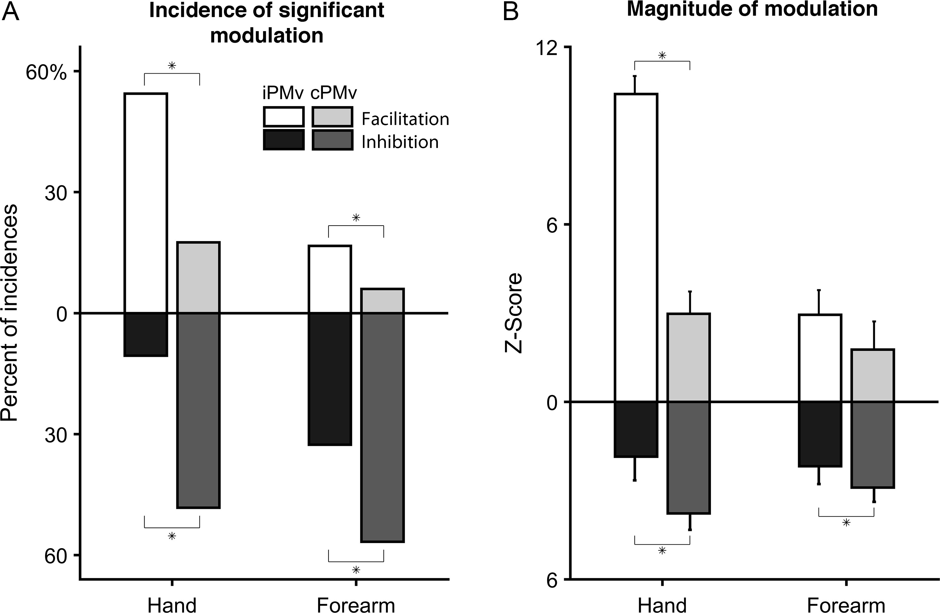
Figure 7. General modulatory effects of iPMv and cPMv conditioning. (A) Incidence of facilitatory and inhibitory ...
Notes:
Figure 7. General modulatory effects of iPMv and cPMv conditioning. (A) Incidence of facilitatory and inhibitory effects induced by iPMv and cPMv conditioning on the two muscle groups for all ISIs combined. The incidence of facilitation and inhibition was affected by the cortical location of the conditioning and the muscle group. For the intrinsic hand muscles (left bars), the number of facilitatory effects was greater when the conditioning was in iPMv (white; n = 62; 54.4%) than in cPMv (light gray; n = 20; 17.5%). Conversely, inhibitory effects were more common when the conditioning was delivered in cPMv (dark gray; n = 55; 48.3%) than in iPMv (black; n = 12; 10.5%). The modulatory effects on MEPs of forearm muscles followed a similar pattern (right bars). Facilitatory effects were more common when the conditioning stimulus was in iPMv (n = 23; 16.7%) than in cPMv (n = 9; 6.0%). In contrast, inhibitory effects were more common when the conditioning stimulus was in cPMv (n = 85; 56.7%) than in iPMv (n = 45; 32.6%). (B) Magnitude of modulatory effects induced by iPMv and cPMv conditioning on the two muscle groups across all ISIs. For the intrinsic hand muscles (left bars), facilitation was much stronger with iPMv conditioning than with cPMv conditioning (mean Z-scores: iPMv = 10.4; cPMv = 3.0). In contrast, the magnitude of inhibitory effects in intrinsic hand muscles induced by conditioning of cPMv (mean Z-score = −3.8) was greater than iPMv (mean Z-score = −1.9). For forearm muscles, the magnitude of facilitatory effects was comparable when the conditioning stimulus was in iPMv or cPMv (mean Z-scores: iPMv = 2.9; cPMv = 1.8). For inhibitory effects, conditioning of cPMv induced greater inhibitory effects (mean Z-score = −2.9) than iPMv (mean Z-score = −2.2). Asterisks show significant differences.
Unless provided in the caption above, the following copyright applies to the content of this slide: © The Author 2016. Published by Oxford University Press.This is an Open Access article distributed under the terms of the Creative Commons Attribution Non-Commercial License (http://creativecommons.org/licenses/by-nc/4.0/), which permits non-commercial re-use, distribution, and reproduction in any medium, provided the original work is properly cited. For commercial re-use, please contact journals.permissions@oup.com

Slide 8
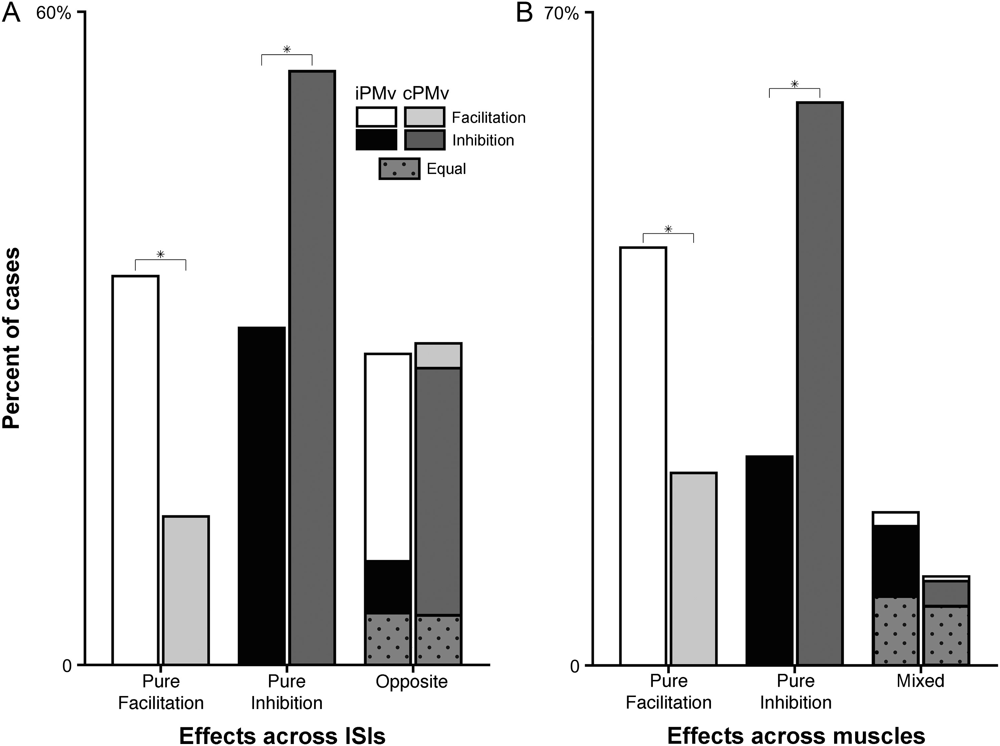
Figure 8. Categories of modulatory effects from iPMv and cPMv across ISIs and recorded muscles. (A) Categories of ...
Notes:
Figure 8. Categories of modulatory effects from iPMv and cPMv across ISIs and recorded muscles. (A) Categories of conditioning effects across ISIs. Out of the 42 MEPs that were conditioned with iPMv stimulation, 15 MEPs were in Group Pure Facilitation (left, white bar; see color code at the top right of the figure) and 13 were in Group Pure Inhibition across ISIs (middle, black bar). In contrast, out of the 44 MEPs with cPMv conditioning, only 6 were in Group Pure Facilitation (left, light gray bar) and 24 in Group Pure Inhibition (middle, dark gray bars). The count of MEPs in Group Opposite was comparable after conditioning of both iPMv (n = 12) and cPMv (n = 13) (right bars). However, for MEPs conditioned by iPMv in Group Opposite, facilitatory effects were more common across ISIs (right, white section in the bar; n = 8). In contrast, for MEPs conditioned by cPMv in Group Opposite, inhibitory effects were more common across ISIs (right, dark gray section in the bar; n = 10). Dotted-gray sections in the bars on the right indicate the number of MEPs for which we found an equal number of occasions of inhibition or facilitation across ISIs. (B) Summary of conditioning effects across muscles. The same color code as in A is used. There were more cases with Pure Facilitation across recorded muscles after iPMv than cPMv conditioning (left bars). In contrast, there were more cases of Pure Inhibition across muscles after cPMv conditioning (middle bars). Finally, conditioning stimulation in both iPMv and cPMv induced comparable proportions of Mixed effects across muscles (i.e., simultaneous facilitation and inhibition in different muscles; right bars). Asterisks show significant differences.
Unless provided in the caption above, the following copyright applies to the content of this slide: © The Author 2016. Published by Oxford University Press.This is an Open Access article distributed under the terms of the Creative Commons Attribution Non-Commercial License (http://creativecommons.org/licenses/by-nc/4.0/), which permits non-commercial re-use, distribution, and reproduction in any medium, provided the original work is properly cited. For commercial re-use, please contact journals.permissions@oup.com

Slide 9
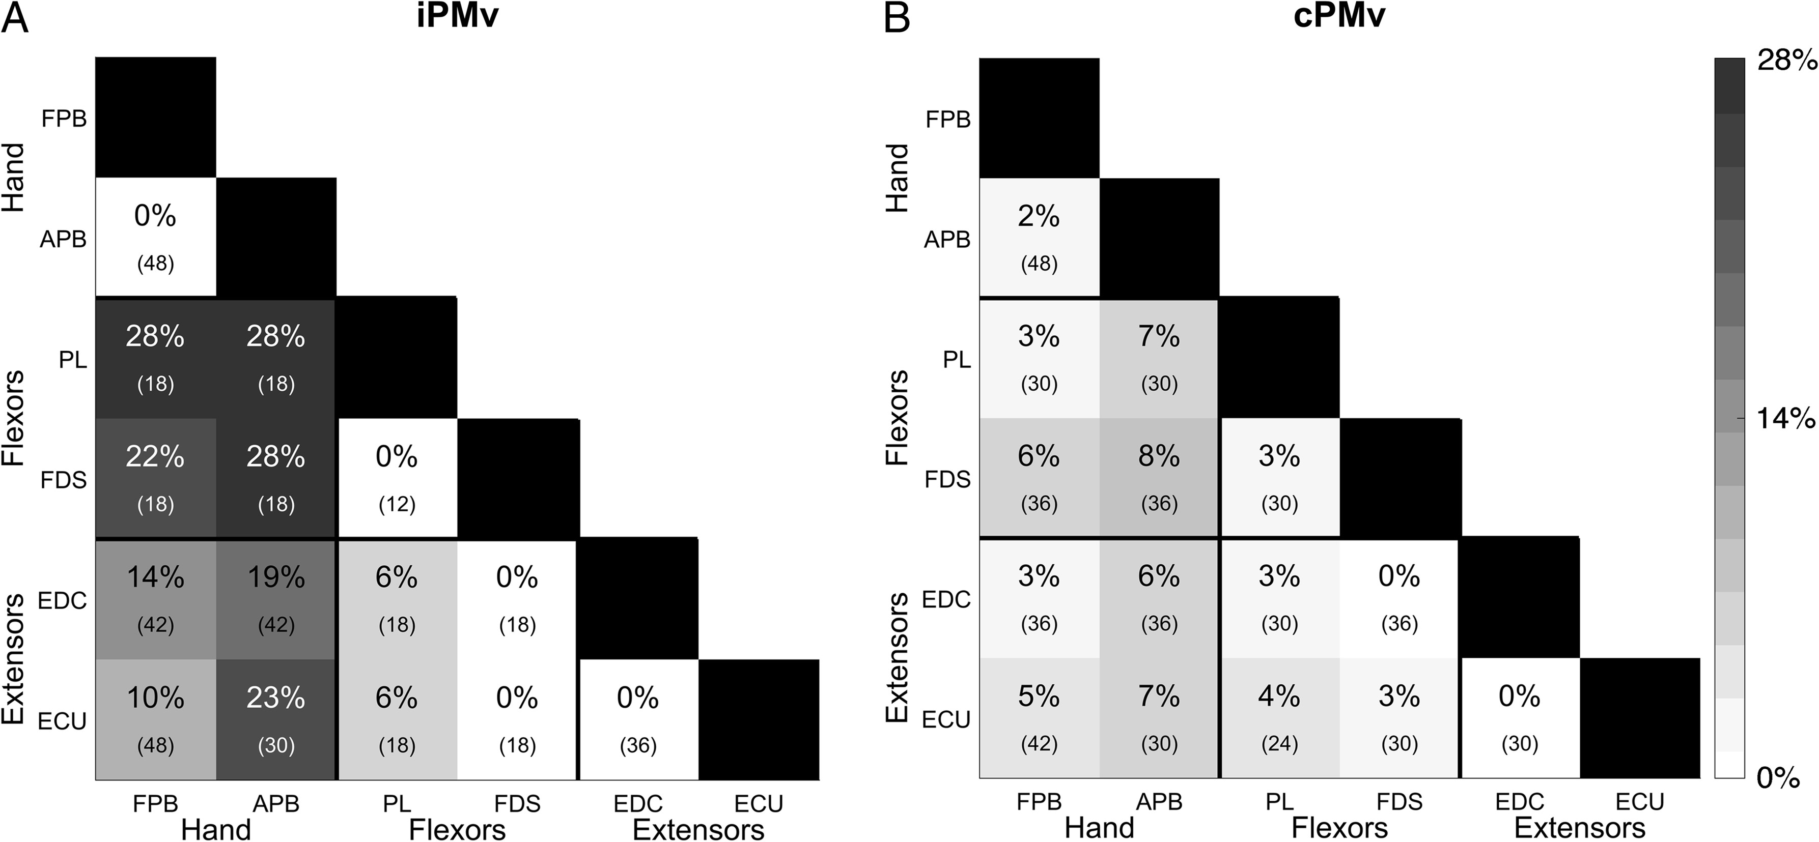
Figure 9. Incidence of opposite effects of PMv conditioning across functional muscle categories. Box diagram showing ...
Notes:
Figure 9. Incidence of opposite effects of PMv conditioning across functional muscle categories. Box diagram showing the incidence of simultaneous significant opposite effects across muscles (see Fig. 8B; Mixed). In the box diagram, thick black vertical and horizontal lines separate muscles into functional categories (intrinsic hand, forearm flexors, and forearm extensors). For each muscle (rows), we counted the number of cases in which the MEP was modulated in one direction (facilitatory or inhibitory) while the MEP in another muscle (columns) was modulated in the opposite direction. The percentage of opposite effects and the number of comparisons is indicated in parentheses in each box. The shade of gray for each box reflects the incidence of opposite effects. (A) Incidence of opposite effects across muscles induced by iPMv conditioning. For example, we observed simultaneous MEPs in both FPB and APB in 48 cases (8 protocols × 6 ISIs), none of which were in the opposite direction (0%). The EDC and APB were simultaneously active in 42 cases (7 protocols × 6 ISIs). This time, in 8 of those cases EDC and APB were significantly modulated in opposite directions (19.0%). Overall, iPMv never had opposite effects on the other muscle of the same category and very rarely had opposite effects in forearm flexors and extensors. In contrast, there were a considerable number of cases in which iPMv had opposite effects on intrinsic hand and forearm muscles, and this was more common for forearm flexors than extensors. (B) Incidence of opposite effects across muscles induced by cPMv conditioning. In comparison to iPMv, there were fewer cases in which cPMv conditioning induced opposite effects in recorded muscles and there were no clear differences between muscle categories.
Unless provided in the caption above, the following copyright applies to the content of this slide: © The Author 2016. Published by Oxford University Press.This is an Open Access article distributed under the terms of the Creative Commons Attribution Non-Commercial License (http://creativecommons.org/licenses/by-nc/4.0/), which permits non-commercial re-use, distribution, and reproduction in any medium, provided the original work is properly cited. For commercial re-use, please contact journals.permissions@oup.com

