Slide 1
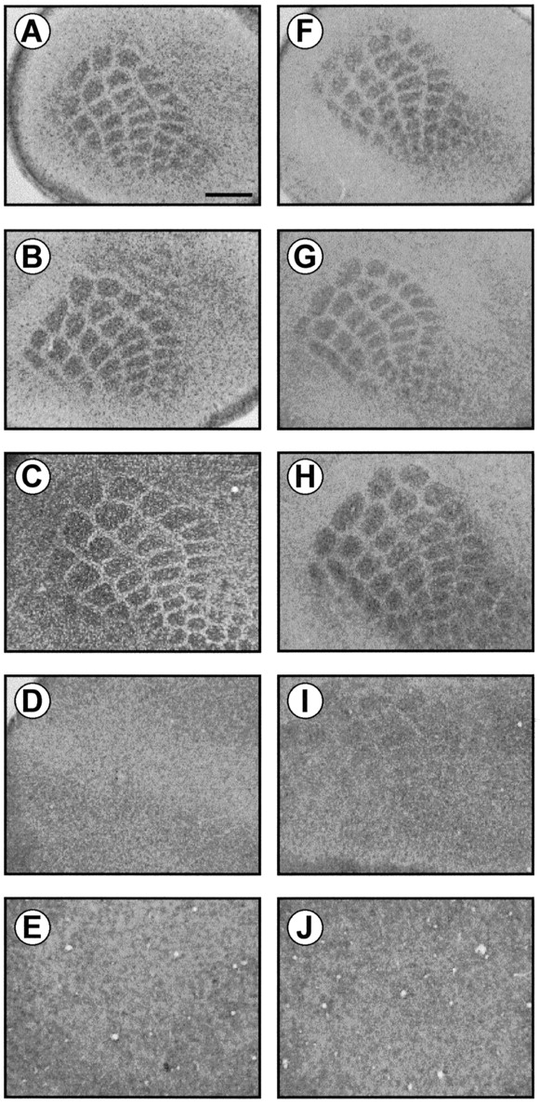
Figure 1. GLAST and GLT-1 immunohistochemical staining in the mouse barrel cortex during development. From P5 to P10, ...
Notes:
Figure 1. GLAST and GLT-1 immunohistochemical staining in the mouse barrel cortex during development. From P5 to P10, GLAST and GLT-1 immunohistochemical staining performed on tangential sections shows individual cell clusters corresponding to mystacial vibrissae. From P12 until adulthood, immunolabeling of GLAST and GLT-1 shows immunoreactive punctae but does not delineate the adult barrel field giving rise to a mottled image at this magnification. Scale bar = 500 μm.
Unless provided in the caption above, the following copyright applies to the content of this slide: © Oxford University Press

Slide 2
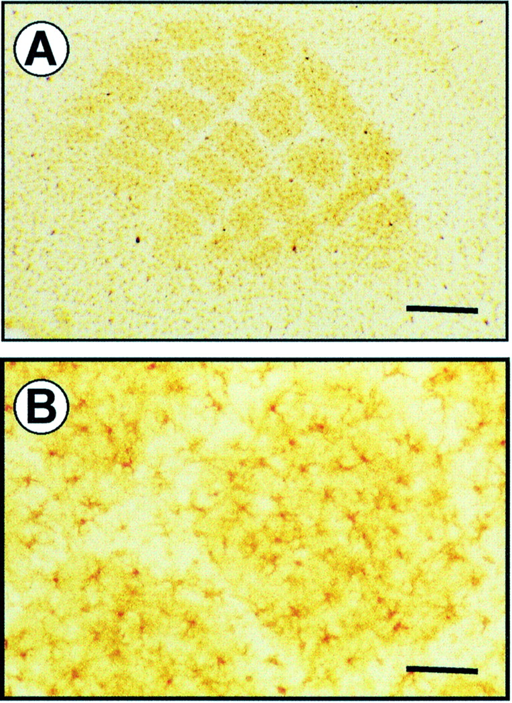
Figure 2. Glutamine synthetase (GS) immunohistochemical staining in the mouse barrel cortex at postnatal day 10. ...
Notes:
Figure 2. Glutamine synthetase (GS) immunohistochemical staining in the mouse barrel cortex at postnatal day 10. Individual barrels fields are parceled by immunopositive GS reactivity (A) which is associated with astrocytes and their processes. Few GS-positive astrocytes arborize the septa (B). Scale bar: A, 400 μm; B, 100 μm.
Unless provided in the caption above, the following copyright applies to the content of this slide: © Oxford University Press

Slide 3
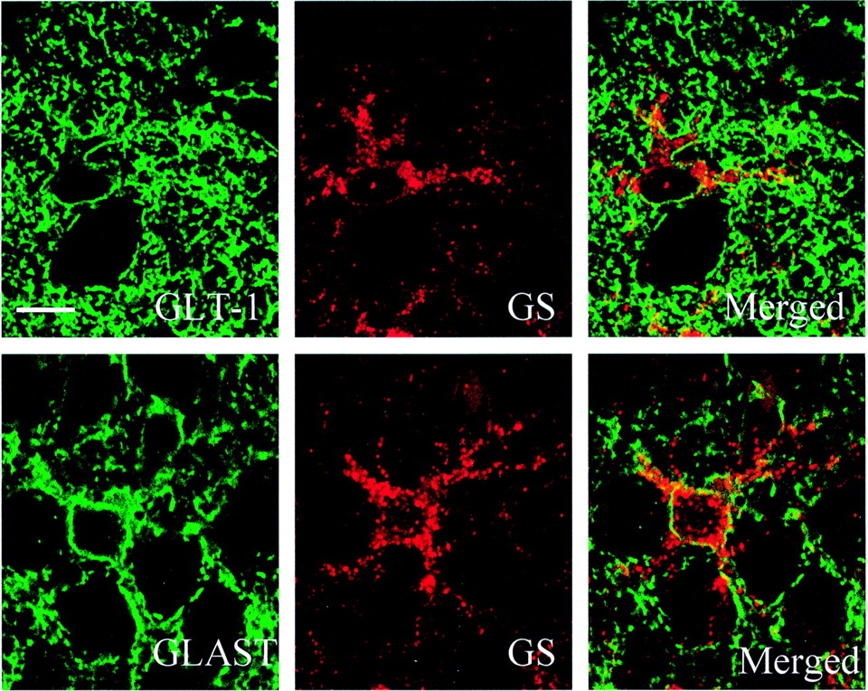
Figure 3. Confocal microscopic images of GLAST, GLT-1 and glutamine synthetase (GS) in the mouse barrel cortex at ...
Notes:
Figure 3. Confocal microscopic images of GLAST, GLT-1 and glutamine synthetase (GS) in the mouse barrel cortex at postnatal day 10. Confocal microscopic images were acquired sequentially through the green channel (GLT-1, GLAST) and the red channel (GS), and subsequently merged for the visualization of double labeling. GLAST and GLT-1 immunostaining was restricted to membrane profiles including the outer limiting membrane. GS reaction product was localized within the cytoplasm around the nucleus and in the processes of astrocytes. Merged images strongly shows that GLAST and GLT-1 were strictly localized in astroglial cells. Scale bar = 10 μm.
Unless provided in the caption above, the following copyright applies to the content of this slide: © Oxford University Press

Slide 4
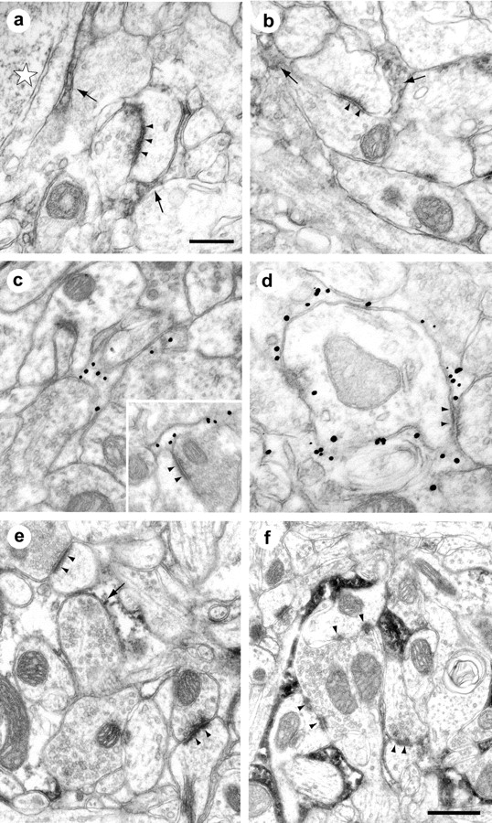
Figure 4. Ultrastructural localization of GLT1 and GLAST in neuropil of layer IV barrel hollows of somatosensory cortex ...
Notes:
Figure 4. Ultrastructural localization of GLT1 and GLAST in neuropil of layer IV barrel hollows of somatosensory cortex from P9, P12 and adult mice. Electron micrographs on the left show the localization of the GLT1 transporter (a, c, e) and those on the right show that for GLAST (b, d, f). (a) GLT1 labeling, using DAB seen at P9, in astrocytic processes (arrow) close to a dendritic spine and its asymmetric synapse (arrowheads) as well adjacent to a neuronal cell body (star). (b) GLAST labeling, using DAB, seen at P9 in astrocytic processes (arrowed) surrounding an asymmetric synapse (arrowheads). (c) GLT-1 labeling, localized with gold conjugated antibody, at P12 in astrocytic elements surrounding asymmetric synapses (arrowheads) seen on a dendritic shaft and a dendritic spine (inset). (d) GLAST labeling, using gold-conjugated secondary antibody, at P12 in astrocytic processes surrounding a dendrite. An axodendritic synapse (arrowheads) is bordered by astrocytic elements, which show immunoreactivity for the glutamate transporter. (e) GLT-1 labeling shown with DAB in neuropil at P60 (adult) mice. Two asymmetric synapses are indicated (arrowheads), both axospinous, however the DAB reaction product localized in astrocytic elements (arrowed) is only seen in close proximity to one. (f) GLAST labeling shown with DAB in neuropil at P60 (adult) mice. Three asymmetric synapses are indicated, two axospinous and one axodendritic (lower left). Each synapse can be seen bordered by astrocytic elements, each containing dense reaction product. Micrographs a–d are the same magnification and the scale bar in a is 0.5 μm. Micrographs e and f are at the same magnification, scale bar in f is 0.5 μm.
Unless provided in the caption above, the following copyright applies to the content of this slide: © Oxford University Press

Slide 5
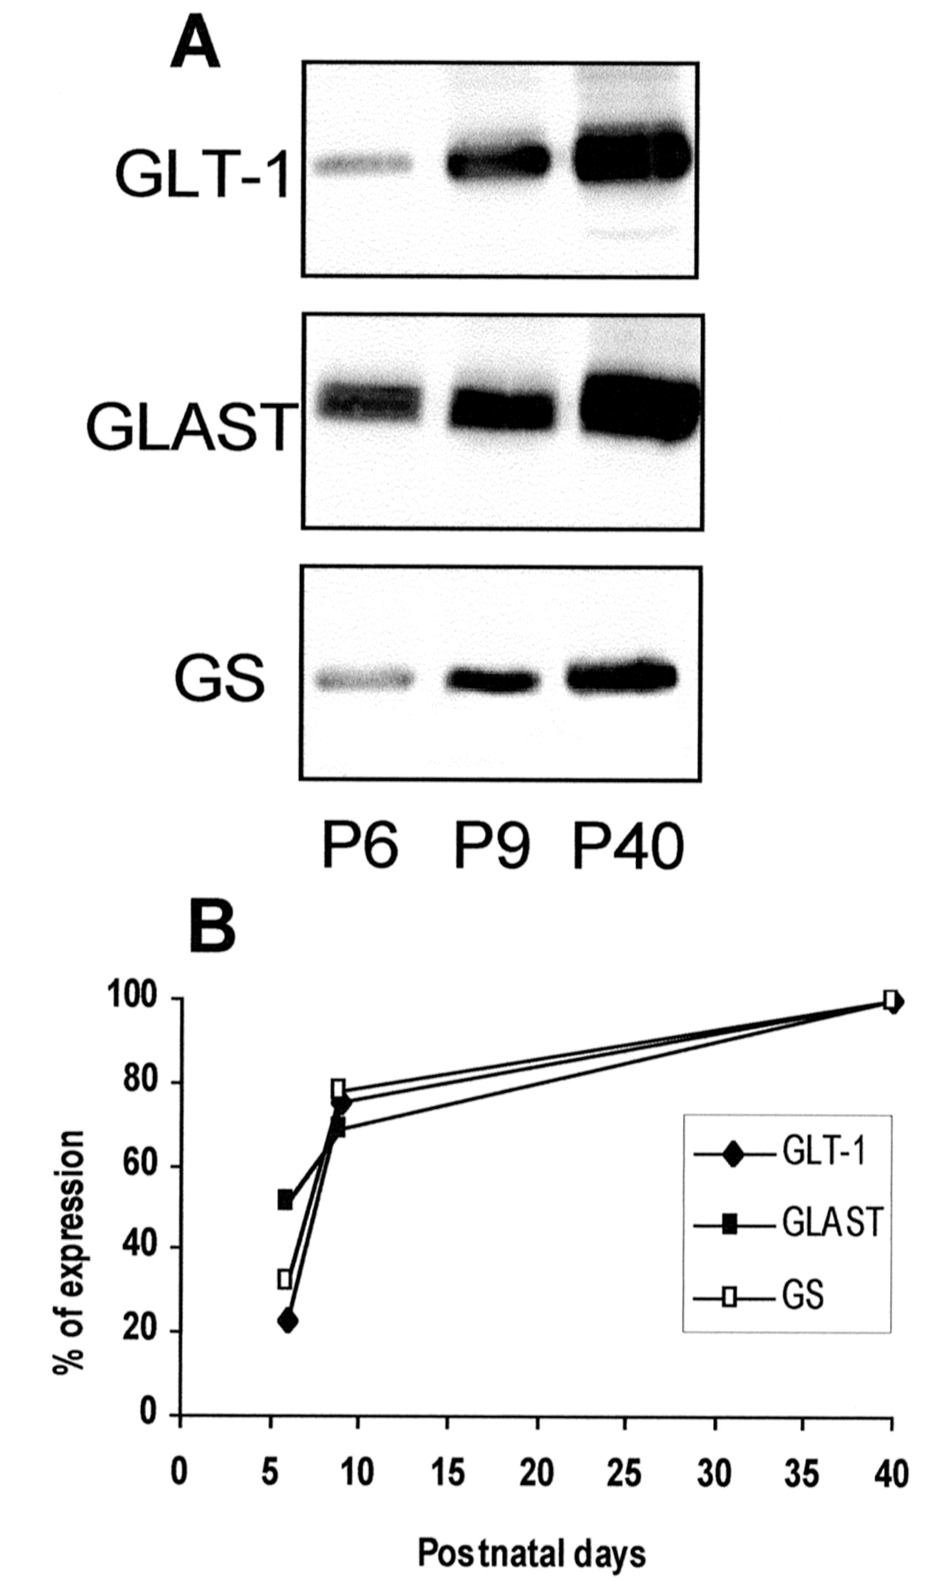
Figure 5. Immunoblots for glutamate transporters subtypes and glutamine synthetase (GS) in developing mouse barrel ...
Notes:
Figure 5. Immunoblots for glutamate transporters subtypes and glutamine synthetase (GS) in developing mouse barrel cortex. While the expression of GLAST at P6 is already 50% of the adult level and increases gradually with age, the expression of both GLT-1 and GS is relatively low at P6 (20–30% of the adult level) and increases very rapidly during the critical period of functional maturation to reach 75% of adult level at P9. Each point corresponds to the mean optical density measured in three different animals at each age.
Unless provided in the caption above, the following copyright applies to the content of this slide: © Oxford University Press

Slide 6
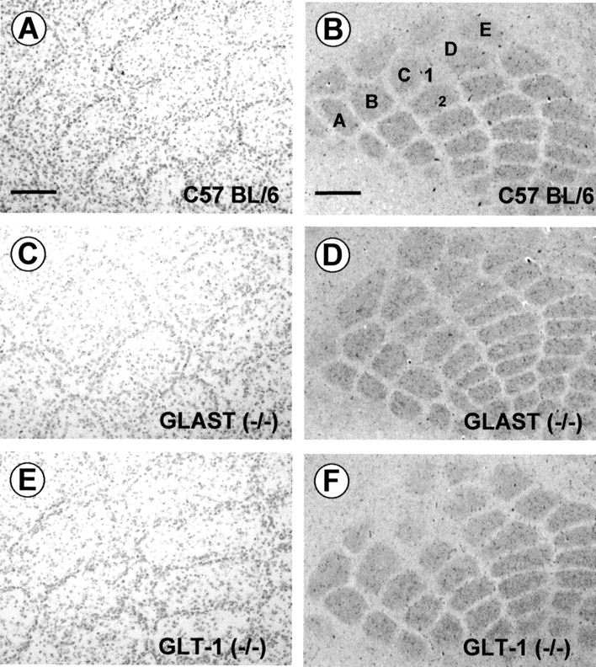
Figure 6. Visualization of barrels in the primary somatosensory cortex in GLAST and GLT-1 P10 KO mice. (A, C, E) Nissl ...
Notes:
Figure 6. Visualization of barrels in the primary somatosensory cortex in GLAST and GLT-1 P10 KO mice. (A, C, E) Nissl staining; (B, D, F) cytochrome oxidase (CO) histochemistry. GLAST (C, D) and GLT-1 (E, F) P10 −/− mice display control barrel segregation as clustered granular cells surrounding a cell-sparse hollow and control CO staining, which label highly active synaptic regions at the terminals of thalamic fibers, as revealed by dense patches organized into five rows in a similar orientation and with a similar density as in wild-type mice. Scale bar: A, C, E, 100 μm; B, D, F, 300 μm.
Unless provided in the caption above, the following copyright applies to the content of this slide: © Oxford University Press

Slide 7
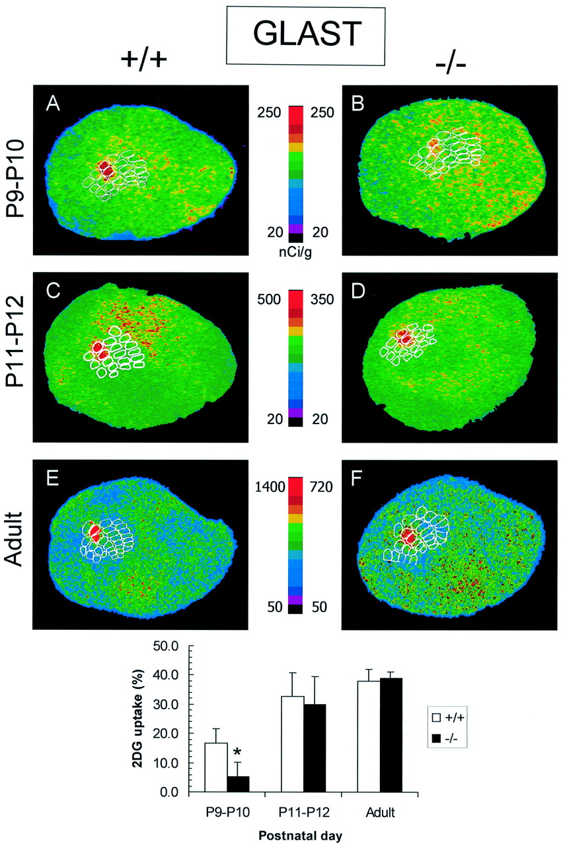
Figure 7. Effect of C1C2 whisker stimulation on 2-DG uptake in the somatosensory cortex of P9–10, P11–12 and adult ...
Notes:
Figure 7. Effect of C1C2 whisker stimulation on 2-DG uptake in the somatosensory cortex of P9–10, P11–12 and adult GLAST +/+ and −/− mice. Representative pseudo-colored digitized autoradiograms obtained from tangential sections through layer IV of the primary somatosensory cortex. The level of 2-DG uptake is color-coded according to the respective colored scales. Stimulation of C1C2 in +/+ mice (P9 to adult) produced a significant increase in 2-DG uptake in the somatosensory cortex that was restricted to the C1C2 barrels (A, C, E). In P9–10 GLAST −/− mice (B), the increase in 2-DG uptake was significantly lower (−64%) than in +/+ mice, while this metabolic response was not different from control matched +/+ mice in the C1C2 barrels of P11–12 (D) and adult GLAST −/− mice (F). Data are presented as mean ± SD; n = 3–8 animals per group (P < 0.05 ; Student’s t-test).
Unless provided in the caption above, the following copyright applies to the content of this slide: © Oxford University Press

Slide 8
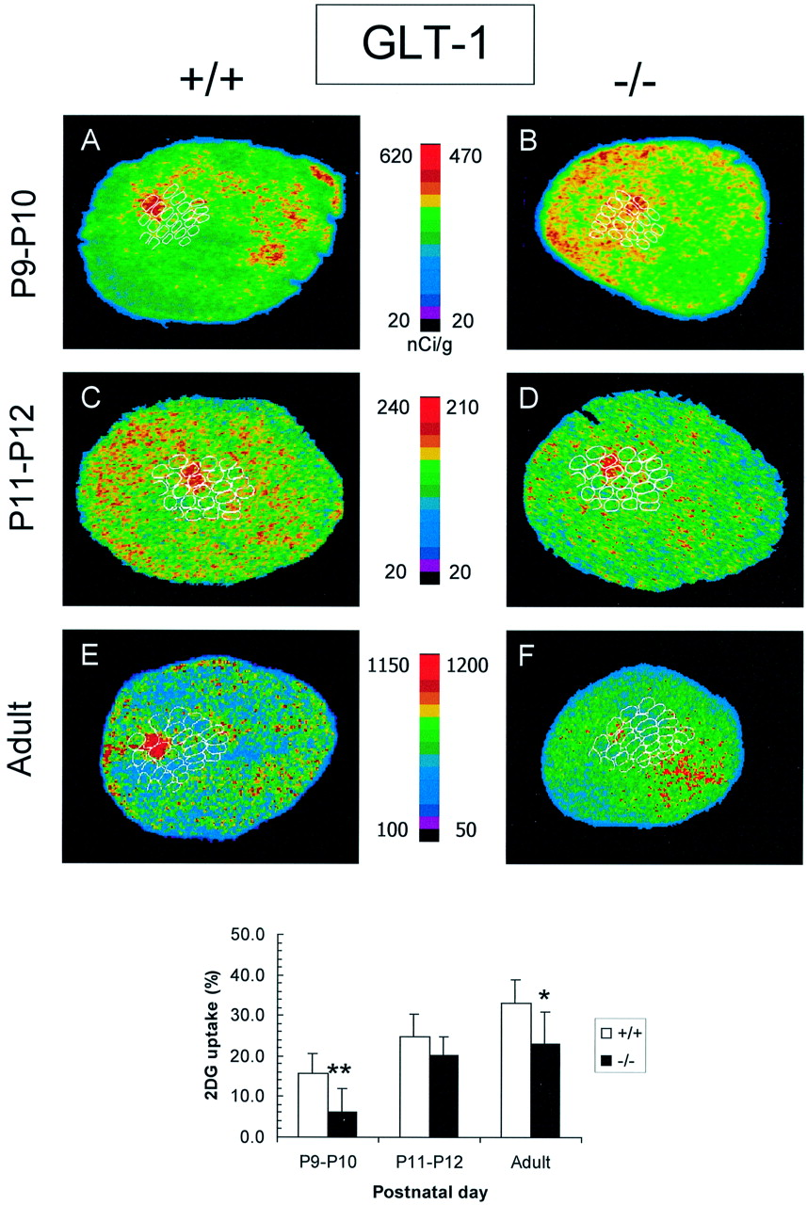
Figure 8. Effect of C1C2 whisker stimulation on 2-DG uptake in somatosensory cortex of P9–10, P11–12 and adult GLT-1 ...
Notes:
Figure 8. Effect of C1C2 whisker stimulation on 2-DG uptake in somatosensory cortex of P9–10, P11–12 and adult GLT-1 +/+ and −/− mice. Representative pseudo-colored digitized autoradiograms obtained from tangential sections through layer IV of the primary somatosensory cortex. The level of 2-DG uptake is color-coded according to the respective colored scales. Stimulation of C1C2 in +/+ mice (P9 to adult) produced a significant increase in 2-DG uptake in the somatosensory cortex that was restricted to the C1C2 barrels (A, C, E). In P9–10 GLT-1 −/− mice (B), the increase in 2-DG uptake was significantly lower (−60%) than in +/+ mice. In P11–12 GLT-1 −/− mice (D), this metabolic response was slightly lower than that in wildtype P11–12 animals (−20%) and was significantly different from matched adult +/+ mice (−31%) in the C1C2 barrels of adult GLT-1 −/− mice (F). Data are presented as mean ± SD; n = 3–6 animals per group (P < 0.05; Student’s t-test).
Unless provided in the caption above, the following copyright applies to the content of this slide: © Oxford University Press

