Slide 1
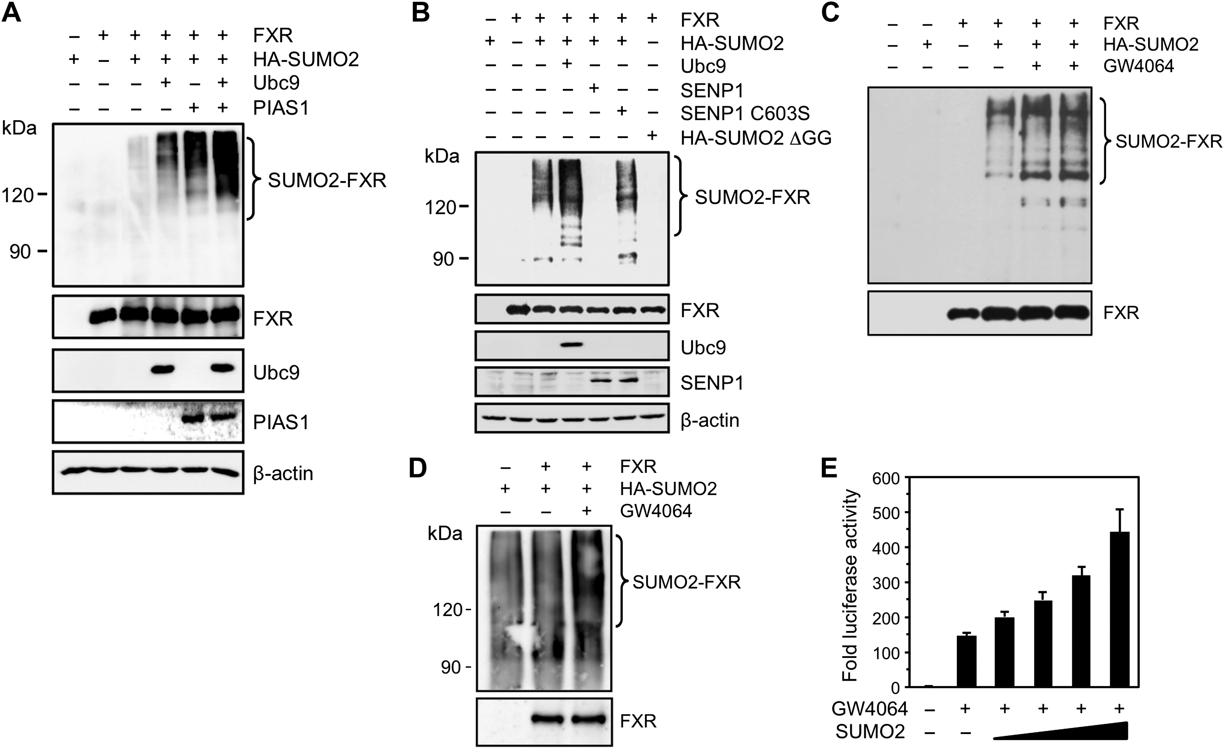
Figure 1 FXR is SUMO2 modified. (A) SUMOylation of FXR is induced by Ubc9 and PIAS1. Human embryonic 293 cells were ...
Notes:
Figure 1 FXR is SUMO2 modified. (A) SUMOylation of FXR is induced by Ubc9 and PIAS1. Human embryonic 293 cells were transfected with FXR and HA-SUMO2 expression plasmids and immunoprecipitation was carried out with an anti-FXR antibody, and bound proteins were analysed by western blot with an anti-HA antibody. FXR was also analysed using an anti-GFP antibody (bottom). Ubc9 and PIAS1 plasmids were also added as indicated and input levels determined by western blot analysis of whole cell extracts. (B) Immunoprecipitation assay performed as described in A, except that plasmids for wild-type SENP1, for the catalytically inactive SENP1 C603S mutant, or for SUMO2 lacking the di-glycine attachment motif were added. Input levels of Ubc9 and SENP1 are also shown. (C) Same as in A, except that cells were also treated for 5 h with 1 μM FXR agonist GW4064. (D) SUMOylation assay performed in HepG2 cells treated or not with 1 μM GW4064. FXR was immunoprecipitated as in A and extracts analysed using an anti-SUMO2 antibody. (E) Transcriptional activation of FXR by SUMO2. 293 cells were transfected with a Gal4-FXR fusion in the presence of a UAStkLuc reporter and increasing amounts (0–200 ng) of SUMO2 plasmid. Cells were then treated or not with 1 μM GW4064 for 16 h. Results are expressed as fold response compared to untreated cells set at 1.0.
Unless provided in the caption above, the following copyright applies to the content of this slide: © The Author (2017). Published by Oxford University Press on behalf of Journal of Molecular Cell Biology, IBCB, SIBS, CAS. All rights reserved.

Slide 2
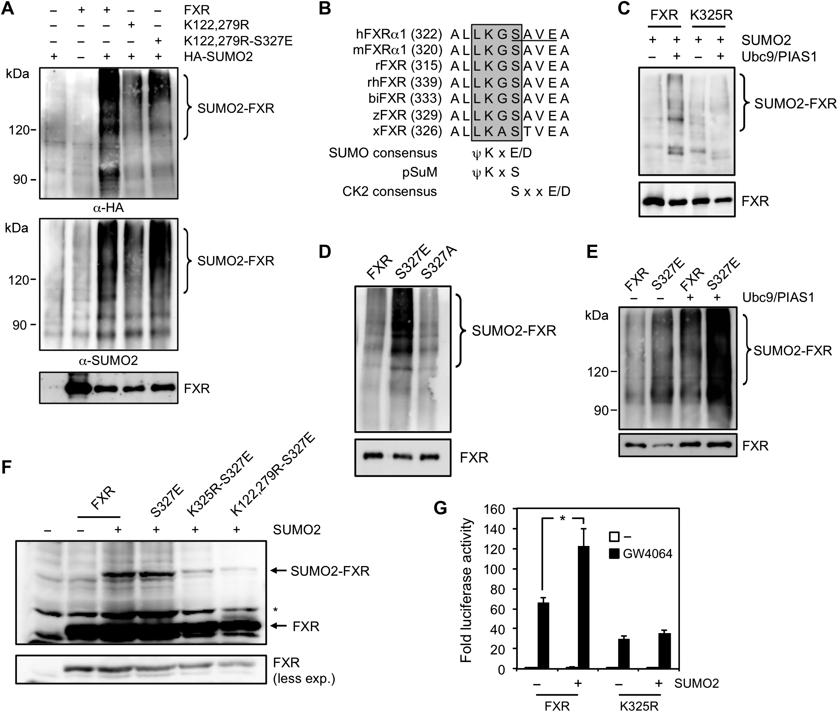
Figure 2 Identification of a novel non-consensus SUMO conjugation motif in FXR. (A) SUMOylation assay of wild-type and ...
Notes:
Figure 2 Identification of a novel non-consensus SUMO conjugation motif in FXR. (A) SUMOylation assay of wild-type and mutated forms of human FXR expressed in 293 cells. FXR immunoprecipitates were analysed using an anti-HA or anti-SUMO2 antibody. (B) Conserved homology sequence alignment of the predicted pSuM SUMOylation motif in the ligand binding domain (LBD) of FXR from various species (h, human; m, mouse; r, rat; rh, rhesus monkey; bi, Sturnus vulgaris; z, zebrafish; x, Xenopus). The position of the first amino acid residue of each sequence is indicated in parenthesis. Highly conserved residues representing the pSuM are shaded. The predicted pSuM differs from the canonical SUMO motif. Also shown is the predicted consensus site for CK2 (underlined) with the targeted serine embedded in the pSuM sequence. (C) Lys-325 is required for maximal FXR SUMOylation. 293 cells were transfected with wild-type and K325R mutant of FXR in the presence of HA-SUMO2 with or without Ubc9 and PIAS1. Cells were harvested for immunoprecipitation with an anti-FXR antibody and analysed by western blot. (D) Ser-327 regulates FXR SUMOylation. SUMOylation was performed as in C using wild-type FXR or Ser-327 mutants. (E) SUMOylation of wild-type and S327E mutant in HepG2 hepatocytes. FXR immunoprecipitates were analysed with an anti-SUMO2 antibody. (F) In vitro SUMOylation of FXR. HA-tagged wild-type and mutated FXR proteins were prepared and incubated with purified human SAE1/2 and SUMO2 proteins for in vitro SUMOylation in the presence of Ubc9. SUMOylation was analysed by western blot with an anti-HA antibody. (G) Lys-325 is essential for SUMO2-mediated activation of FXR. Luciferase assay in 293 cells transfected with Gal4 fusions of wild-type and K325R mutant of FXR in the presence of UAStkLuc reporter and SUMO2. Cells were treated with 1 μM GW4064 for 18 h and harvested for luciferase activity measurement. Results are expressed as fold response compared to untreated cells set at 1.0. *P < 0.05.
Unless provided in the caption above, the following copyright applies to the content of this slide: © The Author (2017). Published by Oxford University Press on behalf of Journal of Molecular Cell Biology, IBCB, SIBS, CAS. All rights reserved.

Slide 3
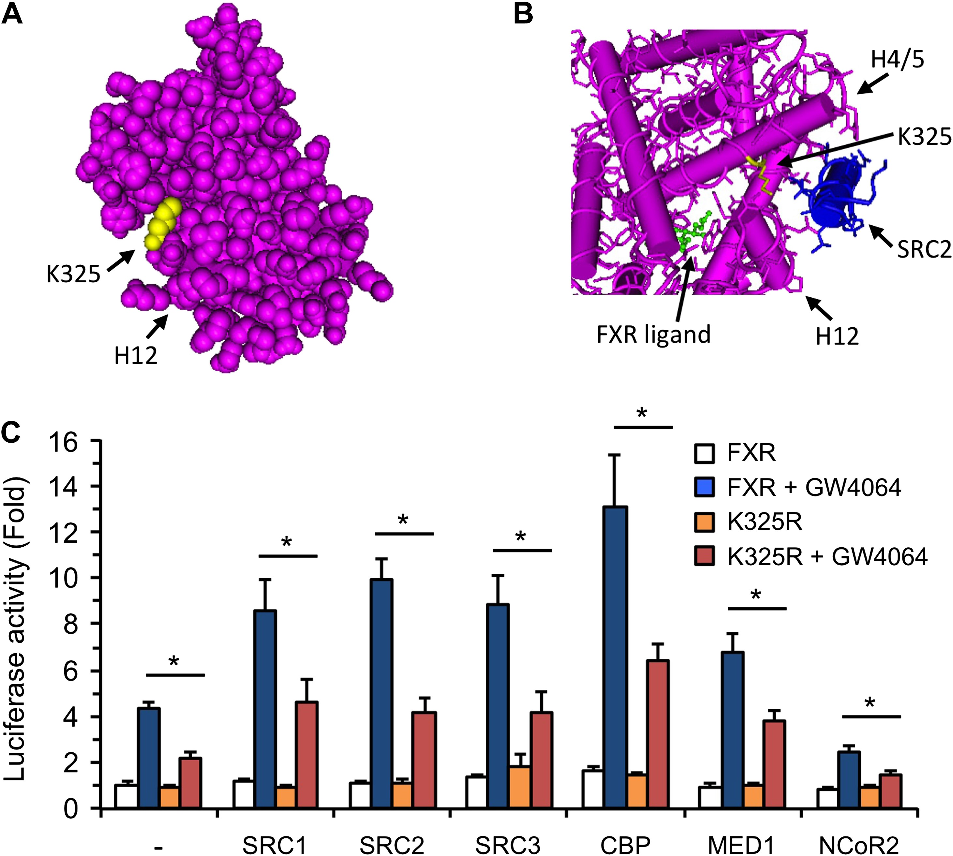
Figure 3 The pSuM is located near the AF-2 of FXR and is involved in FXR response to transcriptional coactivators. (A) ...
Notes:
Figure 3 The pSuM is located near the AF-2 of FXR and is involved in FXR response to transcriptional coactivators. (A) The 3D structure of the LBD of FXR (Protein Data Bank ID 4QE6) shows the exposure of Lys-325 residue to solvent with its side chain protruding from the structure. Also shown is AF-2 helix 12. (B) Wire and tube representation of FXR in the presence of the CDCA ligand and SRC2 peptide (4QE6) shows that Lys-325 residue is located in helix 4 and is in close proximity of the helix 12 (AF-2) and SRC2 interaction motif. (C) The transcriptional response of FXR to coactivators is altered by the K325R mutation. Luciferase assay was performed in 293 cells transfected with FXR and RXRα in the presence of SHPbLuc reporter that contains the proximal promoter of the SHP gene. Transcriptional coregulators (SRC, CBP, MED1, and NCoR2) were also added and cells were treated or not (vehicle) with 1 µM GW4064 for 18 h. Results are expressed as fold response compared to untreated cells in the absence of coregulators set at 1.0. *P < 0.05 wt FXR vs. K325R.
Unless provided in the caption above, the following copyright applies to the content of this slide: © The Author (2017). Published by Oxford University Press on behalf of Journal of Molecular Cell Biology, IBCB, SIBS, CAS. All rights reserved.

Slide 4
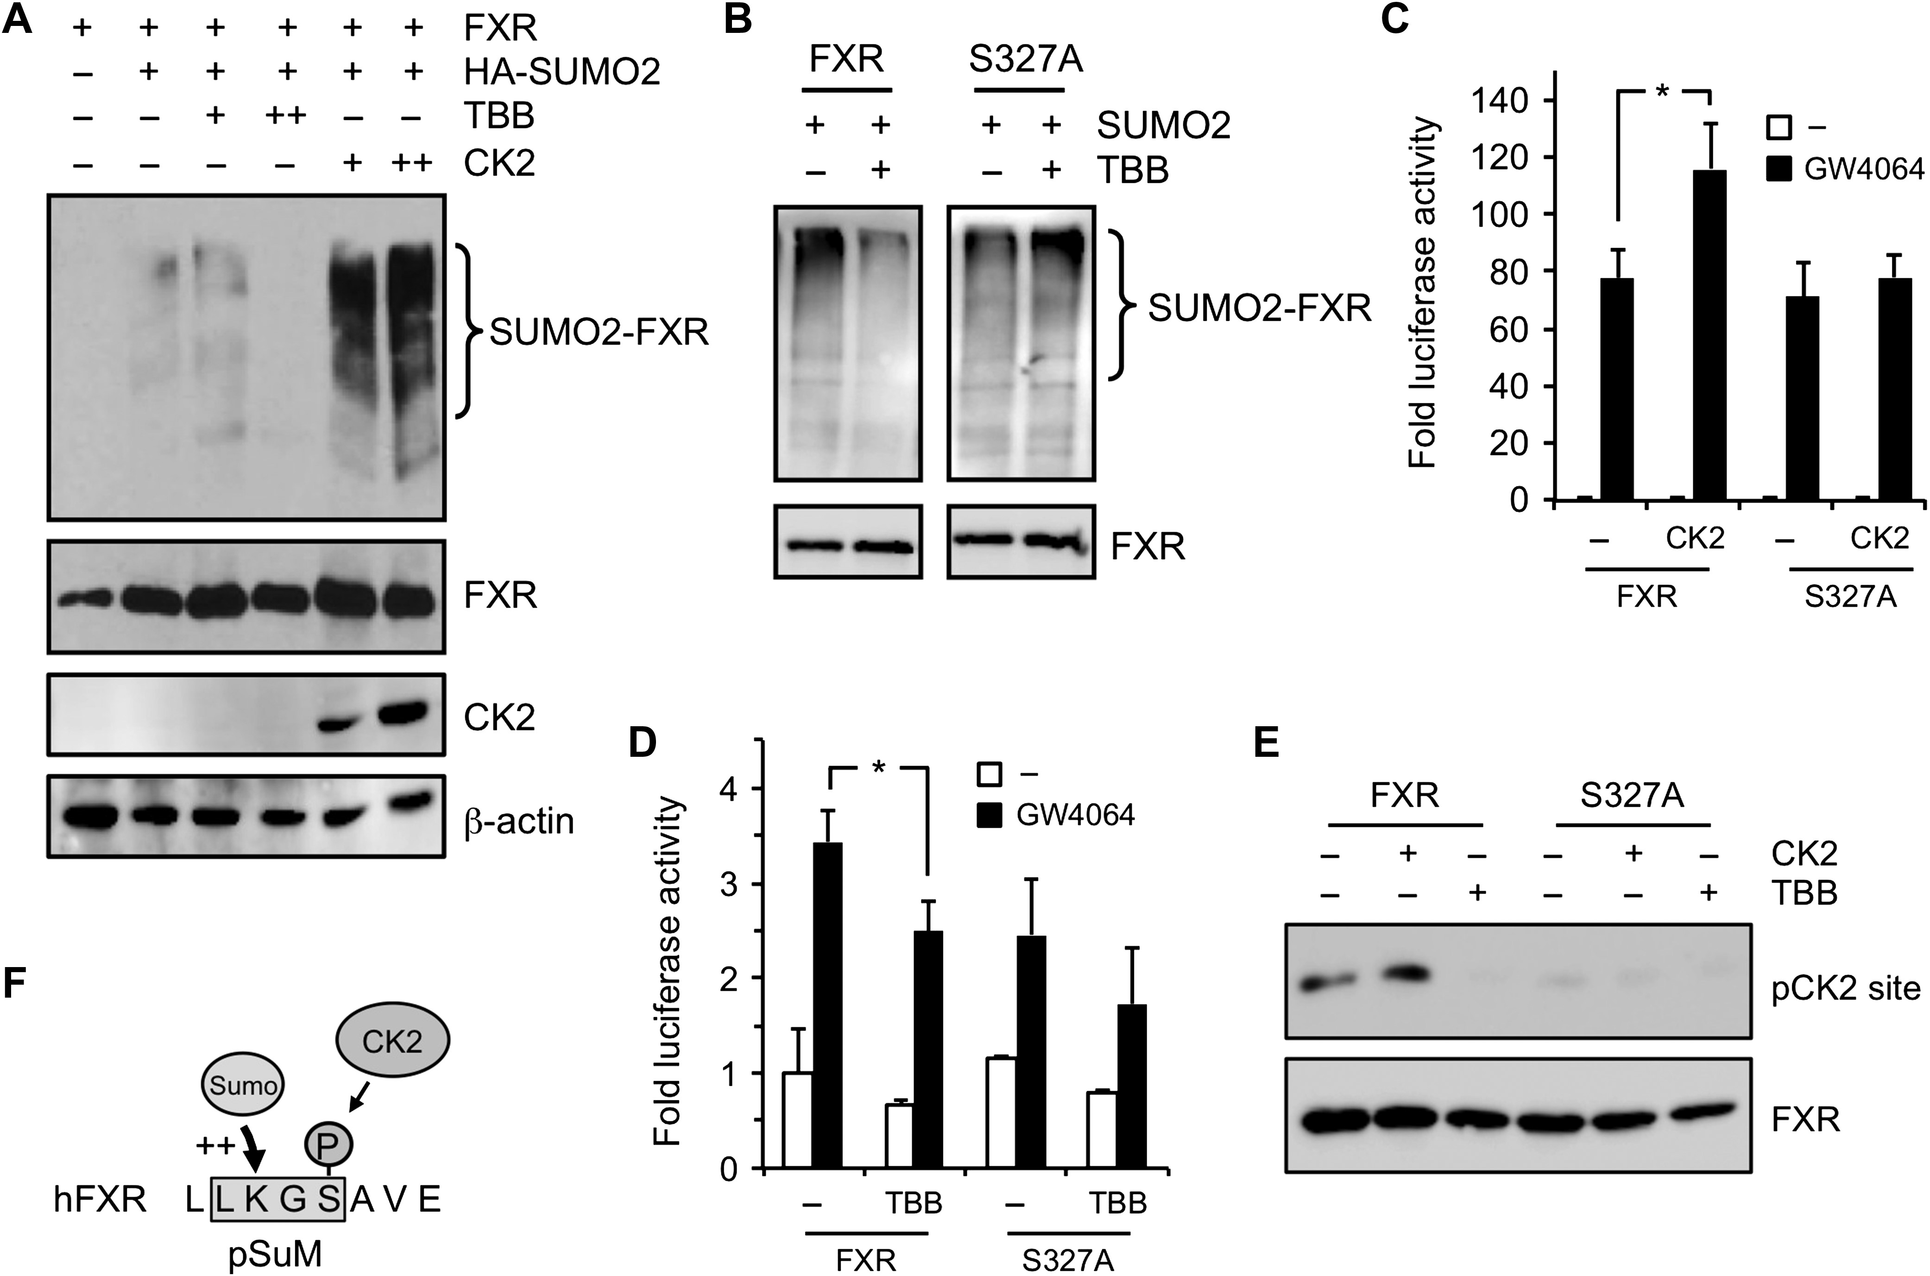
Figure 4 CK2 promotes the SUMOylation and activity of FXR through Ser-327. (A) SUMOylation of FXR is enhanced by CK2 ...
Notes:
Figure 4 CK2 promotes the SUMOylation and activity of FXR through Ser-327. (A) SUMOylation of FXR is enhanced by CK2 activity. SUMOylation assay of FXR was performed in response to increasing expression of the catalytic CK2α1 subunit. Cells were also treated with 2 and 10 µM of CK2 inhibitor TBB for 6 h. Input levels of CK2 are shown. (B) Similar as in A except that S327A mutant was compared to wild-type FXR. Cells were treated with 10 µM TBB. (C) CK2 increases the transcriptional activity of FXR. Luciferase assay were performed in 293 cells transfected with Gal4 constructs of FXR wild-type and S327A mutant in the presence of UAStkLuc reporter and CK2α1. Cells were also treated or not with 1 μM GW4064 for 18 h. *P < 0.05. (D) 293 cells were transfected with FXR (wt or S327A) and RXRα and luciferase assay was determined on a SHPbLuc reporter. Cells were treated with 1 µM GW4064 and 2 µM TBB inhibitor for 18 h. *P < 0.05. (E) CK2 phosphorylates FXR at Ser-327. 293 cells were transfected with a tagged fragment of FXR corresponding to aa 315–345 position of helix 4/5 which contains the pSuM, and compared to the same fragment bearing the S327A mutation. Cells were also transfected with CK2α1 catalytic subunit or treated with 2 µM TBB for 6 h and then harvested for immunoprecipitation and analysed by western blot using an antibody that recognizes the phosphorylated CK2 consensus pS/pTxxE sequence. (F) Schematic representation of FXR pSuM. Ser-327 of the pSuM is phosphorylated by CK2 to allow proper SUMO2 conjugation to accepting Lys-325.
Unless provided in the caption above, the following copyright applies to the content of this slide: © The Author (2017). Published by Oxford University Press on behalf of Journal of Molecular Cell Biology, IBCB, SIBS, CAS. All rights reserved.

Slide 5
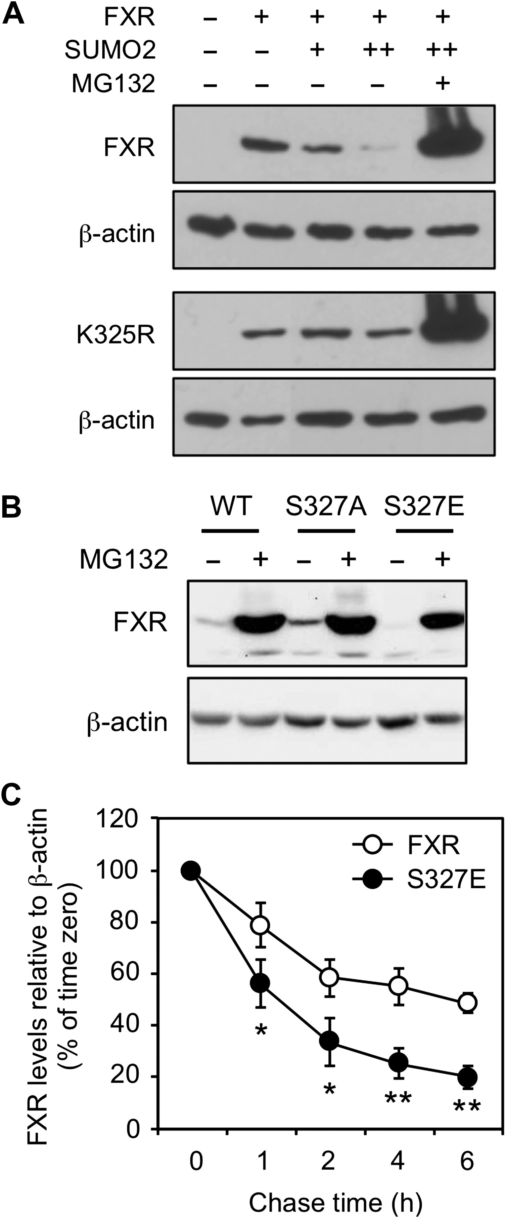
Figure 5 SUMO2 modulates FXR turnover. (A) SUMO2 decreases steady-state levels of FXR. 293 cells were transfected with ...
Notes:
Figure 5 SUMO2 modulates FXR turnover. (A) SUMO2 decreases steady-state levels of FXR. 293 cells were transfected with HA-FXR wild-type and K325R mutant in the presence of increasing amounts of SUMO2 and then analysed by western blot with an anti-HA antibody. Cells were also treated with 1 μM of proteasome inhibitor MG132. Protein loading was monitored with β-actin content. (B) Similar as in A except that Ser-327 mutants were compared to wild-type FXR. (C) The S327E mutation increases FXR turnover. Cycloheximide chase experiments using 293 cells expressing FXR wild-type or S327E mutant. Cells were analysed by western blot at the indicated times after cycloheximide addition. β-actin was used as a loading control. Results are expressed as the percent change from time 0, which was set at 100%. *P < 0.05; **P < 0.01 wt FXR vs. S327E.
Unless provided in the caption above, the following copyright applies to the content of this slide: © The Author (2017). Published by Oxford University Press on behalf of Journal of Molecular Cell Biology, IBCB, SIBS, CAS. All rights reserved.

Slide 6
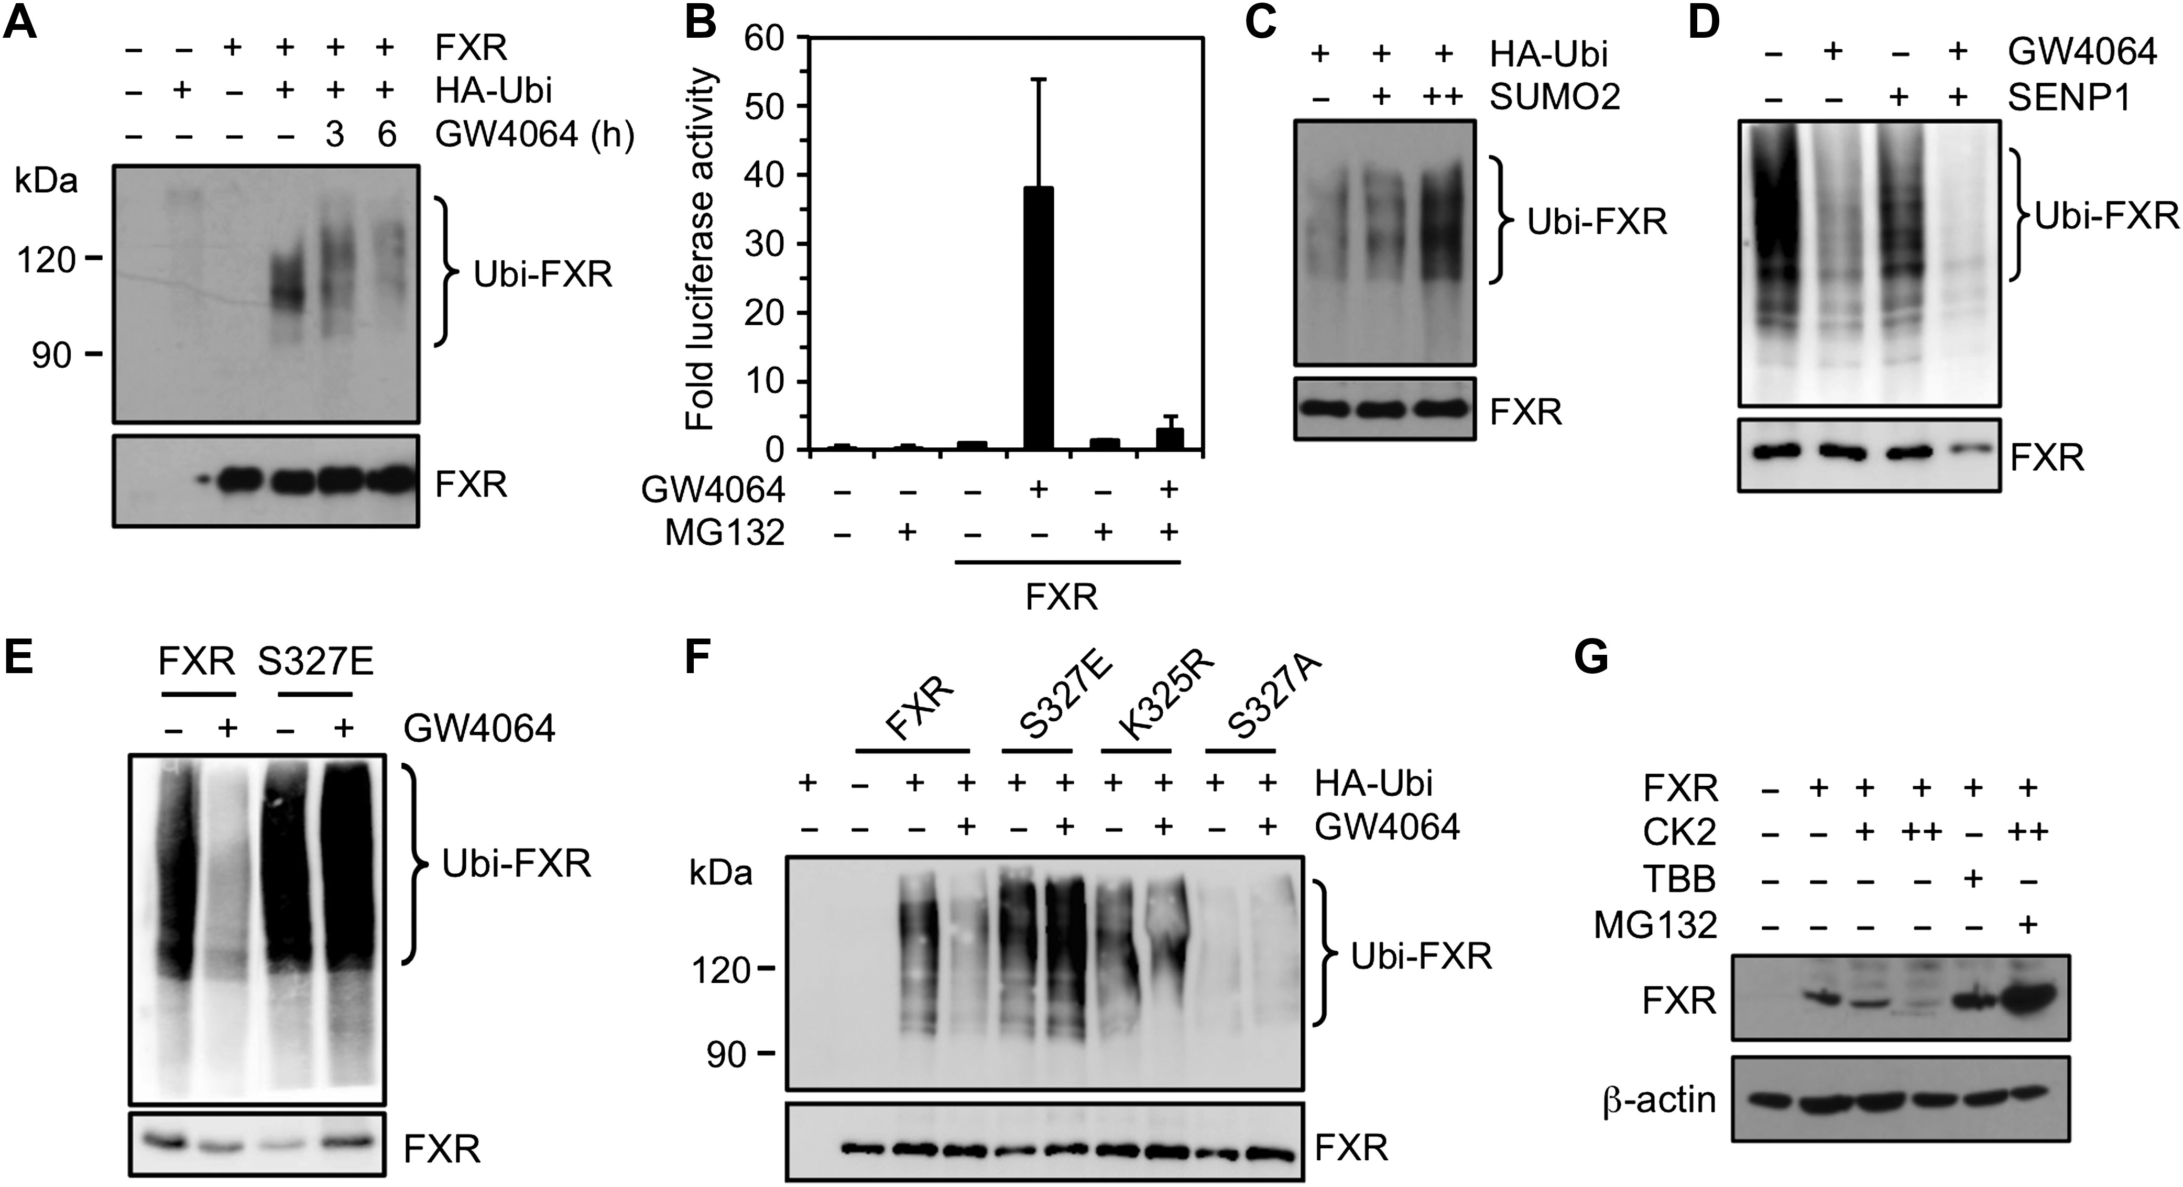
Figure 6 FXR SUMOylation interplays with ubiquitination. (A) FXR is modified by ubiquitin. Ubiquitination assay of 293 ...
Notes:
Figure 6 FXR SUMOylation interplays with ubiquitination. (A) FXR is modified by ubiquitin. Ubiquitination assay of 293 cells transfected with YFP-FXR and HA-ubiquitin. Cells were treated or not with 1 μM GW4064 in the presence of 1 μM MG132. Immunoprecipitation was carried out using anti-FXR antibody and western blot was performed using anti-HA and anti-GFP antibodies. (B) Proteasome activity is essential for maximal transcriptional response of FXR. Luciferase assay was performed in 293 cells transfected with Gal4-FXR and the UAStkluc reporter. Cells were treated with GW4064 and MG132 as in A. (C) SUMO2 expression increases FXR ubiquitination. Ubiquitination assay performed as in A in the presence of increasing concentrations of SUMO2. (D) Similar as in A except that SENP1 was added. (E) Ser-327 regulates FXR ubiquitination. Cells were transfected with FXR wild-type and S327E mutant and analysed for ubiquitination as in D. (F) pSuM mutations affect the ubiquitination of FXR. Ubiquitination assay performed as in A except that HepG2 cells were transfected with FXR wild-type and pSuM mutants and treated or not with GW4064. (G) CK2 activation reduced FXR protein levels. Western blot analysis of steady-state levels of FXR in response to increased CK2α1 expression. Cells were also treated with CK2 inhibitor TBB and MG132. β-actin was used as a loading control.
Unless provided in the caption above, the following copyright applies to the content of this slide: © The Author (2017). Published by Oxford University Press on behalf of Journal of Molecular Cell Biology, IBCB, SIBS, CAS. All rights reserved.

Slide 7
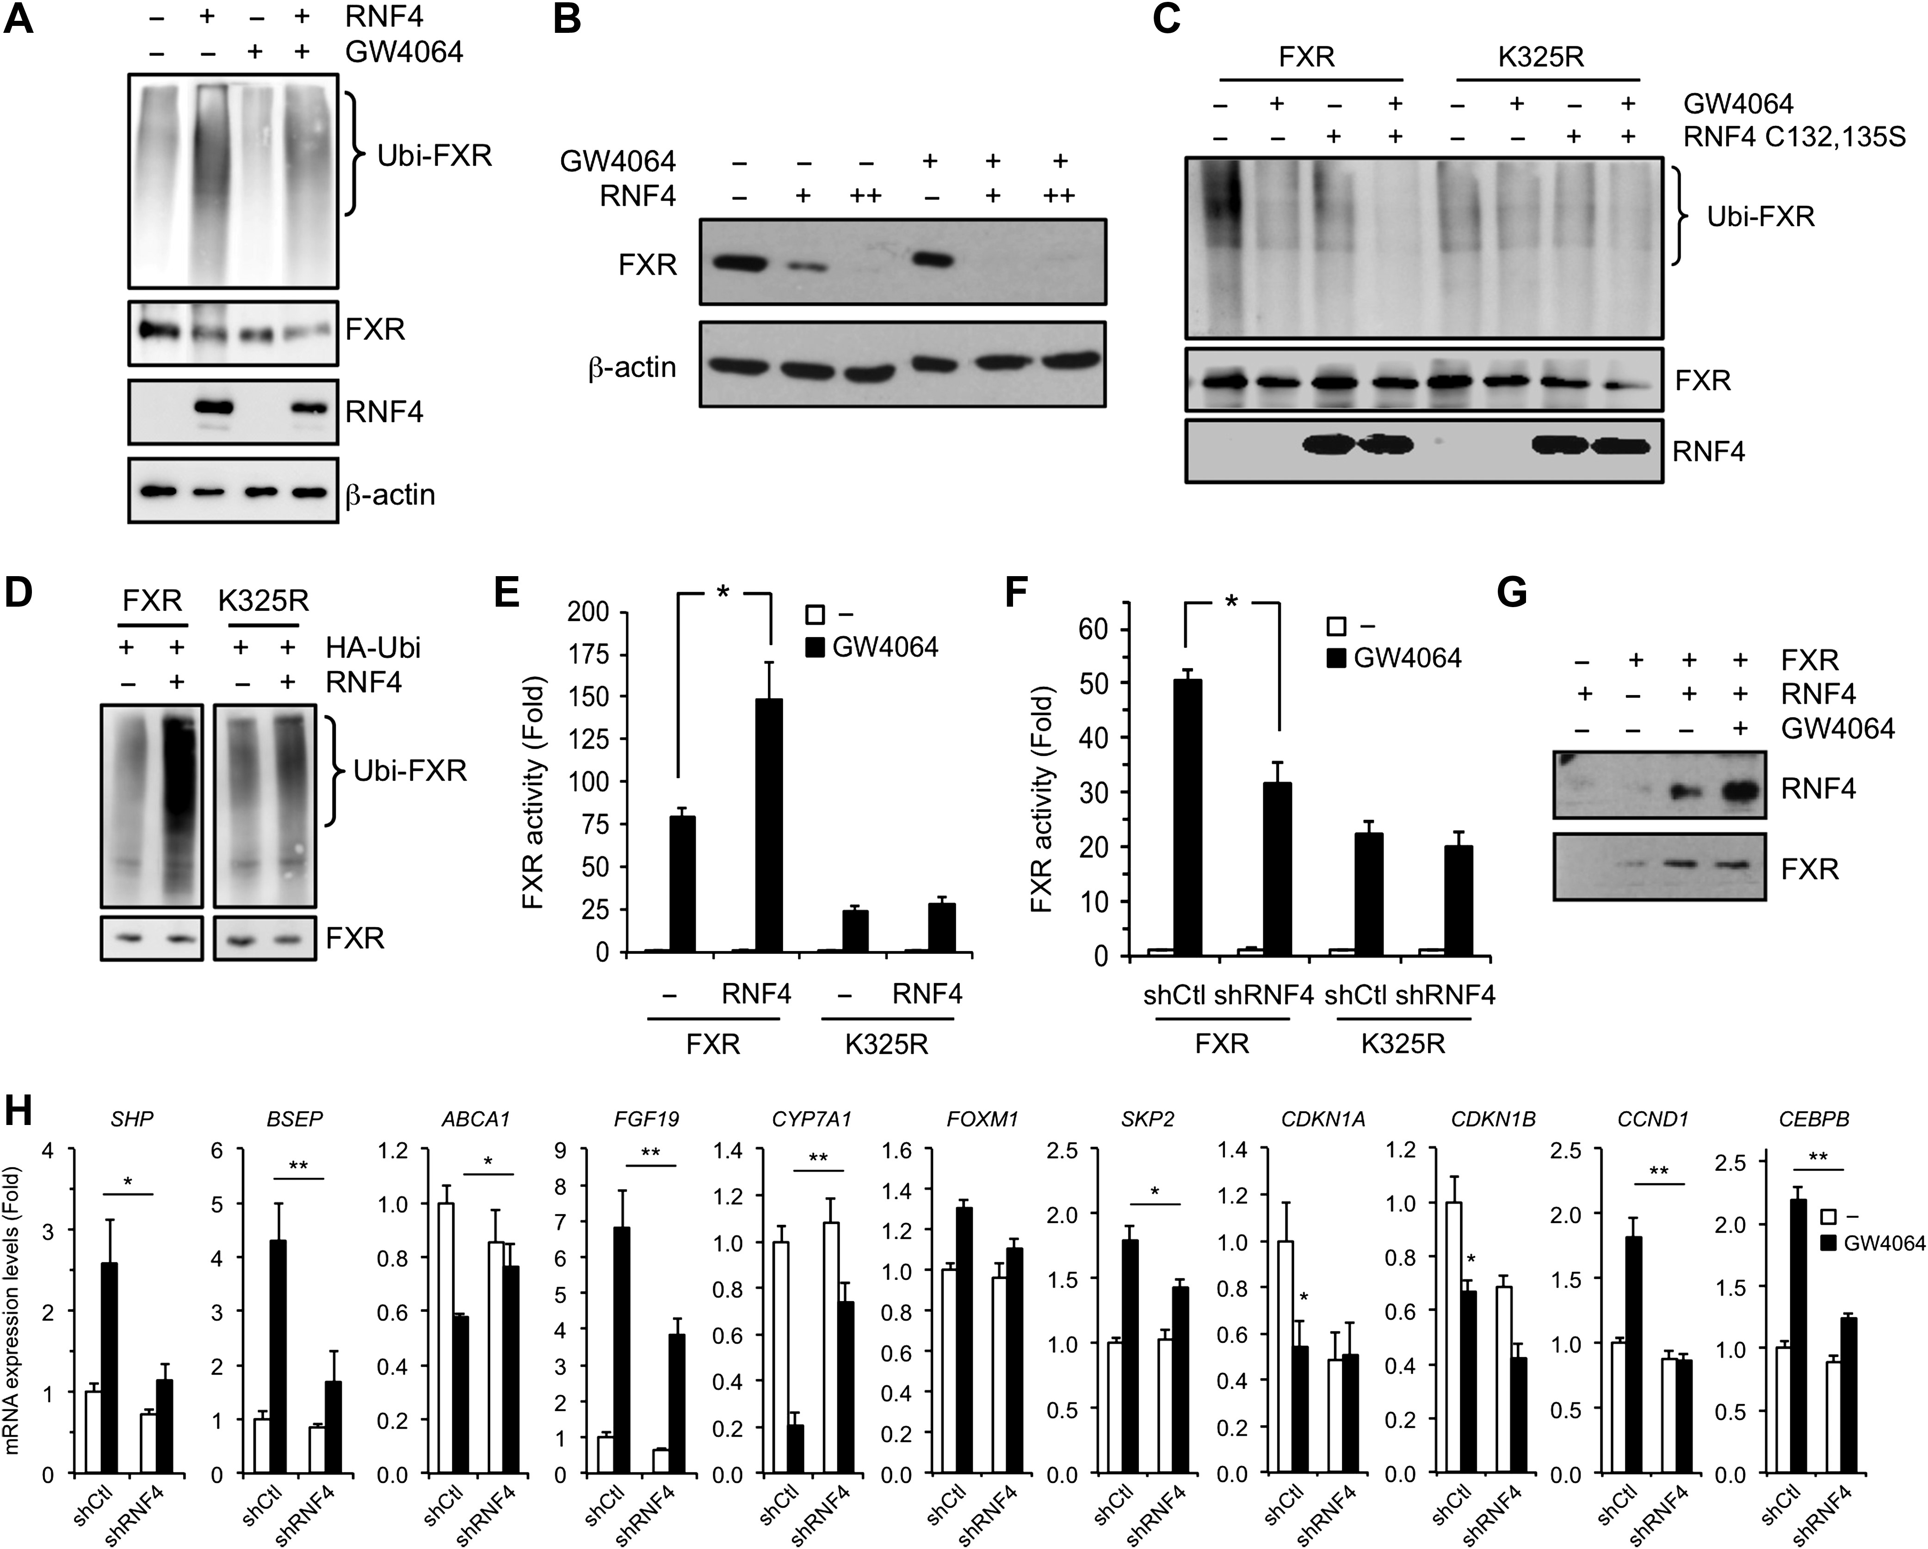
Figure 7 RNF4 increases FXR ubiquitination and transcriptional activity in a SUMO-dependent manner. (A) RNF4 increases ...
Notes:
Figure 7 RNF4 increases FXR ubiquitination and transcriptional activity in a SUMO-dependent manner. (A) RNF4 increases FXR ubiquitination. Ubiquitination assay in 293 cells transfected with FXR and HA-ubiquitin in the presence or absence of RNF4. Cells were treated or not with 1 μM GW4064 in the presence of 1 μM MG132 and then subjected to immunoprecipitation and western blot analysis. Input levels of RNF4 were determined by western blot analysis of whole cell extracts. (B) RNF4 decreases FXR protein levels. Western blot analysis performed on FXR in response to increasing concentrations of RNF4. Cells were treated or not with 1 µM GW4064. (C) Lys-325 is required for RNF4-mediated ubiquitination of FXR. Ubiquitination assay performed as in A except that FXR wild-type and K325R mutant were analysed in response to a dominant negative RNF4 C132,135S mutant. Cells were also treated or not with 1 μM GW4064. RNF4 input levels are shown. (D) Lys-325 is required for RNF4-mediated ubiquitination of FXR. Ubiquitination assay performed as in C in response to RNF4 expression. (E) RNF4 increases FXR transcriptional activity to ligand. HepG2 cells were transfected with Gal4-FXR wild-type and K325R mutant in the presence of RNF4 and UAStkluc reporter. Cells were then treated or not with 1 μM GW4064 and harvested for luciferase activity measurement. *P < 0.05. (F) Stable shRNF4 HepG2 cells generated by lentiviral infection were analysed as in E in luciferase assay and compared to control-infected (shCtl) cells. *P < 0.05. (G) RNF4 is recruited to FXR in a ligand-dependent manner. Co-immunoprecipitation assay in 293 cells transfected with FXR and RNF4 as indicated and treated with 1 µM GW4064. (H) RNF4 is required for optimal target gene regulation by FXR. Real-time PCR analysis was performed on FXR responsive genes in stable shRNF4 HepG2 cells treated or not with 1 μM GW4064. Results are normalized to RPLP0 expression and expressed as fold response compared to untreated shCtl cells, which was set at 1.0. *P < 0.05; **P < 0.02 shCtl vs. shRNF4.
Unless provided in the caption above, the following copyright applies to the content of this slide: © The Author (2017). Published by Oxford University Press on behalf of Journal of Molecular Cell Biology, IBCB, SIBS, CAS. All rights reserved.

Slide 8
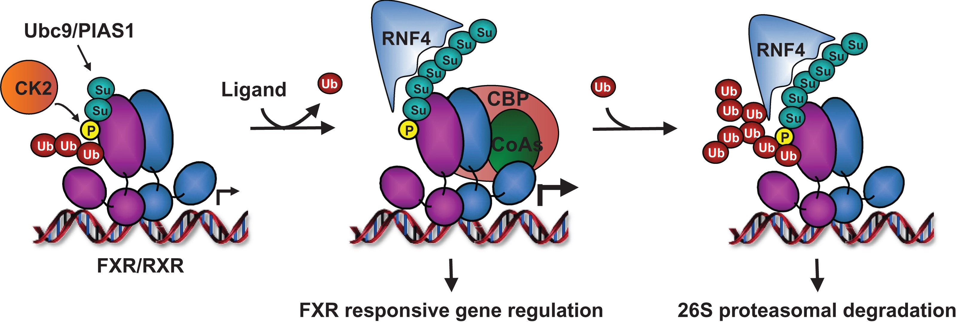
Figure 8 Proposed model for FXR regulation by concerted actions of CK2 and RNF4. FXR conjugates SUMO2 at accepting ...
Notes:
Figure 8 Proposed model for FXR regulation by concerted actions of CK2 and RNF4. FXR conjugates SUMO2 at accepting Lys-325 following phosphorylation of Ser-327 by CK2 providing the required negative charge for Ubc9 action and full pSuM activity. This process is also optimized with the action of E3 ligase PIAS1 and the presence of FXR agonists such as GW4064 and bile acid CDCA. The process by which FXR agonist seems to first result in receptor de-ubiquitination is not known but enhancement of SUMO2 addition to FXR helps recruiting ubiquitin ligase RNF4 presumably through its recognized SIM motifs. Such recruitment of RNF4 is then required for efficient FXR activation in response to ligand and to transcriptional coactivators, and also promotes FXR ubiquitination and 26S proteasome-mediated degradation. It is proposed that this CK2–RNF4 interplay coordinates an activation-degradation cycling pathway that regulates FXR responsive genes.
Unless provided in the caption above, the following copyright applies to the content of this slide: © The Author (2017). Published by Oxford University Press on behalf of Journal of Molecular Cell Biology, IBCB, SIBS, CAS. All rights reserved.

