Slide 1
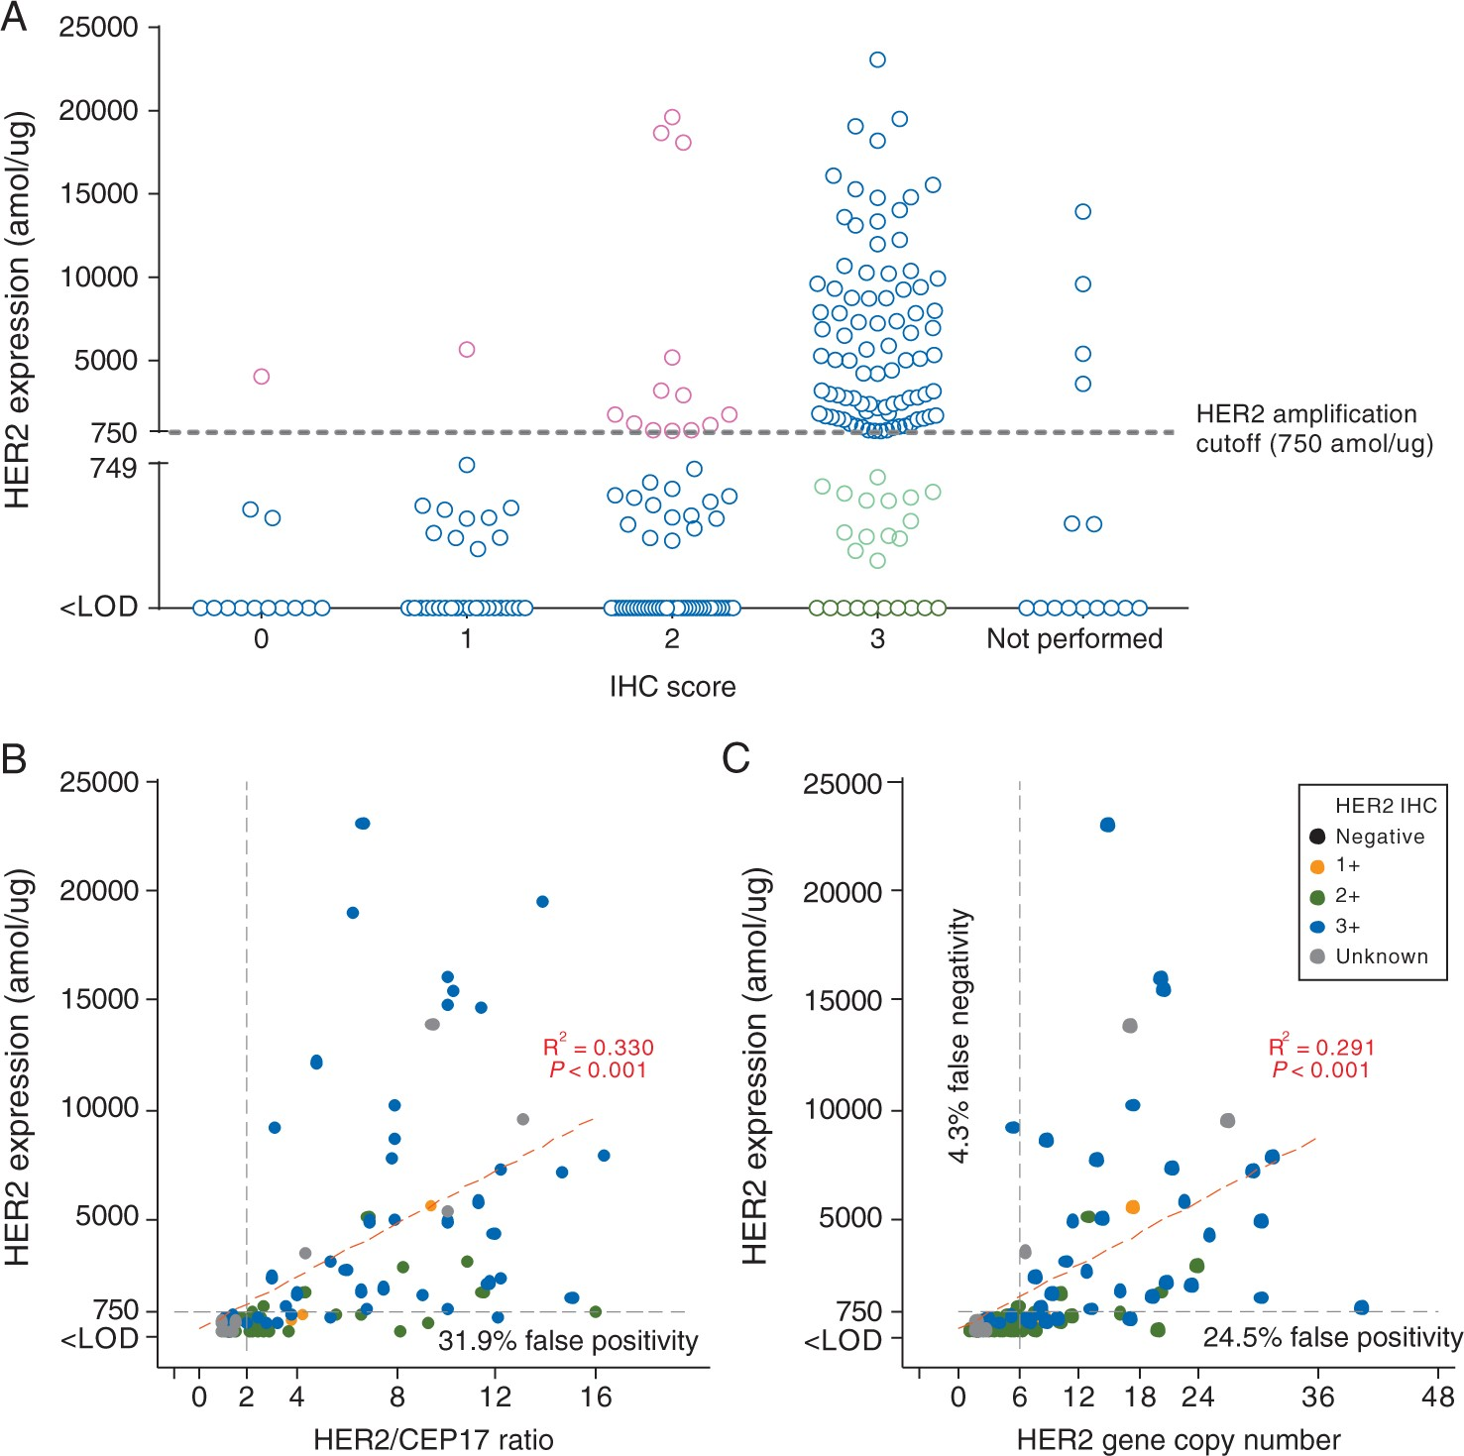
Figure 1. Quantitated HER2 protein levels according to HER2 assessment by immunohistochemistry (IHC) and fluorescence ...
Notes:
Figure 1. Quantitated HER2 protein levels according to HER2 assessment by immunohistochemistry (IHC) and fluorescence in situ hybridization (FISH). (A) In each HER2 IHC category, a wide range of HER2 protein levels were quantitated. Among gastric cancer tumor samples diagnosed as IHC3+, 24/110 (21.8%) expressed low HER2 protein levels (750 amol/µg) and may be falsely negative by IHC (pink circles). (B and C) Linear regression suggests that quantitative HER2 protein levels are loosely correlated with FISH. HER2 protein levels below the 750 amol/µg threshold were measured in tumors that had tested FISH-positive by HER2/CEP17 ratio (23/72; 31.9%) and by gene copy number (GCN) (12/49; 24.5%). These tumors may be false positive by FISH. Of tumors considered FISH-negative by GCN, 3/70 (4.3%) may be false negatives.
Unless provided in the caption above, the following copyright applies to the content of this slide: © The Author 2016. Published by Oxford University Press on behalf of the European Society for Medical Oncology.This is an Open Access article distributed under the terms of the Creative Commons Attribution Non-Commercial License (http://creativecommons.org/licenses/by-nc/4.0/), which permits non-commercial re-use, distribution, and reproduction in any medium, provided the original work is properly cited. For commercial re-use, please contact journals.permissions@oup.com

Slide 2
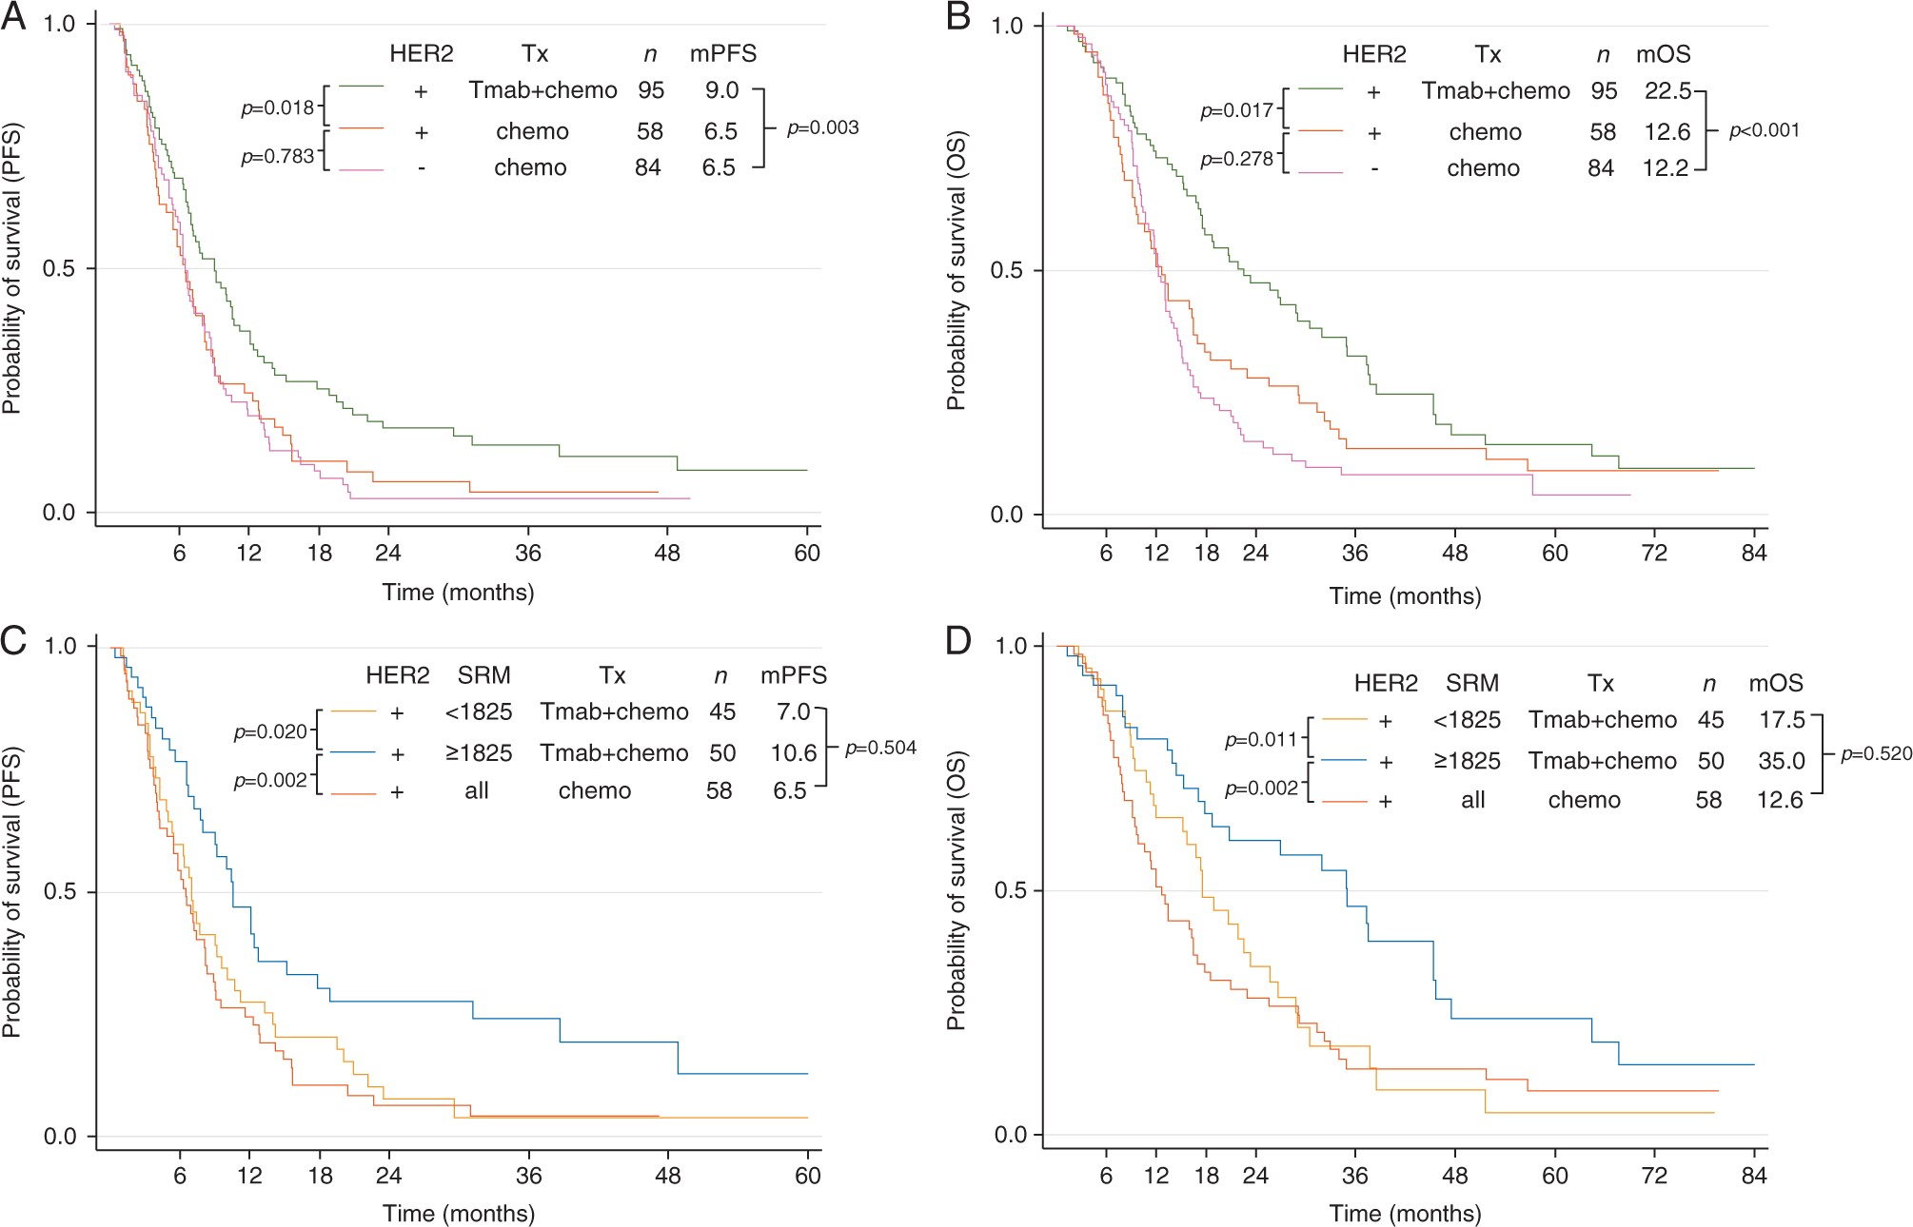
Figure 2. HER2 selected reaction monitoring (SRM) identifies gastric cancer patients who would benefit from ...
Notes:
Figure 2. HER2 selected reaction monitoring (SRM) identifies gastric cancer patients who would benefit from trastuzumab. With conventional HER2 testing methods, HER2-positive patients selected for treatment with trastuzumab plus chemotherapy had better (A) progression-free survival and (B) overall survival than HER2-positive patients who received chemotherapy alone and HER2-negative patients who received chemotherapy. (C and D) The survival benefits are greater with HER2 assessment by quantitative proteomics. Trastuzumab-treated patients with HER2 protein expression above the cutoff (1825 amol/µg) have twice the overall survival of patients whose HER2 levels are below the cutoff. Trastuzumab-treated patients with HER2 levels below the cutoff had survival outcomes similar to patients treated with chemotherapy alone. P-value is for the log rank test. Tx, treatment; Tmab, trastuzumab; chemo, chemotherapy.
Unless provided in the caption above, the following copyright applies to the content of this slide: © The Author 2016. Published by Oxford University Press on behalf of the European Society for Medical Oncology.This is an Open Access article distributed under the terms of the Creative Commons Attribution Non-Commercial License (http://creativecommons.org/licenses/by-nc/4.0/), which permits non-commercial re-use, distribution, and reproduction in any medium, provided the original work is properly cited. For commercial re-use, please contact journals.permissions@oup.com

