Slide 1
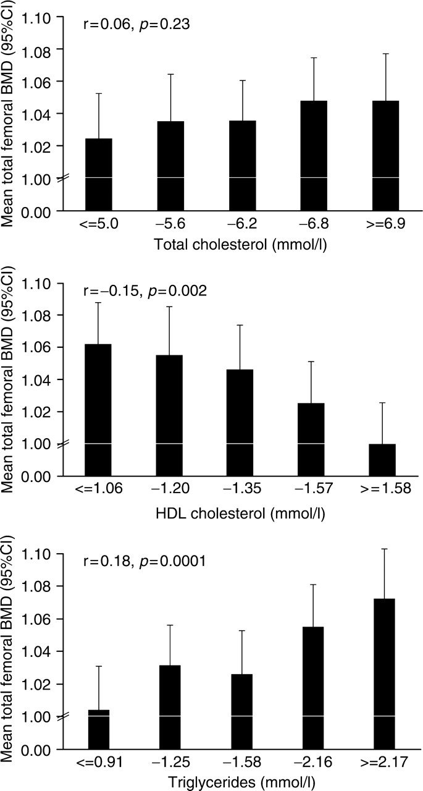
Figure 1. Relationships between total hip BMD and fasting cholesterol in men.
Notes:
Figure 1. Relationships between total hip BMD and fasting cholesterol in men.
Unless provided in the caption above, the following copyright applies to the content of this slide: © The Author 2007. Published by Oxford University Press on behalf of the Association of Physicians. All rights reserved. For Permissions, please email: journals.permissions@oxfordjournals.org

Slide 2
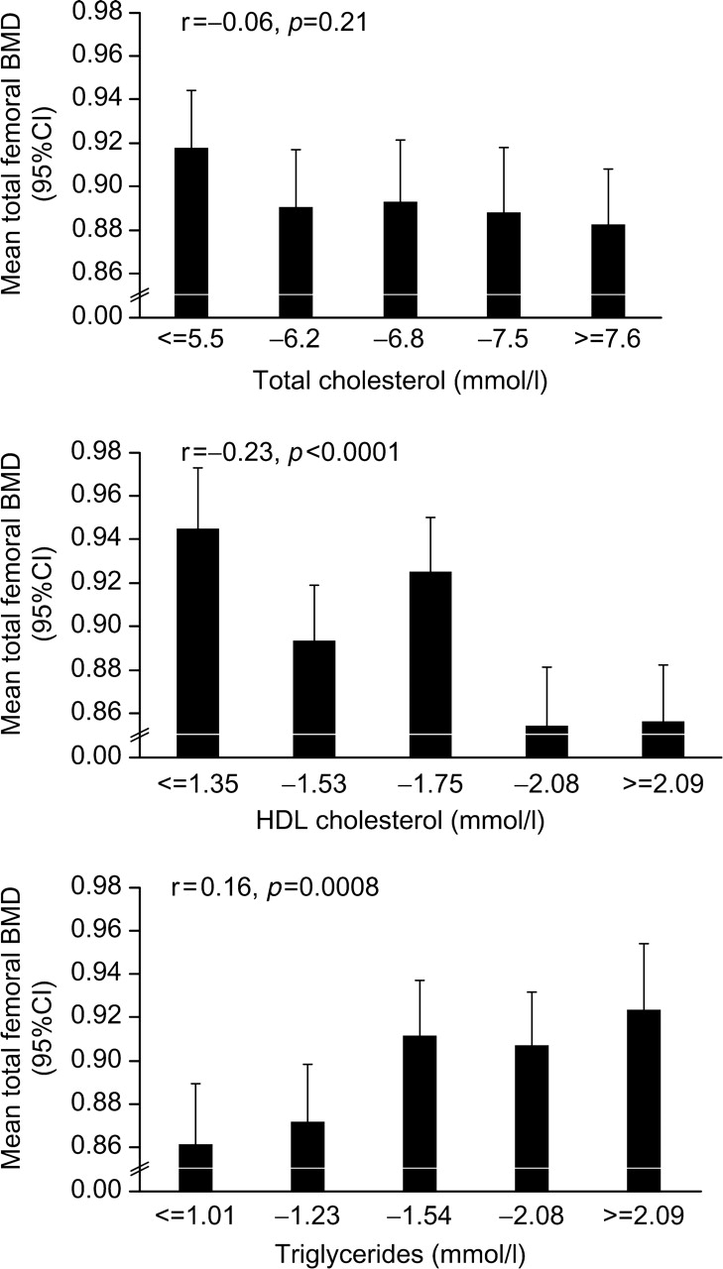
Figure 2. Relationships between total hip BMD and fasting cholesterol in women.
Notes:
Figure 2. Relationships between total hip BMD and fasting cholesterol in women.
Unless provided in the caption above, the following copyright applies to the content of this slide: © The Author 2007. Published by Oxford University Press on behalf of the Association of Physicians. All rights reserved. For Permissions, please email: journals.permissions@oxfordjournals.org

