Slide 1
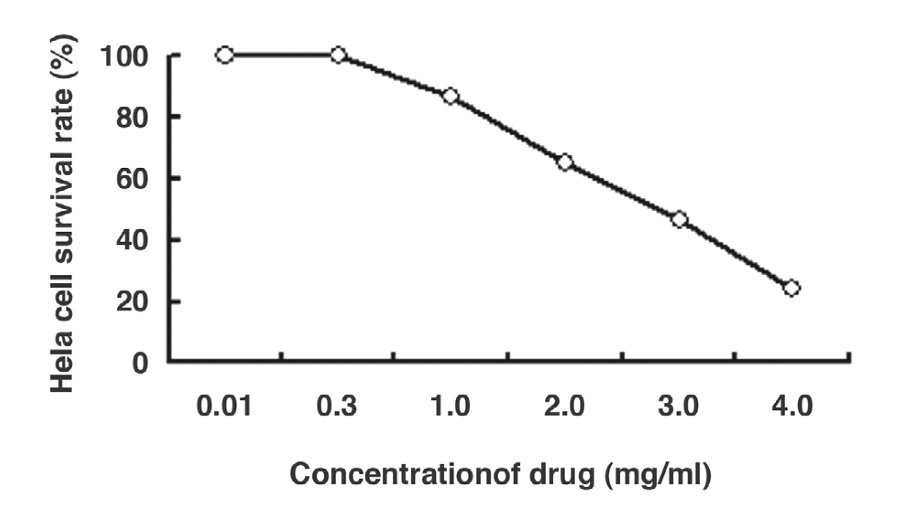
Figure 1 HeLa cell survival rate (%) in different concentrations of cinnamaldehyde. MTT analysis demonstrated the ...
Notes:
Figure 1 HeLa cell survival rate (%) in different concentrations of cinnamaldehyde. MTT analysis demonstrated the toxicity of cinnamaldehyde to HeLa cells. After the addition of 20 μL of MTT solution (5 mg/mL) to each well, the cell cultures were incubated at 37°C in 5% CO2. Dimethylsulfoxide (200 μL) was then added to every hole. The optical density value was measured by shading selection using on enzyme-linked immunosorbent assay. Experiments were repeated 3 times.
Unless provided in the caption above, the following copyright applies to the content of this slide: © American Society of Clinical Pathologists

Slide 2
Image 1 Result of CPE (200x). (A) Normal HeLa cells. (B) HeLa cells infected with ADV3. (C) The effect of ...
Notes:
Image 1 Result of CPE (200x). (A) Normal HeLa cells. (B) HeLa cells infected with ADV3. (C) The effect of cinnamaldehyde on ADV3.
Unless provided in the caption above, the following copyright applies to the content of this slide: © American Society of Clinical Pathologists

Slide 3
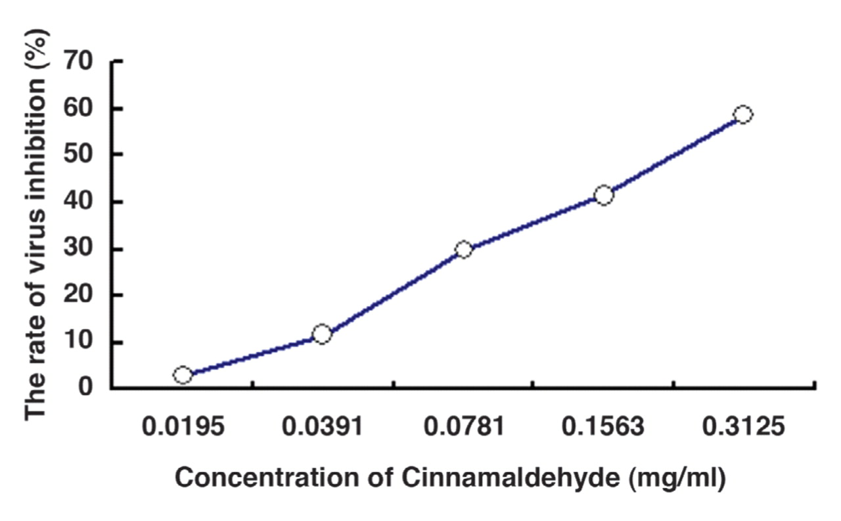
Figure 2 MTT analysis of the anti-ADV3 role of cinnamaldehyde. The MTT method is performed as described in Figure 1.
Notes:
Figure 2 MTT analysis of the anti-ADV3 role of cinnamaldehyde. The MTT method is performed as described in Figure 1.
Unless provided in the caption above, the following copyright applies to the content of this slide: © American Society of Clinical Pathologists

Slide 4
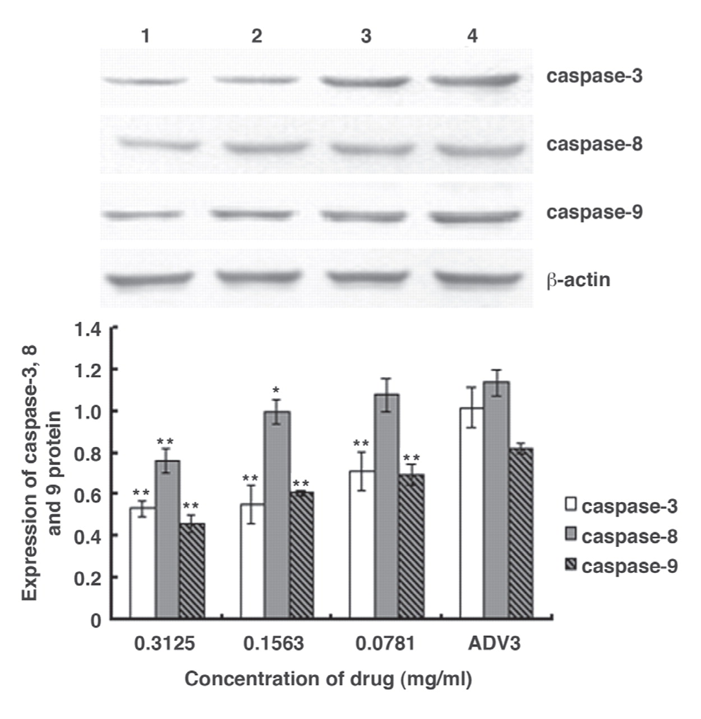
Figure 3 Expression of caspase-3, caspase-8, and caspase-9 proteins (Western blotting). Results are presented as an ...
Notes:
Figure 3 Expression of caspase-3, caspase-8, and caspase-9 proteins (Western blotting). Results are presented as an arithmetic mean of 3 separate experiments ± SE. Single asterisk (*) and double asterisks (**) indicate P<0.05 and P<0.01, respectively, compared with ADV3 group. The data are representative of 3 separate experiments. Lane 1: cinnamaldehyde (0.3125 mg/mL) Lane 2: cinnamaldehyde (0.1563 mg/mL) Lane 3: cinnamaldehyde (0.0781 mg/mL) Lane 4: ADV3
Unless provided in the caption above, the following copyright applies to the content of this slide: © American Society of Clinical Pathologists

Slide 5
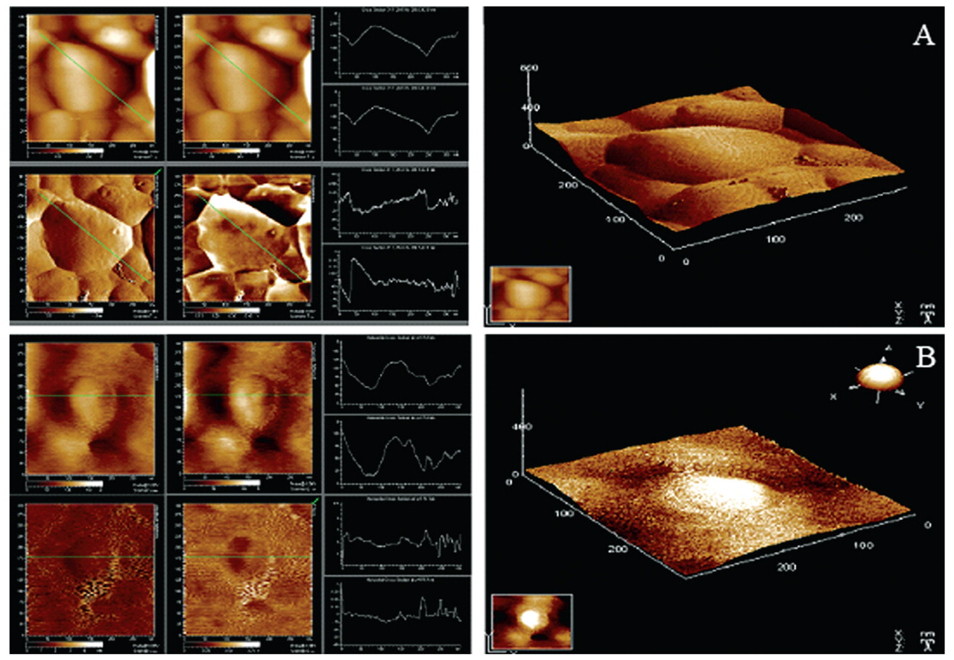
Image 2 AFM analysis of the effect of cinnamaldehyde on ADV3. (A) ADV3. (B) The effect of cinnamaldehyde on ADV3.
Notes:
Image 2 AFM analysis of the effect of cinnamaldehyde on ADV3. (A) ADV3. (B) The effect of cinnamaldehyde on ADV3.
Unless provided in the caption above, the following copyright applies to the content of this slide: © American Society of Clinical Pathologists

Slide 6
Image 3 Expression of apoptosis in the nucleus (immunohistochemistry 100x). (A) Normal HeLa cells. (B) HeLa cells ...
Notes:
Image 3 Expression of apoptosis in the nucleus (immunohistochemistry 100x). (A) Normal HeLa cells. (B) HeLa cells infected with ADV3. (C) The effect of cinnamaldehyde on ADV3.
Unless provided in the caption above, the following copyright applies to the content of this slide: © American Society of Clinical Pathologists

Slide 7
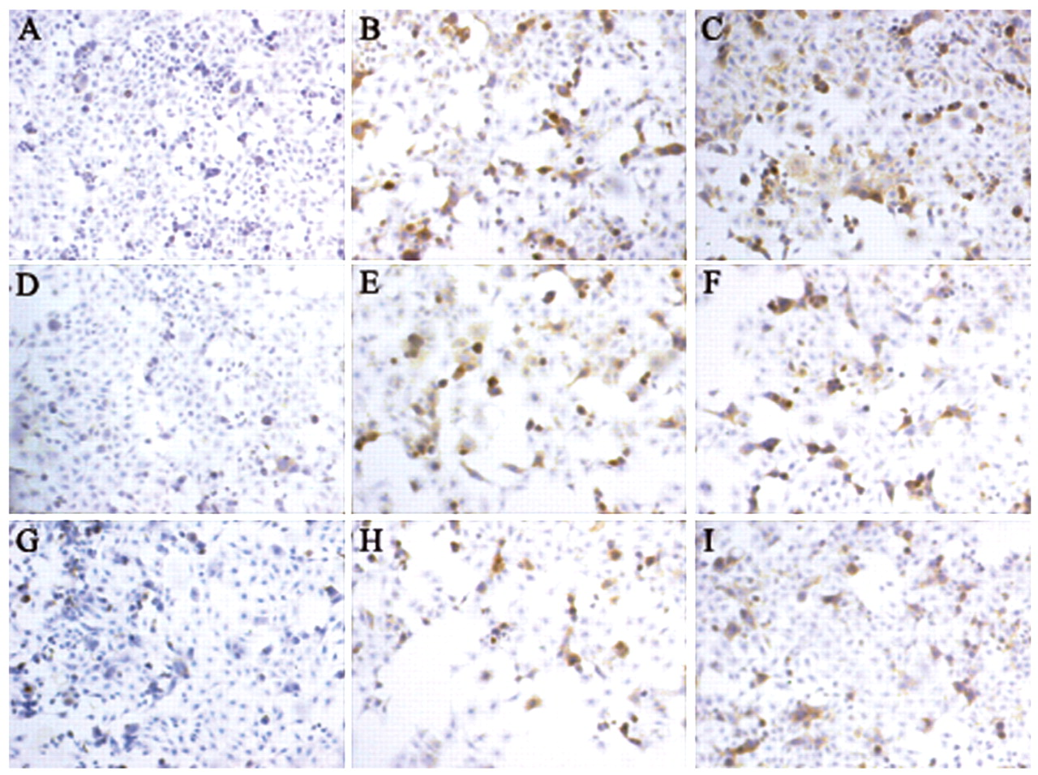
Image 4 Expression of caspase-3, caspase-8, and caspase-9 protein in the cytoplasm (Immunohistochemistry 100x). (A, ...
Notes:
Image 4 Expression of caspase-3, caspase-8, and caspase-9 protein in the cytoplasm (Immunohistochemistry 100x). (A, D, G) Normal HeLa cells. (B, E, H) HeLa cells infected with ADV3. (C, F, I) The effect of cinnamaldehyde on ADV3.
Unless provided in the caption above, the following copyright applies to the content of this slide: © American Society of Clinical Pathologists

