Slide 1
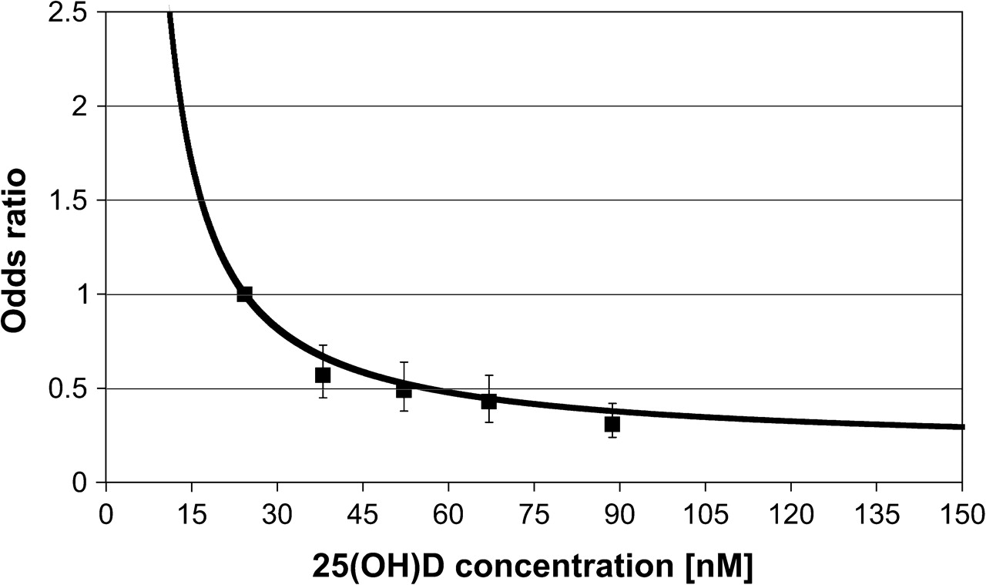
Fig. 1. ORs for post-menopausal breast cancer by 25(OH)D concentrations using fractional polynomial as dose–response ...
Notes:
Fig. 1. ORs for post-menopausal breast cancer by 25(OH)D concentrations using fractional polynomial as dose–response analysis. The resulting function OR( x ) = exp[10.4 × ( x + 1) −0.5 ] is displayed, setting the median of the lowest category from the categorical analysis as reference [24.3 nM 25(OH)D]. The solid squares and respective bars represent the ORs and 95% CIs of the categorical analysis (30–45, 45–60, 60–75 and ≥75 nM). For graphical illustration categorical OR estimates were displayed at the median value in the controls of each category, at 24.3 (reference), 38.0, 52.2, 67.1 and 88.7 nM, respectively.
Unless provided in the caption above, the following copyright applies to the content of this slide: © The Author 2007. Published by Oxford University Press. All rights reserved. For Permissions, please email: journals.permissions@oxfordjournals.org

