Slide 1
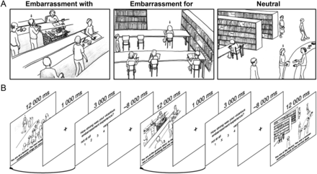
Figure 1. Stimulus material and experimental paradigm. (A) Examples of displayed situations. Subjects see social ...
Notes:
Figure 1. Stimulus material and experimental paradigm. (A) Examples of displayed situations. Subjects see social targets in different scenarios, being embarrassed (embarrassment with, EMB WITH) or not (embarrassment for, EMB FOR), as well as in neutral scenarios (NEUT). The sketches were displayed together with a short description of the situation. For the given examples, these are “You are at the grocery store: a person at the cashier realizes that she cannot pay for her purchase … ” (EMB WITH), “You are at the library: the person in front of you is wearing her pants so low that you can see her underwear … ” (EMB FOR), and “You are at the library: a person returns some books to the service desk … ” (NEUT). (B) Sequences of the experimental paradigm exemplifying the parametric weighting procedure. The hemodynamic response for each of the situations was weighted with the intensity of the self-report of the embarrassment.
Unless provided in the caption above, the following copyright applies to the content of this slide: © The Author 2014. Published by Oxford University Press. All rights reserved. For Permissions, please e-mail: journals.permissions@oup.com

Slide 2
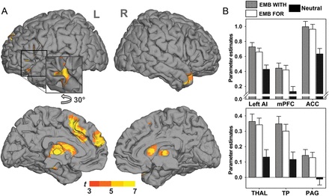
Figure 2. Common activation of embarrassment on behalf of others' mishaps. (A) Activation of the medial prefrontal ...
Notes:
Figure 2. Common activation of embarrassment on behalf of others' mishaps. (A) Activation of the medial prefrontal cortex (mPFC), ACC, left AI, and sub-cortical structures during observation of threats to the social integrity of target person. Render images display the results of a GLM random-effects analysis of the differences of the neutral (NEUT) situations to embarrassment with (EMB WITH) and embarrassment for another (EMB FOR) in a conjunction analysis ([EMB WITH − NEUT] ∩ [EMB FOR − NEUT]). Results have a threshold at t(120) > 4.62, P < 0.05, FWE corrected. (B) Parameter estimates at the peak of significant effects for the EMB WITH and EMB FOR conditions. Parameter estimates show mean ± SEM.
Unless provided in the caption above, the following copyright applies to the content of this slide: © The Author 2014. Published by Oxford University Press. All rights reserved. For Permissions, please e-mail: journals.permissions@oup.com

Slide 3
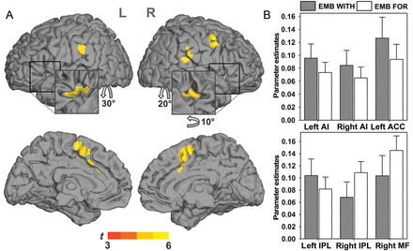
Figure 3. Variability in the hemodynamic responses positively related to the intensity of the self-reported ...
Notes:
Figure 3. Variability in the hemodynamic responses positively related to the intensity of the self-reported embarrassment participants felt while watching the situation. (A) Render images display the average effect of a GLM random-effects analysis of the parametric weights with a threshold at t(118) > 4.64, P < 0.05, FWE corrected. Significant associations were found in the ACC, bilateral AI, bilateral IPL, and the right DLPFC. (B) Parameter estimates at the peak of the effects for the embarrassment for and the embarrassment with condition. Parameter estimates show mean ± SEM.
Unless provided in the caption above, the following copyright applies to the content of this slide: © The Author 2014. Published by Oxford University Press. All rights reserved. For Permissions, please e-mail: journals.permissions@oup.com

Slide 4
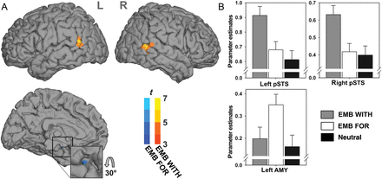
Figure 4. Dissociation of embarrassment with [EMB WITH] and embarrassment for [EMB FOR] another. (A) Render images ...
Notes:
Figure 4. Dissociation of embarrassment with [EMB WITH] and embarrassment for [EMB FOR] another. (A) Render images depict specific activation for embarrassment with and embarrassment for another and show the results of the post hoc contrasts [EMB WITH − NEUT] ∩ [EMB WITH − EMB FOR], as well as [EMB FOR − NEUT] ∩ [EMB FOR − EMB WITH], using a threshold at t(123) > 4.61, P < 0.05, FWE corrected. The stronger activation for EMB WITH in the bilateral posterior STS (pSTS) is coded in red/yellow and the stronger activation in response to EMB FOR in the left amygdala (AMY) is coded in blue. (B) Parameter estimates at the peak of the corresponding effect in the bilateral pSTS and the left AMY for EMB WITH and EMB FOR. Parameter estimates show mean ± SEM.
Unless provided in the caption above, the following copyright applies to the content of this slide: © The Author 2014. Published by Oxford University Press. All rights reserved. For Permissions, please e-mail: journals.permissions@oup.com

Slide 5
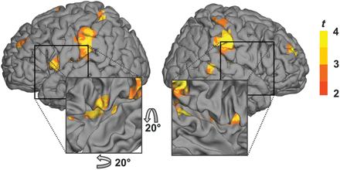
Figure 5. Increased functional connectivity with the right posterior STS (pSTS) during embarrassment with [EMB WITH] ...
Notes:
Figure 5. Increased functional connectivity with the right posterior STS (pSTS) during embarrassment with [EMB WITH] when compared with embarrassment for [EMB FOR] another. Render images show the results of a psychophysiological interaction analysis on the group level, with a threshold at t(31) > 2.74, P < 0.005, uncorrected. Clusters with a significant increase in function coupling with the right pSTS during EMB WITH were found in the bilateral IPL, as well as posterior, middle, and frontal aspects of the left insula.
Unless provided in the caption above, the following copyright applies to the content of this slide: © The Author 2014. Published by Oxford University Press. All rights reserved. For Permissions, please e-mail: journals.permissions@oup.com

