Slide 1
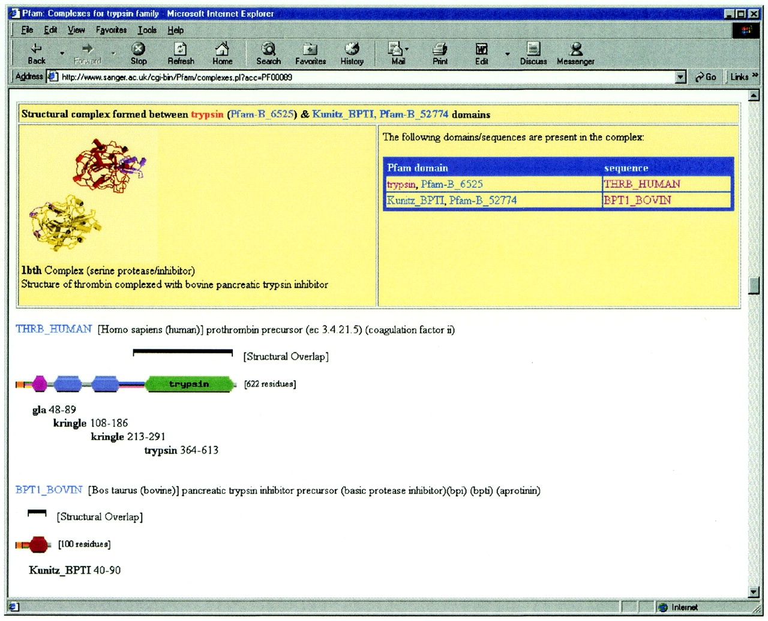
Figure 1. The web view of the structural complex of thrombin with bovine pancreatic trypsin inhibitor. The ...
Notes:
Figure 1. The web view of the structural complex of thrombin with bovine pancreatic trypsin inhibitor. The web page shows the Pfam domain structure of the two proteins in the complex; the regions of the proteins represented in the PDB structure are highlighted by the square bracket above each protein. The protein structure picture has been kindly provided by the PDBsum resource (17).
Unless provided in the caption above, the following copyright applies to the content of this slide:

Slide 2
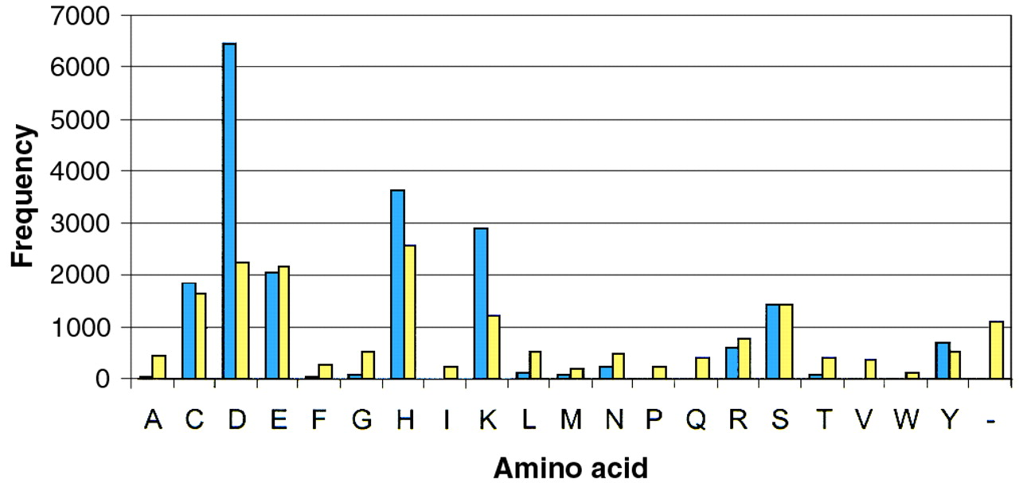
Figure 2. Distribution of active site residues in SWISS-PROT and Pfam seed alignments. Histogram showing the ...
Notes:
Figure 2. Distribution of active site residues in SWISS-PROT and Pfam seed alignments. Histogram showing the frequency of amino acids found in active sites from SWISS-PROT (blue) and the frequency of amino acids aligned to active site residues (yellow).
Unless provided in the caption above, the following copyright applies to the content of this slide:

