Slide 1
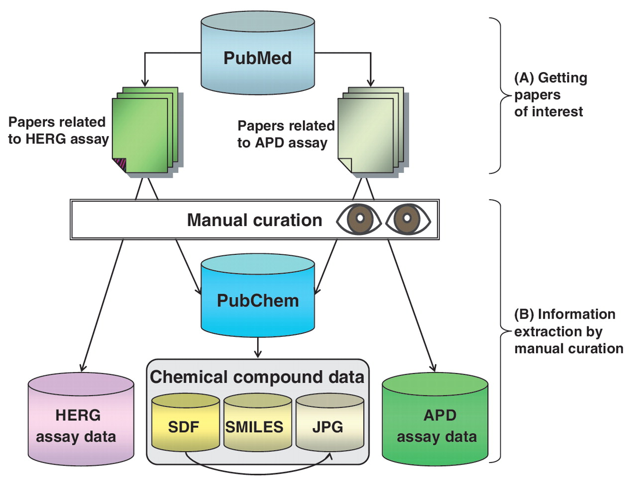
Figure 1. Overall method for hERGAPDbase data collection. (A) Two types of papers related to the hERG assay and the APD ...
Notes:
Figure 1. Overall method for hERGAPDbase data collection. (A) Two types of papers related to the hERG assay and the APD assay found in PubMed. (B) hERG assay data and APD assay data were extracted manually from scientific papers. The structural data of the chemical compounds (SDF; SMILES; and JPEG files) were obtained from PubChem.
Unless provided in the caption above, the following copyright applies to the content of this slide: © The Author(s) 2011. Published by Oxford University Press.This is Open Access article distributed under the terms of the Creative Commons Attribution Non-Commercial License (http://creativecommons.org/licenses/by-nc/2.5), which permits unrestricted non-commercial use, distribution, and reproduction in any medium, provided the original work is properly cited.

Slide 2
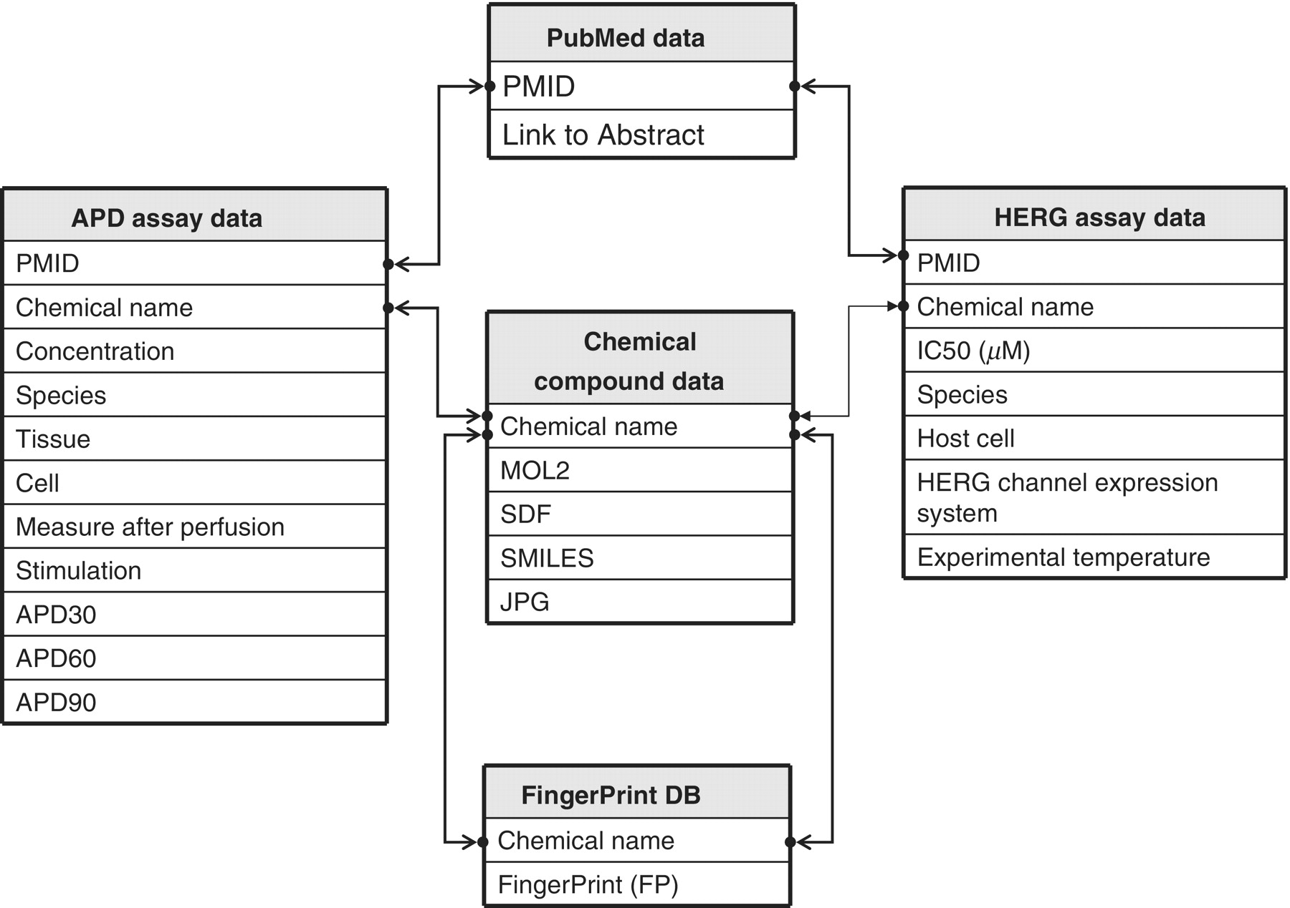
Figure 2. Schematic representation of hERGAPDbase architecture. hERGAPDbase consists of five data tables: PubMed data, ...
Notes:
Figure 2. Schematic representation of hERGAPDbase architecture. hERGAPDbase consists of five data tables: PubMed data, Chemical compound data, FP DB, APD assay data and HERG assay data. The abbreviations APD and HERG indicate APD and hERG, respectively. The PubMed data table consists of two attributes: PubMed Unique Identifier (PMID) and Link to Abstract. The Chemical compound data table consists of five attributes: chemical name, Sybyl Mol2 chemical modeller output (MOL2), SDF, SMILES and JPEG). The FP DB data table consists of two attributes: chemical name and FP. The APD assay data table consists of 11 attributes: PMID, chemical name, concentration, species, tissues, cell, measure after perfusion, stimulation, APD at 30% repolarization (APD30), APD at 60% repolarization (APD60) and APD at 90% repolarization (APD90). The HERG assay data table consists of seven attributes: PMID, chemical name, half maximal inhibitory concentration (IC50; µM), species, host cell, HERG channel expression system and experimental temperature.
Unless provided in the caption above, the following copyright applies to the content of this slide: © The Author(s) 2011. Published by Oxford University Press.This is Open Access article distributed under the terms of the Creative Commons Attribution Non-Commercial License (http://creativecommons.org/licenses/by-nc/2.5), which permits unrestricted non-commercial use, distribution, and reproduction in any medium, provided the original work is properly cited.

Slide 3
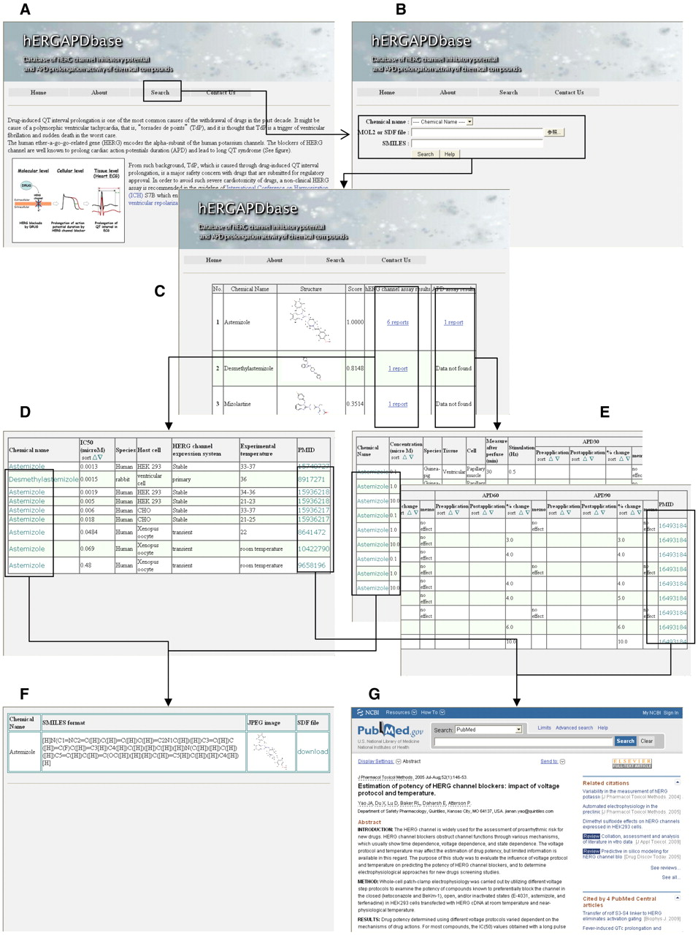
Figure 3. Overall outline of hERGAPDbase. (A) Homepage of hERGAPDbase. (B) Screen capture of the similarity search ...
Notes:
Figure 3. Overall outline of hERGAPDbase. (A) Homepage of hERGAPDbase. (B) Screen capture of the similarity search homepage for query input. In this example, astemizole is specified in the pull-down menu. (C) The resulting table from the similarity search in the FP DB of the hERGAPDbase. (D) Table of the hERG assay data for astemizole in this example. (E) Table of the APD assay data for astemizole. (F) Platform of data download for SDF, SMILES and JPEG files. (G) Paper abstracts of data resources for the hERG and APD assays from PubMed.
Unless provided in the caption above, the following copyright applies to the content of this slide: © The Author(s) 2011. Published by Oxford University Press.This is Open Access article distributed under the terms of the Creative Commons Attribution Non-Commercial License (http://creativecommons.org/licenses/by-nc/2.5), which permits unrestricted non-commercial use, distribution, and reproduction in any medium, provided the original work is properly cited.

Slide 4
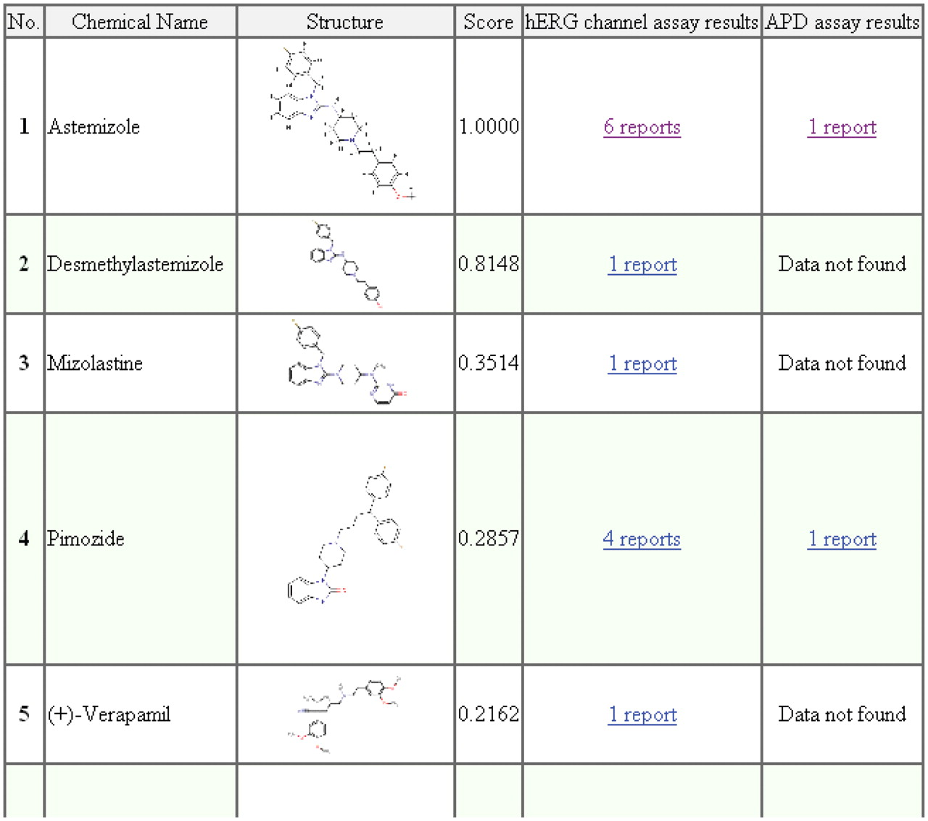
Figure 4. Screen capture of the similarity search results for astemizole. The attributes listed in the results table, ...
Notes:
Figure 4. Screen capture of the similarity search results for astemizole. The attributes listed in the results table, i.e. No., chemical name, structure, score, hERG channel assay results and APD assay results, indicate the compound's similarity rank among the top 30 compounds, the name of the chemical compounds, JPG images of the chemical compounds, the similarity score calculated by tanimoto.pl, hERG assay results and the APD assay results, respectively.
Unless provided in the caption above, the following copyright applies to the content of this slide: © The Author(s) 2011. Published by Oxford University Press.This is Open Access article distributed under the terms of the Creative Commons Attribution Non-Commercial License (http://creativecommons.org/licenses/by-nc/2.5), which permits unrestricted non-commercial use, distribution, and reproduction in any medium, provided the original work is properly cited.

Slide 5
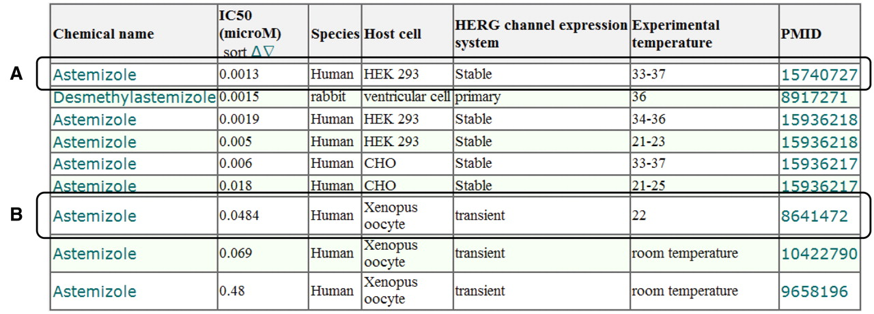
Figure 5. Screen capture of the hERG assay results for astemizole. (A) Example of hERG assay result using hERG channel ...
Notes:
Figure 5. Screen capture of the hERG assay results for astemizole. (A) Example of hERG assay result using hERG channel stably expressed on HEK 293 cells. (B) Example of hERG assay result using a hERG channel transiently expressed in a Xenopus oocyte. The attributes listed in the results table, i.e. chemical name, IC50 (µM), species, host cell and PMID, indicate the name of the chemical compounds, the half maximal inhibitory concentration of the hERG channel, the origin of the hERG channel, cell with natural and/or artificial expression of hERG channel and PMID, respectively.
Unless provided in the caption above, the following copyright applies to the content of this slide: © The Author(s) 2011. Published by Oxford University Press.This is Open Access article distributed under the terms of the Creative Commons Attribution Non-Commercial License (http://creativecommons.org/licenses/by-nc/2.5), which permits unrestricted non-commercial use, distribution, and reproduction in any medium, provided the original work is properly cited.

Slide 6
Figure 6. Screen capture of the APD assay results for astemizole. (A) Example of APD in the case of 0.1 μmol/l ...
Notes:
Figure 6. Screen capture of the APD assay results for astemizole. (A) Example of APD in the case of 0.1 μmol/l concentration. (B) Example of APD in the case of 10.0 μmol/l concentration. The attributes listed in the results table, i.e. chemical name, concentration (µM), species, tissue, cell, measure after perfuse (min), stimulation (Hz), APD30, APD60, APD90 and PMID, indicate the name of the chemical compounds, concentration of the chemical compounds and/or drugs for measurement of the action potential, origin of tissues and cells tested for the action potential of the compounds, tissues for extracting cells, cells extracted from tissues for measuring the action potential, time measurement of the action potential after perfusion of compounds, electrical stimulation frequency for the preparation, APD at 30% repolarization, APD at 60% repolarization, APD at 90% repolarization and PMID, respectively.
Unless provided in the caption above, the following copyright applies to the content of this slide: © The Author(s) 2011. Published by Oxford University Press.This is Open Access article distributed under the terms of the Creative Commons Attribution Non-Commercial License (http://creativecommons.org/licenses/by-nc/2.5), which permits unrestricted non-commercial use, distribution, and reproduction in any medium, provided the original work is properly cited.

