Slide 1
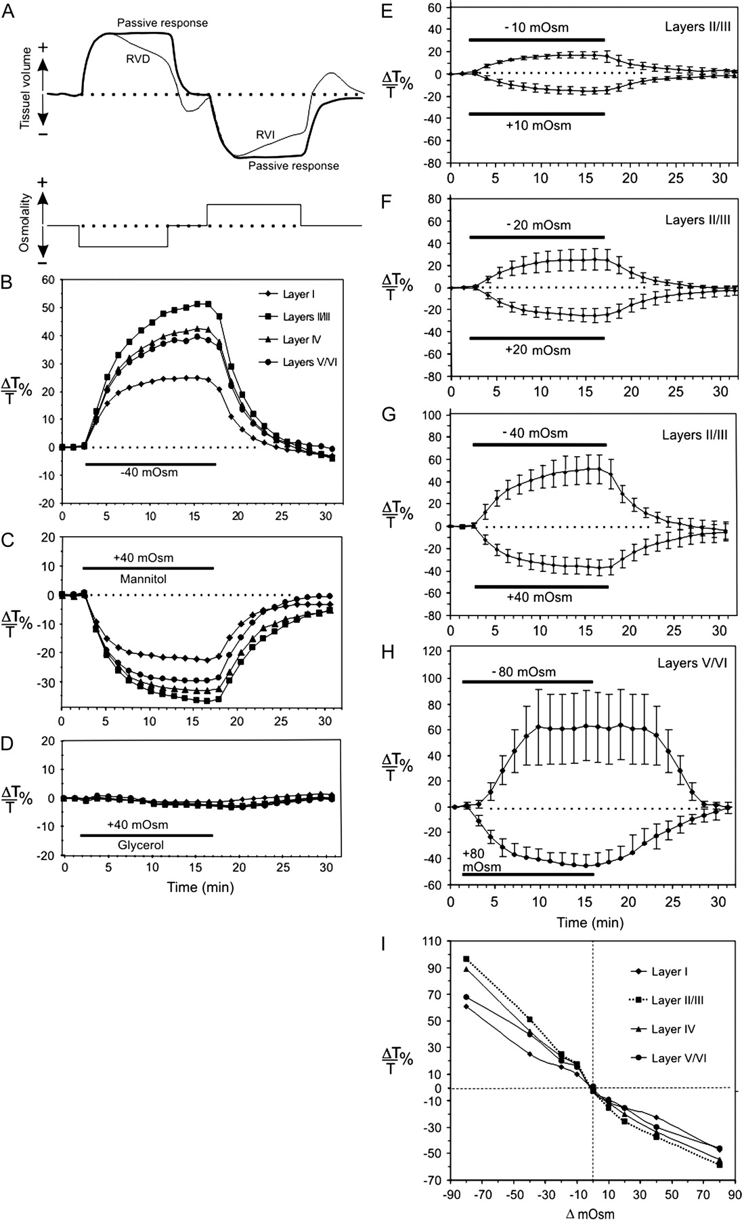
Figure 1. Imaging LT provides evidence for osmotically induced tissue swelling and shrinking. (A) Schematic depiction ...
Notes:
Figure 1. Imaging LT provides evidence for osmotically induced tissue swelling and shrinking. (A) Schematic depiction of volume responses to osmotic change. Tissue may respond passively or actively compensate with an RVD or RVI. (B) Time course of LT change measured simultaneously in several layers of rat neocortex during exposure to hypo-osmotic aCSF of 40 mOsm (−40 mOsm). Cells that undergo transmembrane water flux take up water, swell, and increase slice LT, expressed as ΔT/T%. (C) Mean LT change induced during exposure to hyperosmotic aCSF (+40 mOsm) using mannitol. Mannitol does not permeate plasma membrane and will rapidly draw water out of cells with functional water channels (aquaporins). (D) Acute hyperosmotic stress (+40 mOsm) using glycerol does not alter LT in neocortex. Glycerol is osmotically ineffective by virtue of its permeation through water channels (aquaglyceroporins) in glial cells. (E–H) Dose-response relation between the level of acute osmotic stress and the normalized change in LT (n = 9 slices per treatment) in neocortical gray matter. The time course is plotted of the mean LT change (ΔT/T% ± standard deviation) in response to a 15-min exposure to ±10, ±20, ±40, or ±80 mOsm aCSF using mannitol. Because −80 mOsm aCSF often induced a propagating increase in LT (spreading depression) in layers I–IV, layers V–VI were sampled in this case. (I) Plot of the mean peak change in LT versus shift in osmolality from a control level of 287–289 mOsm. Slices (n = 9) display an inverse relationship between Δ osmolality and ΔLT in all neocortical layers.
Unless provided in the caption above, the following copyright applies to the content of this slide: © 2006 The AuthorsThis is an Open Access article distributed under the terms of the Creative Commons Attribution Non-Commercial License (http://creativecommons.org/licenses/by-nc/2.0/uk/) which permits unrestricted non-commercial use, distribution, and reproduction in any medium, provided the original work is properly cited.

Slide 2
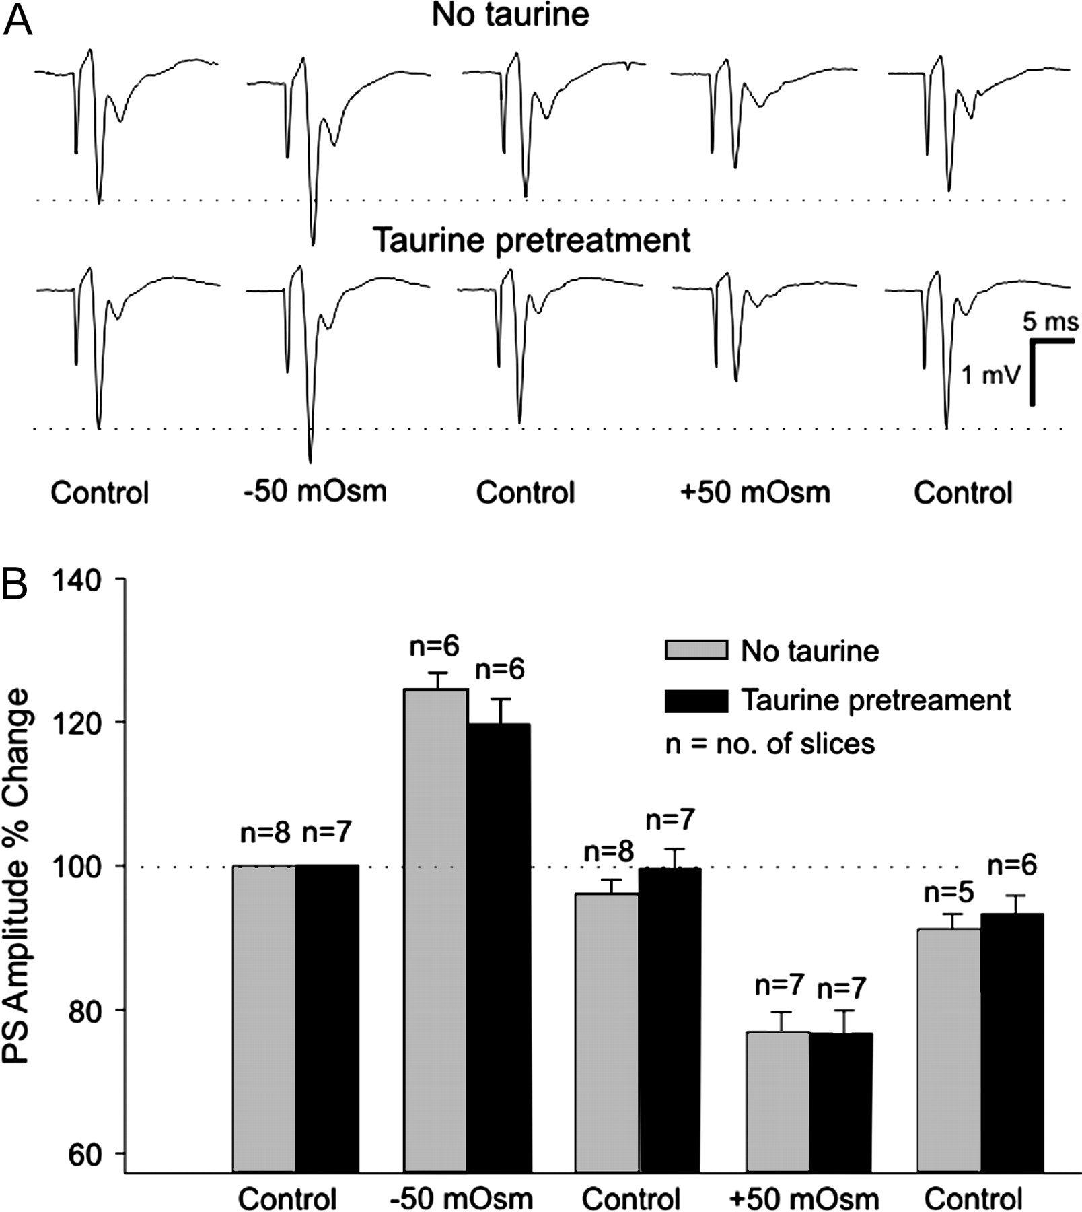
Figure 2. Electrophysiological evidence for osmotically induced tissue swelling and shrinking. (A) The amplitude of the ...
Notes:
Figure 2. Electrophysiological evidence for osmotically induced tissue swelling and shrinking. (A) The amplitude of the evoked field potential (here recorded in CA1 stratum pyramidale) is an indirect measure of the extracellular resistance, which in turn is inversely proportional to osmolality. Amplitude reversibly increases in −50 mOsm aCSF and decreases in +50 mOsm aCSF. (B) Slice pretreatment with taurine, an amino acid that is proposed to facilitate volume regulation, has no significant effect upon the peak change in extracellular tissue resistance during 10 min of hypo- or hyperosmolality. A significant reduction in population spike amplitude would be expected following −50-mOsm exposure if RVD was promoted. The means of signal-averaged amplitudes are shown as ±standard error.
Unless provided in the caption above, the following copyright applies to the content of this slide: © 2006 The AuthorsThis is an Open Access article distributed under the terms of the Creative Commons Attribution Non-Commercial License (http://creativecommons.org/licenses/by-nc/2.0/uk/) which permits unrestricted non-commercial use, distribution, and reproduction in any medium, provided the original work is properly cited.

Slide 3
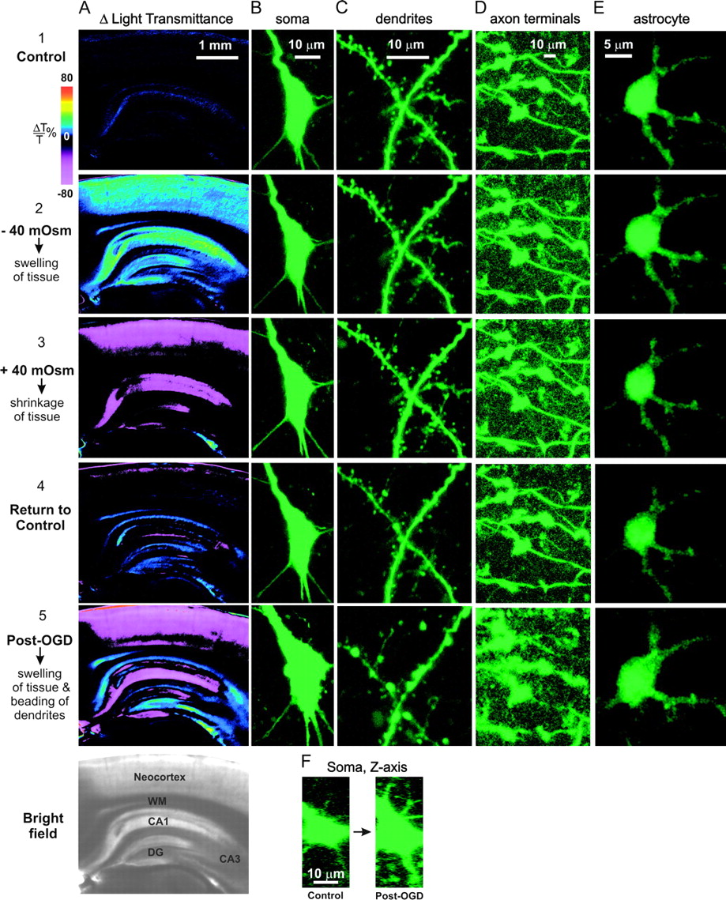
Figure 3. (A) Overview of changes in LT (ΔT/T%) in the neocortical/hippocampal slice preparation correlated with (B) ...
Notes:
Figure 3. (A) Overview of changes in LT (ΔT/T%) in the neocortical/hippocampal slice preparation correlated with (B) 2PLSM imaging of pyramidal cell bodies, (C) dendrites, (D) cerebellar MF axon terminals, and (E) astrocytes. Normosmotic measurements (row 1) are taken prior to hypo-osmolar treatment (row 2) that increases LT by neocortical gray matter (A2) as plotted in Figure 1B. Neuronal cell bodies (B2), dendrites (C2), and axons (D2) do not appear to change volume, whereas astrocytes swell (E2). Superfusion of hyperosmotic aCSF (row 3) exposes the slice to an 80-mOsm-step increase that greatly reduces LT in gray matter, denoting tissue shrinkage (A3). However, again this is not accompanied by volume decreases of nerve cell bodies (B3), dendrites (C3), or axon terminals (D3), whereas the astrocytes shrink (E3). Back in control aCSF, LT levels return to near baseline (A4) as do the astrocytes (E4). Following 10 min of OGD, the gray matter displays a propagating wave of elevated LT (the anoxic depolarization, not shown) caused by cell swelling. Pyramidal cell bodies swell during the 10 min following OGD exposure. Dendrites also swell but quickly form beads that reduce LT (Obeidat and others 2000). Beading is considered an extreme version of swelling by dendrites (C5) that paradoxically lowers LT in swollen tissue because the beads readily scatter light (A5). This overcomes the elevated LT signal caused by swelling of neurons (B5) and glia (E5). (F) Viewing the neuron in (B) along the z axis reveals its pyramidal shape.
Unless provided in the caption above, the following copyright applies to the content of this slide: © 2006 The AuthorsThis is an Open Access article distributed under the terms of the Creative Commons Attribution Non-Commercial License (http://creativecommons.org/licenses/by-nc/2.0/uk/) which permits unrestricted non-commercial use, distribution, and reproduction in any medium, provided the original work is properly cited.

Slide 4
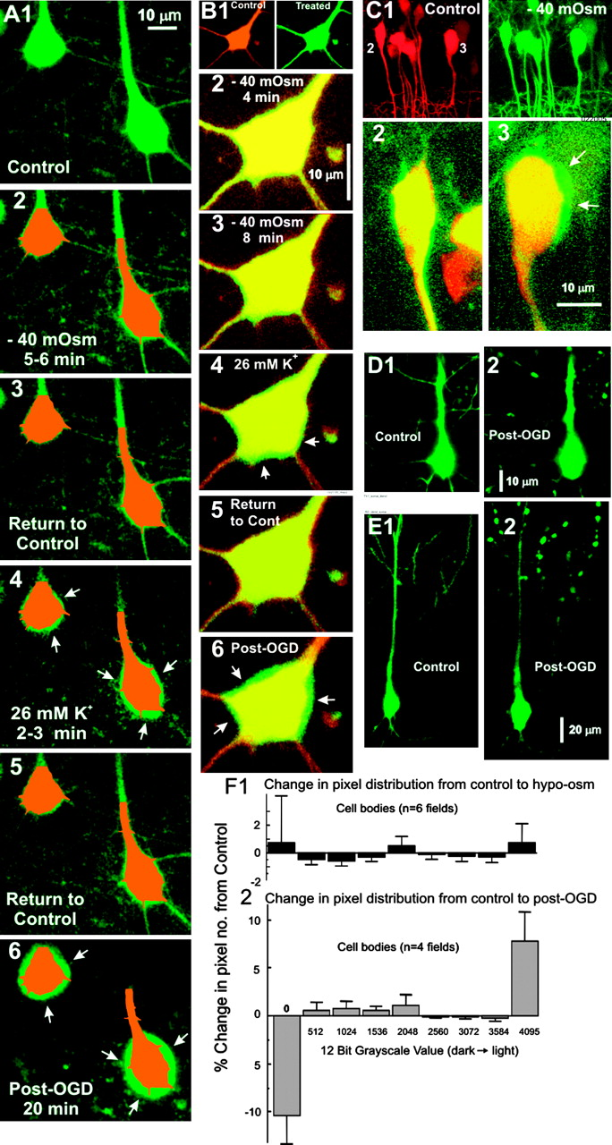
Figure 4. Pyramidal cell bodies resist volume increases induced by osmotic stress but not by prolonged depolarization. ...
Notes:
Figure 4. Pyramidal cell bodies resist volume increases induced by osmotic stress but not by prolonged depolarization. (A) Masks representing the control volumes of the 2 somata in (A1) are placed over the same somata following subsequent treatments. Exposure to hypo-osmotic aCSF (−40 mOsm) reveals no increase in somata volume at 5–6 min (A2) or 15 min (not shown). Following return to control aCSF (A3), exposure to aCSF with 26 mM K+ for 2–3 min evokes cell body swelling (A4, arrows), which is reversible (A5). Following OGD (A6), somata swelling is even more pronounced (arrows) and proximal dendrites fade. (B) Overlays of a soma in control (red) and experimental (green) aCSF reveal no cell body swelling in hypo-osmotic aCSF at 4 (B2) or 8 min (B3) but obvious swelling in 26 mM K+ at 5 min (B4, arrows), which reverses (B5). Note that the effects of high-K+ aCSF are detailed in Figure 8. Following OGD (B6, arrows), swelling is even more pronounced. (C) The only example of a neuron induced to swell in hypo-osmotic aCSF (C3) did not recover upon return to normosmotic aCSF (not shown), so the cell was likely damaged. At the same time, its partners imaged in the same field (one shown in C2) displayed no volume change. (D, E) Two pyramidal cells (D1, E1) exposed to OGD for 10-min swell and undergo dendritic beading (D2, E2), resulting from anoxic depolarization. The fields of both cells are cropped to show the same region before and after OGD. The area of each field increased by ∼10%. (F) Analysis of imaged pixel values to detect volume change. Pixel values are binned along the x axis with higher values representing lighter pixels. A decrease in lower value pixels and an increase in higher value pixels indicate an increased neuronal volume in a fixed image field. (F1) Histogram of the mean change in pixel gray value relative to control for 6 somatic fields exposed to −40 mOsm aCSF for 20 min. There is no general increase in volume as signified by the lack of recruitment of light pixels from dark, indicating no volume change. (F2) In 4 somatic fields, a dark to light shift is apparent post-OGD, indicating an expansion of cell body volume. Experiments showing GFP fading interferes with the analysis and were not included.
Unless provided in the caption above, the following copyright applies to the content of this slide: © 2006 The AuthorsThis is an Open Access article distributed under the terms of the Creative Commons Attribution Non-Commercial License (http://creativecommons.org/licenses/by-nc/2.0/uk/) which permits unrestricted non-commercial use, distribution, and reproduction in any medium, provided the original work is properly cited.

Slide 5
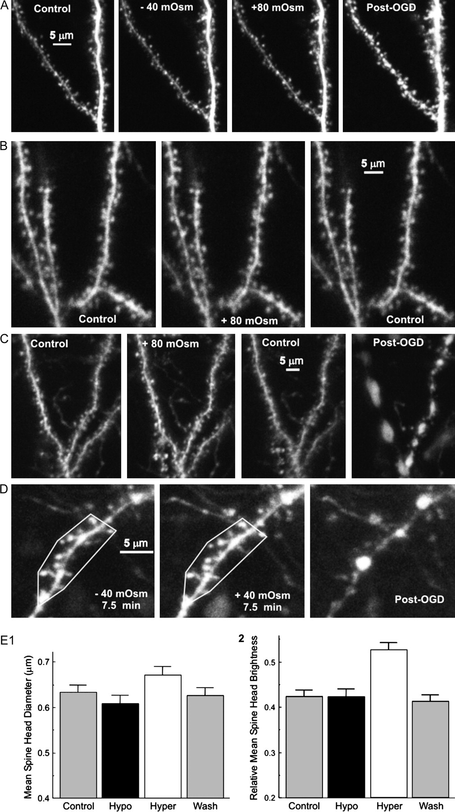
Figure 5. Imaging pyramidal cell dendrites during a 20-min osmotic challenge or OGD (A–D). Dendrites and their spines ...
Notes:
Figure 5. Imaging pyramidal cell dendrites during a 20-min osmotic challenge or OGD (A–D). Dendrites and their spines do not increase in volume in hypo-osmotic aCSF of −40 mOsm (A). Similarly, a shift to hyperosmotic aCSF using mannitol reveals no change in volume during a 20-min increase of +40 mOsm (D) or +80 mOsm (A, B, C). Measuring a polygonal area demarcated by neuronal landmarks (D) reveals no significant change in the dendritic field area (see Fig. 6D) induced by osmotic change from −40 to +40 mOsm. In contrast, 10 min of OGD leads to anoxic depolarization and dendritic beading in the ensuing 10 min (right panels in C, D). Spines are quickly lost and beads form as the neurons (and surrounding glia, not shown) swell. The GFP fades in most neurons exposed to OGD (C, D) so quantifying swelling is difficult. (E) Spine diameter remains unchanged despite exposure to −40 mOsm aCSF as shown in (E1). The volume of these same spines is also not altered in hypo-osmotic aCSF, as measured by spine fluorescence (E2). Although spine fluorescence (corresponding to spine volume) tended to increase in hyperosmotic media, this is in the opposite expected for an osmotic response. As an internal control, no significant change in the brightness of the field contained within the parent dendrite of each spine was observed (not shown).
Unless provided in the caption above, the following copyright applies to the content of this slide: © 2006 The AuthorsThis is an Open Access article distributed under the terms of the Creative Commons Attribution Non-Commercial License (http://creativecommons.org/licenses/by-nc/2.0/uk/) which permits unrestricted non-commercial use, distribution, and reproduction in any medium, provided the original work is properly cited.

Slide 6
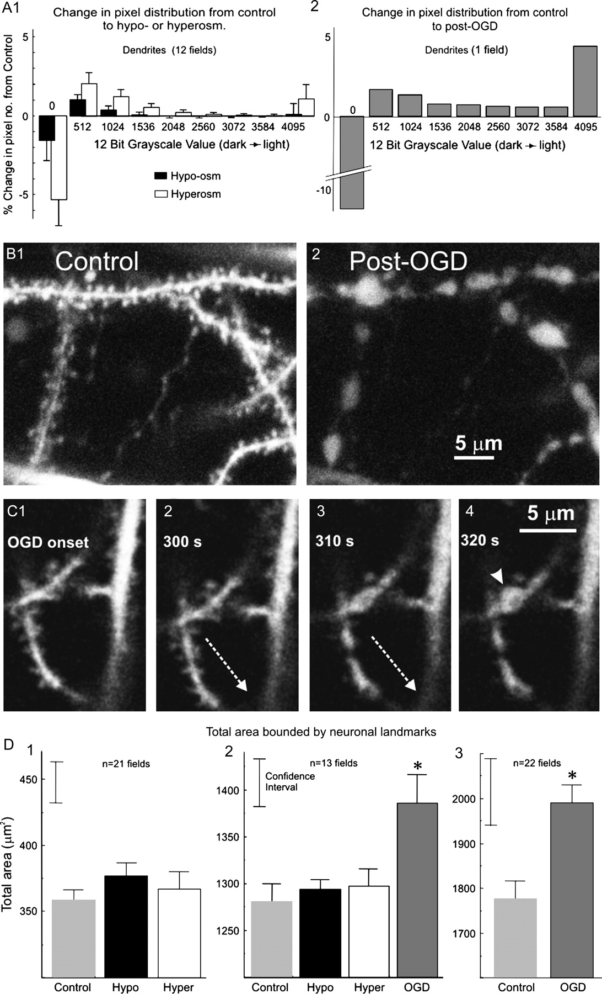
Figure 6. (A) Exposure to hypo-osmotic conditions (A1) does not shift pixel distribution from dark to light across the ...
Notes:
Figure 6. (A) Exposure to hypo-osmotic conditions (A1) does not shift pixel distribution from dark to light across the population of imaged dendrites. Similarly, hyperosmolality does not impose a shift from light to dark. (A2) A net decrease in dark pixels and corresponding increase in light pixels relative to control indicate that dendrites are swelling in this one field example. Dendritic fields generally drift and fade during OGD, making swelling difficult to quantify. (B) Example of beading and fading of dendrites following OGD exposure. (C) During the initial 300 s of OGD (C1, C2), there is specimen drift (dashed arrow) as the slice swells. (C3) Beads suddenly form within the next 10 s. (C4) A single bead expands (arrowhead) within the next 10 s. (D) Quantification of neuronal volume change pooled from cell body, dendrite, and axon fields. Areas with their peripheries demarcated by neuronal landmarks in the x–y axes (e.g., Fig. 5D) are measured in square microns. The hypo-osmotic treatment was −40 mOsm. The +40- and +80-mOsm measurements were combined. Means are presented with standard error bars calculated based on data normalized relative to the grand mean in order to remove absolute magnitude differences between slices (which were large), that is, values from all slices were normalized so that their mean across conditions was equal to the grand mean. Confidence intervals were calculated for repeated measures designs (Loftus and Masson 1994). (D1) Means of slices where only osmotic conditions were imaged displayed no significant shift in neuronal landmarks, implicating little change in neuronal volume. (D2) Although there was no change in field area during osmotic stress, there was significant outward expansion of landmarks following OGD. (D3) A larger population of slices exposed to OGD (including those from D2) confirmed significant field expansion upon exposure to OGD compared with control aCSF. Such neuronal swelling and beading normally poorly recover in cortical slices but can recover significantly in vivo (Zhang and others 2005).
Unless provided in the caption above, the following copyright applies to the content of this slide: © 2006 The AuthorsThis is an Open Access article distributed under the terms of the Creative Commons Attribution Non-Commercial License (http://creativecommons.org/licenses/by-nc/2.0/uk/) which permits unrestricted non-commercial use, distribution, and reproduction in any medium, provided the original work is properly cited.

Slide 7
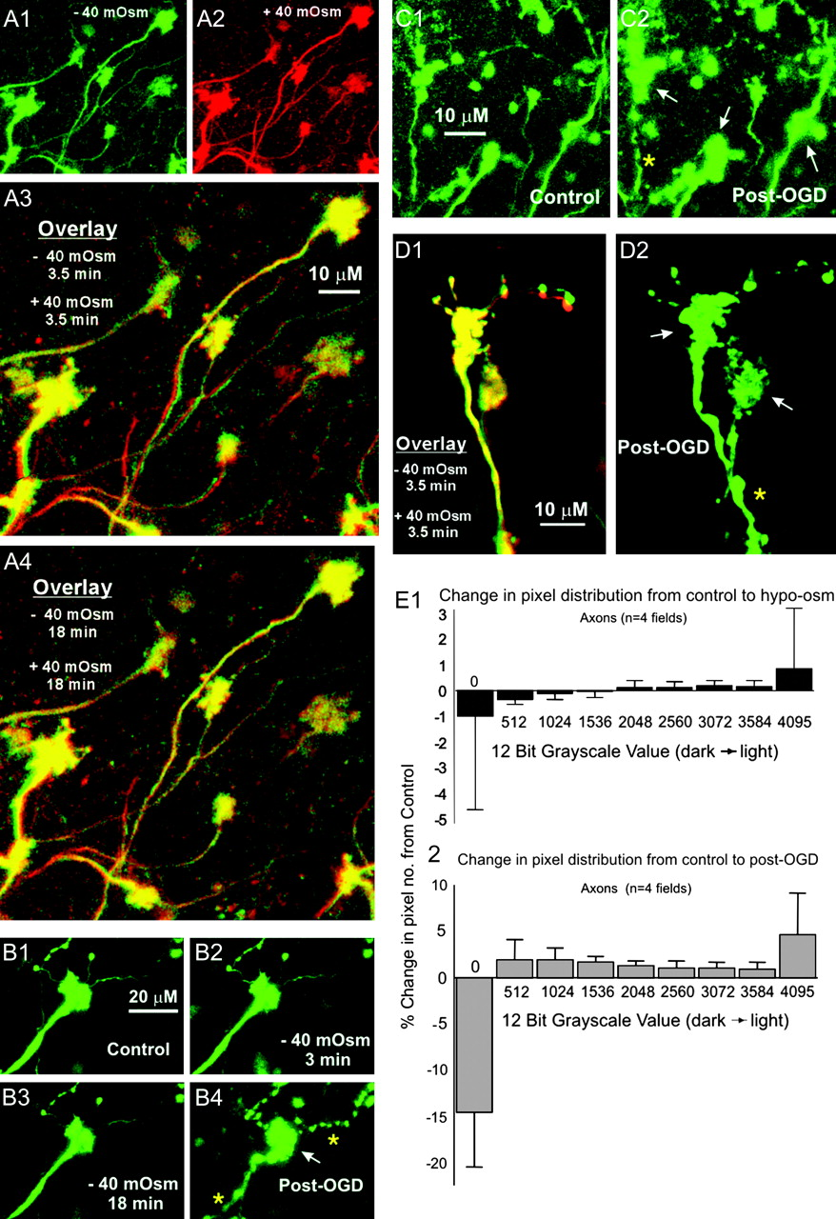
Figure 7. Chains of GFP-positive MF terminals in cerebellum are formed by axons that originate from cell bodies in ...
Notes:
Figure 7. Chains of GFP-positive MF terminals in cerebellum are formed by axons that originate from cell bodies in brain stem and spinal cord. (A, B) No detectable volume change is observed when osmolality is lowered or raised by 40 mOsm. This is true even when aCSF is shifted directly from −40 to +40 mOsm. In (A3), overlays of hypo- and hyperosmotic images (each following 3.5 min of exposure) show both images in near-perfect register. Likewise at 17 min of exposure (A4), overlays almost completely overlap, demonstrating no volume regulation. (C, D) With exposure to OGD, preterminal axons occasionally bead (*), whereas terminal rosettes expand (arrows). (E) Histogram of the mean change in grayscale values of pixels relative to control for 4 axon fields exposed to −40 mOsm aCSF for 20 min. (E1) There is no general increase in volume signified by a recruitment of dark to light pixels. (E2) A shift does occur in the same 4 axon fields post-OGD, indicating an expansion of terminal volume. Only the experiments showing consistent GFP fluorescence were analyzed because fading interferes with the pixel distribution.
Unless provided in the caption above, the following copyright applies to the content of this slide: © 2006 The AuthorsThis is an Open Access article distributed under the terms of the Creative Commons Attribution Non-Commercial License (http://creativecommons.org/licenses/by-nc/2.0/uk/) which permits unrestricted non-commercial use, distribution, and reproduction in any medium, provided the original work is properly cited.

Slide 8
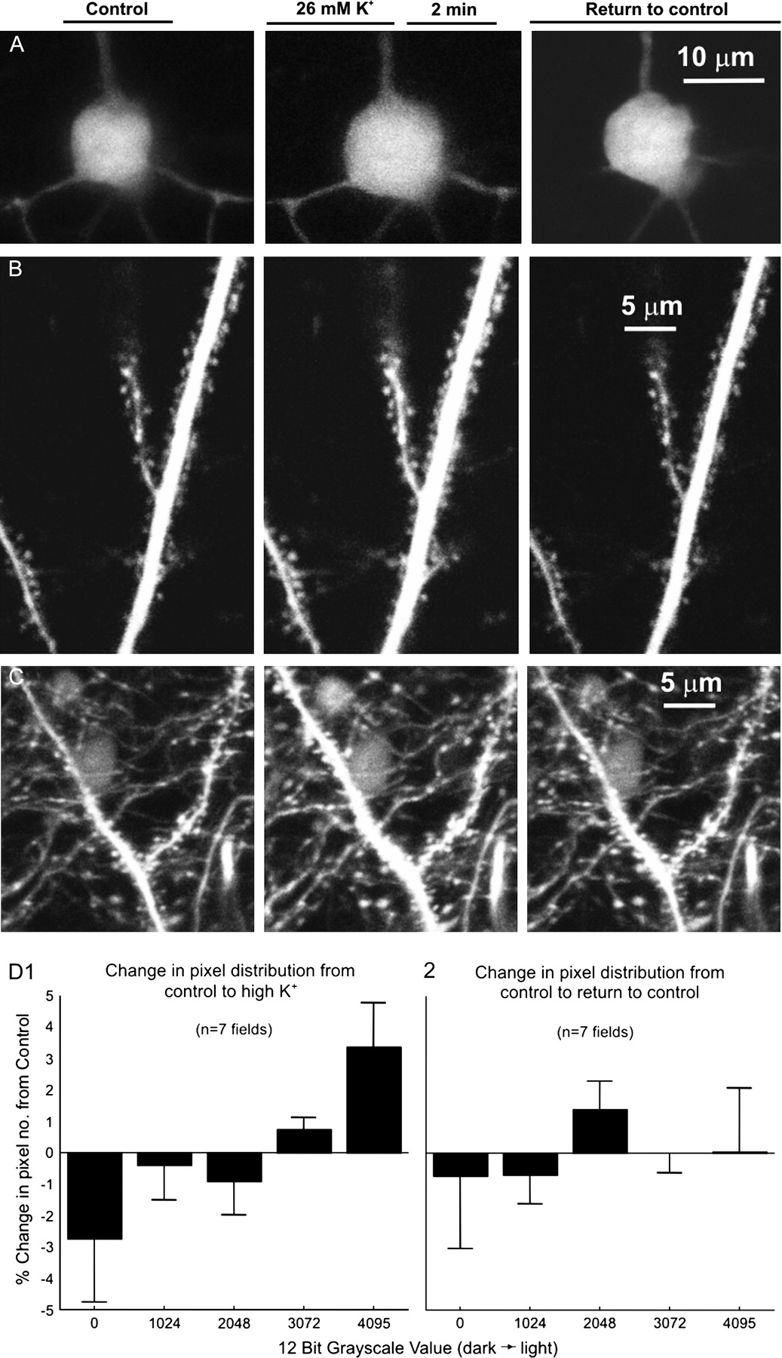
Figure 8. (A) Exposure to aCSF with 26 mM K⁺ evokes reversible cell body swelling within 2 min. (B, C) ...
Notes:
Figure 8. (A) Exposure to aCSF with 26 mM K+ evokes reversible cell body swelling within 2 min. (B, C) Likewise, dendrites reversibly swell in response to elevated K+ and return to control volume by 20 min. In (C), there are many GFP-positive axon varicosities and 2 faint CA1 cell bodies. (D) Histogram of the mean change in pixel gray value relative to control for a pool of 4 somatic fields and 3 dendritic fields exposed to 26 mM K+ aCSF for 2–5 min. As signified by the recruitment of dark to light pixels, there is an expansion of neuronal volume in comparing control to high K+ aCSF(D1) but not in comparing control to return to control (D2).
Unless provided in the caption above, the following copyright applies to the content of this slide: © 2006 The AuthorsThis is an Open Access article distributed under the terms of the Creative Commons Attribution Non-Commercial License (http://creativecommons.org/licenses/by-nc/2.0/uk/) which permits unrestricted non-commercial use, distribution, and reproduction in any medium, provided the original work is properly cited.

