Slide 1
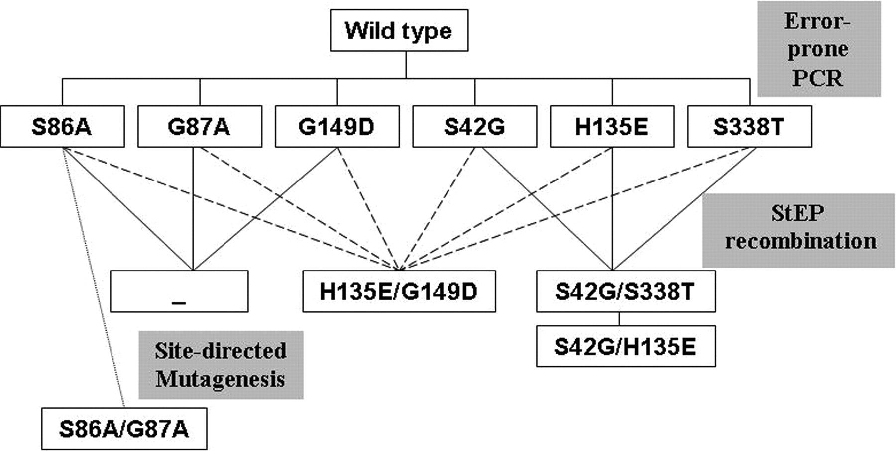
Fig. 1 Lineage of psychrophilic alkaline phosphatase variants. First generation variants were created by error-prone ...
Notes:
Fig. 1 Lineage of psychrophilic alkaline phosphatase variants. First generation variants were created by error-prone PCR. The six mutations selected from the first generation variants were recombined by StEP in three different combinations. Site-directed mutagenesis was used to create double mutant S86A/G87A. Only non-synonymous mutations are shown.
Unless provided in the caption above, the following copyright applies to the content of this slide: © The Author 2008. Published by Oxford University Press. All rights reserved. For Permissions, please e-mail: journals.permissions@oxfordjournals.org

Slide 2
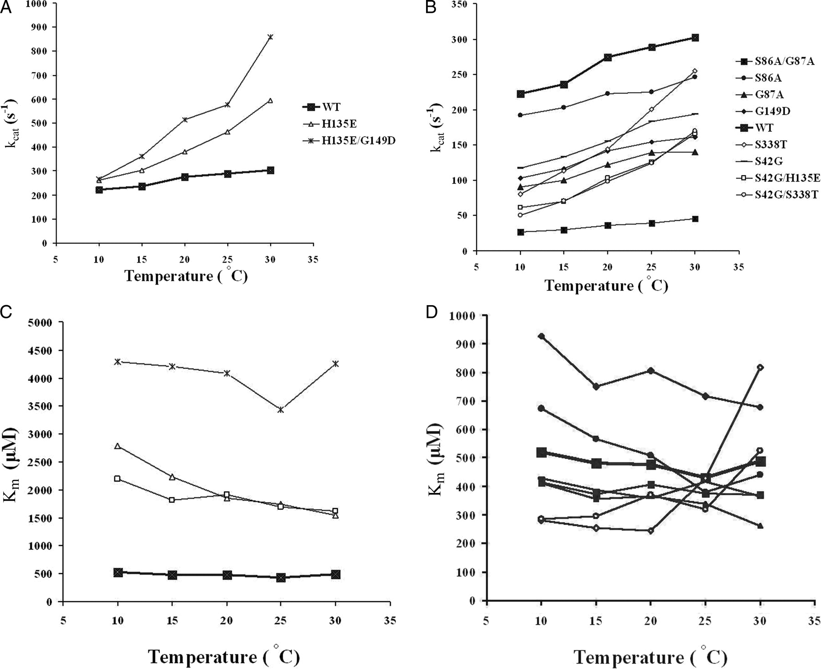
Fig. 2 Kinetic studies of wild-type and mutant APs. Temperature dependence of k_{cat} (A and B) and ...
Notes:
Fig. 2 Kinetic studies of wild-type and mutant APs. Temperature dependence of kcat (A and B) and Km (C and D) of wild-type and selected mutant APs at temperature range 10–30°C. All values were determined in a buffer containing 1 M diethanolamine-Cl pH 10, 10% glycerol, 10 mM MgCl2, 1 mM ZnCl2 and pNPP in various concentrations at 15°C. The kcat values were calculated from Vmax using a molecular weight for the enzyme of 35 861 Da. Reported values are the average of three measurements. The standard deviations do not exceed 5%. Symbols in C and D are as in A and B.
Unless provided in the caption above, the following copyright applies to the content of this slide: © The Author 2008. Published by Oxford University Press. All rights reserved. For Permissions, please e-mail: journals.permissions@oxfordjournals.org

Slide 3
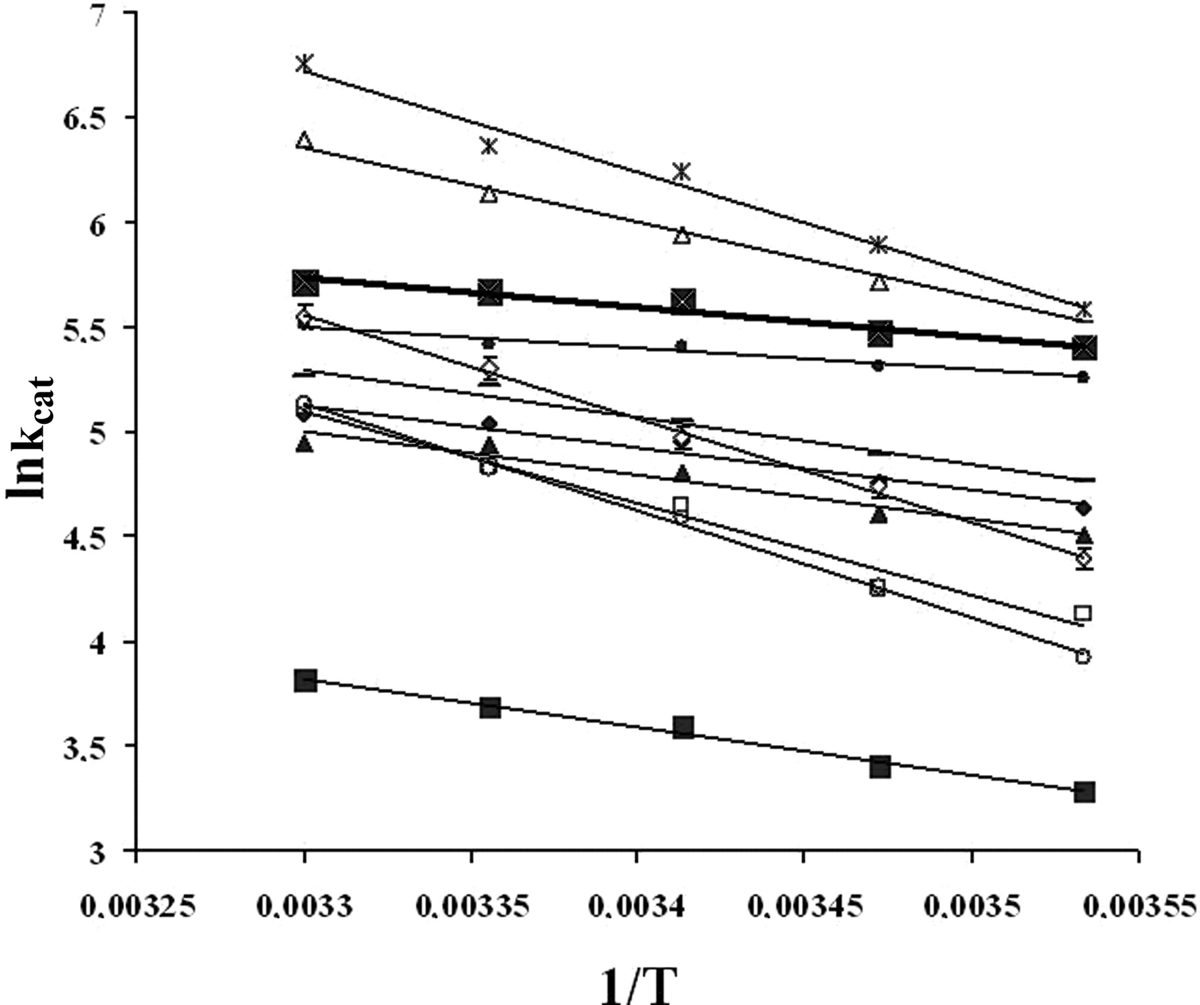
Fig. 3 Arrhenius plots for the k_{cat} of mutants and wild-type AP. Reported values are the average of three ...
Notes:
Fig. 3 Arrhenius plots for the kcat of mutants and wild-type AP. Reported values are the average of three measurements. The standard deviations do not exceed 5%. Symbols are as in Fig. 2.
Unless provided in the caption above, the following copyright applies to the content of this slide: © The Author 2008. Published by Oxford University Press. All rights reserved. For Permissions, please e-mail: journals.permissions@oxfordjournals.org

Slide 4
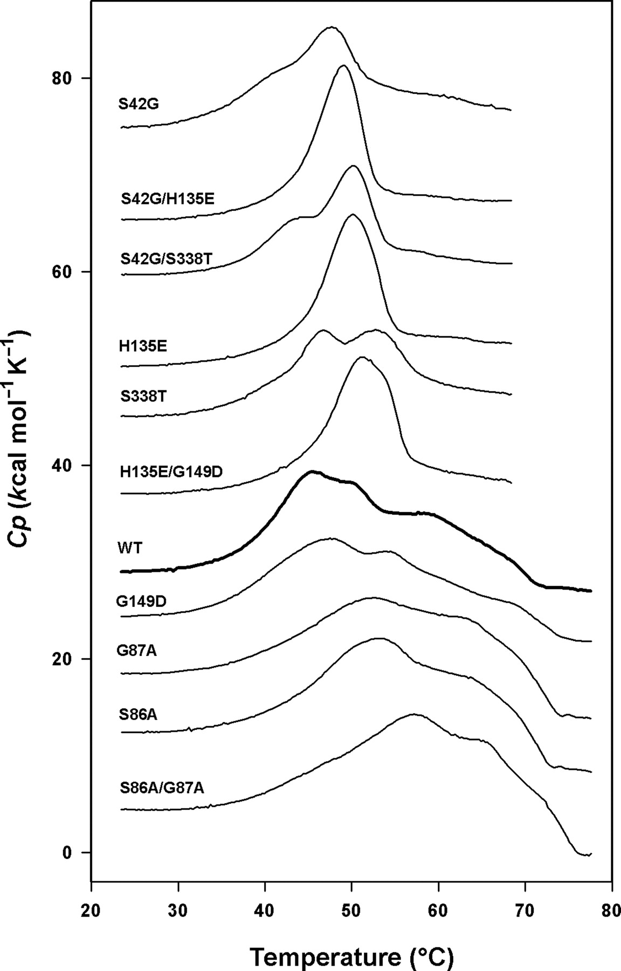
Fig. 4 Differential scanning calorimetry records of wild-type AP and of its mutants. Thermograms are normalised for ...
Notes:
Fig. 4 Differential scanning calorimetry records of wild-type AP and of its mutants. Thermograms are normalised for protein concentration and have been displaced along the y-axis for clarity. Mutants displayed below wild-type AP are protected against heat inactivation of the activity and mutants displayed above wild-type AP have a reduced stability of the activity.
Unless provided in the caption above, the following copyright applies to the content of this slide: © The Author 2008. Published by Oxford University Press. All rights reserved. For Permissions, please e-mail: journals.permissions@oxfordjournals.org

Slide 5
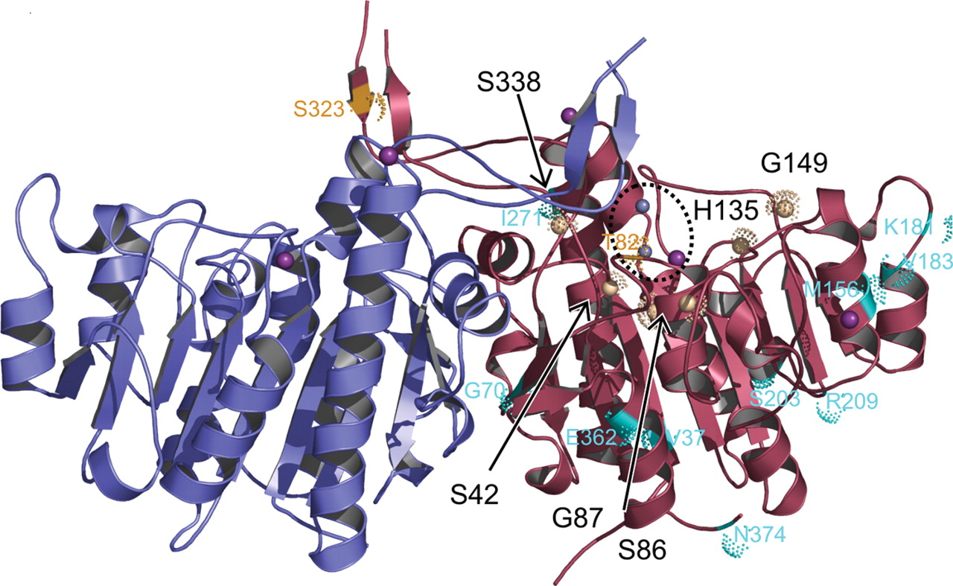
Fig. 5 The overall structure of the homodimeric wild-type TAB5 AP (Wang et al., 2007) (pdb, 2iuc). The monomers of ...
Notes:
Fig. 5 The overall structure of the homodimeric wild-type TAB5 AP (Wang et al., 2007) (pdb, 2iuc). The monomers of the TAB5 AP dimer are coloured in red and blue. The active site containing the metal ions is circled by a dotted line and selected mutated sites are indicated by brown balls. All characterised mutations were located close to the active site. Mutations that were not further characterised are in cyan (increased residual activity) and yellow (decreased residual activity).
Unless provided in the caption above, the following copyright applies to the content of this slide: © The Author 2008. Published by Oxford University Press. All rights reserved. For Permissions, please e-mail: journals.permissions@oxfordjournals.org

Slide 6
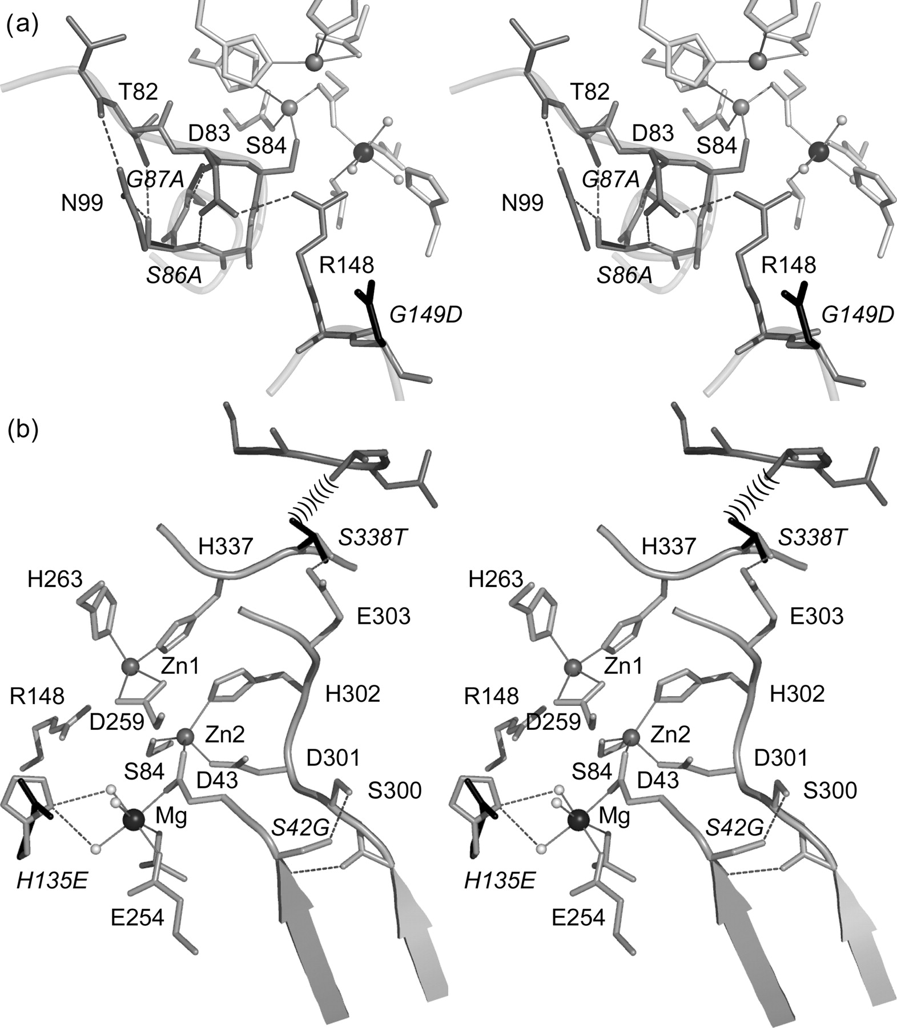
Fig. 6 A detailed stereo-image showing the characterised mutations in the TAB5 AP structure (pdb, 2iuc,Wang et al., ...
Notes:
Fig. 6 A detailed stereo-image showing the characterised mutations in the TAB5 AP structure (pdb, 2iuc,Wang et al., 2007) (A) displaying mutations S86A, G87A and G149D and (B) H135E, S42G and S338T. Native structure is in grey and mutated residues in black, Zn2+ and Mg2+ are in dark grey and black, respectively. Metal coordination is shown with solid and hydrogen bonds with dotted lines.
Unless provided in the caption above, the following copyright applies to the content of this slide: © The Author 2008. Published by Oxford University Press. All rights reserved. For Permissions, please e-mail: journals.permissions@oxfordjournals.org

