Slide 1
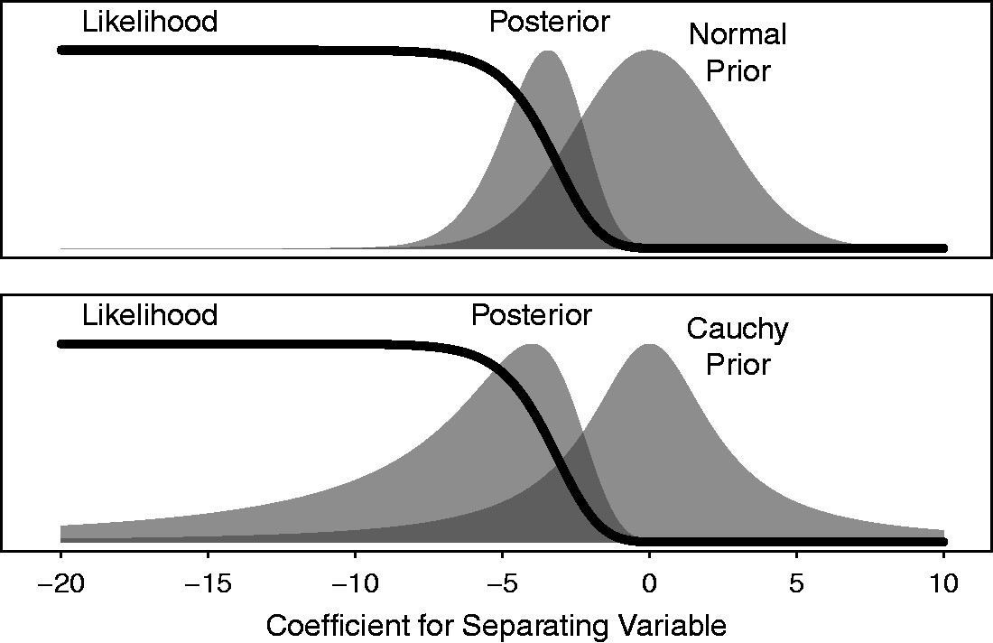
Fig. 1 This figure provides an example monotonic likelihood, prior, and posterior that illustrate the key idea of ...
Notes:
Fig. 1 This figure provides an example monotonic likelihood, prior, and posterior that illustrate the key idea of Theorem 1. Notice that the likelihood is highly informative about the right-hand side of the posterior distribution, but not informative about the left-hand side of the posterior distribution. The choice of normal or Cauchy prior essentially determines the shape of the posterior in the direction of the separation.
Unless provided in the caption above, the following copyright applies to the content of this slide: © The Author 2016. Published by Oxford University Press on behalf of the Society for Political Methodology. All rights reserved. For Permissions, please email: journals.permissions@oup.com

Slide 2
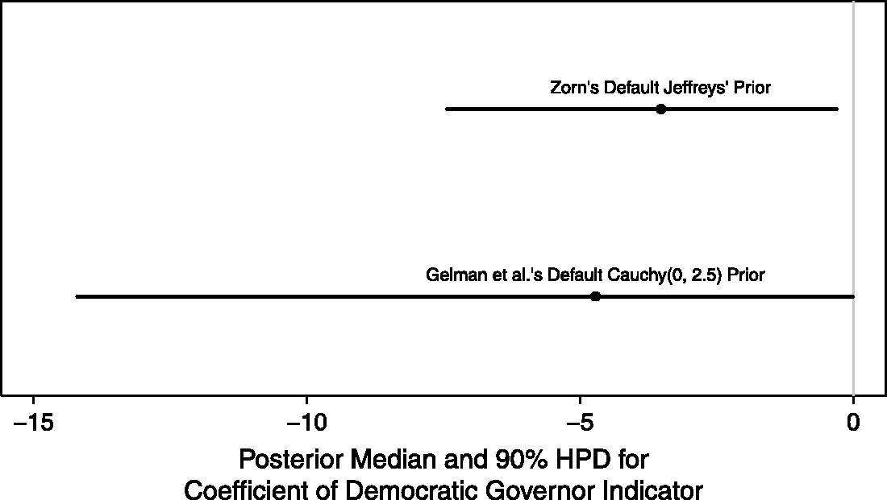
Fig. 2 This figure provides the posterior medians and 90% credible intervals for the coefficient of the indicator ...
Notes:
Fig. 2 This figure provides the posterior medians and 90% credible intervals for the coefficient of the indicator for Democratic governors in the model used by Barrilleaux and Rainey (2014a). Notice that Jeffreys’ prior injects more information, as indicated by the smaller posterior median and credible interval. The credible interval using Cauchy(0, 2.5) prior is about twice as wide as the credible interval using Jeffreys’ prior. Further, the posterior median using the Cauchy(0, 2.5) prior is about 40% larger in magnitude than the posterior median using Jeffreys’ prior.
Unless provided in the caption above, the following copyright applies to the content of this slide: © The Author 2016. Published by Oxford University Press on behalf of the Society for Political Methodology. All rights reserved. For Permissions, please email: journals.permissions@oup.com

Slide 3
Fig. 3 This figure shows the posterior distribution for the coefficient of the indicator for Democratic governors in ...
Notes:
Fig. 3 This figure shows the posterior distribution for the coefficient of the indicator for Democratic governors in the model offered by Barrilleaux and Rainey (2014a) for different default prior distributions. The gray shading indicates the 90% credible interval. Notice that the location and the spread of the posterior depend on the prior chosen, especially the left-hand side of the distribution, as suggested by Theorem 1.
Unless provided in the caption above, the following copyright applies to the content of this slide: © The Author 2016. Published by Oxford University Press on behalf of the Society for Political Methodology. All rights reserved. For Permissions, please email: journals.permissions@oup.com

Slide 4
Fig. 4 This figure shows the partial prior distribution for the risk ratio of war in nonnuclear dyads to nuclear ...
Notes:
Fig. 4 This figure shows the partial prior distribution for the risk ratio of war in nonnuclear dyads to nuclear dyads. The risk ratio tells us how many times more likely war is in nonnuclear dyads compared to nuclear dyads. Notice that the informative prior treats effects smaller than about 1000 as plausible, but essentially rules out larger effects. The skeptical prior essentially rules out effects larger than 25, whereas the enthusiastic prior treats effects between 1 and 100,000 as essentially equally likely.
Unless provided in the caption above, the following copyright applies to the content of this slide: © The Author 2016. Published by Oxford University Press on behalf of the Society for Political Methodology. All rights reserved. For Permissions, please email: journals.permissions@oup.com

Slide 5
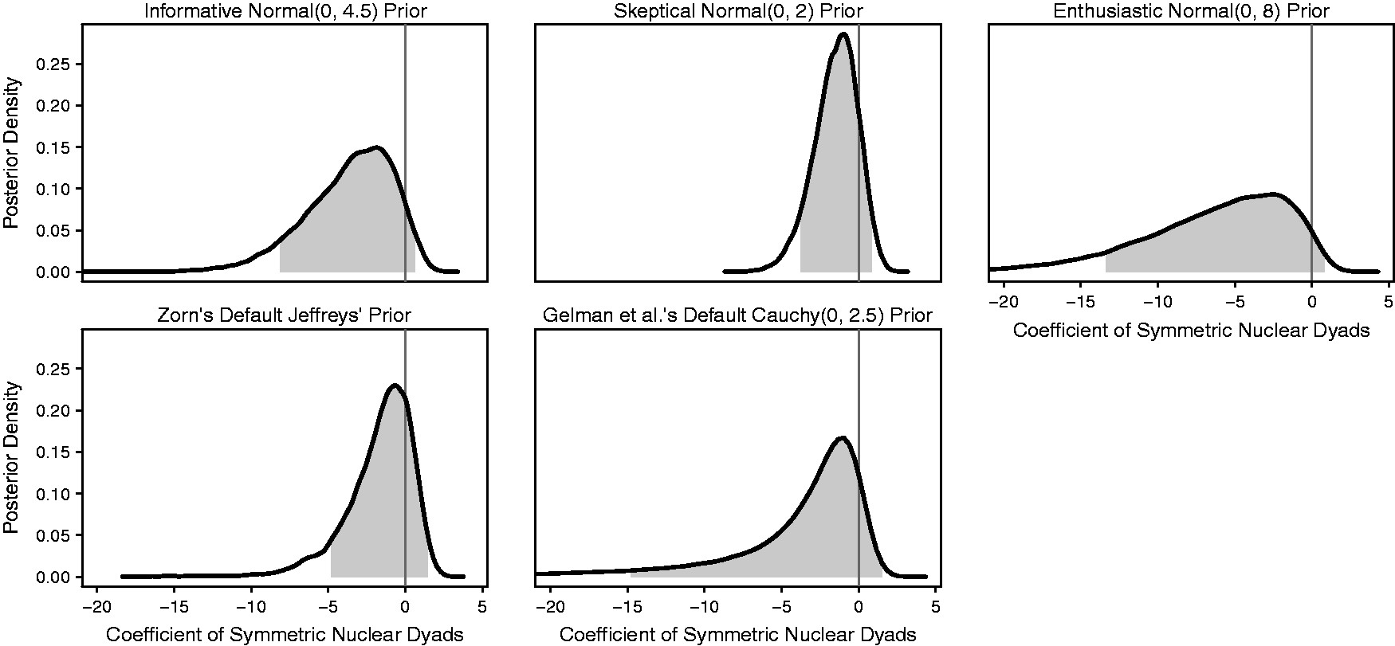
Fig. 5 This figure shows the posterior distribution for the logit coefficient of the indicator of nuclear dyads ...
Notes:
Fig. 5 This figure shows the posterior distribution for the logit coefficient of the indicator of nuclear dyads using each of the five prior distributions. The gray shading indicates the 90% credible interval. Notice that the choice of prior has a large effect on the inferences. For example, using the enthusiastic prior suggests the coefficient might be as large as −15, whereas using the skeptical prior suggests the coefficient is probably not larger than −4. Importantly, notice the similarity between the posterior using Zorn’s (2005) suggested default prior and the skeptical prior, in terms of their peak (i.e., mode), shape, and credible interval.
Unless provided in the caption above, the following copyright applies to the content of this slide: © The Author 2016. Published by Oxford University Press on behalf of the Society for Political Methodology. All rights reserved. For Permissions, please email: journals.permissions@oup.com

Slide 6
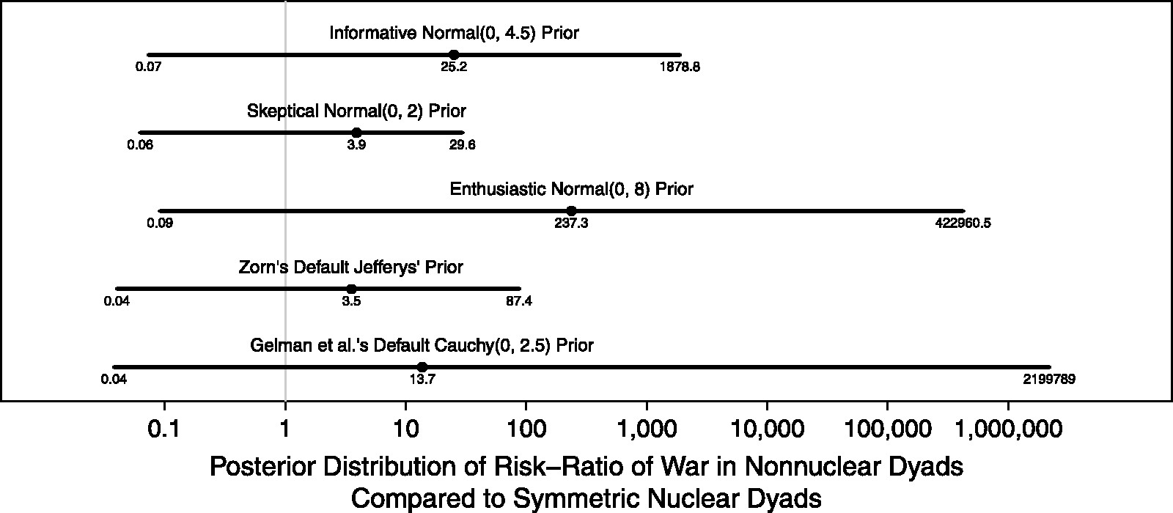
Fig. 6 This figure shows the posterior median and 90% credible intervals for the risk ratio using each of the five ...
Notes:
Fig. 6 This figure shows the posterior median and 90% credible intervals for the risk ratio using each of the five prior distributions on the log scale. Notice that the choice of prior has a huge effect on the inferences about the risk ratio. For example, the skeptical prior suggests the ratio might be as large as about 30, whereas the enthusiastic prior suggests the ratio might be as large as about 400,000. Also, notice that the posterior median from Zorn’s proposed default prior is smaller than the posterior median from the skeptical prior.
Unless provided in the caption above, the following copyright applies to the content of this slide: © The Author 2016. Published by Oxford University Press on behalf of the Society for Political Methodology. All rights reserved. For Permissions, please email: journals.permissions@oup.com

Slide 7
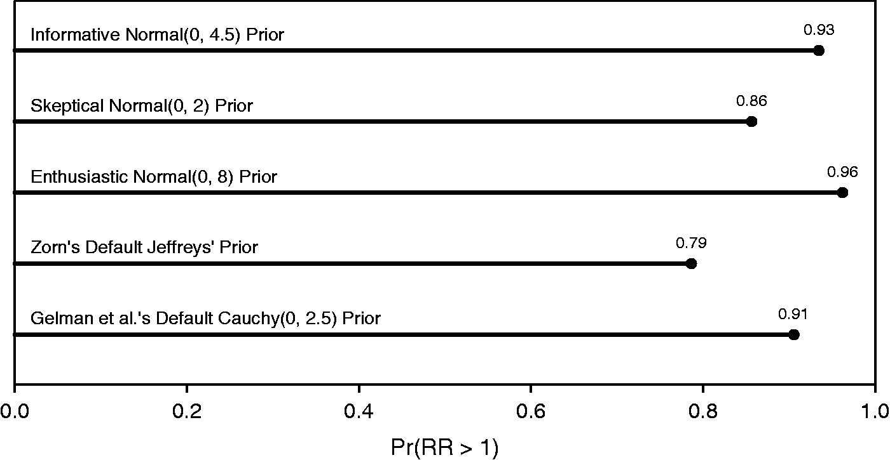
Fig. 7 This figure shows the posterior probability of the hypothesis that nonnuclear dyads are more likely to engage ...
Notes:
Fig. 7 This figure shows the posterior probability of the hypothesis that nonnuclear dyads are more likely to engage in war than symmetric nuclear dyads for each of the five prior distribution. From a hypothesis testing perspective, the evidence for the hypothesis is borderline or suggestive for each prior. However, notice that the skeptical prior, perhaps held by a researcher who believes the pacifying effect of nuclear weapons is small or nil, yields greater evidence for the hypothesis than Jeffreys’ invariant prior suggested as a default by Zorn (2005).
Unless provided in the caption above, the following copyright applies to the content of this slide: © The Author 2016. Published by Oxford University Press on behalf of the Society for Political Methodology. All rights reserved. For Permissions, please email: journals.permissions@oup.com

