Slide 1
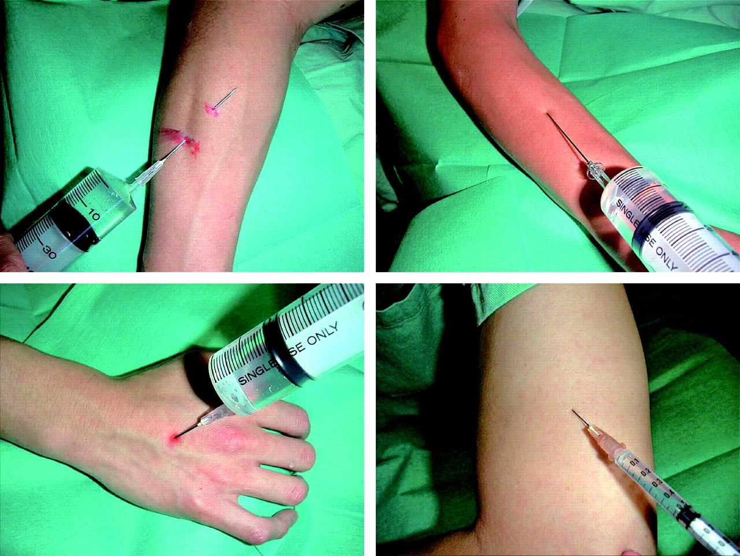
Figure 1. Sample painful images. We used 15 images for each condition (pain, fear, and rest conditions). In addition to ...
Notes:
Figure 1. Sample painful images. We used 15 images for each condition (pain, fear, and rest conditions). In addition to the “images showing painful events” taken from IAPS (Lang and others 2005), we used 8 pictures made by the authors in the pain condition to fill up the deficit of images showing painful events taken from IAPS. Images shown in Figure 1 are the examples of images showing painful events, which were made using the author's arm and hand punctured by needles and syringes and red ink for simulating blood; a needle appears to have punctured the hand or arm in the images presented, but actually it has not. The subjects were not informed of this setup.
Unless provided in the caption above, the following copyright applies to the content of this slide: © The Author 2006. Published by Oxford University Press. All rights reserved. For permissions, please e-mail: journals.permissions@oxfordjournals.org

Slide 2
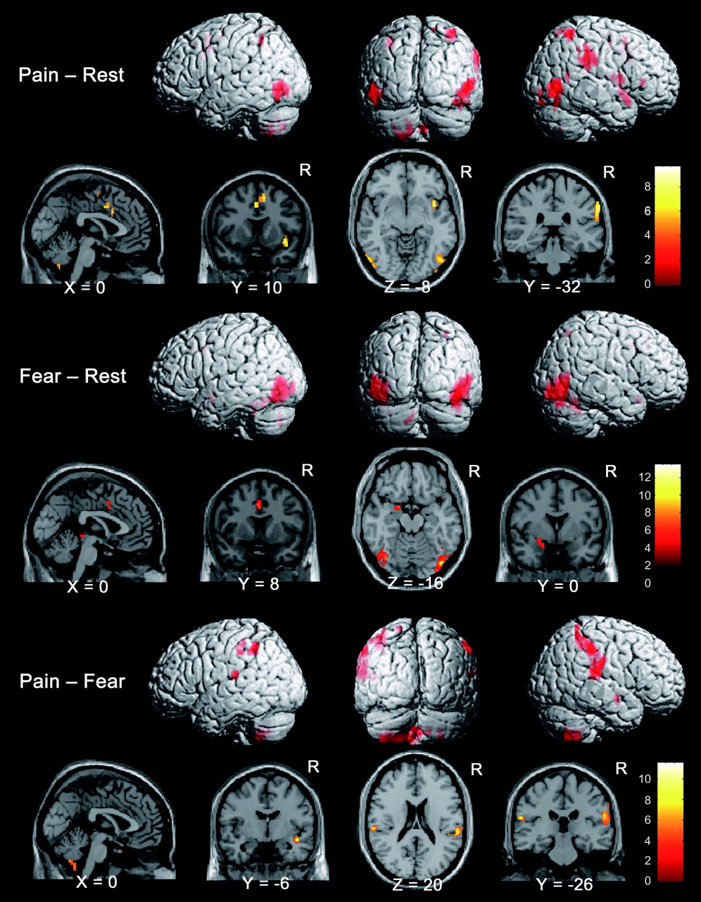
Figure 2. Brain activations in each contrast. Activated brain areas in each contrast: pain − rest, fear − rest, and ...
Notes:
Figure 2. Brain activations in each contrast. Activated brain areas in each contrast: pain − rest, fear − rest, and pain − fear conditions. Pain − rest and pain − fear contrasts revealed activations in the SII region and PPC areas and in the affective components of the pain matrix such as the ACC, anterior insula, and cerebellum while viewing images showing painful events. The fear − rest contrast revealed activations in the left amygdala and ACC. The brain region is superimposed with orthogonal sections (sagittal, coronal, and axial) of a structural scan rendered in standard space, and the corresponding t-value is also shown in the color scale on the lower right side for each contrast. Uncorrected P < 0.001 was adopted as the height threshold, and the extent threshold of 5 voxels was adopted.
Unless provided in the caption above, the following copyright applies to the content of this slide: © The Author 2006. Published by Oxford University Press. All rights reserved. For permissions, please e-mail: journals.permissions@oxfordjournals.org

