Slide 1
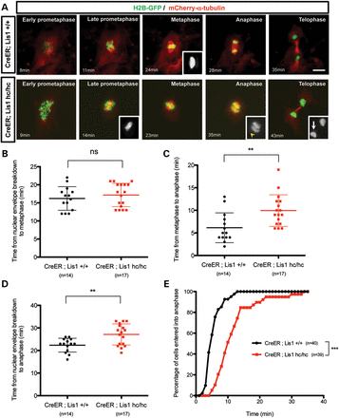
Figure 1. Loss of LIS1 results in a prolonged mitotic cell cycle to induce anaphase onset delay. (A) Frame series of ...
Notes:
Figure 1. Loss of LIS1 results in a prolonged mitotic cell cycle to induce anaphase onset delay. (A) Frame series of time-lapse live imaging movies from Lis1-CKO-Cre MEFs (CreER ; Lis1hc/hc) and control WT-Cre MEFs (CreER; Lis1+/+). MEFs were co-infected with H2B-GFP (green) and mCherry–α-tubulin (red) retroviruses. Cre activation was induced by treatment of 4-hydroxy-TM for 12 h. Inset from WT-Cre; Metaphase—normal spindle morphology (mCherry–α-tubulin). Insets from Lis1-CKO-Cre; Late prometaphase—kinked and curved spindle morphology (mCherry–α-tubulin), Anaphase—arrowhead: unattached chromosomes (H2B-GFP), Telophase—arrow: lagging chromosomes (H2B-GFP). Minutes indicate the time from nuclear envelope breakdown. Scale bar: 10 μm. (B) Time from nuclear envelope breakdown to metaphase plate formation. (C) Time from metaphase plate formation to anaphase onset. (D) Time from nuclear envelope breakdown to anaphase onset. (E) Accumulated percentage of cells entered into anaphase from metaphase. Lines in (B–D): mean ± SD, asterisks: **P < 0.01, ***P < 0.001 by Student's t-test. ns, not significant.
Unless provided in the caption above, the following copyright applies to the content of this slide: © The Author 2013. Published by Oxford University Press. All rights reserved. For Permissions, please email: journals.permissions@oup.com

Slide 2
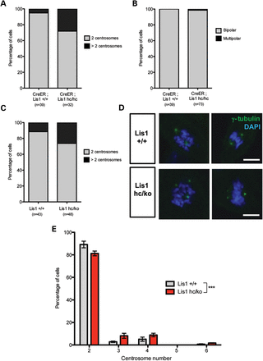
Figure 2. Loss of LIS1 leads to extra centrosomes formation with centrosome number abnormality. (A) Time-lapse live ...
Notes:
Figure 2. Loss of LIS1 leads to extra centrosomes formation with centrosome number abnormality. (A) Time-lapse live cell imaging analysis reveals the centrosome number abnormality in Lis1-CKO-Cre MEFs compared with WT-Cre MEFs. (B) Multipolar division was found in time-lapse live cell imaging of Lis1-CKO-Cre MEFs (1/73). (C) Fixed sample analysis of centrosome number from WT and Lis1hc/ko MEFs. (D) WT MEFs with normal two centrosomes and Lis1hc/ko MEFs with extra centrosomes. MEFs were stained with γ-tubulin (green) and DAPI (blue). Scale bars: 10 μm. (E) Centrosome number distributions in WT and Lis1hc/ko MEFs. More than three slides were analyzed, n > 250 cells from each genotype. Bars: mean ± SEM, asterisk: ***P < 0.001 by the two-way ANOVA test.
Unless provided in the caption above, the following copyright applies to the content of this slide: © The Author 2013. Published by Oxford University Press. All rights reserved. For Permissions, please email: journals.permissions@oup.com

Slide 3
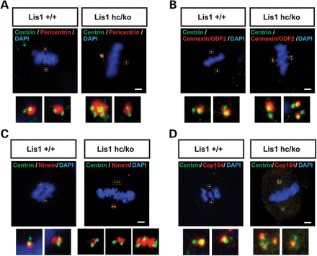
Figure 3. Lis1 mutant MEFs exhibit centrosome clustering phenotype during mitosis. (A–D) Centrosome clustering ...
Notes:
Figure 3. Lis1 mutant MEFs exhibit centrosome clustering phenotype during mitosis. (A–D) Centrosome clustering phenotype with normal centrosome maturation in Lis1hc/ko MEFs. (A) Co-staining with pericentrin (pericentriolar material marker) and centrin (each centriole). Co-staining with centrin and several mature centriole markers: (B) cennexin/ODF2, (C) ninein, (D) Cep164, respectively. Insets in (A–D): high magnification images of centrosomes. Scale bars: 5 μm.
Unless provided in the caption above, the following copyright applies to the content of this slide: © The Author 2013. Published by Oxford University Press. All rights reserved. For Permissions, please email: journals.permissions@oup.com

Slide 4
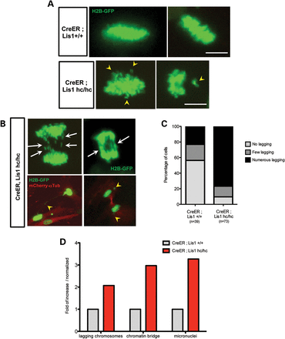
Figure 4. Loss of LIS1 induces chromosome misalignment in metaphase and chromosome missegregation in anaphase during ...
Notes:
Figure 4. Loss of LIS1 induces chromosome misalignment in metaphase and chromosome missegregation in anaphase during mitosis. (A) Time-lapse live cell imaging analysis of chromosomal behavior (labeled with H2B-GFP, green) from Lis1-CKO-Cre MEFs and WT-Cre MEFs. Arrowhead: misaligned chromosomes in Lis1-CKO-Cre MEFs. Scale bars: 5 μm. (B) Chromosome missegregation phenotypes in mitosis of Lis1-CKO-Cre MEFs. Arrow: numerous lagging chromosomes; arrowhead: (left) the chromosomes stuck in intercellular chromatin bridge, (right) micronuclei formation in telophase. MT networks were visualized by mCherry–α-tubulin (red). (C) Quantification of lagging chromosome appearance in time-lapse live cell imaging of Lis1-CKO-Cre MEFs and WT-Cre MEFs. Numbers of lagging chromosomes—no lagging: 0, few lagging: 1–3, numerous lagging: ≥4. (D) Increased incidence of various chromosome segregation defects Lis1-CKO-Cre MEFs compared with WT-Cre MEFs.
Unless provided in the caption above, the following copyright applies to the content of this slide: © The Author 2013. Published by Oxford University Press. All rights reserved. For Permissions, please email: journals.permissions@oup.com

Slide 5
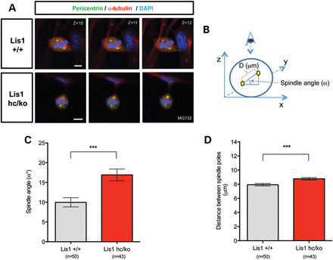
Figure 5. Loss of LIS1 impairs spindle orientation during mitosis of MEFs. (A) Confocal Z-stack image series of mitotic ...
Notes:
Figure 5. Loss of LIS1 impairs spindle orientation during mitosis of MEFs. (A) Confocal Z-stack image series of mitotic spindles stained with pericentrin (centrosomal marker, green), α-tubulin (mitotic spindle, red) and DAPI (blue). MEFs were arrested in metaphase with MG132 treatment for 2 h. Scale bars: 5 μm. (B) Schematic representation of spindle orientation in mitotic cells. Spindle angle (α°) and distance between spindle poles (D, μm) were measured by taking Z-stack confocal images from 0.5 μm thick sections. Centrosomes were identified with co-localization of pericentrin and α-tubulin (marked in yellow). (C) Average spindle angles of Lis1hc/ko MEFs and WT MEFs. (D) Average distance between spindle poles. Bars in (C) and (D): mean ± SEM, Asterisks in (C) and (D): ***P < 0.001 by Student's t-test.
Unless provided in the caption above, the following copyright applies to the content of this slide: © The Author 2013. Published by Oxford University Press. All rights reserved. For Permissions, please email: journals.permissions@oup.com

Slide 6
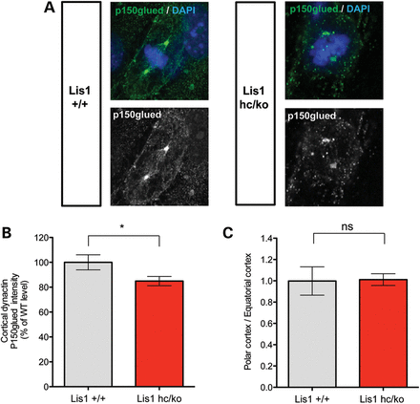
Figure 6. Loss of LIS1 results in less cortical dynein/dynactin complex recruitment to the cell cortex during mitosis. ...
Notes:
Figure 6. Loss of LIS1 results in less cortical dynein/dynactin complex recruitment to the cell cortex during mitosis. (A) Distribution of a dynactin subunit, p150glued (green) in mitosis of WT and Lis1hc/ko MEFs. Chromosomes were stained with DAPI (blue). Scale bars: 5 μm. (B) Relative fluorescence intensity of cortically located dynactin p150glued in WT and Lis1hc/ko MEFs. (C) Ratio of polar cortex-associated dynactin normalized by equatorial cortex-associated dynactin p150glued (more than eight cells were analyzed from each genotype). Asterisk in (A): *P < 0.05, (B) ns: not significant by Student's t-test.
Unless provided in the caption above, the following copyright applies to the content of this slide: © The Author 2013. Published by Oxford University Press. All rights reserved. For Permissions, please email: journals.permissions@oup.com

Slide 7
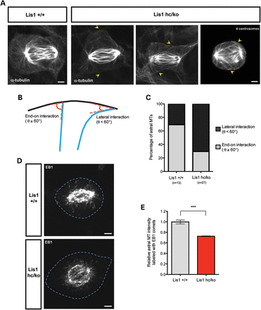
Figure 7. Loss of LIS1 causes aberrant interactions between astral MT plus-ends and the cell cortex. (A) The astral MTs ...
Notes:
Figure 7. Loss of LIS1 causes aberrant interactions between astral MT plus-ends and the cell cortex. (A) The astral MTs in early anaphase from Lis1hc/ko MEFs and WT MEFs stained with α-tubulin after glutaraldehyde fixation. Arrow: aberrant astral MT tips in Lis1hc/ko MEFs. (Right panel) Misattachment of astral MTs to the opposite polar cortex in Lis1hc/ko MEFs harboring extra centrosomes (four centrosomes). (B) Schematic representation of interaction between astral MTs and the cell cortex–end-on interaction (θ° ≥ 60) versus lateral interaction (θ° < 60). (C) Quantification of types of astral MT interaction with the cell cortex in MEFs. (D) Localization of MT plus-ends stained with EB1 (MT plus-end binding protein) in metaphase of Lis1hc/ko MEFs and WT MEFs. Blue dashed lines indicate the cell membranes. Scale bars: 5 μm. (E) Relative intensity of astral MTs labeled with EB1 in metaphase-arrested MEFs (more than eight cells were analyzed from each genotype). Asterisk in (E): ***P < 0.001 by Student's t-test.
Unless provided in the caption above, the following copyright applies to the content of this slide: © The Author 2013. Published by Oxford University Press. All rights reserved. For Permissions, please email: journals.permissions@oup.com

Slide 8
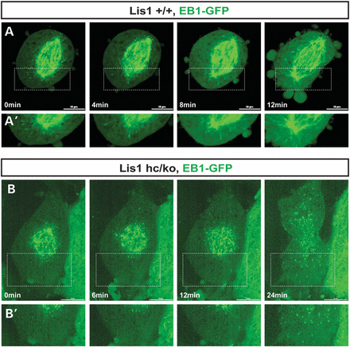
Figure 8. Reduced frequency of movements of EB1-labeled astral MT plus-ends near the cell cortex. (A) Frame series of ...
Notes:
Figure 8. Reduced frequency of movements of EB1-labeled astral MT plus-ends near the cell cortex. (A) Frame series of time-lapse live cell imaging movies from WT MEF infected with EB1-GFP adenovirus. (B) Frame series of time-lapse live cell imaging movies from Lis1hc/ko MEF. (A′, B′) High magnification images from insets in (A) and (B). Scale bars: 10 μm. These montages are generated from the representative movies of dividing MEFs from each genotype (more than ten cells were imaged for live cell imaging).
Unless provided in the caption above, the following copyright applies to the content of this slide: © The Author 2013. Published by Oxford University Press. All rights reserved. For Permissions, please email: journals.permissions@oup.com

Slide 9
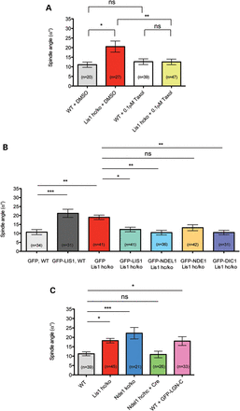
Figure 9. Spindle misorientation phenotype in Lis1 mutant MEFs is rescued by MT stabilization and overexpression of ...
Notes:
Figure 9. Spindle misorientation phenotype in Lis1 mutant MEFs is rescued by MT stabilization and overexpression of several components of the LIS1–NDEL1–dynein complex. (A) Average spindle angles in WT and Lis1hc/ko MEFs treated with DMSO and taxol. (B) MEFs infected with retroviruses encoding GFP, GFP-LIS1, GFP-NDEL1, GFP-NDE1 and GFP-DIC1. (C) Average spindle angles in NDE1 KO MEFs (Nde1ko/ko), NDEL1 CKO MEFs (Ndel1hc/hc + Cre) and GFP-LGN-C overexpressing WT MEFs. Bars in (A)–(C): mean ± SEM, Asterisks in (A)–(C): *P < 0.05, **P < 0.01, ***P < 0.001 by ANOVA with Bonferroni's post hoc test. ns, not significant.
Unless provided in the caption above, the following copyright applies to the content of this slide: © The Author 2013. Published by Oxford University Press. All rights reserved. For Permissions, please email: journals.permissions@oup.com

Slide 10
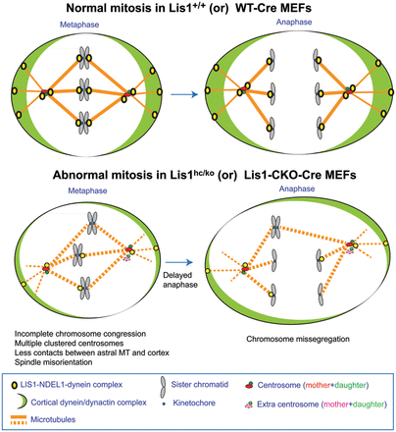
Figure 10. Proposed working model of LIS1 function in mitotic cell divisions. See text in discussion.
Notes:
Figure 10. Proposed working model of LIS1 function in mitotic cell divisions. See text in discussion.
Unless provided in the caption above, the following copyright applies to the content of this slide: © The Author 2013. Published by Oxford University Press. All rights reserved. For Permissions, please email: journals.permissions@oup.com

