Slide 1
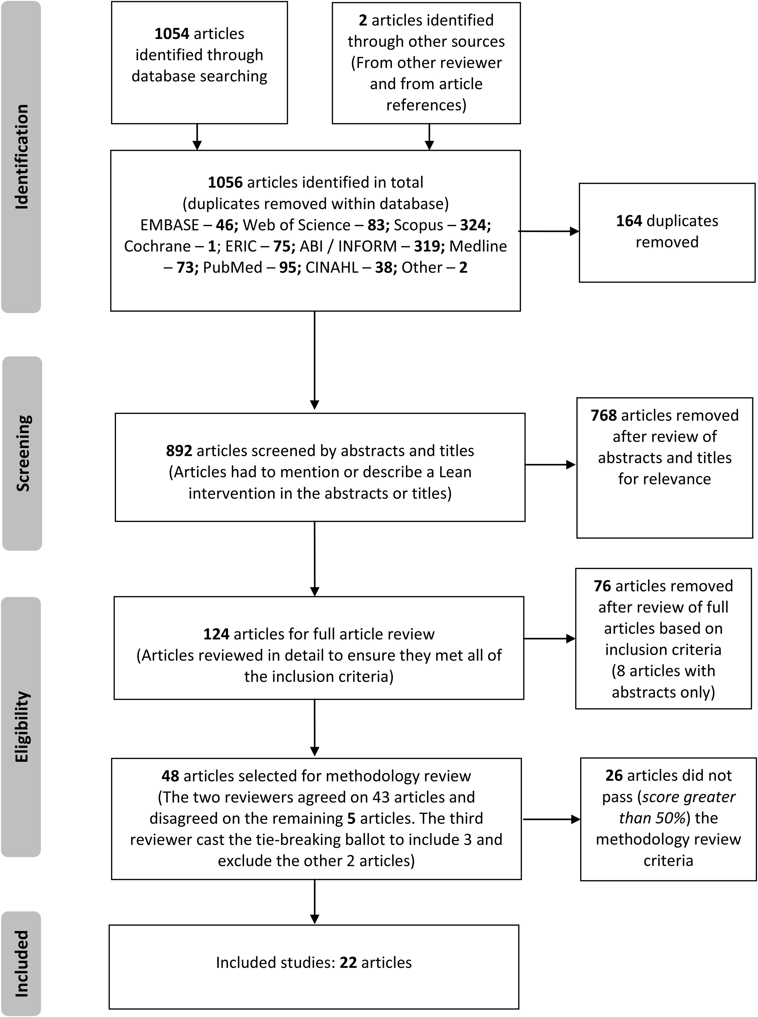
Figure 1 Prisma flow diagram of the included studies.
Notes:
Figure 1 Prisma flow diagram of the included studies.
Unless provided in the caption above, the following copyright applies to the content of this slide: © The Author 2016. Published by Oxford University Press in association with the International Society for Quality in Health CareThis is an Open Access article distributed under the terms of the Creative Commons Attribution Non-Commercial License (http://creativecommons.org/licenses/by-nc/4.0/), which permits non-commercial re-use, distribution, and reproduction in any medium, provided the original work is properly cited. For commercial re-use, please contact journals.permissions@oup.com

Slide 2
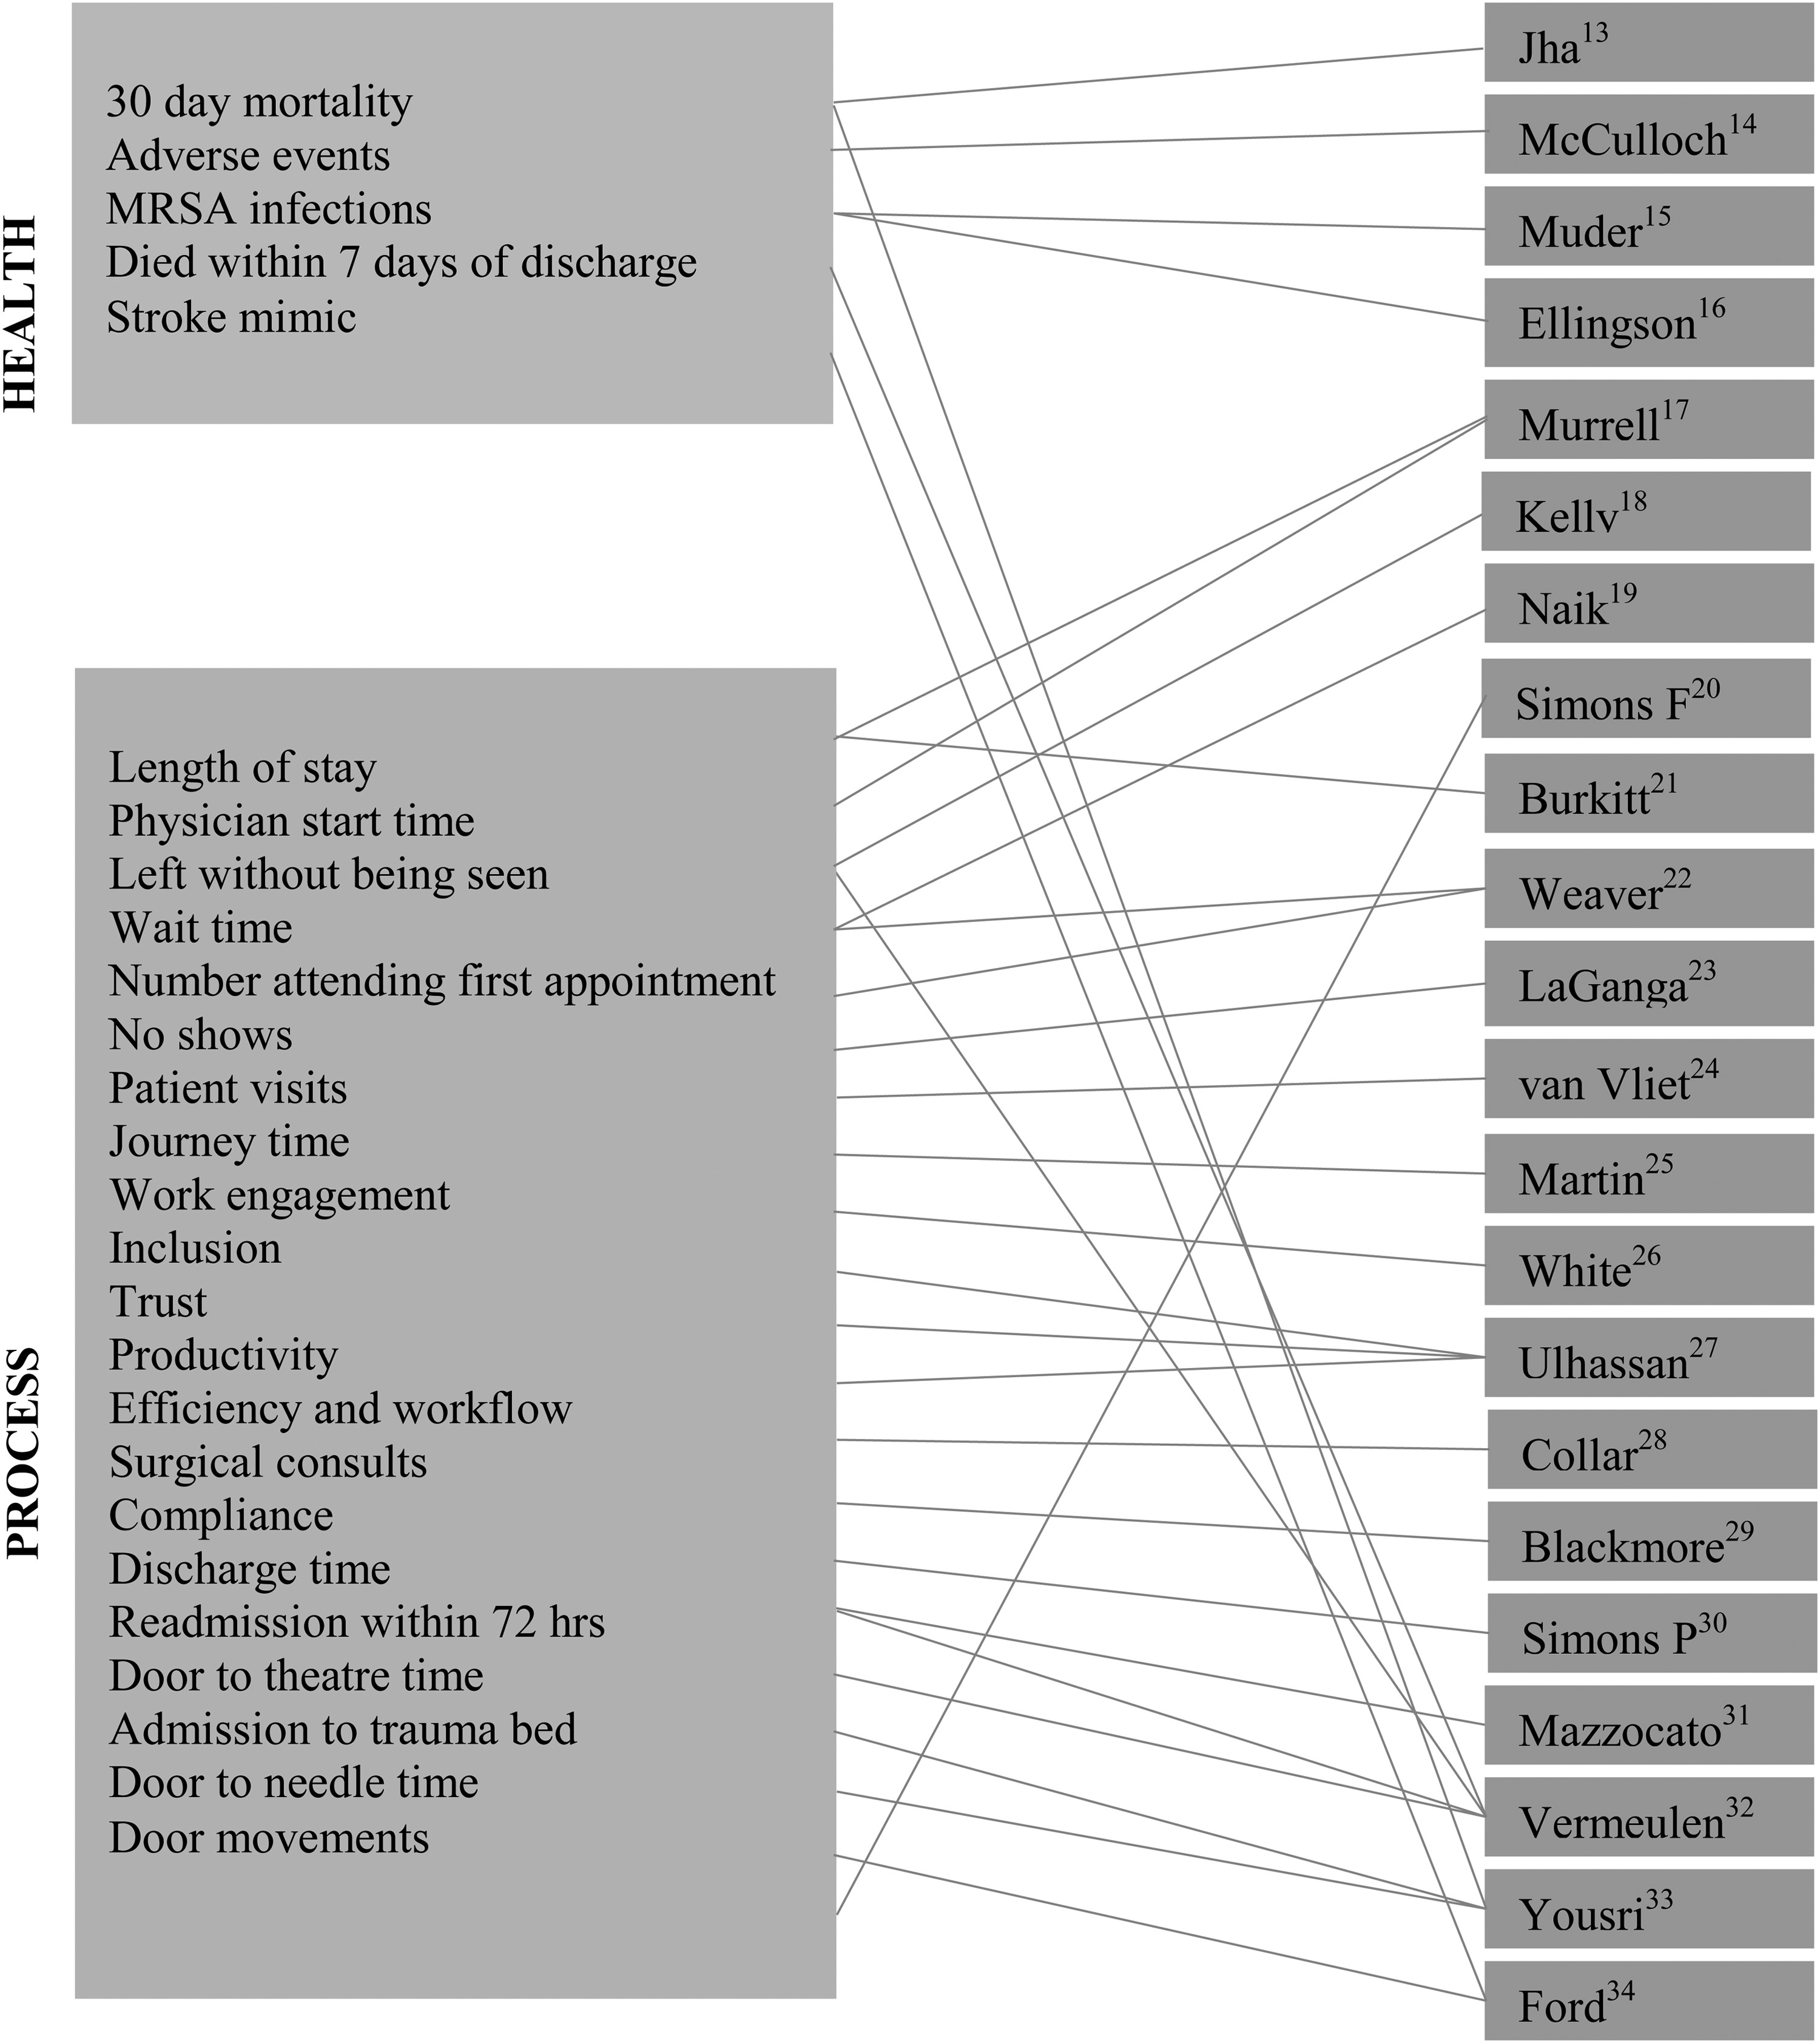
Figure 2 Diagrammatic mapping of included studies to specific outcomes.
Notes:
Figure 2 Diagrammatic mapping of included studies to specific outcomes.
Unless provided in the caption above, the following copyright applies to the content of this slide: © The Author 2016. Published by Oxford University Press in association with the International Society for Quality in Health CareThis is an Open Access article distributed under the terms of the Creative Commons Attribution Non-Commercial License (http://creativecommons.org/licenses/by-nc/4.0/), which permits non-commercial re-use, distribution, and reproduction in any medium, provided the original work is properly cited. For commercial re-use, please contact journals.permissions@oup.com

