Slide 1
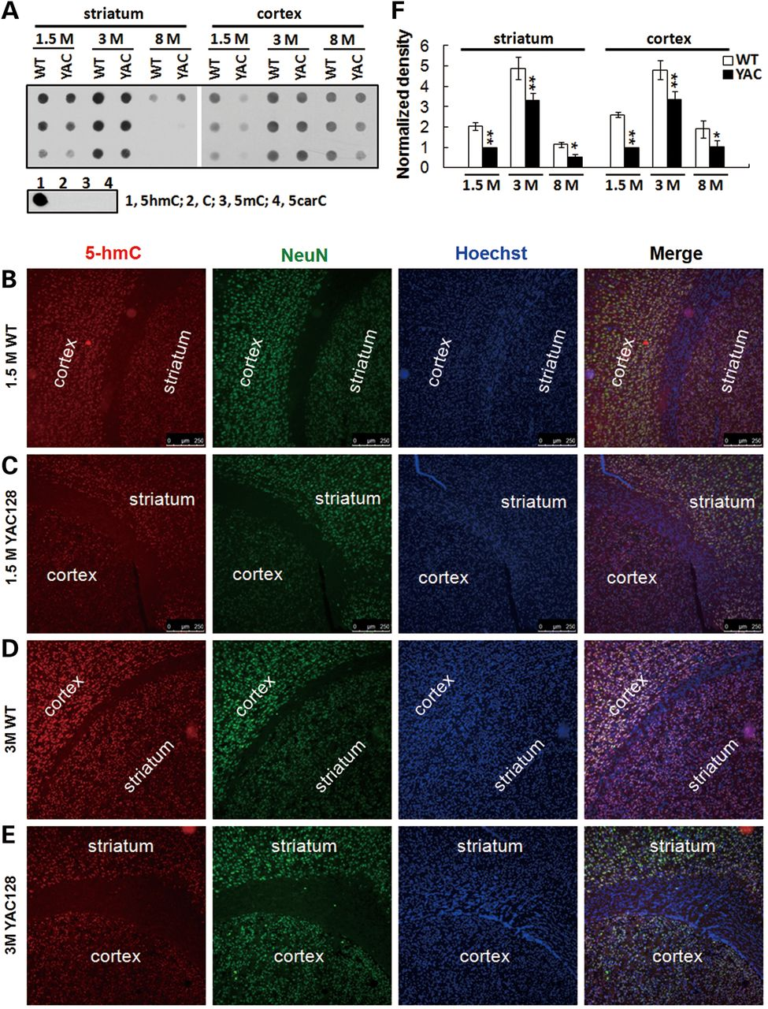
Figure 1. Quantification of the 5-hmC content in WT and YAC128 HD mouse brain tissues. (A) Dot-blot assay of 5-hmC in ...
Notes:
Figure 1. Quantification of the 5-hmC content in WT and YAC128 HD mouse brain tissues. (A) Dot-blot assay of 5-hmC in WT/YAC128 mouse striatum and cortex genome. 50, 20 and 10 ng striatal and cortical DNA samples from 6-week-, 3-month- and 8-month-old WT and YAC128 mice were dot-blotted using a 5-hmC-specific antibody. 5-hmC-containing DNA was used as the positive control, and normal C, 5-mC, 5-carC-containing DNA were used as the negative controls to verify the specificity of 5-hmC antibody. (B–E) IF of 5-hmC (red) in striatum and cortex regions from 6-week-old WT (B) and YAC128 (C), 4-month-old WT (D) and YAC128 (E) mouse brains. Brain sections were counterstained with NeuN antibody and Hochest33342 to visualize neurons (green) and nuclei (blue). (F) Quantification of the striatal and cortical 5-hmC content in WT and YAC128 DNA samples extracted at 6 weeks, 3 and 8 months of age. Striatal and cortical 5-hmC signals were normalized to 5-hmC density of 6-week-old YAC128 striatum and cortex, respectively (n = 5, mean ± s.e.; *P < 0.05; **P < 0.01).
Unless provided in the caption above, the following copyright applies to the content of this slide: © The Author 2013. Published by Oxford University Press. All rights reserved. For Permissions, please email: journals.permissions@oup.com

Slide 2
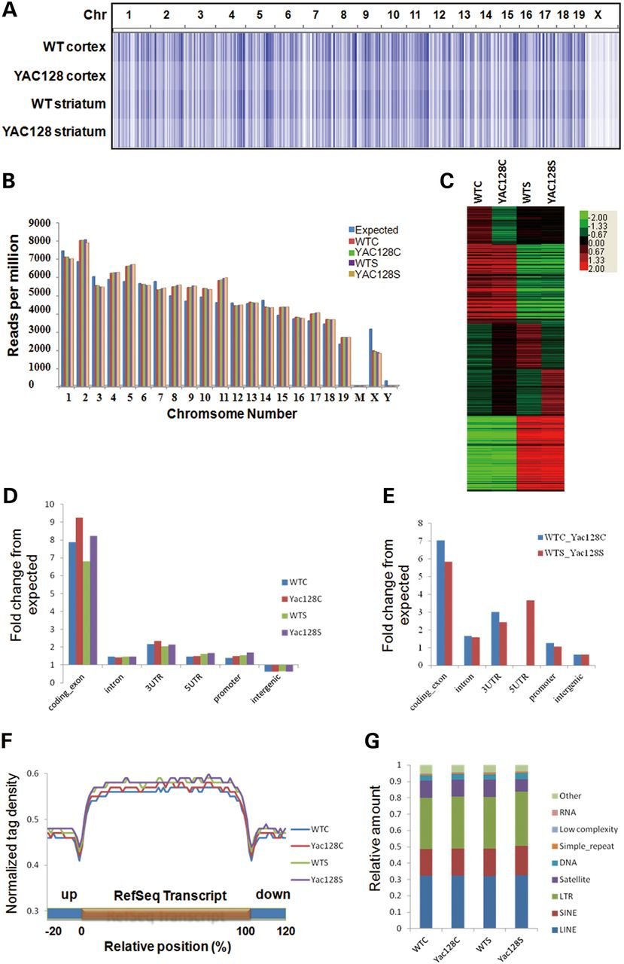
Figure 2. Genomic mapping and features of 5-hmC across two brain regions in WT/YAC128 mice. (A) Genome-scale of 5-hmC ...
Notes:
Figure 2. Genomic mapping and features of 5-hmC across two brain regions in WT/YAC128 mice. (A) Genome-scale of 5-hmC profiles and enrichment in mouse striatum and cortex. The heatmap represents the read densities which have been equally scaled and then normalized based on the total number of mapped reads per sample. (B) Chromosomal read densities of 5-hmC in cortex and striatum from WT/YAC128 mice brains. The chromosome-wide densities were determined as reads per chromosome divided by the total number of reads in millions. Expected values were determined by dividing 106 by the total genome length and multiplying by the chromosome length. (C) Heatmap of 5-hmC levels of RefSeq genes. Five distinct clusters of genes were identified based on the dynamic changes of their 5-hmC levels in WT/YAC128 striatum and cortex. The heatmap represents the normalized 5-hmC tag density of each gene. (D) Normalized densities of 5-hmC reads (per kilobase per million) in regions with various genomic features (obtained from the University of California Santa Cruz tables, mm9) including promoters (−2 kb to +0.5 kb relative to TSS), exons (5′ UTR, 3′ UTR, coding exons), introns and intergenic regions. (E) Normalized peak densities of DhMR (differential 5-hmC region) in regions with various genomic features, including promoters (−2 kb to +0.5 kb relative to TSS), exons (5′ UTR, 3′ UTR, coding exons), introns and intergenic regions. The dynamic peaks were identified between WT and YAC128 with each brain region (cortex or striatum). (F) Normalized 5-hmC read densities across the transcript unit of all reference genes in striatum and cortex from both WT and YAC128 brains. Each protein-coding gene body was normalized to 0–100%. 5-hmC densities are shown along the transcript unit with both 5′ and 3′ flanking regions. 5-hmC densities were normalized to the total number of aligned reads from each sample (in millions). (G) Normalized densities of 5-hmC reads on repetitive sequences of striatum and cortex samples from WT/YAC128 mice brains. For each type of repeat (annotated by RepeatMasker), relative enrichment of 5-hmC between different samples at different repeat classes was assessed by determining the fraction of total reads aligned to each class of repetitive element.
Unless provided in the caption above, the following copyright applies to the content of this slide: © The Author 2013. Published by Oxford University Press. All rights reserved. For Permissions, please email: journals.permissions@oup.com

Slide 3
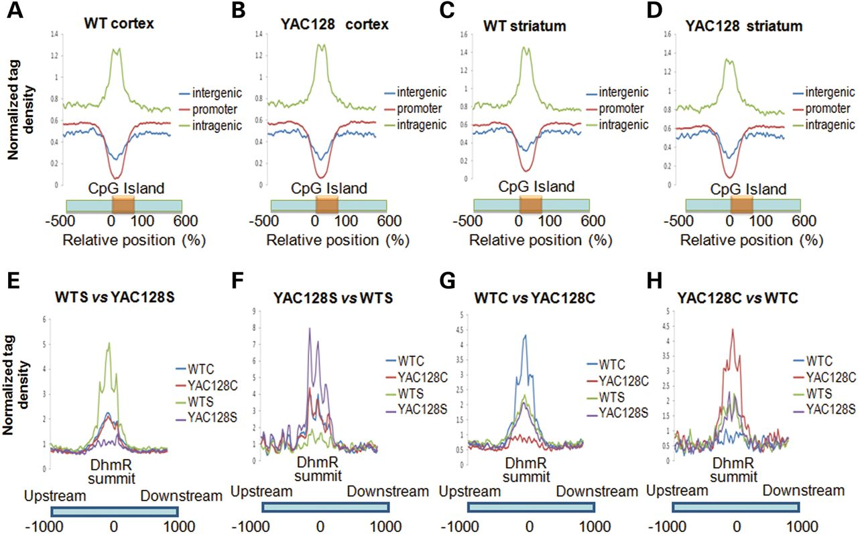
Figure 3. Characterization of 5-hmC around CGIs and identification of disease-related DhMRs. (A–D) Normalized 5-hmC ...
Notes:
Figure 3. Characterization of 5-hmC around CGIs and identification of disease-related DhMRs. (A–D) Normalized 5-hmC read densities across the CGIs belonging to the promoter (Red), intragenic (Green) and intergenic (Blue) regions of each sample. Each CpG island was normalized to 0–100%. 5-hmC tag density was plotted from 500% upstream to 500% downstream of the normalized CGIs. (E–H) Disease-related (i.e., genotype-specific) DhMRs. DhMRs identified in bidirectional comparisons of 5-hmC peaks between WT striatum and YAC128 striatum were assigned to genotype-specific (i.e., disease-related) striatum-DhMRs (WT versus YAC128, 698 DhMRs; YAC128 versus WT, 49 DhMRs); Disease-related cortex-DhMRs were identified similarly (WT versus YAC128, 324 DhMRs; YAC128 versus WT, 38 DhMRs).
Unless provided in the caption above, the following copyright applies to the content of this slide: © The Author 2013. Published by Oxford University Press. All rights reserved. For Permissions, please email: journals.permissions@oup.com

Slide 4
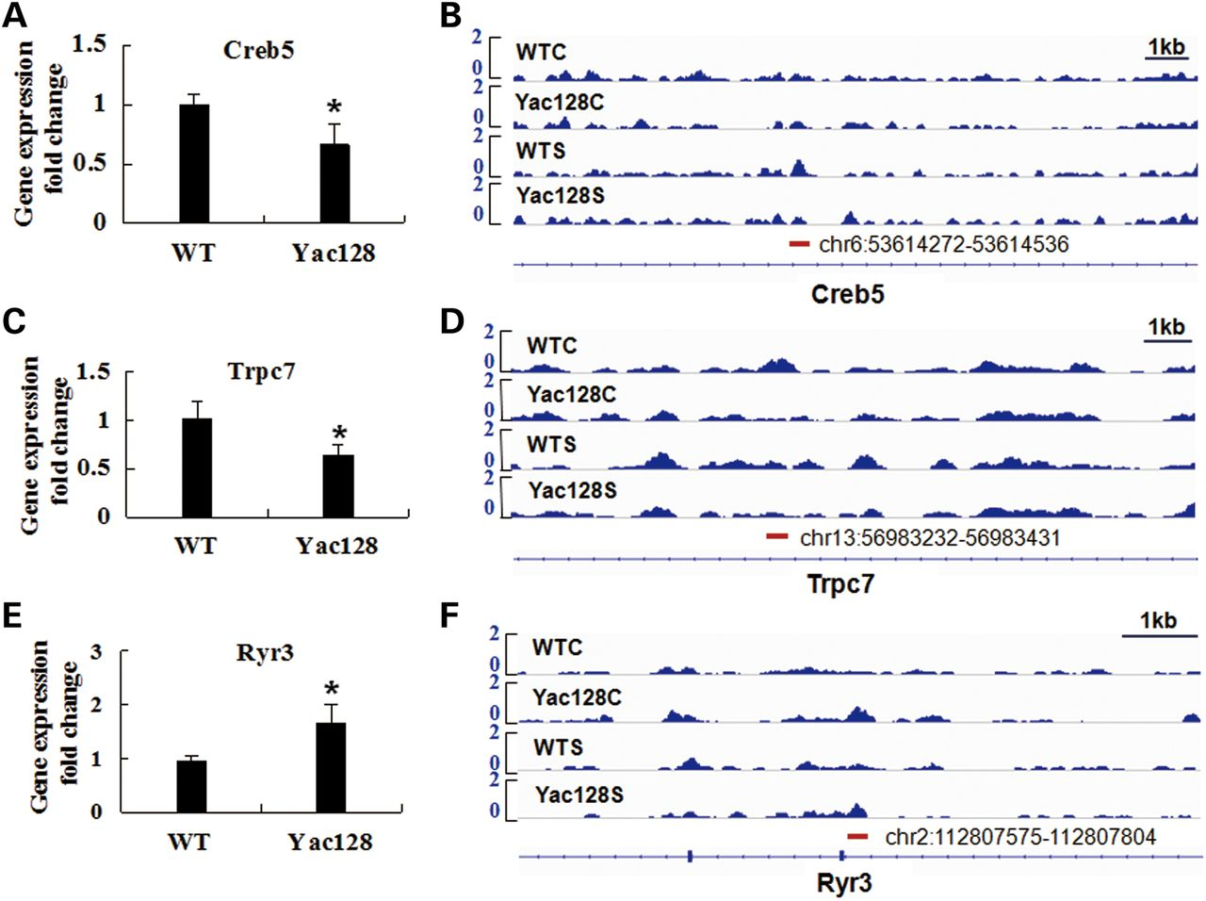
Figure 4. Association of disease-related DhMRs with gene transcription. (A) The Creb5 gene showed a higher ...
Notes:
Figure 4. Association of disease-related DhMRs with gene transcription. (A) The Creb5 gene showed a higher transcription level in WT striatum than in YAC128 striatum (n = 4, P < 0.05). (B) Genomic view one of the DhMRs lost in YAC128 striatum comparing with WT striatum located in Creb5 gene. (C) The Trpc7 gene showed a higher transcription level in WT cortex than in YAC128 cortex (n = 4, P < 0.05). (D) Genomic view one of the DhMRs lost in YAC128 cortex comparing with WT cortex located in Trpc7 gene. (E) The Ryr3 gene showed a higher transcription level in YAC128 cortex than in WT cortex (n = 4, P < 0.05). (F) Genomic view one of the DhMRs acquired in YAC128 cortex comparing with WT cortex located in Ryr3 gene. Data are represented as mean ± s.e. (*P < 0.05 comparing with the gene transcription of WT tissue). WTC, WT cortex; YAC128C, YAC128 cortex; WTS, WT striatum; YAC128S, YAC128 striatum.
Unless provided in the caption above, the following copyright applies to the content of this slide: © The Author 2013. Published by Oxford University Press. All rights reserved. For Permissions, please email: journals.permissions@oup.com

Slide 5
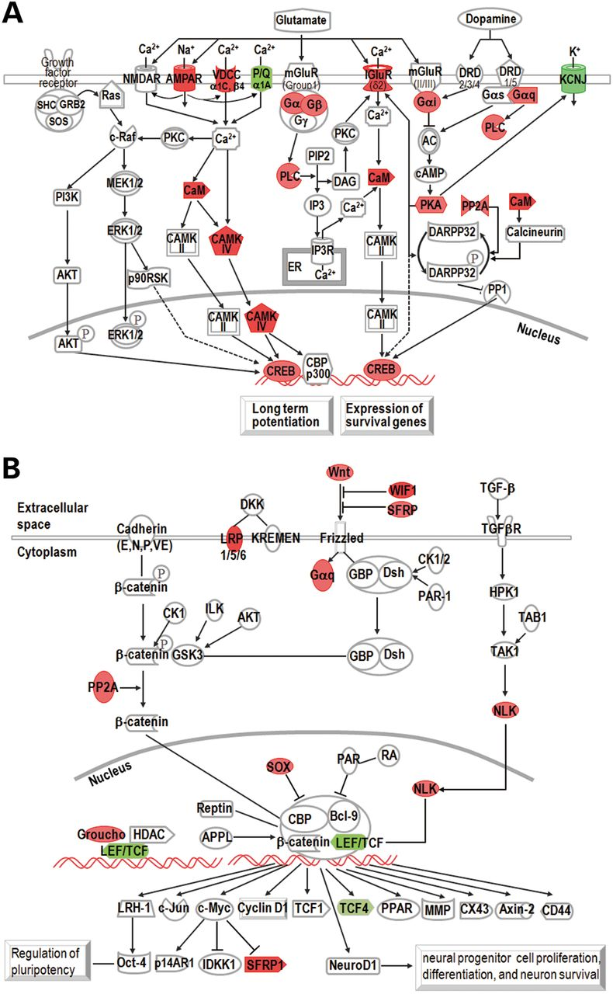
Figure 5. Pathway analyses of the disease-related DhMRs-located genes. The functions data represent the logarithm of ...
Notes:
Figure 5. Pathway analyses of the disease-related DhMRs-located genes. The functions data represent the logarithm of P-values calculated by Fisher's exact test, with a threshold for statistical significance, P < 0.05. Canonical pathways with P < 0.05 were deﬁned as signiﬁcant. Genes involved in each specific pathway and function are listed in Supplementary Material, Datasets S7 and 8, respectively. (A) Enrichment of genes acquired/lost DhMRs in YAC128 striatum in glutamate receptor signaling, dopamine/cAMP/DARPP32 feedback pathway, CREB signaling in neuron and LTP. Color indicates the strength of fold change of 5-hmC read densities. Red represents 5-hmC peak decrease in YAC128; Green represents 5-hmC peak increase in YAC128. The fold change value of each gene encoding the protein in the signaling is listed below. GNAI2 (Gαi), 4.38; CAMK4, 8.33; PRKAG2 (PKA), 4.27; GNAQ (Gαq), 4.11; CACNA1C (VDCC-α1C, β4), 4.97; PPP2R2C (PP2A, regulatory subunit B), 4.11; KCNJ6, 6.55; CREB5, 4.71; CACNA1A (VDCC-α1A, P/Q), 5.62; GNB1 (Gβ1), 5.05; GRIA1 (AMPAR1), 8.63; GRID2 (IGluRδ2, ionotropic glutamate receptor delta 2), 8.79. (B) Enrichment of genes acquired/lost DhMRs in YAC128 striatum in the wnt/β-catenin/Sox pathway. Color indicates the strength of fold change of 5-hmC read densities. Red represents 5-hmC peak decrease in YAC128; Green represents 5-hmC peak increase in YAC128. The fold change value of each gene encoding the protein in the signaling is listed below. WNT4, 5.37; WNT9B, 4.35; WIF1, 6.7; SFRP1, 4.21; LRP6, 6.16; NLK, 6.94; TLE3 (Groucho), 4.55; GNAQ (Gαq), 4.11; PPP2R2C (PP2A, regulatory subunit B), 4.11; SOX5, 4.93; TCF4, 4.45.
Unless provided in the caption above, the following copyright applies to the content of this slide: © The Author 2013. Published by Oxford University Press. All rights reserved. For Permissions, please email: journals.permissions@oup.com

