Slide 1
Figure 1. Task design. Cost–benefit contingencies associated with responding on either lever (A) and format of a single ...
Notes:
Figure 1. Task design. Cost–benefit contingencies associated with responding on either lever (A) and format of a single free-choice trial (B) of the risk-discounting task.
Unless provided in the caption above, the following copyright applies to the content of this slide: © The Author 2009. Published by Oxford University Press. All rights reserved. For permissions, please e-mail: journals.permissions@oxfordjournals.org

Slide 2
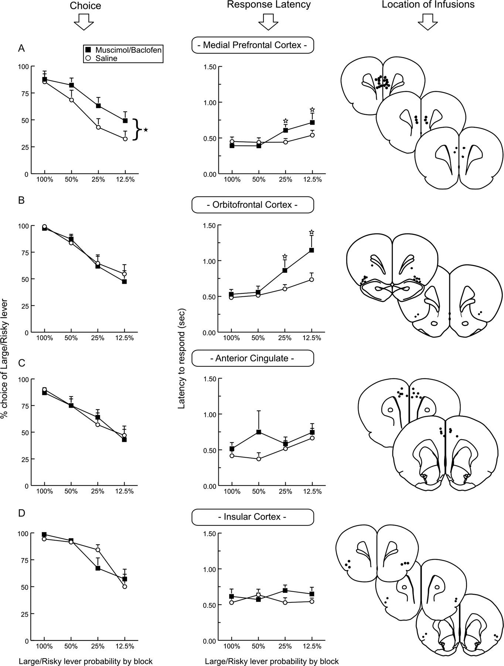
Figure 2. Effects of inactivation of different PFC regions on risk discounting. The panels of each figure plots ...
Notes:
Figure 2. Effects of inactivation of different PFC regions on risk discounting. The panels of each figure plots percentage choice of the Large/Risky lever (left) and response latencies (middle) as a function of the trial block (x-axis) following infusions of saline (white circles) or muscimol/baclofen (inactivation, black squares) into each of the 4 PFC subregions: (A) Medial PFC; (B) OFC; (C) anterior cingulate; and (D) insular cortex. Symbols represent mean + standard error of the mean. Black stars denote a significant (P < 0.05) main effect of treatment. White stars denote significant (P < 0.05) differences between treatments during a specific block. Right panels are schematics of coronal sections of the rat brain showing the location of acceptable infusion placements through the rostral–caudal extent of each of the 4 PFC regions.
Unless provided in the caption above, the following copyright applies to the content of this slide: © The Author 2009. Published by Oxford University Press. All rights reserved. For permissions, please e-mail: journals.permissions@oxfordjournals.org

Slide 3
Figure 3. Effects of medial PFC inactivation on risk discounting with ascending probabilities. (A) Percentage of choice ...
Notes:
Figure 3. Effects of medial PFC inactivation on risk discounting with ascending probabilities. (A) Percentage of choice of the Large/Risky lever during free-choice trials following infusions of saline or muscimol/baclofen into the medial PFC for all 12 rats used in this experiment. Inactivation of the medial PFC decreased risky choice. Inset displays data from a subset of rats (n = 9) that demonstrated comparable levels of choice of the Large/Risky lever after both saline and inactivation treatments during the initial, 12.5% probability block (i.e., matching for performance). (B) Response latencies displayed as a function of trial block. Black stars denote a significant (P < 0.05) main effect of treatment. (C) Location of acceptable infusion placements for rats used in this experiment.
Unless provided in the caption above, the following copyright applies to the content of this slide: © The Author 2009. Published by Oxford University Press. All rights reserved. For permissions, please e-mail: journals.permissions@oxfordjournals.org

Slide 4
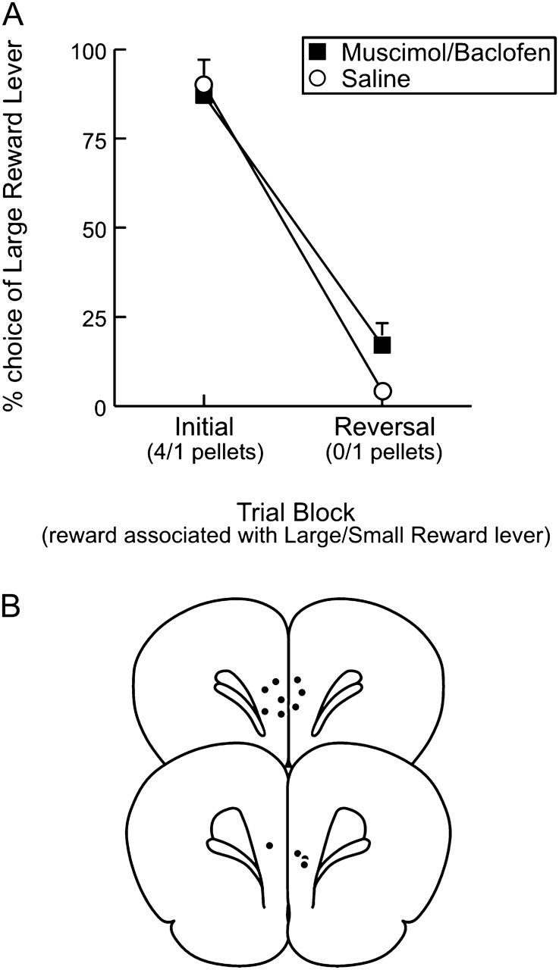
Figure 4. Medial PFC inactivation does not affect performance of a within-session reversal. Data are plotted as ...
Notes:
Figure 4. Medial PFC inactivation does not affect performance of a within-session reversal. Data are plotted as percentage choice of the LR lever over 2 blocks of 20 free-choice trials (initial and reversal). The LR lever was associated with a 4-pellet reward during the initial block, but did not deliver any reward (0 pellets) during the reversal block. Responding on the SR lever delivered 1 pellet during both blocks. Rats were able to shift responding away from the LR lever during the reversal block after both saline and muscimol/baclofen treatment. (B) Location of acceptable infusion placements for rats used in this experiment.
Unless provided in the caption above, the following copyright applies to the content of this slide: © The Author 2009. Published by Oxford University Press. All rights reserved. For permissions, please e-mail: journals.permissions@oxfordjournals.org

Slide 5
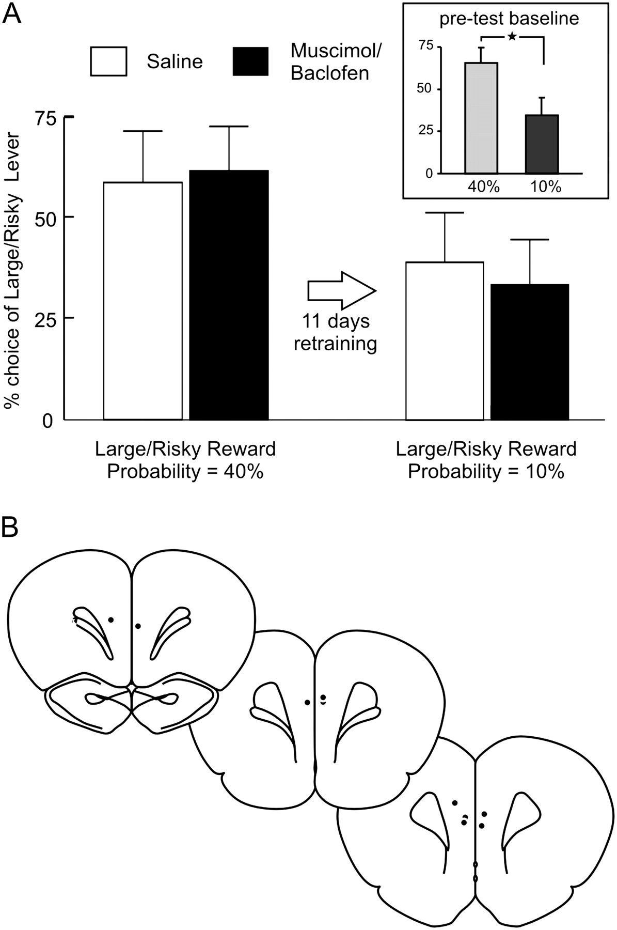
Figure 5. Inactivation of the medial PFC does not affect risky choice using fixed probabilities associated with larger ...
Notes:
Figure 5. Inactivation of the medial PFC does not affect risky choice using fixed probabilities associated with larger reward. Bars represent percentage choice of the Large/Risky lever following saline (white) or muscimol/baclofen (black) infusions into the medial PFC. The left panel displays data from infusion tests days when the Large/Risky reward probability was fixed at 40%. The right panel displays data from infusions test days following 11 days of retraining with the Large/Risky probability at 10%. The inset diagrams the significant reduction in preference for the Large/Risky lever averaged across the last 3 days of training prior to the first (40%) and second infusion tests (10%). The star denotes a significant (P < 0.05) difference between reward probability conditions. (B) Location of acceptable infusion placements for rats used in this experiment.
Unless provided in the caption above, the following copyright applies to the content of this slide: © The Author 2009. Published by Oxford University Press. All rights reserved. For permissions, please e-mail: journals.permissions@oxfordjournals.org

