Slide 1
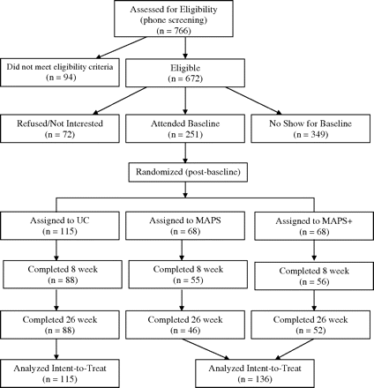
Figure 1. CONSORT flowchart of recruitment and attendance at follow-up appointments.
Notes:
Figure 1. CONSORT flowchart of recruitment and attendance at follow-up appointments.
Unless provided in the caption above, the following copyright applies to the content of this slide: © The Author 2010. Published by Oxford University Press on behalf of the Society for Research on Nicotine and Tobacco. All rights reserved. For permissions, please e-mail: journals.permissions@oxfordjournals.org

Slide 2
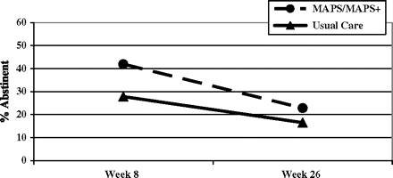
Figure 2. Abstinence rates by treatment group at 8 and 26-weeks postpartum.
Notes:
Figure 2. Abstinence rates by treatment group at 8 and 26-weeks postpartum.
Unless provided in the caption above, the following copyright applies to the content of this slide: © The Author 2010. Published by Oxford University Press on behalf of the Society for Research on Nicotine and Tobacco. All rights reserved. For permissions, please e-mail: journals.permissions@oxfordjournals.org

Slide 3
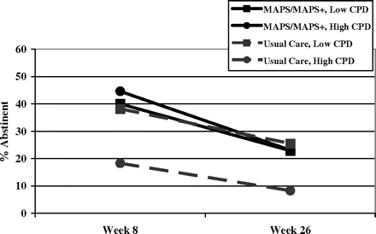
Figure 3. Illustration of the interaction effect of treatment group with prequit cigarettes per day (CPD) in unadjusted ...
Notes:
Figure 3. Illustration of the interaction effect of treatment group with prequit cigarettes per day (CPD) in unadjusted analyses.
Unless provided in the caption above, the following copyright applies to the content of this slide: © The Author 2010. Published by Oxford University Press on behalf of the Society for Research on Nicotine and Tobacco. All rights reserved. For permissions, please e-mail: journals.permissions@oxfordjournals.org

