Slide 1
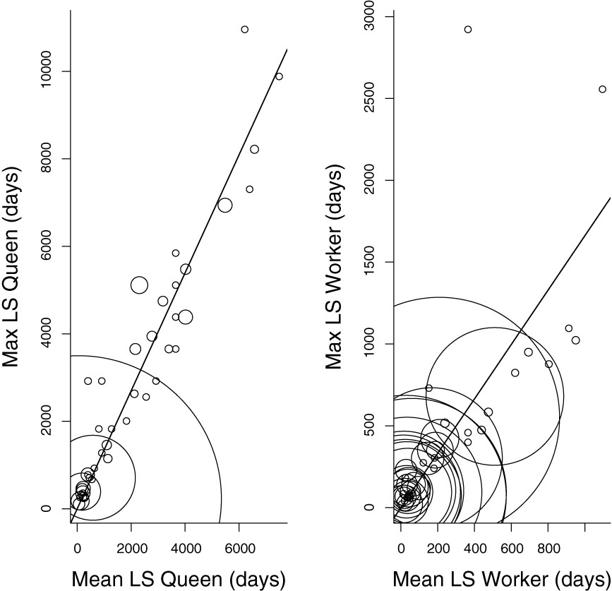
Figure 1. Linear regressions between mean and maximum lifespan for queens (left) and workers (right). Each circle ...
Notes:
Figure 1. Linear regressions between mean and maximum lifespan for queens (left) and workers (right). Each circle represents mean and maximum lifespan of a species. The size of the circle represents sample size. The lines represent the slope (conversion factor) estimated from regression through the origin weighted by sample size. Left: mean and maximum queen lifespan; slope: 1.34 ± 0.05 (t1, 44 = 28.32, P < 0.001, R2 = 0.95, F = 802.2). Right: mean and maximum worker lifespan; slope: 1.66 ± 0.07 (t1, 55 = 21.15, P < 0.001, R2 = 0.89, F = 447.3).
Unless provided in the caption above, the following copyright applies to the content of this slide: © 2013 The Linnean Society of London

Slide 2
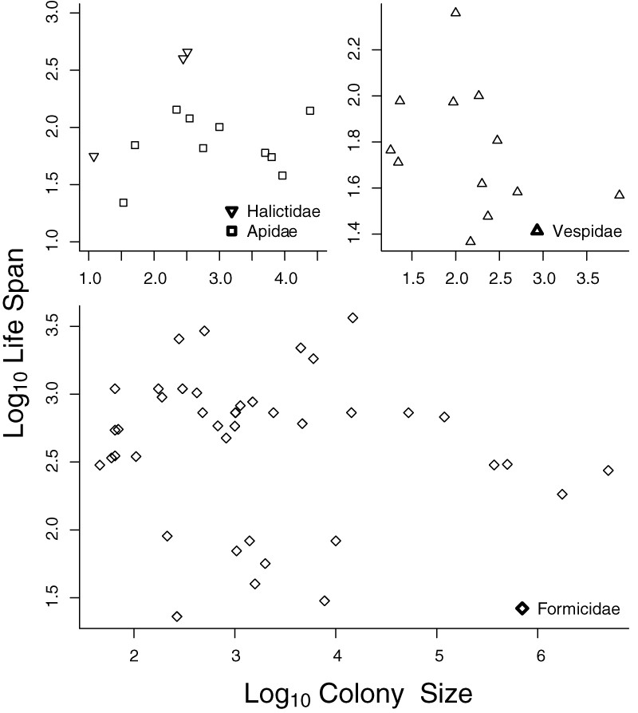
Figure 2. Maximum worker lifespan and group size. Sixty-six species (Hymenoptera) are included in this plot [Formicidae ...
Notes:
Figure 2. Maximum worker lifespan and group size. Sixty-six species (Hymenoptera) are included in this plot [Formicidae = 41 species (intercept = 792.9, P < 0.001, slope = −0.0001, P = 0.362, R2 = 0.021, d.f. = 39, F = 0.85), Vespidae = 12 species (intercept = 76.21, P = 0.002, slope = −0.006, P = 0.503, R2 = 0.046, d.f. = 10, F = 0.483), Apidae = 10 species (intercept = 74.42, P = 0.002, slope = 0.0015, P = 0.448, R2 = 0.074, d.f. = 8, F = 0.638), Halictidae = 3 species)].
Unless provided in the caption above, the following copyright applies to the content of this slide: © 2013 The Linnean Society of London

Slide 3
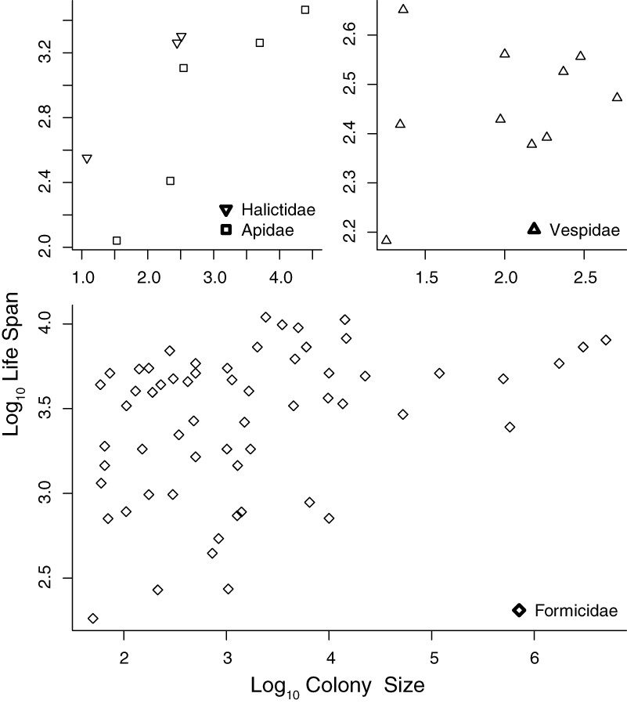
Figure 3. Maximum queen lifespan and colony size. Seventy-nine species (Hymenoptera) are included [Formicidae = 61 ...
Notes:
Figure 3. Maximum queen lifespan and colony size. Seventy-nine species (Hymenoptera) are included [Formicidae = 61 species (intercept = 3736, P < 0.001, slope = 0.001, P = 0.039, R2 = 0.07, d.f. = 59, F = 4.447), Vespidae = 10 species (intercept = 286.89, P < 0.001, slope = 0.064, P = 0.745, R2 = 0.014, d.f. = 8, F = 0.114), Apidae = 5 species (intercept = 698.62, P = 0.139, slope = 0.0967, P = 0.054, R2 = 0.761, d.f. = 3, F = 9.528), Halictidae = 3 species)].
Unless provided in the caption above, the following copyright applies to the content of this slide: © 2013 The Linnean Society of London

Slide 4
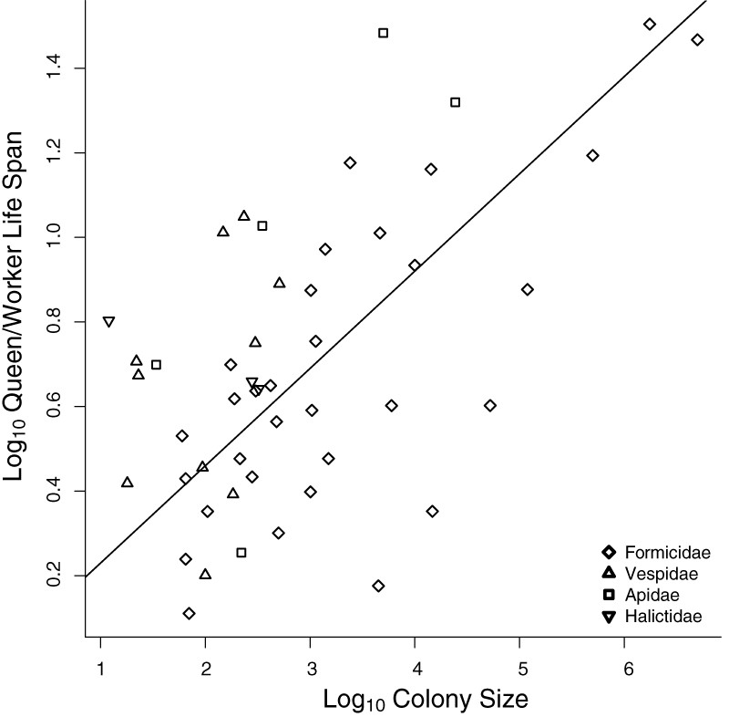
Figure 4. Maximum lifespan ratio and group size including 49 eusocial Hymenoptera species (Formicidae = 31 species, ...
Notes:
Figure 4. Maximum lifespan ratio and group size including 49 eusocial Hymenoptera species (Formicidae = 31 species, Vespidae = 10 species, Apidae = 5 species, Halictidae = 3 species). The line represents the results of the linear regression: slope = 0.23 ± 0.01 (t1, 48 = 17.14, P < 0.001, R2 = 0.86, F = 293.7).
Unless provided in the caption above, the following copyright applies to the content of this slide: © 2013 The Linnean Society of London

