Slide 1
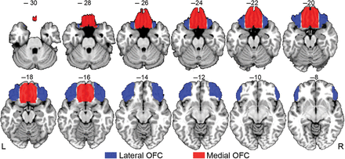
Figure 1. lOFC and mOFC seed ROIs for the MACM analysis displayed on the Colin T₁ MNI template. Slice ...
Notes:
Figure 1. lOFC and mOFC seed ROIs for the MACM analysis displayed on the Colin T1 MNI template. Slice numbers indicate MNI z coordinates.
Unless provided in the caption above, the following copyright applies to the content of this slide: © The Author 2012. Published by Oxford University Press. All rights reserved. For Permissions, please e-mail: journals.permissions@oup.com

Slide 2
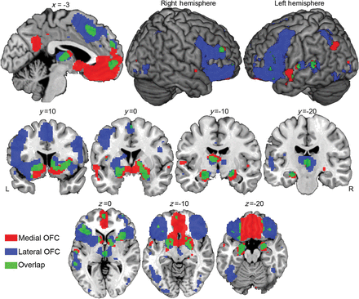
Figure 2. Areas showing significant coactivation with mOFC and lOFC seed ROIs. Areas in red indicate coactivation with ...
Notes:
Figure 2. Areas showing significant coactivation with mOFC and lOFC seed ROIs. Areas in red indicate coactivation with mOFC; areas in blue indicate coactivation with lOFC. Areas in green indicate regions with overlapping mOFC and lOFC coactivation.
Unless provided in the caption above, the following copyright applies to the content of this slide: © The Author 2012. Published by Oxford University Press. All rights reserved. For Permissions, please e-mail: journals.permissions@oup.com

Slide 3
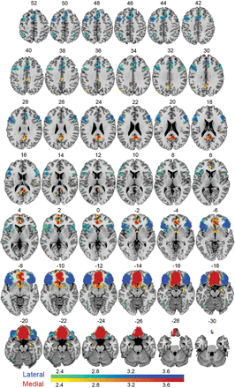
Figure 3. Regions showing statistically significant differences in the frequency of coactivation between the lOFC and ...
Notes:
Figure 3. Regions showing statistically significant differences in the frequency of coactivation between the lOFC and mOFC seed regions. The color scale reflects the magnitude of the difference with areas in green to blue showing significantly greater coactivation with the lOFC, and areas in yellow to red showing significantly greater coactivation with the mOFC.
Unless provided in the caption above, the following copyright applies to the content of this slide: © The Author 2012. Published by Oxford University Press. All rights reserved. For Permissions, please e-mail: journals.permissions@oup.com

Slide 4
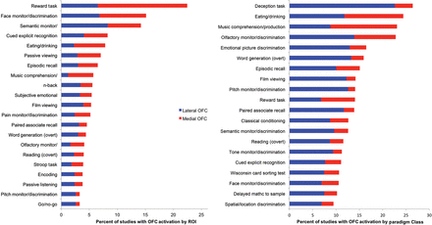
Figure 4. Top 20 paradigm classes with reported OFC activation (A) as a percentage of all studies reporting OFC ...
Notes:
Figure 4. Top 20 paradigm classes with reported OFC activation (A) as a percentage of all studies reporting OFC activation and (B) as a percentage of paradigm class. Asterisks indicate paradigm classes for which OFC activations occurred more frequently than predicted by chance relative to the whole-brain distribution of activations for the given paradigm.
Unless provided in the caption above, the following copyright applies to the content of this slide: © The Author 2012. Published by Oxford University Press. All rights reserved. For Permissions, please e-mail: journals.permissions@oup.com

Slide 5
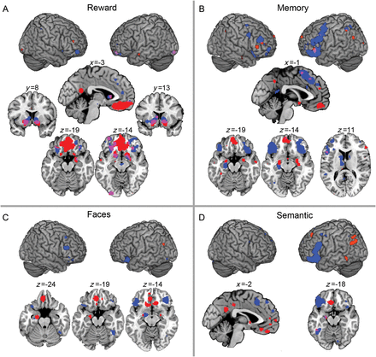
Figure 5. Significant coactivations in analyses restricted to specific functional domains. In all cases, red shows ...
Notes:
Figure 5. Significant coactivations in analyses restricted to specific functional domains. In all cases, red shows areas coactivated with the mOFC seed region, blue with the lOFC seed region, and purple with both.
Unless provided in the caption above, the following copyright applies to the content of this slide: © The Author 2012. Published by Oxford University Press. All rights reserved. For Permissions, please e-mail: journals.permissions@oup.com

