Slide 1
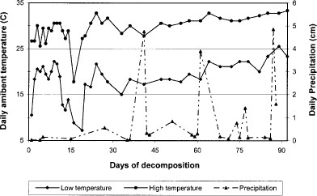
Fig. 1 Meterological data recorded on site per sampling event from 1 April 1999 to 1 July 1999. Daily precipitation ...
Notes:
Fig. 1 Meterological data recorded on site per sampling event from 1 April 1999 to 1 July 1999. Daily precipitation recorded at a local station of the Louisiana Office of State Climatology.
Unless provided in the caption above, the following copyright applies to the content of this slide: © 2003 Entomological Society of America

Slide 2
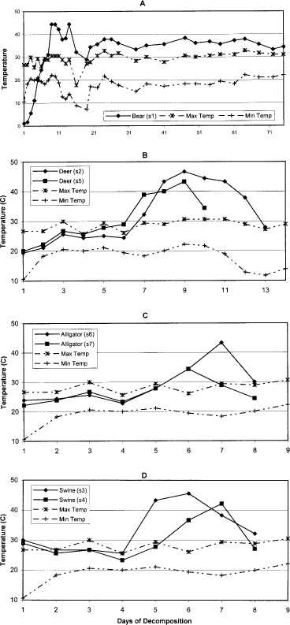
Fig. 2 Internal carcass temperatures for each animal per sampling eventª. Max/min ambient temperatures ...
Notes:
Fig. 2 Internal carcass temperatures for each animal per sampling eventa. Max/min ambient temperatures recorded on site. A, LA black bear (site 1); B, deer (sites 2 and 5); C, alligator (sites 6 and 7); D, swine (sites 3 and 4). aA terminated at day 75; B-D terminated at skeletonization/dry remains.
Unless provided in the caption above, the following copyright applies to the content of this slide: © 2003 Entomological Society of America

Slide 3
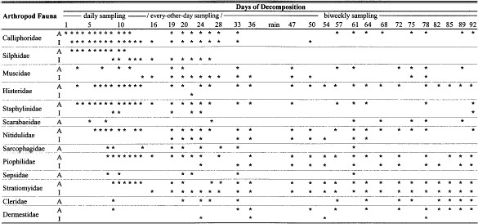
Fig. 3 Arthropod succession of manually collected necrophilous insects on one Louisiana black bear carcass from 1 ...
Notes:
Fig. 3 Arthropod succession of manually collected necrophilous insects on one Louisiana black bear carcass from 1 April 1999 to 1 July 1999. AAdultsonly. IImmature stages including larvae and/or pupae.
Unless provided in the caption above, the following copyright applies to the content of this slide: © 2003 Entomological Society of America

Slide 4
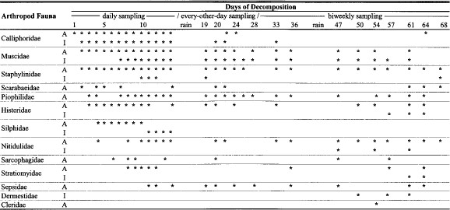
Fig. 4 Arthropod succession of manually collected necrophilous insects on two white-tailed deer carcasses from 1 ...
Notes:
Fig. 4 Arthropod succession of manually collected necrophilous insects on two white-tailed deer carcasses from 1 April 1999 to 7 June 1999. AAdultsonly. IImmature stages including larvae and/or pupae.
Unless provided in the caption above, the following copyright applies to the content of this slide: © 2003 Entomological Society of America

Slide 5
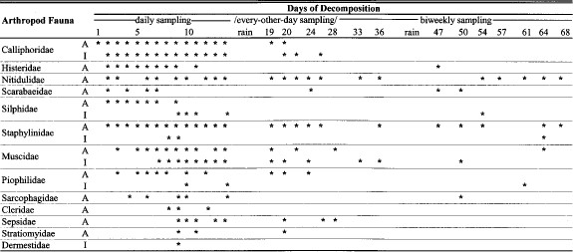
Fig. 5 Arthropod succession of manually collected necrophilous insects on two swine carcasses from 1 April 1999 to 7 ...
Notes:
Fig. 5 Arthropod succession of manually collected necrophilous insects on two swine carcasses from 1 April 1999 to 7 June 1999. AAdultsonly. IImmature stages including larvae and/or pupae.
Unless provided in the caption above, the following copyright applies to the content of this slide: © 2003 Entomological Society of America

Slide 6
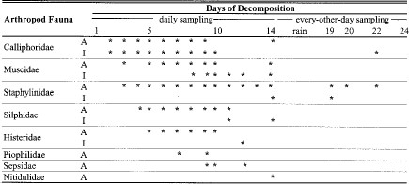
Fig. 6 Arthropod succession of manually collected necrophilous insects on two juvenile alligator carcasses from 1 ...
Notes:
Fig. 6 Arthropod succession of manually collected necrophilous insects on two juvenile alligator carcasses from 1 April 1999 to 24 April 1999. AAdultsonly. IImmature stages including larvae and/or pupae.
Unless provided in the caption above, the following copyright applies to the content of this slide: © 2003 Entomological Society of America

