Slide 1
Figure 1. Schematic representation of the deduced amino acid structure of human COCH , encoding the protein cochlin, ...
Notes:
Figure 1. Schematic representation of the deduced amino acid structure of human COCH , encoding the protein cochlin, shows a predicted signal peptide (SP), followed by a domain initially designated as FCH, also known as the LCCL domain, followed by an intervening domain, and two domains (vWFA1 and vWFA2) separated by an intervening domain. Twelve mutations (all missense except for one in-frame deletion), causing DFNA9 deafness and vestibular disorder, are indicated. The positions of all cysteine residues are shown as ‘C’.
Unless provided in the caption above, the following copyright applies to the content of this slide: © The Author 2008. Published by Oxford University Press. All rights reserved. For Permissions, please email: journals.permissions@oxfordjournals.org

Slide 2
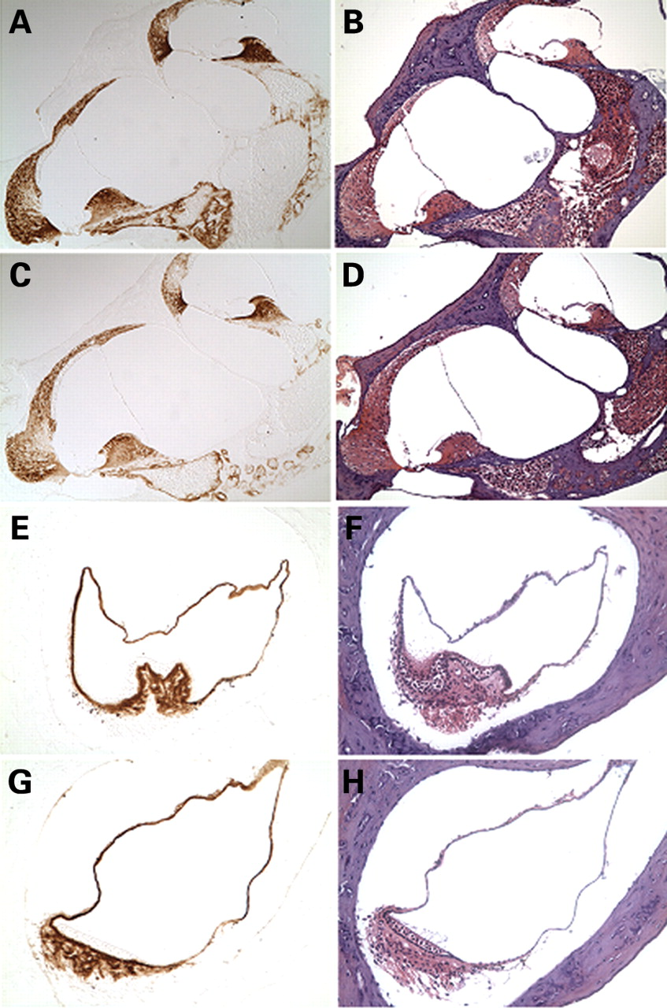
Figure 2. Immunohistochemistry on postnatal (3-month-old) Coch^{G88E/G88E} ( C, G ) and Coch^{+/+} ( ...
Notes:
Figure 2. Immunohistochemistry on postnatal (3-month-old) CochG88E/G88E ( C, G ) and Coch+/+ ( A, E ) mouse cochlea (A, C ×150) and crista of the posterior ampulla in the vestibular system (E, G ×200) with anti-cochlin. Immunostaining (in the left panels) appears as a reddish brown DAB reaction product; no counterstain was applied on these sections. Serial sections stained with H&E are shown in parallel in the right panels. The CochG88E/G88E mice contain only mutant Coch , therefore all immunostaining represents mutant cochlin, confirming successful translation of the mutant cochlin protein. The pattern of immunostaining in the CochG88E/G88E inner ear is similar to that of the Coch+/+ mice, as previously described ( 4 ). Prominent cochlin immunostaining is present in the fibrocytes and in the extracellular matrix throughout the spiral ligament [filled arrows in (A)] and spiral limbus [open arrow in (A)] and in the fibrocytes and stroma underlying the sensory epithelium in the crista [open arrow in (E)], as well as in the ampullary wall [filled arrow in (E)].
Unless provided in the caption above, the following copyright applies to the content of this slide: © The Author 2008. Published by Oxford University Press. All rights reserved. For Permissions, please email: journals.permissions@oxfordjournals.org

Slide 3
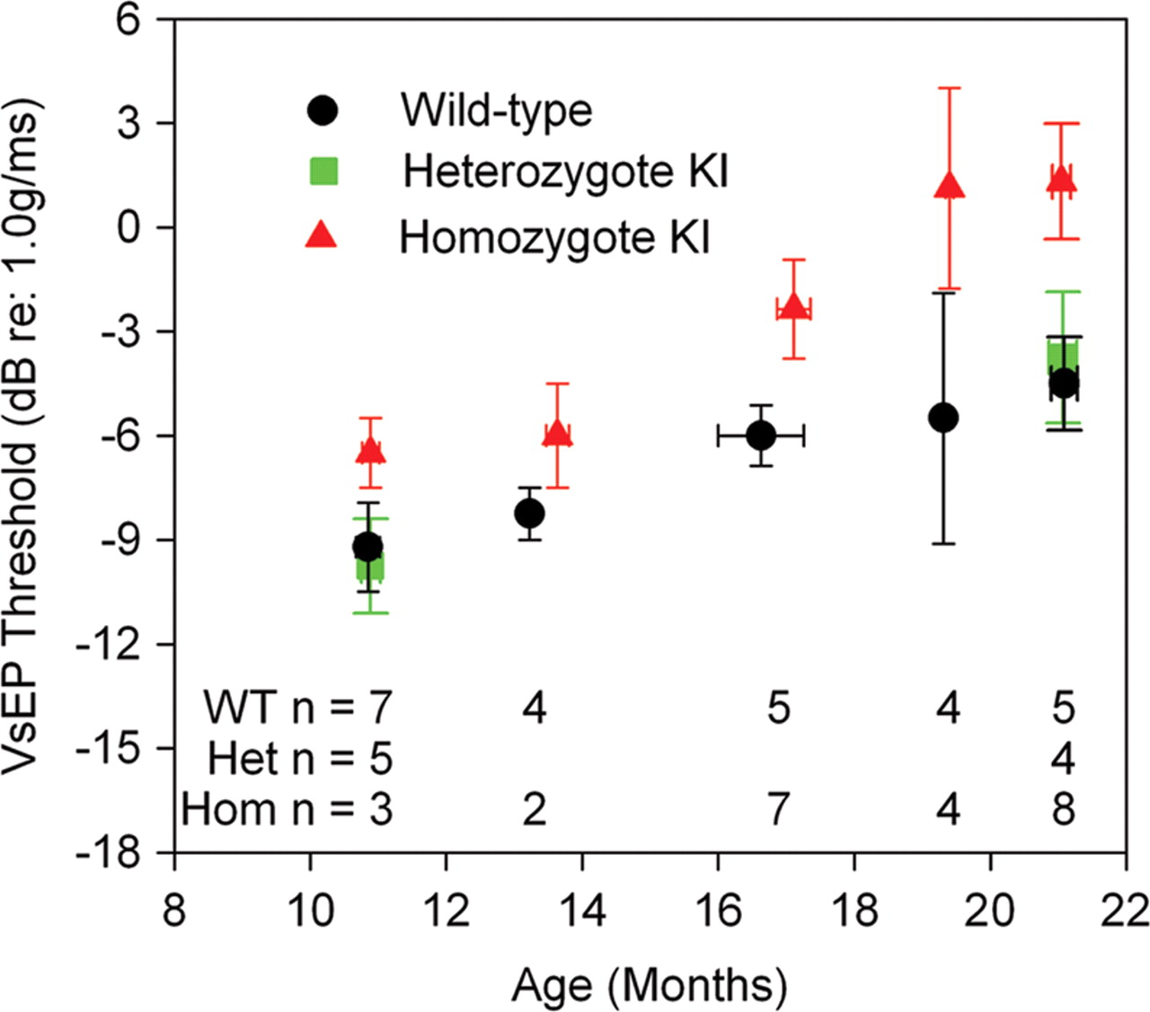
Figure 3. Means and standard errors for VsEP thresholds as a function of age. Coch^{+/+} and ...
Notes:
Figure 3. Means and standard errors for VsEP thresholds as a function of age. Coch+/+ and CochG88E/G88E mice are represented at all ages tested. CochG88E/+ mice were tested at the youngest and oldest ages. Although age-related decline in gravity receptor sensitivity can be seen for all genotypes, VsEP thresholds for CochG88E/G88E mice were significantly higher than for Coch+/+ mice at all ages tested, indicating poorer vestibular function for CochG88E/G88E mice. In fact, at 19 and 21 months of age, two of the CochG88E/G88E mice had no measurable VsEP.
Unless provided in the caption above, the following copyright applies to the content of this slide: © The Author 2008. Published by Oxford University Press. All rights reserved. For Permissions, please email: journals.permissions@oxfordjournals.org

Slide 4
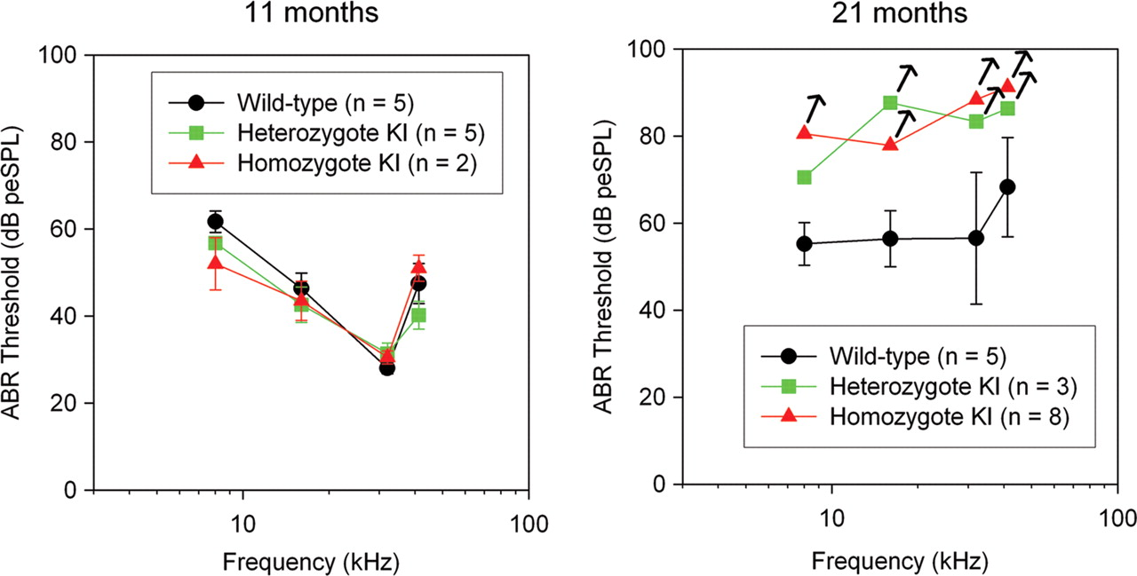
Figure 4. Means and standard errors for ABR thresholds at 8, 16, 32 and 41.2 kHz. Data for all genotypes at two ages ...
Notes:
Figure 4. Means and standard errors for ABR thresholds at 8, 16, 32 and 41.2 kHz. Data for all genotypes at two ages are shown. At 21 months, four of eight CochG88E/G88E mice had absent ABRs at all frequencies tested, and two of three CochG88E/+ mice had absent ABRs in three of four frequencies tested; therefore, symbols for these groups represent a conservative estimate of ‘average’ thresholds. Arrows denote that true thresholds may be higher than estimated. Overall, the data demonstrate an age-related decline in hearing among all genotypes, but the most substantial declines were seen in the CochG88E/G88E mice where half of the animals tested had profound hearing loss at all frequencies. CochG88E/+ mice also show decline in auditory function at a level similar to that of the CochG88E/G88E mice.
Unless provided in the caption above, the following copyright applies to the content of this slide: © The Author 2008. Published by Oxford University Press. All rights reserved. For Permissions, please email: journals.permissions@oxfordjournals.org

Slide 5
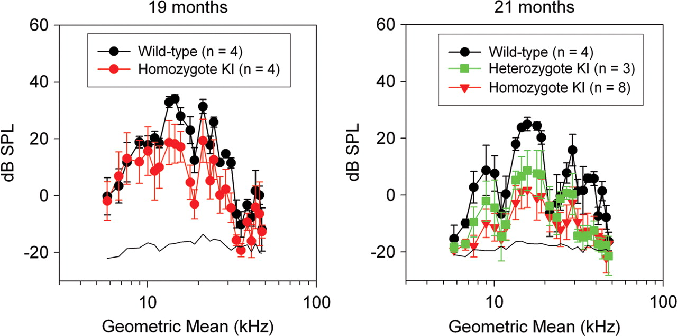
Figure 5. Average DPOAE amplitudes are shown at 19 and 21 months. Error bars represent standard errors. Primaries ...
Notes:
Figure 5. Average DPOAE amplitudes are shown at 19 and 21 months. Error bars represent standard errors. Primaries (f2/f1 = 1.25) from 5 to 55 kHz were presented at 65 dB SPL. At 19 months, DPOAEs were present for CochG88E/G88E and Coch+/+ mice although emissions for CochG88E/G88E mice were 10–15 dB smaller than those of the Coch+/+ mice. At 21 months, smaller DPOAE amplitudes were recorded for all genotypes suggesting age-related changes; however, emissions for the CochG88E/G88E mice decreased by up to 20 dB while Coch+/+ mice emissions dropped only by ∼10 dB. Emission amplitudes for CochG88E/G88E mice were substantially smaller than those of Coch+/+ mice at 21 months. Consistent with the ABR results, half of the CochG88E/G88E mice (i.e. those with absent ABRs) also had absent DPOAEs (i.e. DPOAE amplitudes indistinguishable from the noise floor).
Unless provided in the caption above, the following copyright applies to the content of this slide: © The Author 2008. Published by Oxford University Press. All rights reserved. For Permissions, please email: journals.permissions@oxfordjournals.org

Slide 6
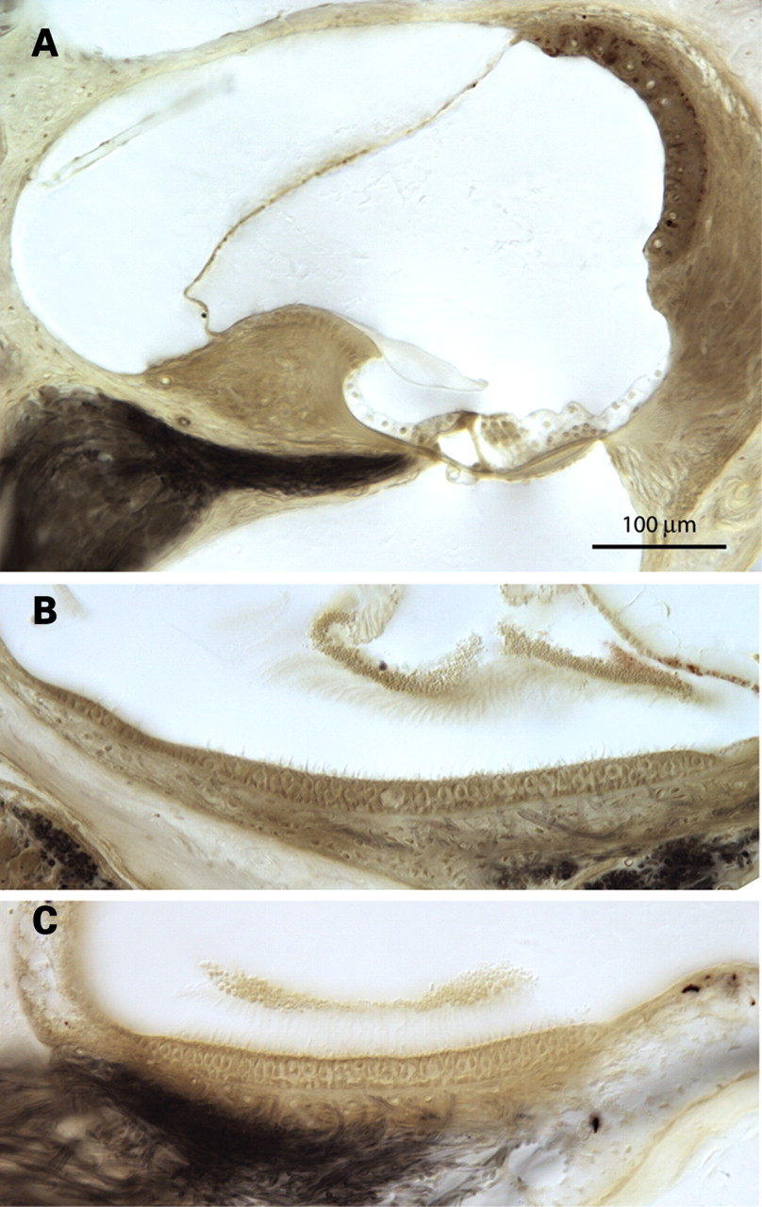
Figure 6. Photomicrograph of ( A ) the cochlear duct of a 26-month-old Coch^{G88E/G88E} mouse, and ( B ) the ...
Notes:
Figure 6. Photomicrograph of ( A ) the cochlear duct of a 26-month-old CochG88E/G88E mouse, and ( B ) the utricular macula and ( C ) saccular macula of a 21-month-old CochG88E/G88E mouse. Some loss of type IV fibrocytes in the cochlea in these mice is observed, but similar changes are present in the Coch+/+ mice (data not shown). There is no obvious deterioration of cochlear and vestibular sensory epithelia.
Unless provided in the caption above, the following copyright applies to the content of this slide: © The Author 2008. Published by Oxford University Press. All rights reserved. For Permissions, please email: journals.permissions@oxfordjournals.org

Slide 7
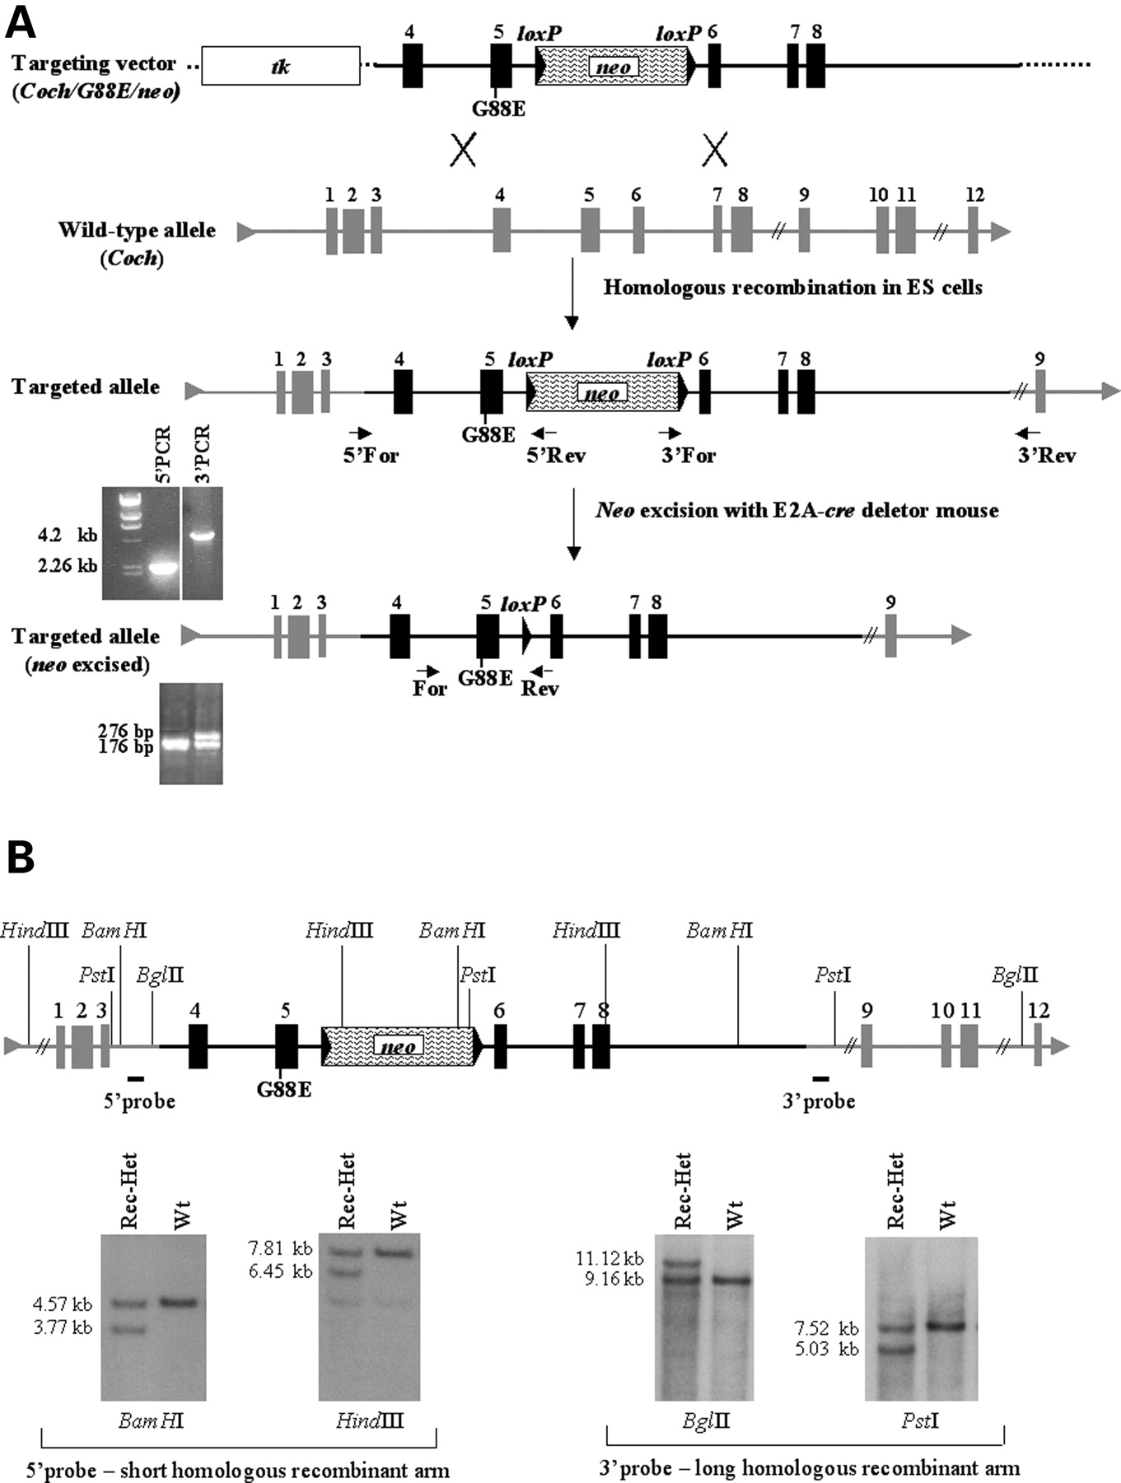
Figure 7. ( A ) Representation of the Coch targeting construct, homologous recombination with the wild-type allele ...
Notes:
Figure 7. ( A ) Representation of the Coch targeting construct, homologous recombination with the wild-type allele (targeted locus), screening strategy for recombinants by PCR analysis, and removal of the neo cassette in the targeted allele, followed by PCR analysis to identify recombinants with neo excised. ( B ) Screening strategy for homologous recombinants by Southern blot analysis.
Unless provided in the caption above, the following copyright applies to the content of this slide: © The Author 2008. Published by Oxford University Press. All rights reserved. For Permissions, please email: journals.permissions@oxfordjournals.org

