Slide 1
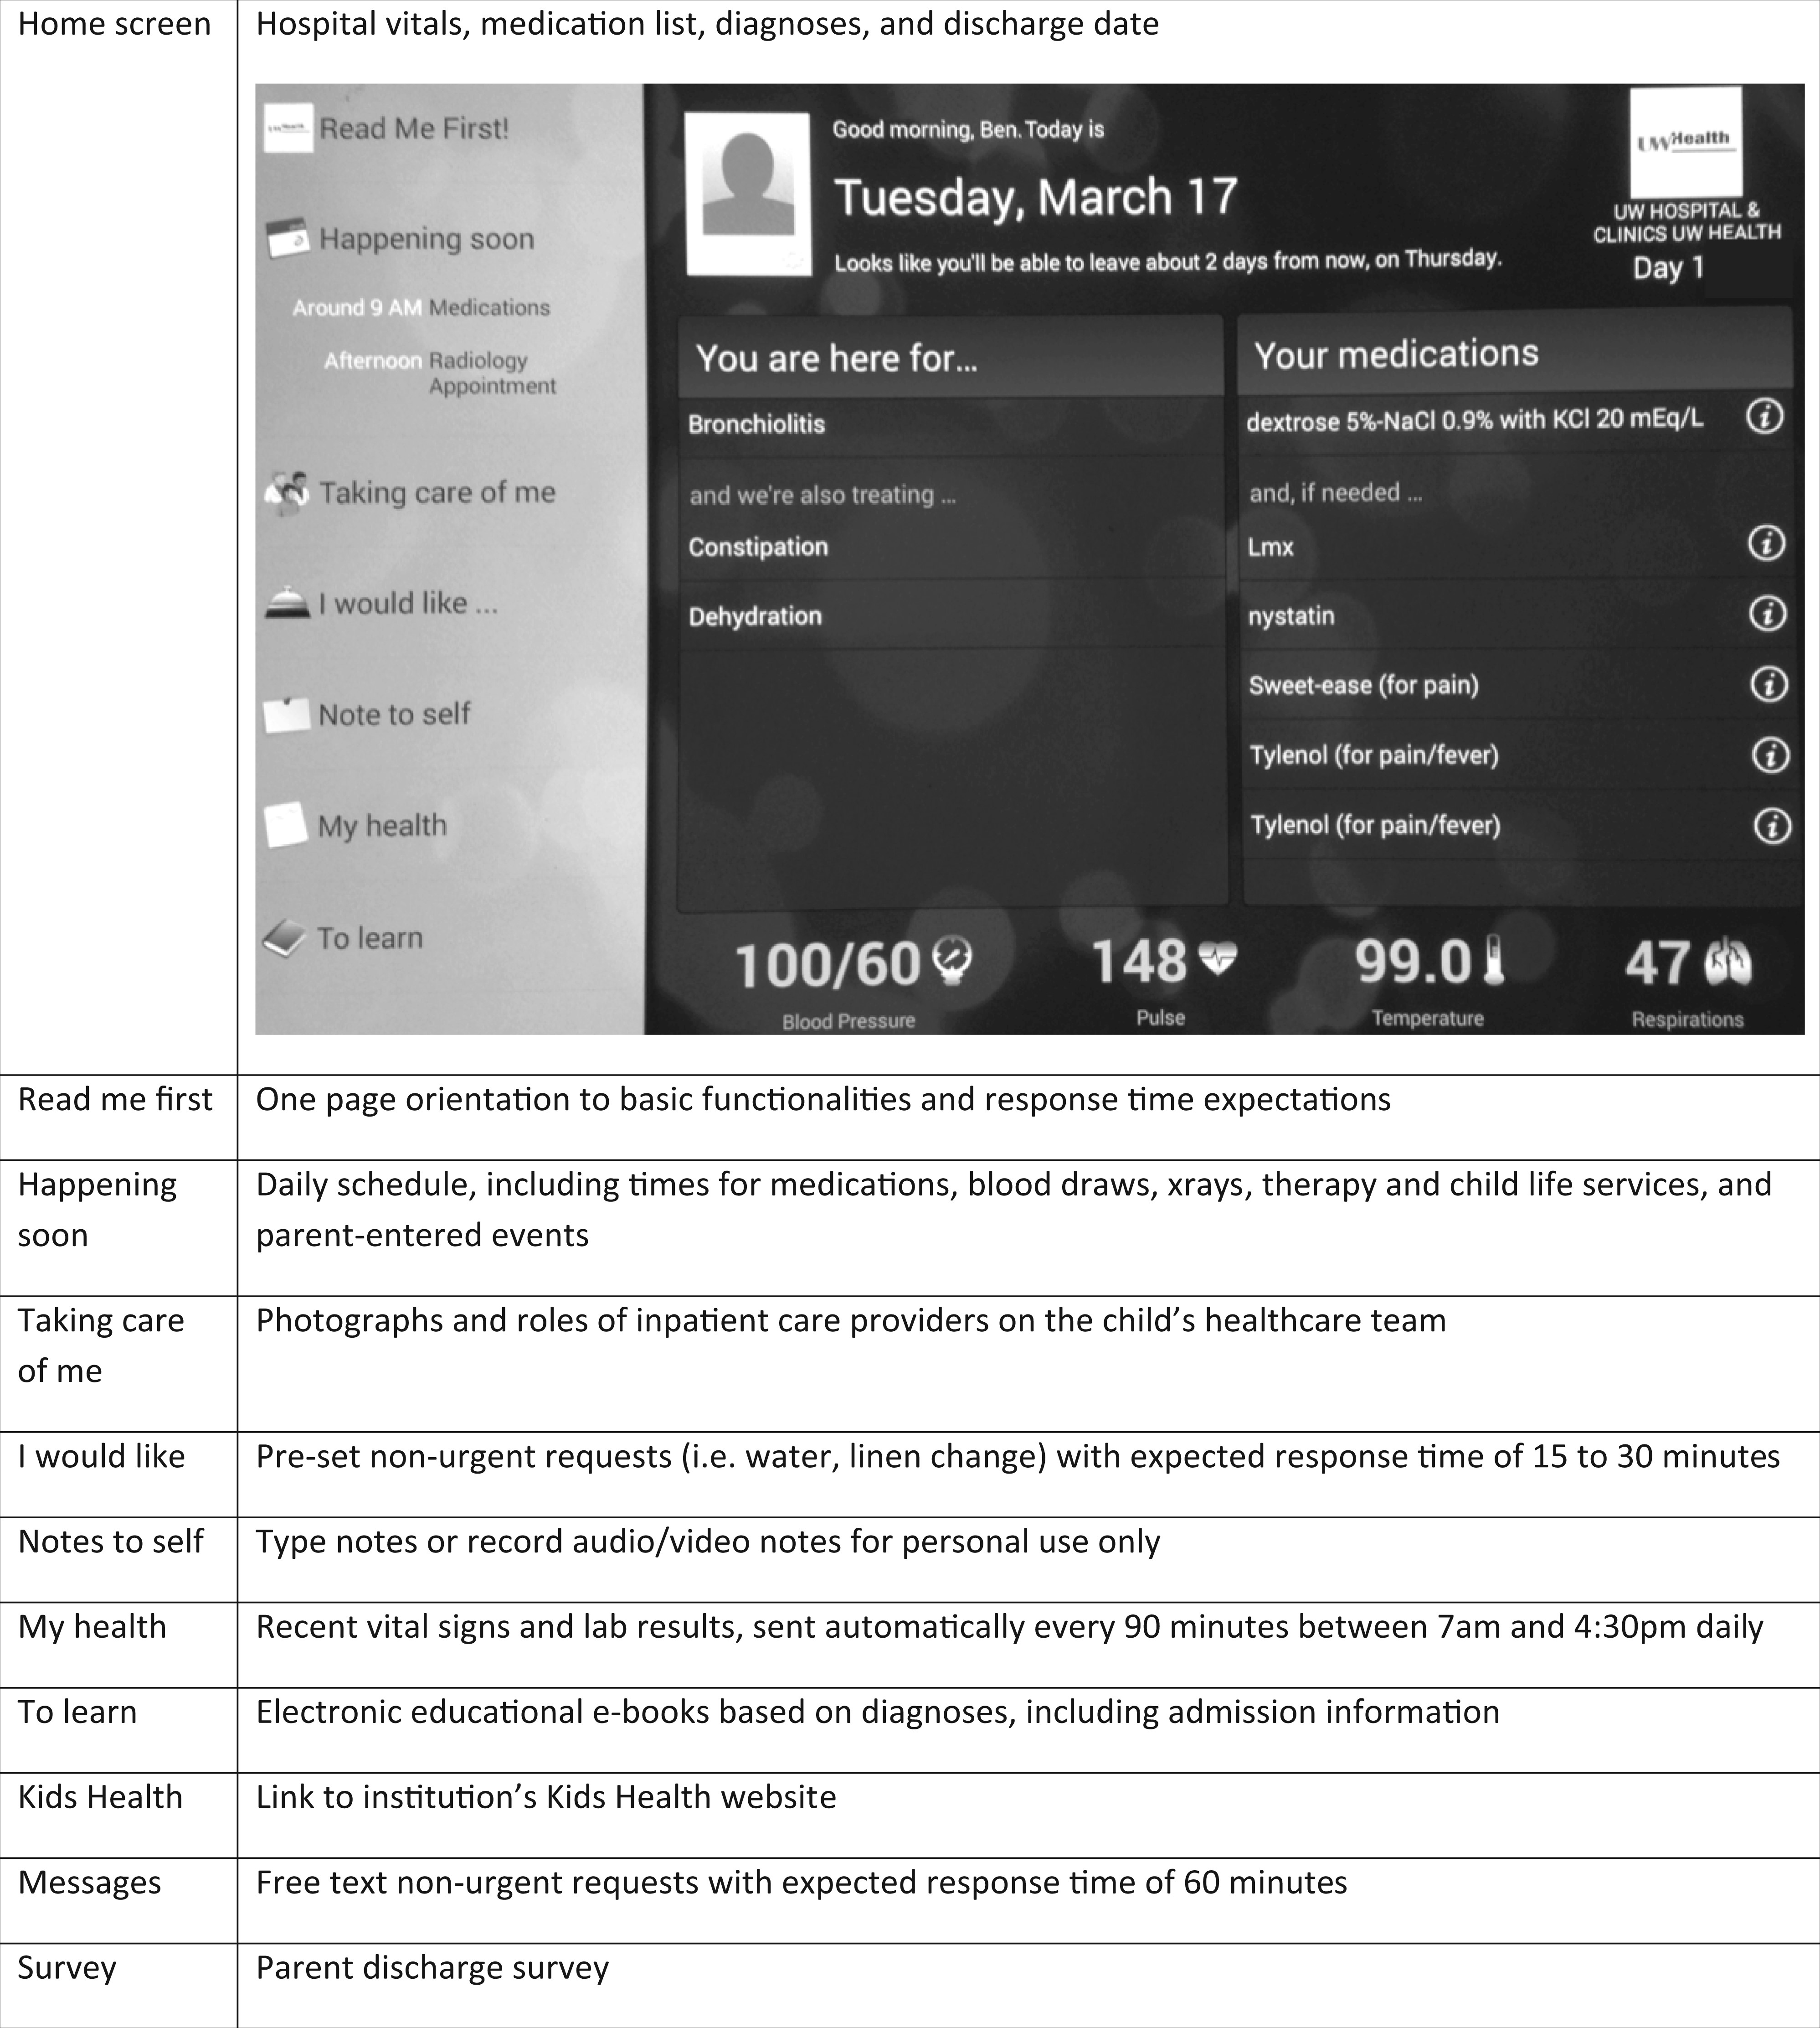
Figure 1. Home screen of the inpatient portal and descriptions of portal functionalities, with italicized text ...
Notes:
Figure 1. Home screen of the inpatient portal and descriptions of portal functionalities, with italicized text representing institutional-specific modifications (MyChart Bedside, screenshot, © 2016 Epic Systems Corp. Used with permission.)
Unless provided in the caption above, the following copyright applies to the content of this slide: © The Author 2016. Published by Oxford University Press on behalf of the American Medical Informatics Association. All rights reserved. For Permissions, please email: journals.permissions@oup.com

Slide 2
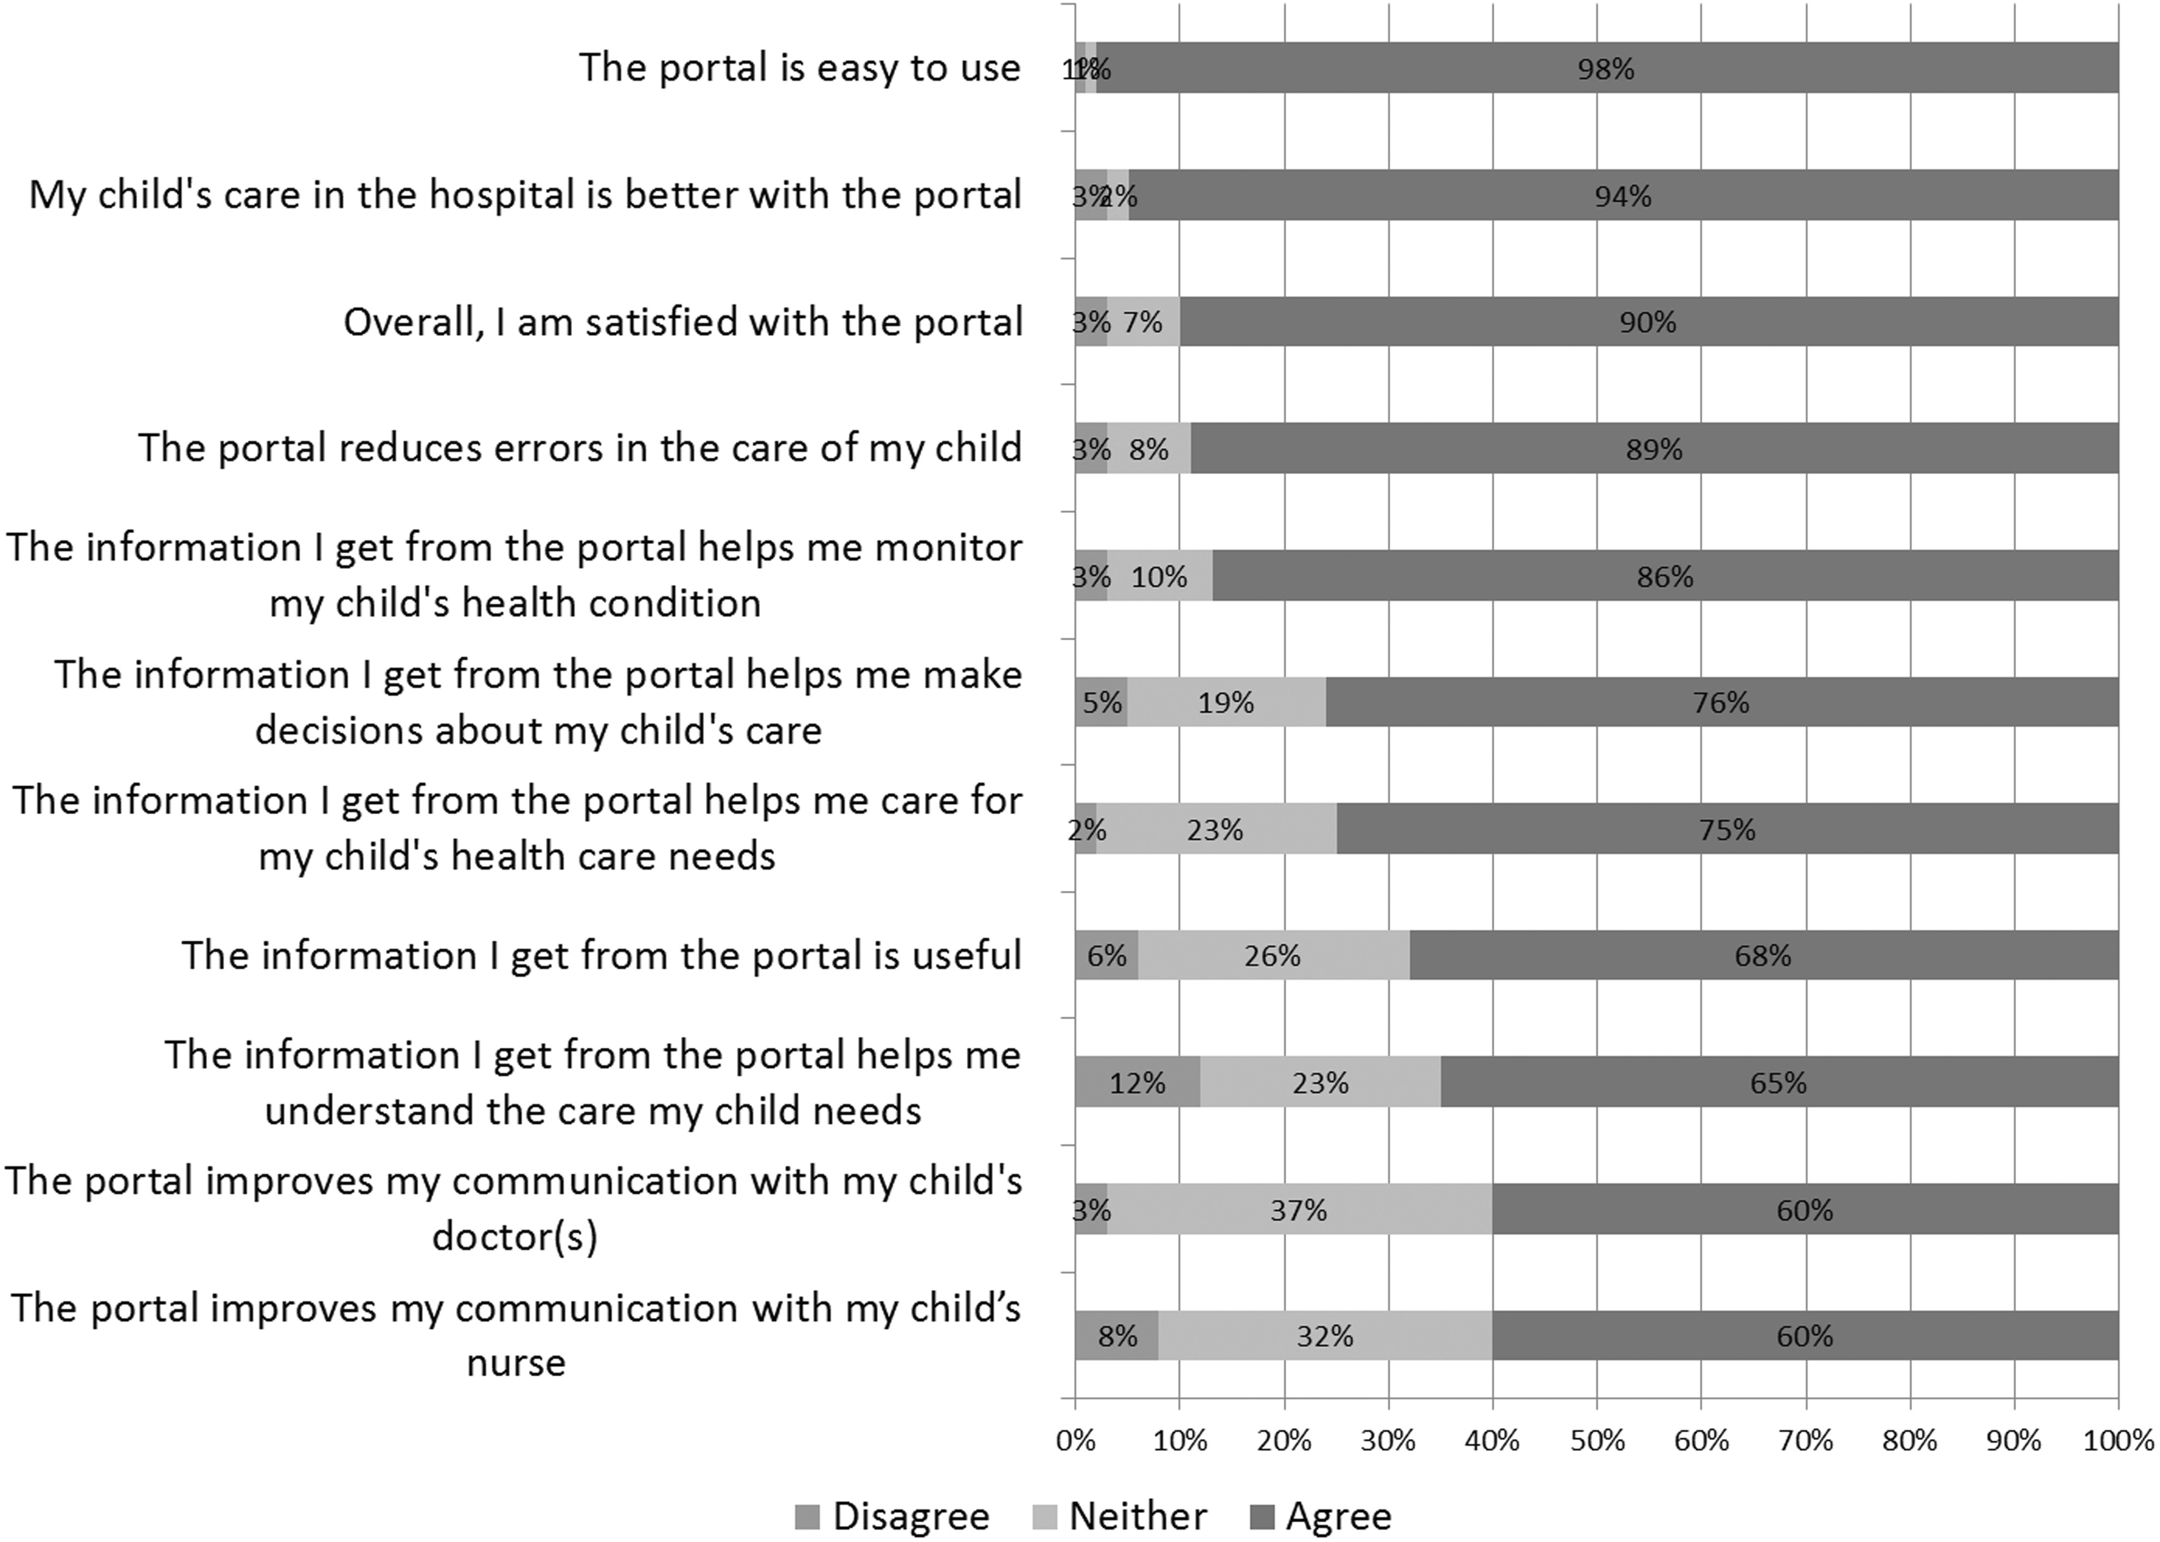
Figure 2. Parent perceptions of the inpatient portal, n = 87
Notes:
Figure 2. Parent perceptions of the inpatient portal, n = 87
Unless provided in the caption above, the following copyright applies to the content of this slide: © The Author 2016. Published by Oxford University Press on behalf of the American Medical Informatics Association. All rights reserved. For Permissions, please email: journals.permissions@oup.com

