Slide 1
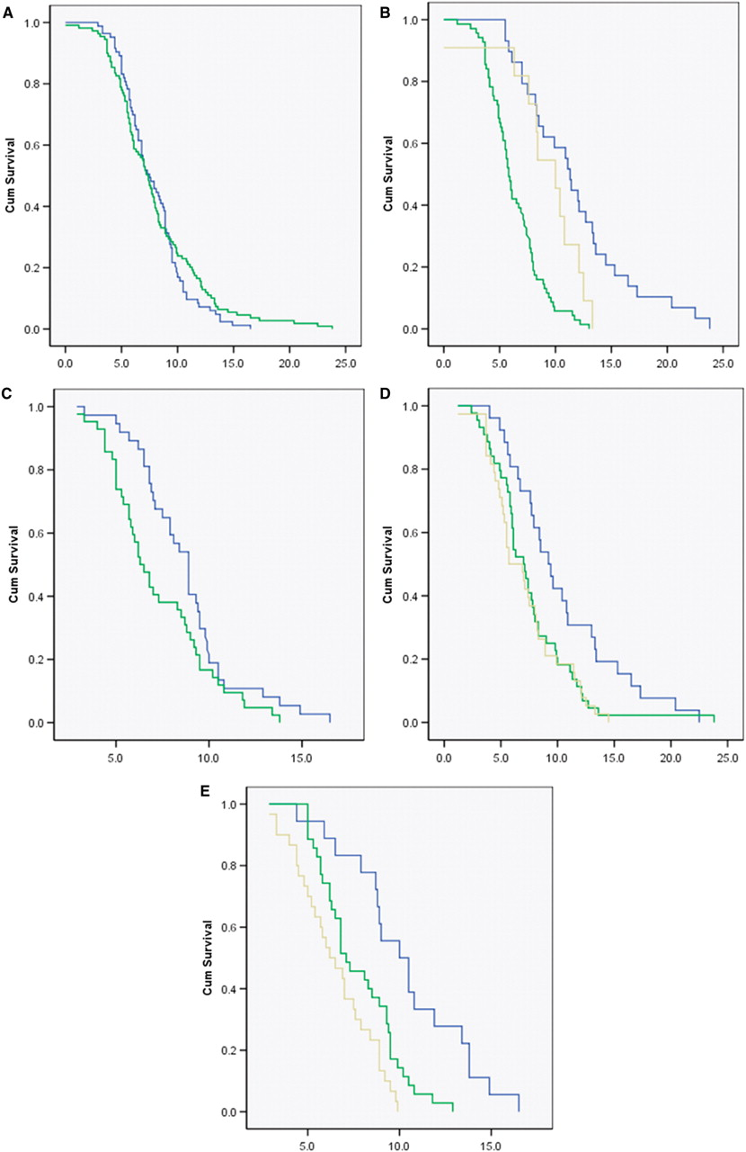
Fig. 1 Kaplan-Meier survival curves from symptom onset according to clinical subtypes. (A) Interval from disease ...
Notes:
Fig. 1 Kaplan-Meier survival curves from symptom onset according to clinical subtypes. (A) Interval from disease onset to death in PSP and MSA (years). Log Rank (Mantel-Cox) df = 1, P = 0.5. PSP, green doted line; MSA, blue dotted line. (B) Interval from disease onset to death in PSP subtypes (years). Log Rank (Mantel-Cox), df = 2, P = 0.000. RS, green doted line; PSP-P, blue dotted line; Unclassified, Yellow dotted line. (C) Interval from disease onset to death in MSA subtype (years). Log Rank (Mantel-Cox), df = 1, P = 0.037. Early autonomic dysfunction, green dotted line; No early autonomic dysfunction, blue dotted line. (D) Interval from disease onset to death in PSP subtype (years) according to the age of symptom onset. Log Rank (Mantel-Cox), df = 2, P = 0.011 70-years-old, yellow dotted line. (E) Interval from disease onset to death in MSA subtype (years) according to the age of symptom onset. Log Rank (Mantel-Cox), df = 2, P = 0.000. Less than 50-years-old, blue dotted line; 50- to 59.9-years-old, green dotted line; >60-years-old, yellow dotted line.
Unless provided in the caption above, the following copyright applies to the content of this slide: © The Author (2008). Published by Oxford University Press on behalf of the Guarantors of Brain. All rights reserved. For Permissions, please email: journals.permissions@oxfordjournals.org

Slide 2
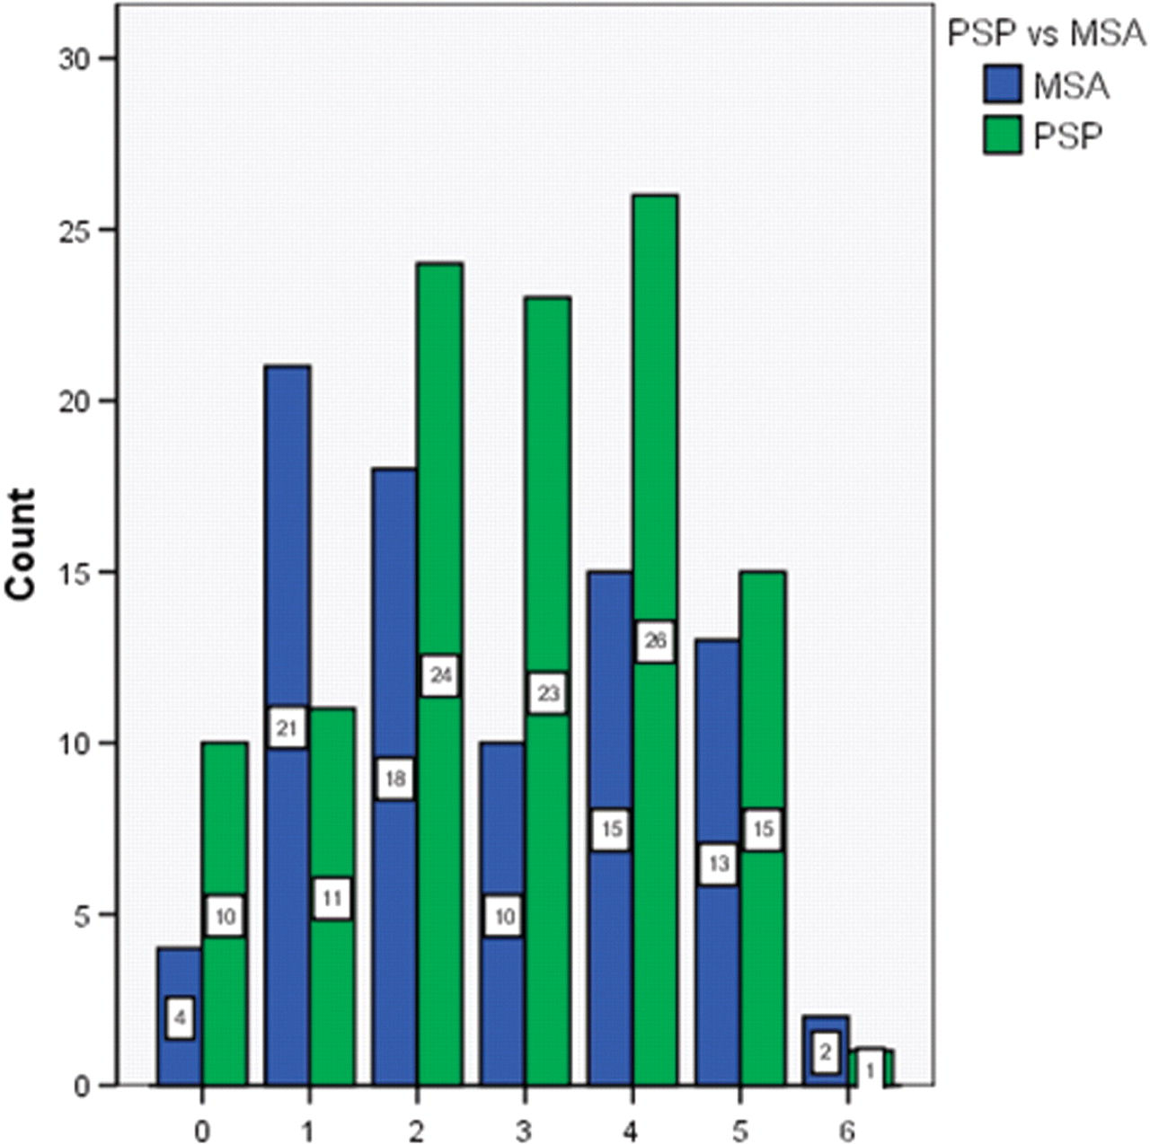
Fig. 2 Number of clinical milestones per patient prior to death according to diagnosis.
Notes:
Fig. 2 Number of clinical milestones per patient prior to death according to diagnosis.
Unless provided in the caption above, the following copyright applies to the content of this slide: © The Author (2008). Published by Oxford University Press on behalf of the Guarantors of Brain. All rights reserved. For Permissions, please email: journals.permissions@oxfordjournals.org

Slide 3
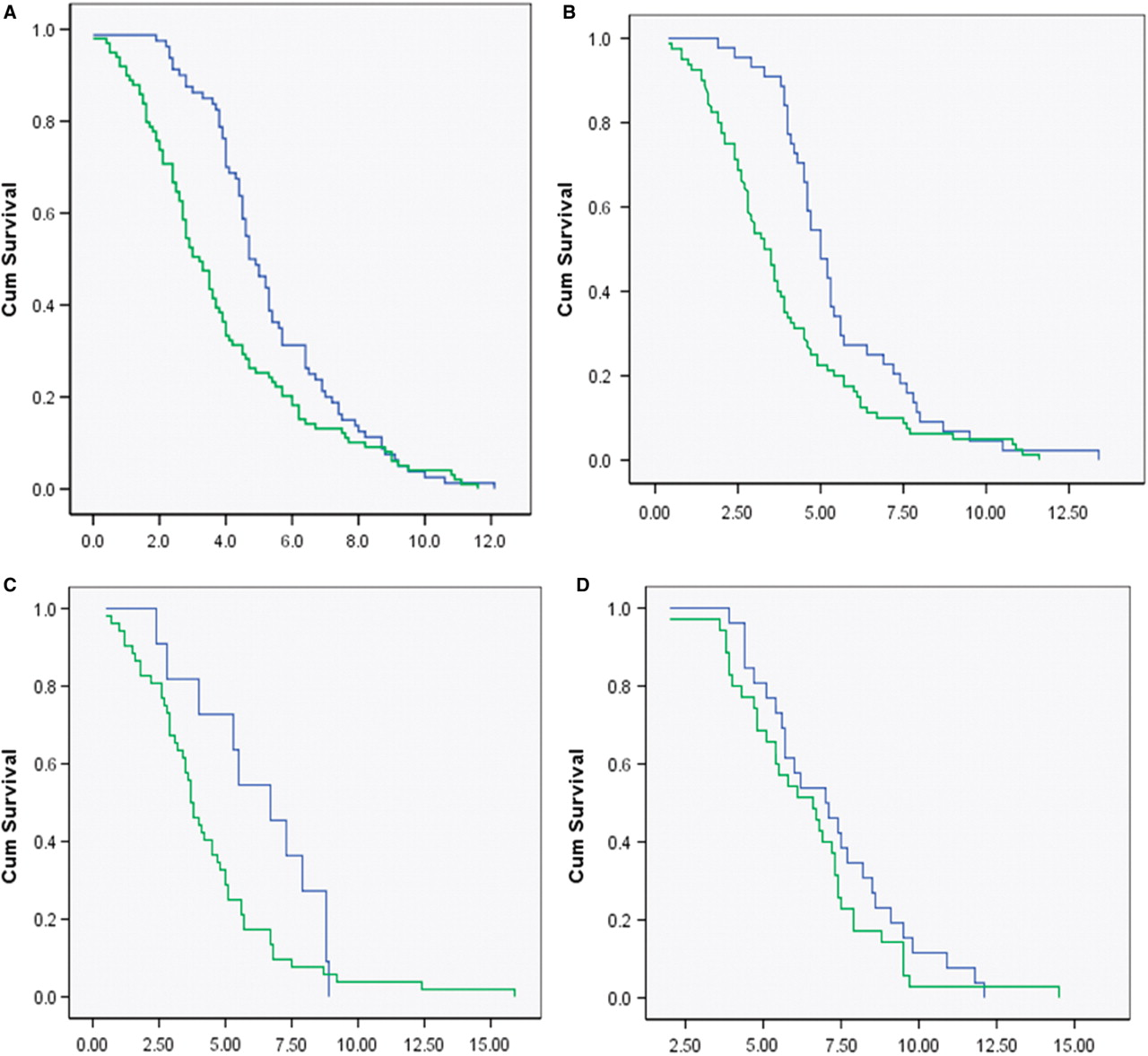
Fig. 3 Comparison between PSP and MSA of interval from disease onset to reaching clinical milestones. (A) Interval ...
Notes:
Fig. 3 Comparison between PSP and MSA of interval from disease onset to reaching clinical milestones. (A) Interval in years from disease onset to the first clinical milestone reached. Log Rank (Mantel-Cox), df = 1, P = 0.004. PSP, green dotted line; MSA, blue dotted line. (B) Interval in years from disease onset to developing frequent falls. Log Rank (Mantel-Cox), df = 1, P = 0.003. PSP, green dotted line, MSA, blue dotted line. (C) Interval in years from disease onset to developing significant cognitive impairment. Log Rank (Mantel-Cox), df = 1, P = 0.07. PSP, green dotted line MSA, blue dotted line. (D) Interval in years from disease onset to developing significant dysphagia. Log Rank (Mantel-Cox), df = 1, P = 0.29. PSP, green dotted line; MSA, blue dotted line. (E) Interval in years from disease onset to developing wheelchair dependence. Log Rank (Mantel-Cox), df = 1, P = 0.95. PSP, green dotted line; MSA, blue dotted line. (F) Interval in years from disease onset to developing unintelligible speech. Log Rank (Mantel-Cox), df = 1, P = 0.28. PSP, green dotted line; MSA, blue dotted line. (G) Interval in years from disease onset to requiring urinary catheterization. Log Rank (Mantel-Cox), df = 1, P = 0.79. PSP, green dotted line; MSA, blue dotted line. (H) Interval in years from disease onset to requiring residential care. Log Rank (Mantel-Cox), df = 1, P = 0.23. PSP, green dotted line, MSA, blue dotted line.
Unless provided in the caption above, the following copyright applies to the content of this slide: © The Author (2008). Published by Oxford University Press on behalf of the Guarantors of Brain. All rights reserved. For Permissions, please email: journals.permissions@oxfordjournals.org

Slide 4
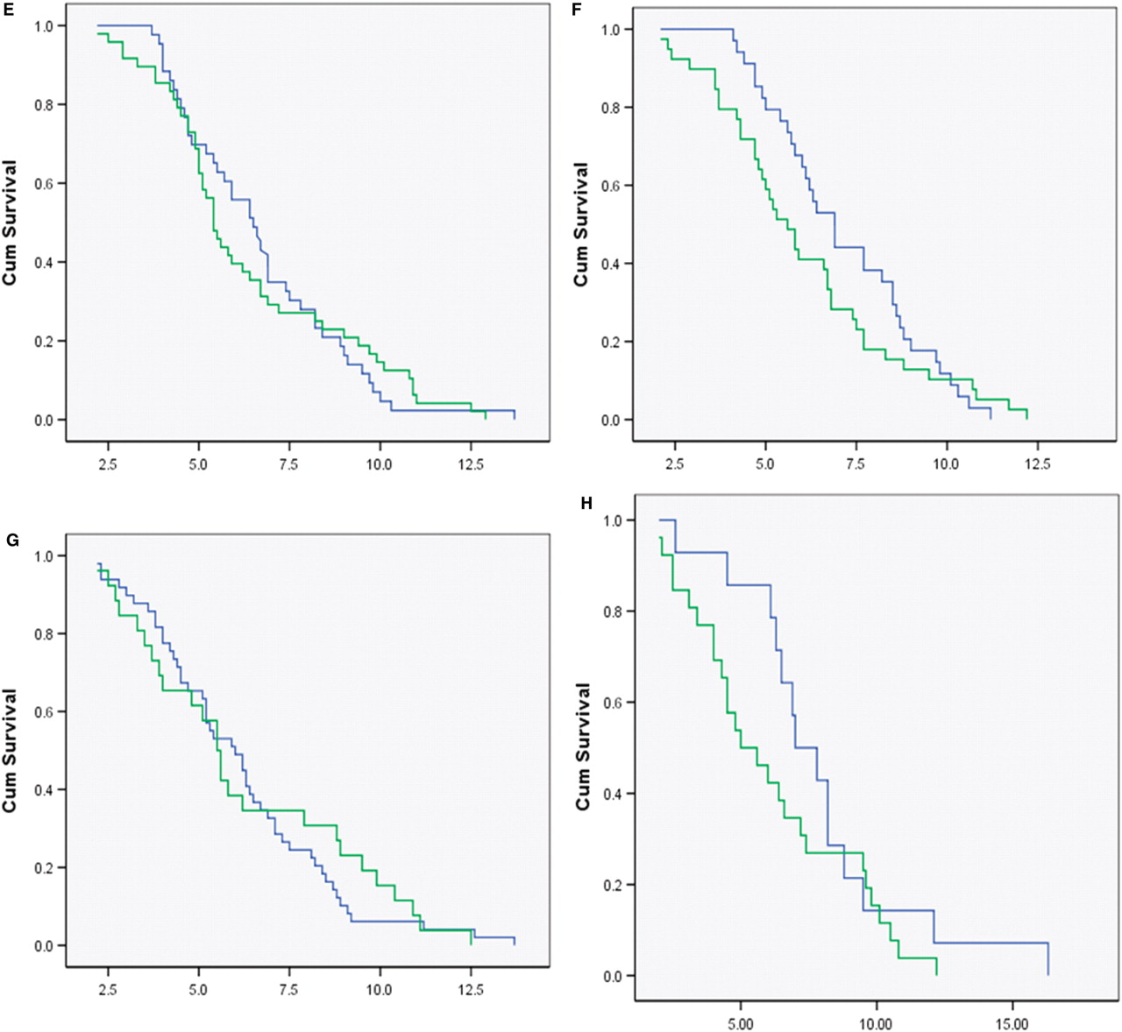
Fig. 3 Comparison between PSP and MSA of interval from disease onset to reaching clinical milestones. (A) Interval ...
Notes:
Fig. 3 Comparison between PSP and MSA of interval from disease onset to reaching clinical milestones. (A) Interval in years from disease onset to the first clinical milestone reached. Log Rank (Mantel-Cox), df = 1, P = 0.004. PSP, green dotted line; MSA, blue dotted line. (B) Interval in years from disease onset to developing frequent falls. Log Rank (Mantel-Cox), df = 1, P = 0.003. PSP, green dotted line, MSA, blue dotted line. (C) Interval in years from disease onset to developing significant cognitive impairment. Log Rank (Mantel-Cox), df = 1, P = 0.07. PSP, green dotted line MSA, blue dotted line. (D) Interval in years from disease onset to developing significant dysphagia. Log Rank (Mantel-Cox), df = 1, P = 0.29. PSP, green dotted line; MSA, blue dotted line. (E) Interval in years from disease onset to developing wheelchair dependence. Log Rank (Mantel-Cox), df = 1, P = 0.95. PSP, green dotted line; MSA, blue dotted line. (F) Interval in years from disease onset to developing unintelligible speech. Log Rank (Mantel-Cox), df = 1, P = 0.28. PSP, green dotted line; MSA, blue dotted line. (G) Interval in years from disease onset to requiring urinary catheterization. Log Rank (Mantel-Cox), df = 1, P = 0.79. PSP, green dotted line; MSA, blue dotted line. (H) Interval in years from disease onset to requiring residential care. Log Rank (Mantel-Cox), df = 1, P = 0.23. PSP, green dotted line, MSA, blue dotted line.
Unless provided in the caption above, the following copyright applies to the content of this slide: © The Author (2008). Published by Oxford University Press on behalf of the Guarantors of Brain. All rights reserved. For Permissions, please email: journals.permissions@oxfordjournals.org

Slide 5
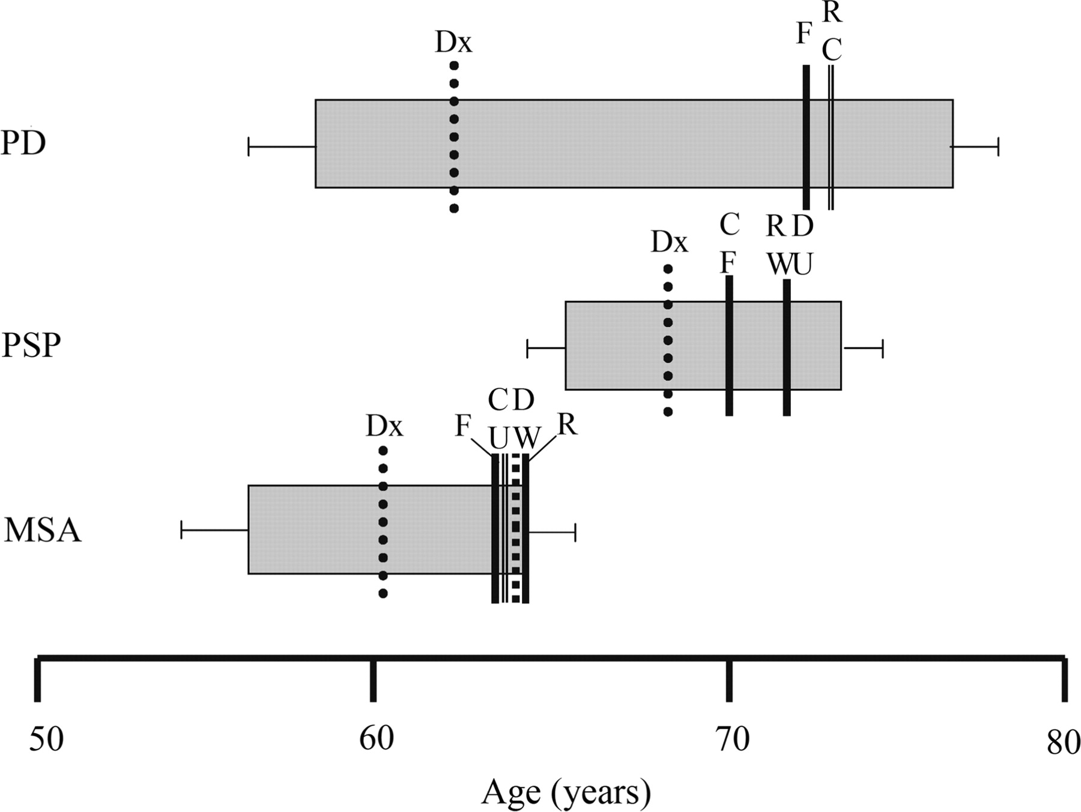
Fig. 4 Milestones of disease advancement and total disease course. The grey rectangles represent disease duration, ...
Notes:
Fig. 4 Milestones of disease advancement and total disease course. The grey rectangles represent disease duration, commencing with the time point of first symptoms. The vertical lines denote time of clinical diagnosis of a parkinsonian or cerebellar syndrome (Dx) and time of documentation of milestones of disease advancement (Residential care, R; Cognitive disability, C; Dysarthria/dysphagia, D; Frequent falls, F; Wheelchair dependant, W; Urinary catheter, U). Error bars for standard error of the mean.
Unless provided in the caption above, the following copyright applies to the content of this slide: © The Author (2008). Published by Oxford University Press on behalf of the Guarantors of Brain. All rights reserved. For Permissions, please email: journals.permissions@oxfordjournals.org

