Slide 1
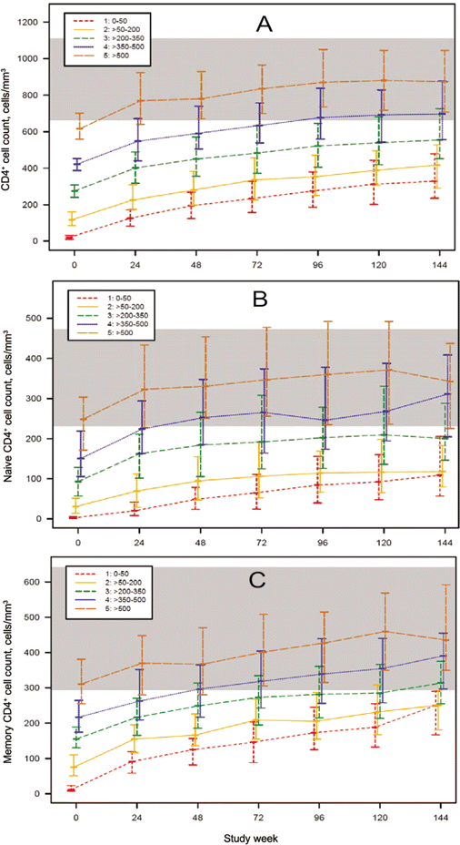
Figure 1 Median (interquartile range) CD4⁺ cell counts (A), CD4⁺ naive cell counts (B), and ...
Notes:
Figure 1 Median (interquartile range) CD4+ cell counts (A), CD4+ naive cell counts (B), and CD4+ memory cell counts (C) by baseline CD4+ stratum and study week for patients who underwent comprehensive immunological assessments by advanced flow cytometry. The shaded band reflects the lowest and highest interquartiles of the 2 age groups of HIV-negative control subjects (from AIDS Clinical Trials Group protocol A5113) [33].
Unless provided in the caption above, the following copyright applies to the content of this slide: © 2009 by the Infectious Diseases Society of America

Slide 2
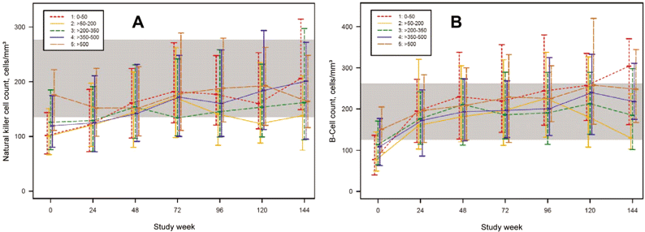
Figure 5 Median (interquartile range) for natural killer cell (CD3/CD56+ and CD16+) counts (A) and B cell (CD3/CD19+) ...
Notes:
Figure 5 Median (interquartile range) for natural killer cell (CD3/CD56+ and CD16+) counts (A) and B cell (CD3/CD19+) counts (B) by baseline CD4+ stratum over time for patients who underwent comprehensive immunological assessments by advanced flow cytometry. The shaded area reflects the lowest and highest interquartiles of the 2 age groups of HIV-negative control subjects (from AIDS Clinical Trials Group protocol A5113) [33].
Unless provided in the caption above, the following copyright applies to the content of this slide: © 2009 by the Infectious Diseases Society of America

Slide 3
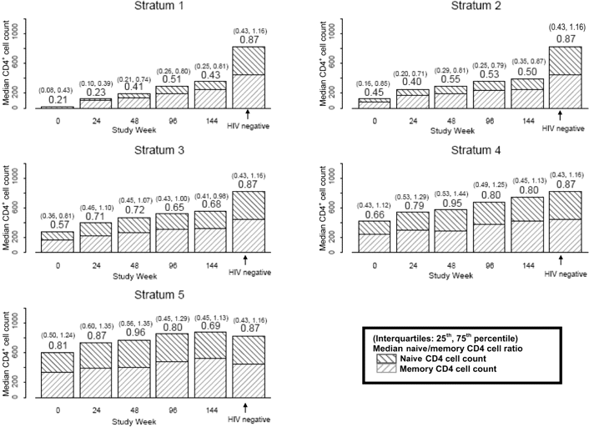
Figure 6 Median (interquartile range) CD4⁺ naive-memory cell ratios by baseline CD4⁺ stratum and ...
Notes:
Figure 6 Median (interquartile range) CD4+ naive-memory cell ratios by baseline CD4+ stratum and study week for patients who underwent comprehensive immunological assessments by advanced flow cytometry and HIV-negative control subjects (from AIDS Clinical Trials Group [ACTG] protocol A5113) [33]. The y-axis reflects the absolute count for both CD4+ naive and memory cells. CD4+ naive-memory cell ratios are shown above the bars at each time point, and the interquartile ranges are shown above, in parentheses. Results for HIV-negative control subjects from ACTG protocol A5113 are shown to the right of the week 144 bars, for comparison. After controlling for baseline HIV RNA level, the CD4+ naive-memory cell ratio for stratum 1 was significantly different from stratum 3 (weeks 0 and 24), stratum 4 (weeks 0, 24, 48, and 96), and stratum 5 (weeks 0, 24, and 48), and the stratum 2 CD4+ naive-memory ratio was significantly different from stratum 4 (weeks 24 and 96) and stratum 5 (weeks 0, 24, and 48).
Unless provided in the caption above, the following copyright applies to the content of this slide: © 2009 by the Infectious Diseases Society of America

Slide 4
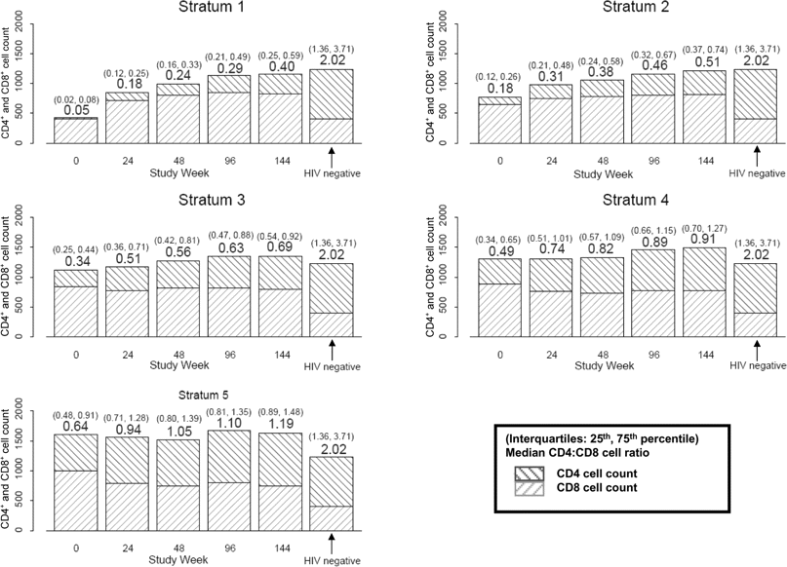
Figure 7 Median (interquartile range) CD4⁺ :CD8⁺ cell ratios by baseline CD4⁺ stratum ...
Notes:
Figure 7 Median (interquartile range) CD4+ :CD8+ cell ratios by baseline CD4+ stratum over time for patients who underwent comprehensive immunological assessments by advanced flow cytometry and for HIV-negative control subjects (from AIDS Clinical Trials Group [ACTG] protocol A5113) [33]. The y-axis reflects the absolute count for both CD4+ and CD8+ cells. Median CD4+ :CD8+ cell ratios are shown above the box plot at each time point, and interquartile ranges are above in parentheses. Results for HIV-negative control subjects from ACTG protocol A5113 are shown to the right of the week 144 bars, for comparison.
Unless provided in the caption above, the following copyright applies to the content of this slide: © 2009 by the Infectious Diseases Society of America

Slide 5
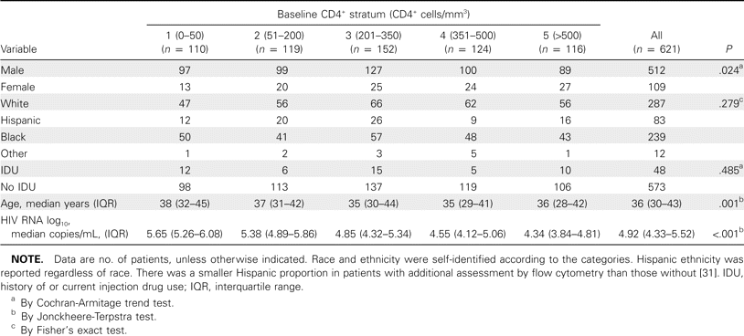
Table 1 Baseline characteristics of patients with additional flow cytometry assessment, by baseline CD4⁺ ...
Notes:
Table 1 Baseline characteristics of patients with additional flow cytometry assessment, by baseline CD4+ stratum.
Unless provided in the caption above, the following copyright applies to the content of this slide: © 2009 by the Infectious Diseases Society of America

Slide 6
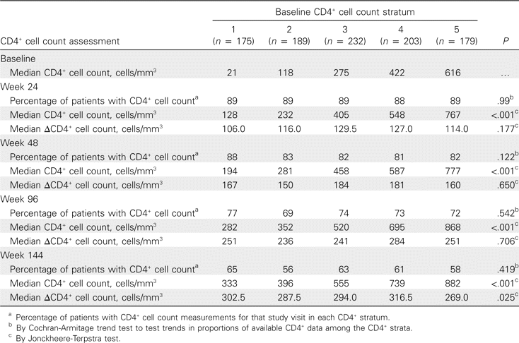
Table 2 Median CD4⁺ and DCD4⁺ cell counts by baseline CD4⁺ stratum and study week.
Notes:
Table 2 Median CD4+ and DCD4+ cell counts by baseline CD4+ stratum and study week.
Unless provided in the caption above, the following copyright applies to the content of this slide: © 2009 by the Infectious Diseases Society of America

Slide 7
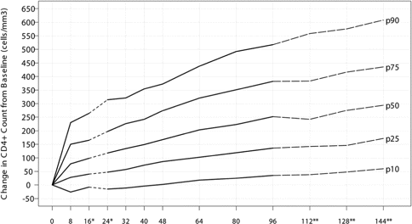
Figure 8 Change in CD4⁺ cell count from baseline in percentiles (10th, 25th, 50th, 75th, and 90th) for all ...
Notes:
Figure 8 Change in CD4+ cell count from baseline in percentiles (10th, 25th, 50th, 75th, and 90th) for all AIDS Clinical Trials Group (ACTG) protocol 384 patients (). np978 This plot is based on HIV-positive antiretroviral therapy-naive patients after initiating HAART in ACTG protocol 384 with a median (interquartile range) baseline CD4+ cell count of 279 (98-444) cells/mm3. *At weeks 16 and 24, the ΔCD4+ cell count was positively associated with the baseline CD4+ cell count. The median ΔCD4+ cell count was µ47 and 39 cells greater for patients with a baseline CD4+ cell count of >500 cells/mm3 versus ⩽50 cells/mm3 at weeks 16 and 24, respectively. **There might be a lack of precision after week 96 because of dropouts and limited follow-up in ACTG protocol 384.
Unless provided in the caption above, the following copyright applies to the content of this slide: © 2009 by the Infectious Diseases Society of America

Slide 8
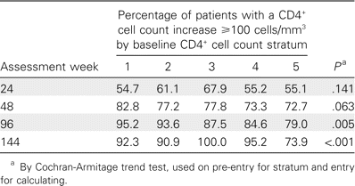
Table 3 Percentage of patients with a CD4⁺ cell count increase ⩾100 cells/mm³ by baseline ...
Notes:
Table 3 Percentage of patients with a CD4+ cell count increase ⩾100 cells/mm3 by baseline CD4+ stratum and study week.
Unless provided in the caption above, the following copyright applies to the content of this slide: © 2009 by the Infectious Diseases Society of America

Slide 9
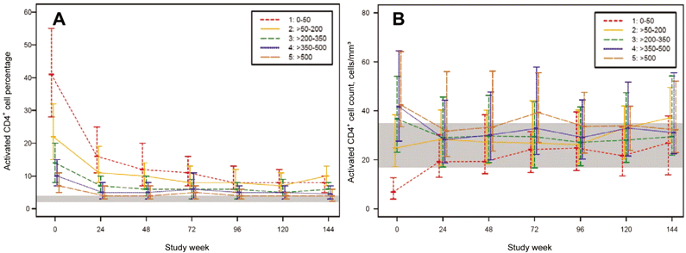
Figure 2 Median (interquartile range) activated CD4⁺ cell counts (CD4⁺/CD38+/HLA-DR+) for ...
Notes:
Figure 2 Median (interquartile range) activated CD4+ cell counts (CD4+/CD38+/HLA-DR+) for patients who underwent comprehensive immunological assessments by advanced flow cytometry. Percentages (A) and absolute counts (B) by baseline CD4+ stratum over time are shown. The shaded area reflects the lowest and highest interquartiles of the 2 age groups of HIV-negative control subjects (from AIDS Clinical Trials Group protocol A5113) [33].
Unless provided in the caption above, the following copyright applies to the content of this slide: © 2009 by the Infectious Diseases Society of America

Slide 10
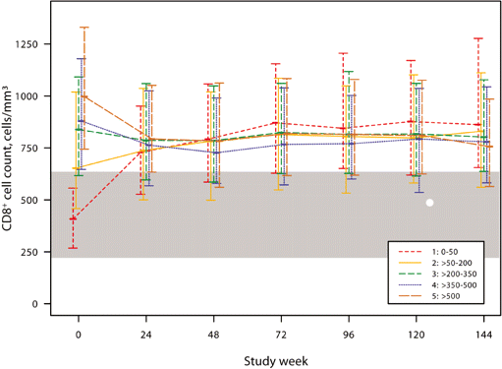
Figure 3 Median (interquartile range) CD8⁺ cell counts by baseline CD4⁺ stratum over time for ...
Notes:
Figure 3 Median (interquartile range) CD8+ cell counts by baseline CD4+ stratum over time for patients who underwent comprehensive immunological assessments by advanced flow cytometry. The shaded area reflects the lowest and highest interquartiles of the 2 age groups of HIV-negative control subjects (from AIDS Clinical Trials Group protocol A5113) [33].
Unless provided in the caption above, the following copyright applies to the content of this slide: © 2009 by the Infectious Diseases Society of America

Slide 11
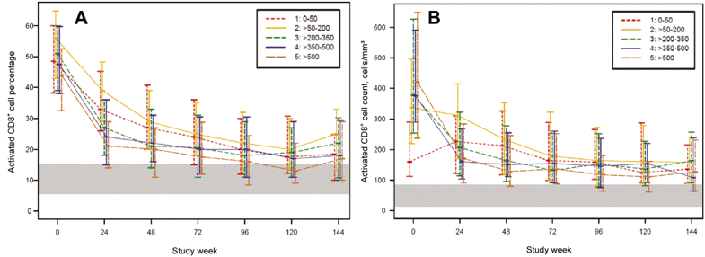
Figure 4 Median (interquartile range) activated CD8⁺ cell counts (CD8⁺/CD38+/HLA-DR+) ...
Notes:
Figure 4 Median (interquartile range) activated CD8+ cell counts (CD8+/CD38+/HLA-DR+) percentages (A) and absolute counts (B) by baseline CD4+ stratum over time for patients who underwent comprehensive immunological assessments by advanced flow cytometry. The shaded area reflects the lowest and highest interquartiles of the 2 age groups of HIV-negative control subjects (from AIDS Clinical Trials Group protocol A5113) [33].
Unless provided in the caption above, the following copyright applies to the content of this slide: © 2009 by the Infectious Diseases Society of America

