Slide 1
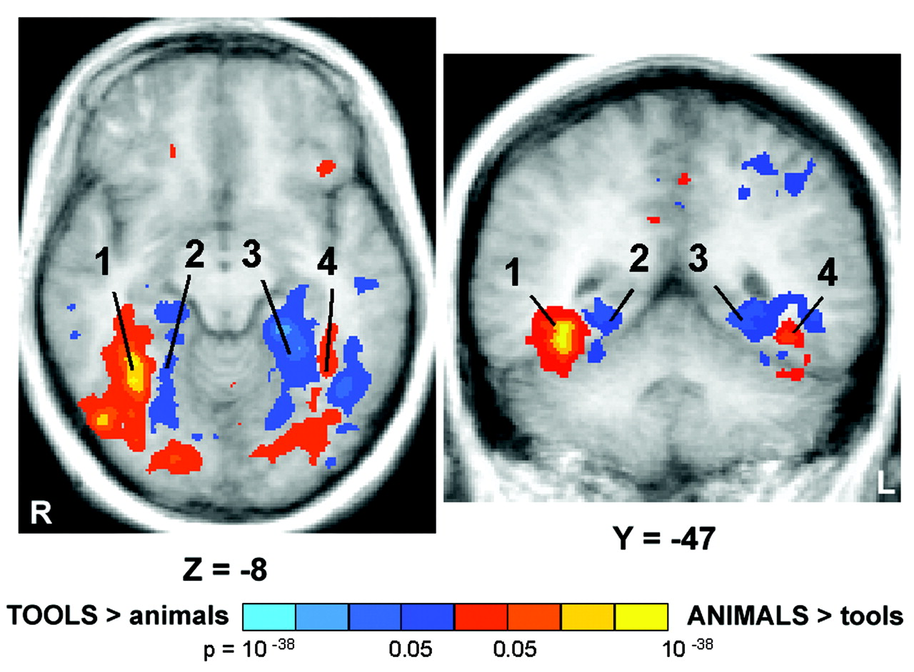
Figure 1. fMRI response in the ventral occipito-temporal cortex during animal and tool naming. The averaged ...
Notes:
Figure 1. fMRI response in the ventral occipito-temporal cortex during animal and tool naming. The averaged significance maps from seven subjects are overlaid on an averaged anatomical image from the same subjects. The maps, which are illustrated in axial (z = –8) and coronal (y = –47) sections, show the locations of four ventral occipito-temporal regions (1, right lateral fusiform; 2, right medial fusiform; 3, left medial fusiform; 4, left lateral fusiform) that responded differentially to naming pictures of animals and tools. Regions that responded maximally to naming animals are shown in the red–yellow color spectrum and regions that responded maximally to naming tools are shown in the blue–violet color spectrum.
Unless provided in the caption above, the following copyright applies to the content of this slide: © Oxford University Press

Slide 2
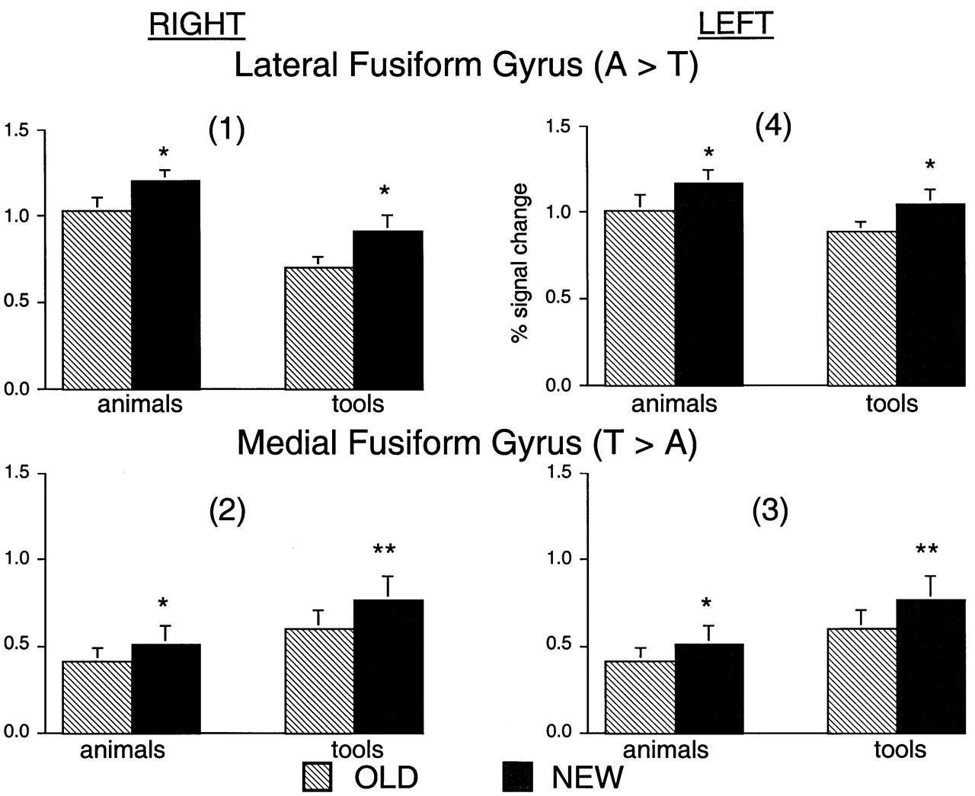
Figure 2. Mean amplitude of the fMRI signal in the regions of the fusiform gyrus depicted in Figure 1. The data are ...
Notes:
Figure 2. Mean amplitude of the fMRI signal in the regions of the fusiform gyrus depicted in Figure 1. The data are averaged across all repetitions of task blocks in each subject and across all subjects. Error bars indicate standard errors of the mean. Note the decrease in the fMRI signal associated with naming old pictures of animals and tools in both the lateral and medial regions of the fusiform gyrus, bilaterally (*P ≤ 0.05, **P ≤ 0.01).
Unless provided in the caption above, the following copyright applies to the content of this slide: © Oxford University Press

Slide 3
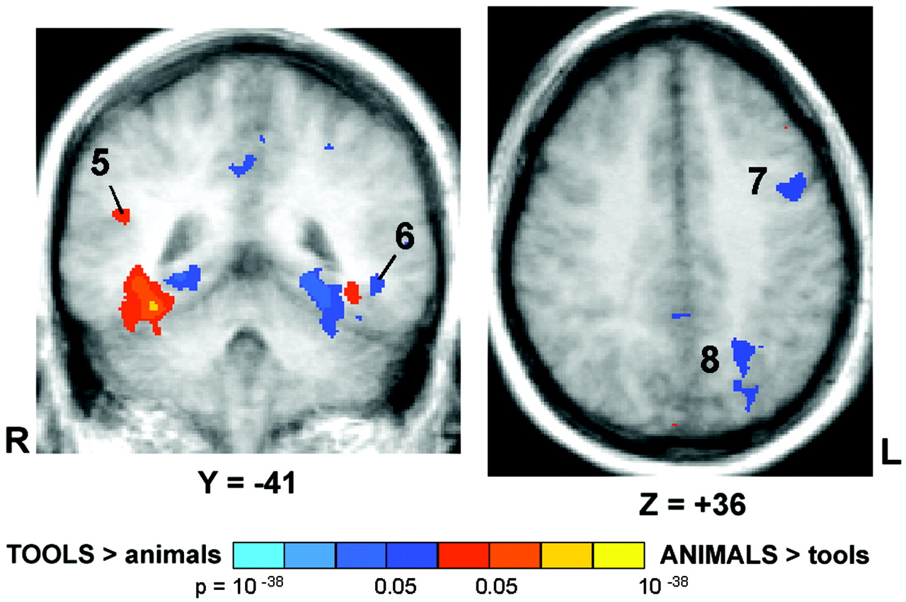
Figure 3. fMRI responses in the lateral temporal, left premotor and left parietal cortices during animal and tool ...
Notes:
Figure 3. fMRI responses in the lateral temporal, left premotor and left parietal cortices during animal and tool naming. The averaged significance maps are overlaid on an averaged anatomical image from seven subjects. The maps, which are illustrated in coronal (y = –41) and axial (z = 36) sections, show the locations of the regions in the lateral temporal, left premotor and left parietal cortices that responded differentially to naming pictures of animals and tools. Within the lateral temporal cortex, the right superior temporal sulcus (5) responded maximally to naming animal pictures while the left middle temporal gyrus (6) responded maximally to naming tool pictures. In addition, regions within the left ventral premotor cortex (7) and left posterior parietal cortex (8) also responded maximally to naming tools.
Unless provided in the caption above, the following copyright applies to the content of this slide: © Oxford University Press

Slide 4
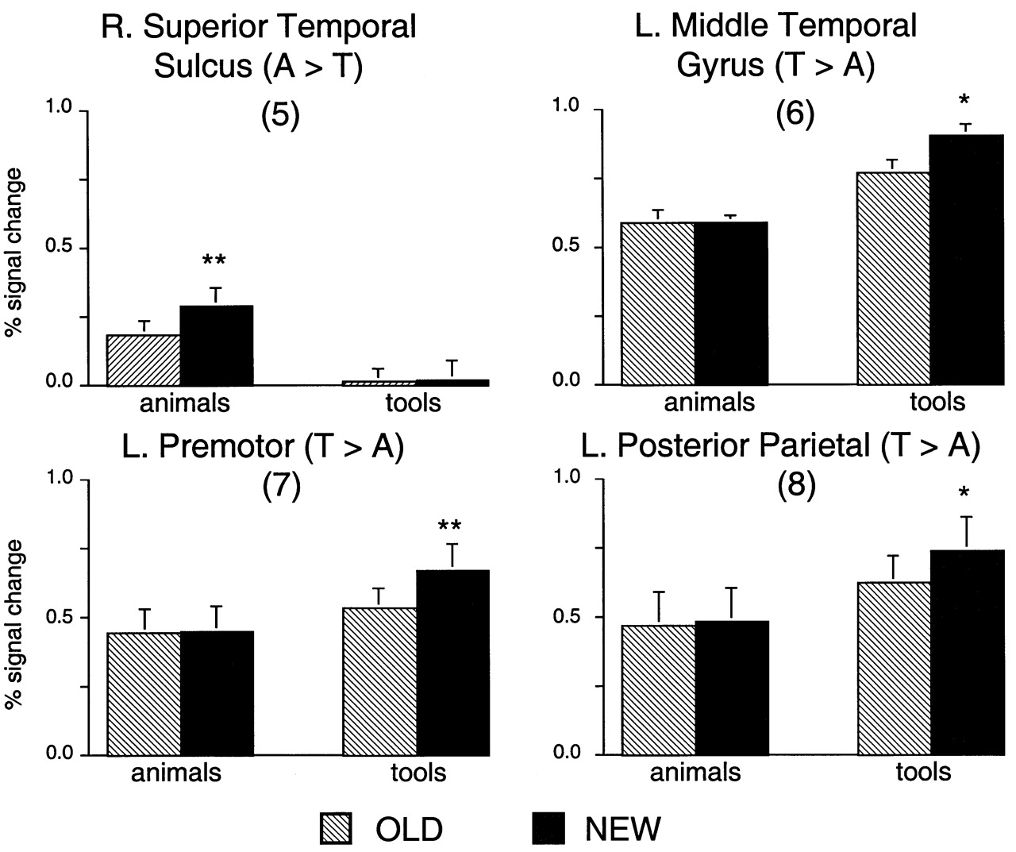
Figure 4. Mean amplitude of the fMRI signal in the regions depicted in Figure 3. A decrease in the fMRI signal in the ...
Notes:
Figure 4. Mean amplitude of the fMRI signal in the regions depicted in Figure 3. A decrease in the fMRI signal in the right superior temporal sulcus (5) was only associated with naming old pictures of animals; pictures of tools did not elicit a response above the scrambled object baseline. Pictures of animals elicited a response above baseline in the left middle temporal gyrus (6) and premotor (7) and posterior parietal (8) cortices. Nevertheless, the decrease in the fMRI signal was only associated with naming old pictures of tools (*P ≤ 0.05, **P ≤ 0.01).
Unless provided in the caption above, the following copyright applies to the content of this slide: © Oxford University Press

Slide 5
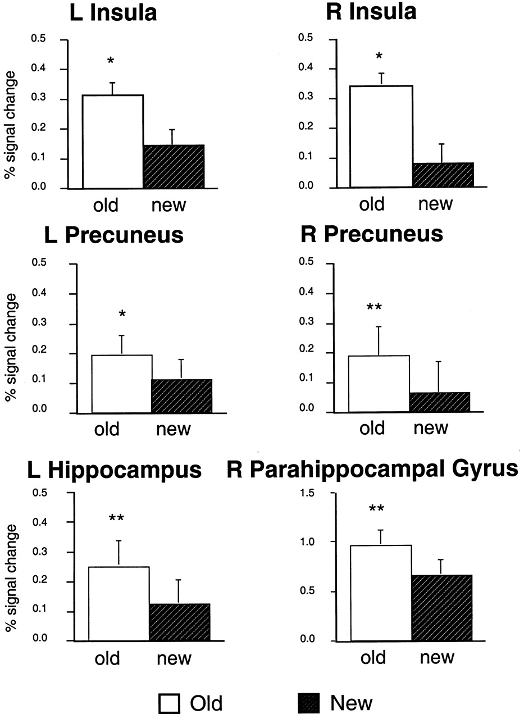
Figure 5. Mean amplitude of the fMRI signal in non-category-biased regions that showed learning-related increases in ...
Notes:
Figure 5. Mean amplitude of the fMRI signal in non-category-biased regions that showed learning-related increases in activity. Note that the fMRI signal is significantly increased for naming old as compared to new objects. (*P ≤ 0.05; **P ≤ 0.01.)
Unless provided in the caption above, the following copyright applies to the content of this slide: © Oxford University Press

