Slide 1
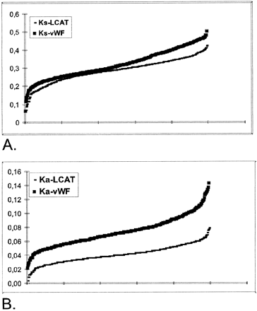
Fig. 1.—Synonymous (K_{s}) and nonsynonymous (K_{a}) changes for 496 pairs of rodent ...
Notes:
Fig. 1.—Synonymous (Ks) and nonsynonymous (Ka) changes for 496 pairs of rodent sequences in the LCAT gene and exon 28 of the vWF gene. In the two curves, data are organized by increasing values in order to illustrate (A) the similar rates of synonymous change in both genes and (B) the faster rate of nonsynonymous change in vWF sequences
Unless provided in the caption above, the following copyright applies to the content of this slide:

Slide 2
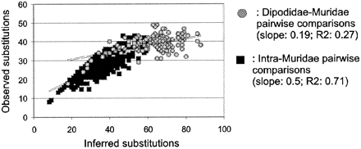
Fig. 2.—Graphic estimation of saturation in vWF for transitions at third codon positions. The inferred number ...
Notes:
Fig. 2.—Graphic estimation of saturation in vWF for transitions at third codon positions. The inferred number of changes, derived from the patristic distance matrix taken from a most-parsimonious tree, are plotted against the pairwise numbers of observed differences. Equations of the linear regression (straight lines) and correlation coefficients are given for Dipodidae-Muridae and intra-Muridae pairwise comparisons
Unless provided in the caption above, the following copyright applies to the content of this slide:

Slide 3
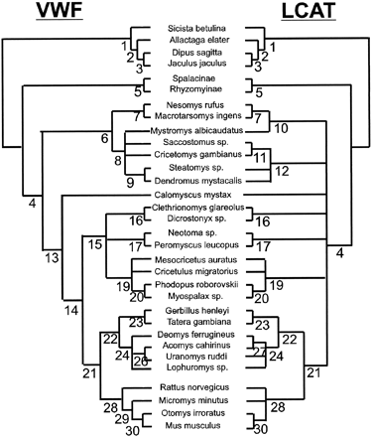
Fig. 3.—Synthetic trees summarizing the results derived from four approaches on 32 mammalian DNA sequences of ...
Notes:
Fig. 3.—Synthetic trees summarizing the results derived from four approaches on 32 mammalian DNA sequences of the LCAT and vWF genes. The robustness of each node (labeled 1–30) is described in table 2 for maximum-parsimony (bootstrap percentage [BP] and Bremer's support index), distance (BP), maximum-likelihood (BP), and Markov evolution analyses (BP). The trees were rooted by the four Dipodidae sequences
Unless provided in the caption above, the following copyright applies to the content of this slide:

Slide 4
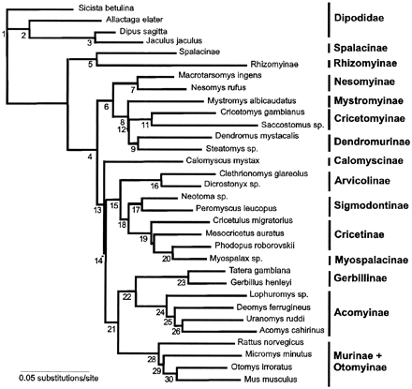
Fig. 4.—Synthetic tree summarizing the results from the combined analysis using LCAT and vWF genes. The ...
Notes:
Fig. 4.—Synthetic tree summarizing the results from the combined analysis using LCAT and vWF genes. The robustness of each node (labeled 1–30) is described in table 2 for maximum-parsimony (bootstrap percentage [BP] and Bremer's support index), distance (BP), maximum-likelihood (reliability percentages), and Markov evolution analyses (BP). The tree was rooted by four Dipodidae sequences
Unless provided in the caption above, the following copyright applies to the content of this slide:

Slide 5
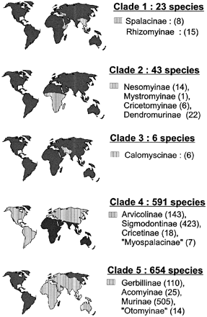
Fig. 5.—Approximate geographic distribution (from data in Wilson and Reeder 1993) of living species in each ...
Notes:
Fig. 5.—Approximate geographic distribution (from data in Wilson and Reeder 1993) of living species in each major lineage within Muridae. The numbers of species are those derived from Musser and Carleton (1993) assuming that each subfamily is monophyletic
Unless provided in the caption above, the following copyright applies to the content of this slide:

