Slide 1
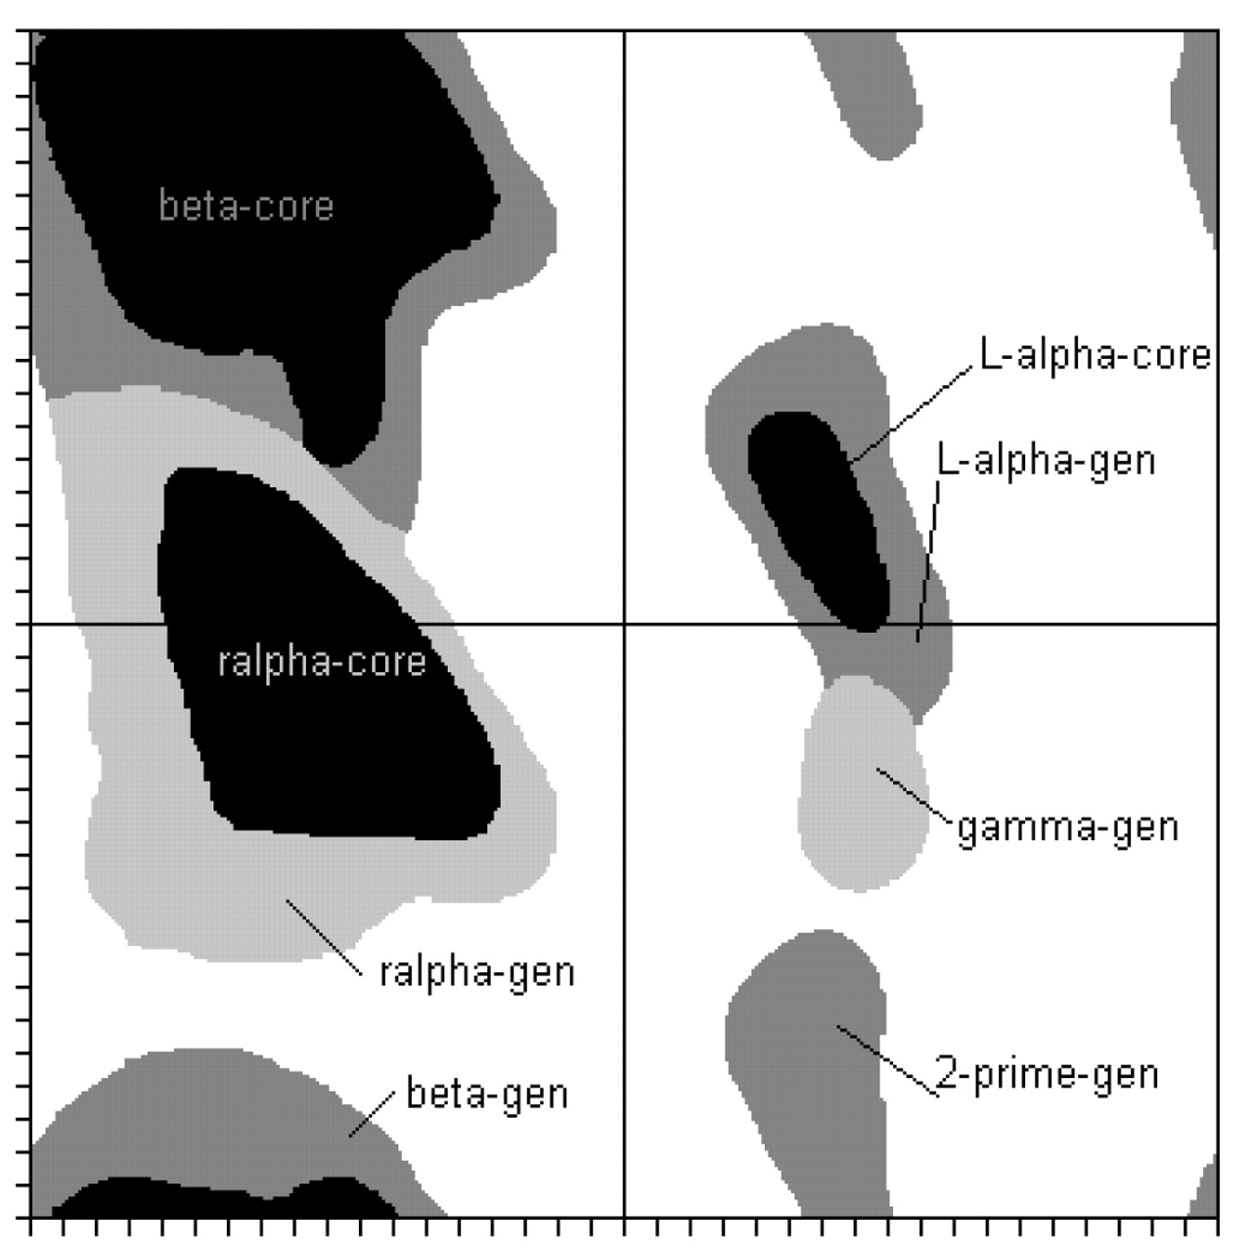
Fig. 1 Dihedral regions estimated from (Lovell, 2003). The region interfaces of the generously allowed regions were ...
Notes:
Fig. 1 Dihedral regions estimated from (Lovell, 2003). The region interfaces of the generously allowed regions were defined manually by us and are partially overlapping.
Unless provided in the caption above, the following copyright applies to the content of this slide: © The Author 2006. Published by Oxford University Press. All rights reserved. For Permissions, please email: journals.permissions@oxfordjournals.org

Slide 2
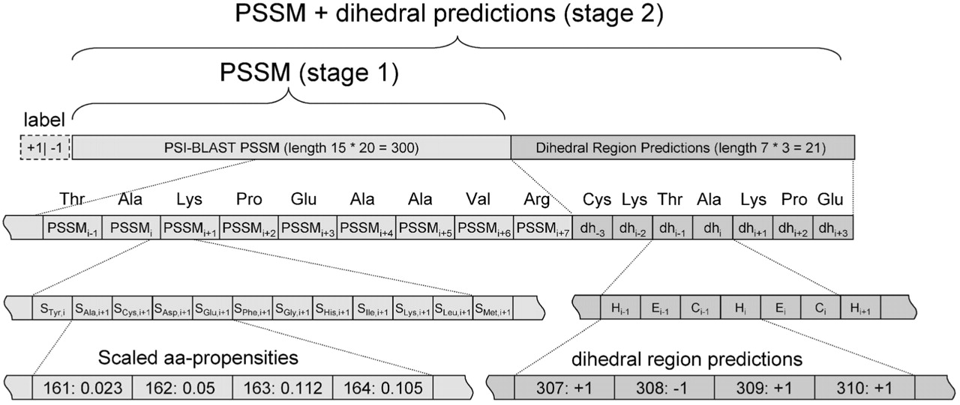
Fig. 2 Encoding of vectors for SVM training.
Notes:
Fig. 2 Encoding of vectors for SVM training.
Unless provided in the caption above, the following copyright applies to the content of this slide: © The Author 2006. Published by Oxford University Press. All rights reserved. For Permissions, please email: journals.permissions@oxfordjournals.org

Slide 3
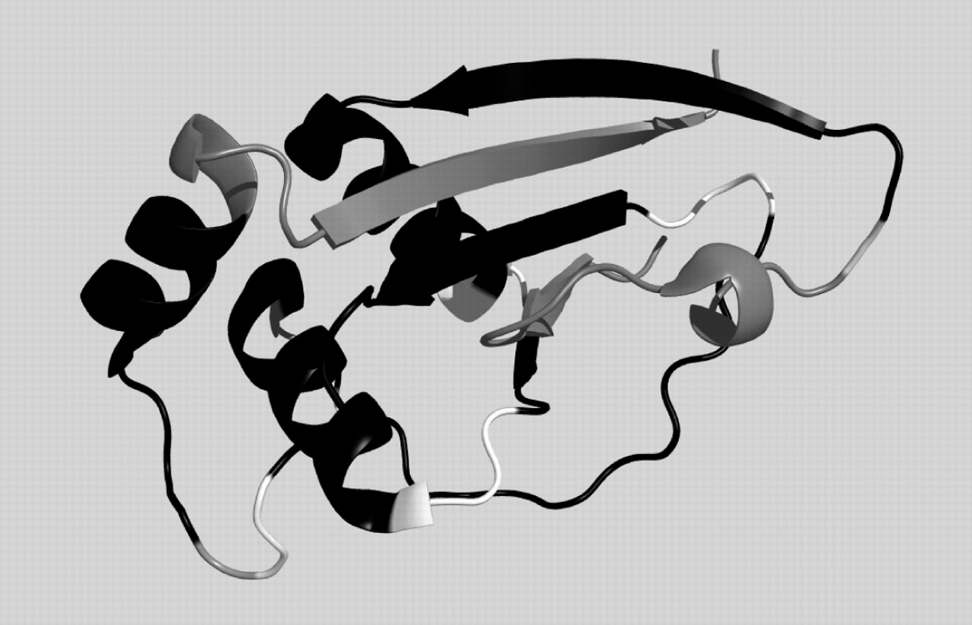
Fig. 3 Prediction for CASP6 target 242 (2blkA). Black: correct prediction, white: wrong prediction, gray: not ...
Notes:
Fig. 3 Prediction for CASP6 target 242 (2blkA). Black: correct prediction, white: wrong prediction, gray: not evaluated (chain ends and outliers).
Unless provided in the caption above, the following copyright applies to the content of this slide: © The Author 2006. Published by Oxford University Press. All rights reserved. For Permissions, please email: journals.permissions@oxfordjournals.org

Slide 4
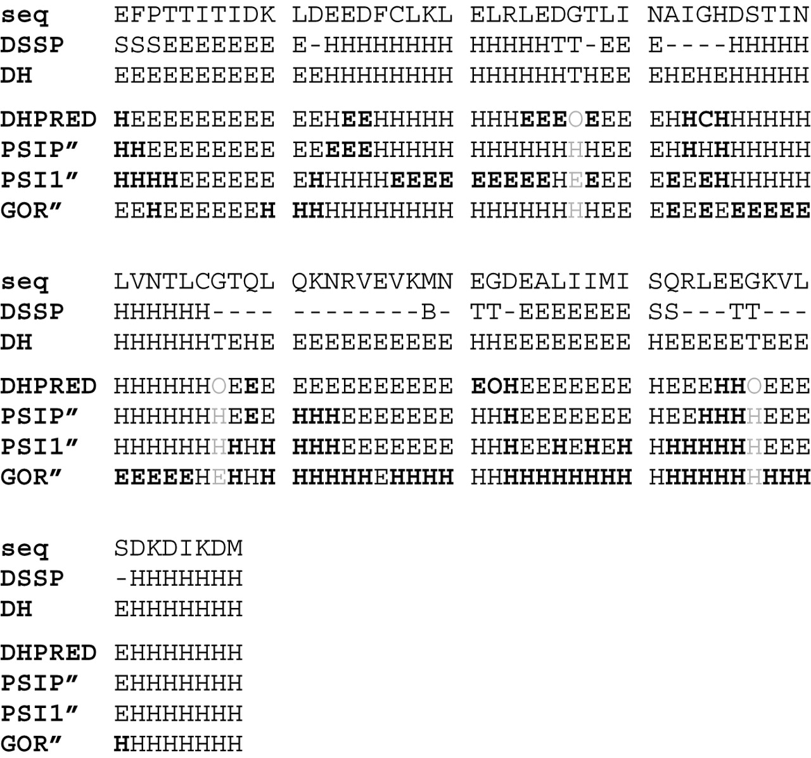
Fig. 4 True dihedral state and predictions for CASP6 target 242 (2blkA) with different algorithms. Normal face: ...
Notes:
Fig. 4 True dihedral state and predictions for CASP6 target 242 (2blkA) with different algorithms. Normal face: correct, bold: wrong, gray: not evaluated. seq = amino acid sequence in one-letter-code, DSSP = secondary structure annotation by DSSP, DH = dihedral region according to the Lovell definitions: E = within beta-gen (extended), H = within ralpha-gen, O = outside of both regions (turn), DHPRED: dihedral region predicted by our SVM approach, GOR′: predicted preference by GOR-IV when ignoring coil prediction, PSI1′: same for PSIPRED without using profile information, PSIP′: same for PSIPRED using profile information.
Unless provided in the caption above, the following copyright applies to the content of this slide: © The Author 2006. Published by Oxford University Press. All rights reserved. For Permissions, please email: journals.permissions@oxfordjournals.org

Slide 5
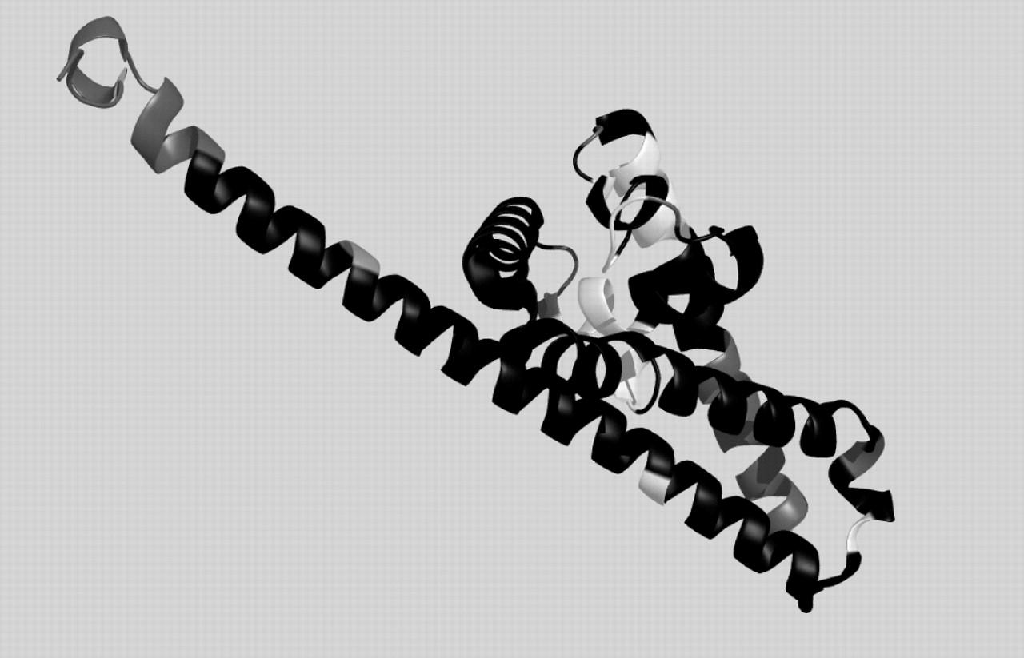
Fig. 5 Prediction for CASP6 target 238 (1w33A). Black: correct prediction, white: wrong prediction, gray: not ...
Notes:
Fig. 5 Prediction for CASP6 target 238 (1w33A). Black: correct prediction, white: wrong prediction, gray: not evaluated (chain ends and outliers).
Unless provided in the caption above, the following copyright applies to the content of this slide: © The Author 2006. Published by Oxford University Press. All rights reserved. For Permissions, please email: journals.permissions@oxfordjournals.org

Slide 6
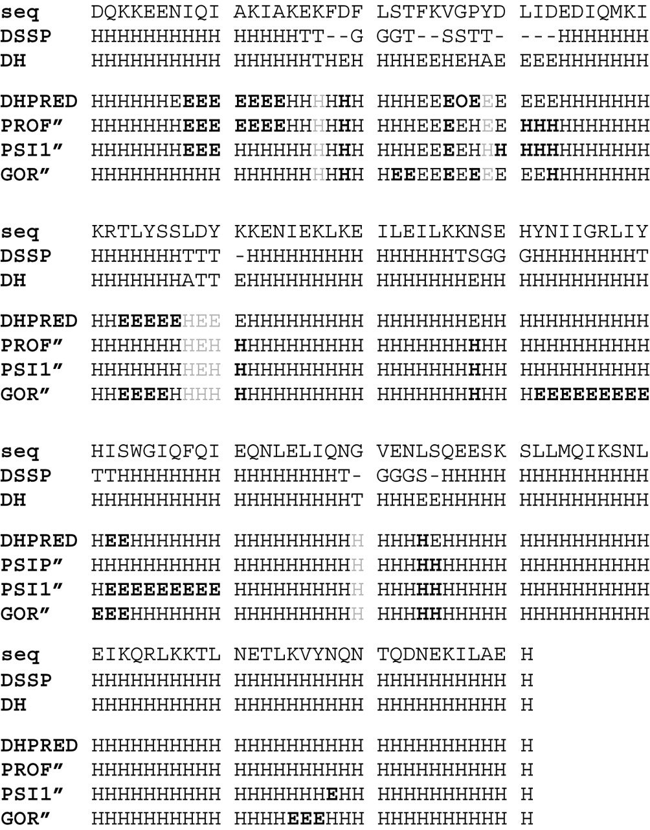
Fig. 6 True dihedral state and predictions for CASP6 target 238 (1w33A) with different algorithms. Normal font: ...
Notes:
Fig. 6 True dihedral state and predictions for CASP6 target 238 (1w33A) with different algorithms. Normal font: correct prediction, bold font: wrong prediction, gray: not evaluated (ambiguous or outliers). (Fig. 4. for detailed legend).
Unless provided in the caption above, the following copyright applies to the content of this slide: © The Author 2006. Published by Oxford University Press. All rights reserved. For Permissions, please email: journals.permissions@oxfordjournals.org

Slide 7
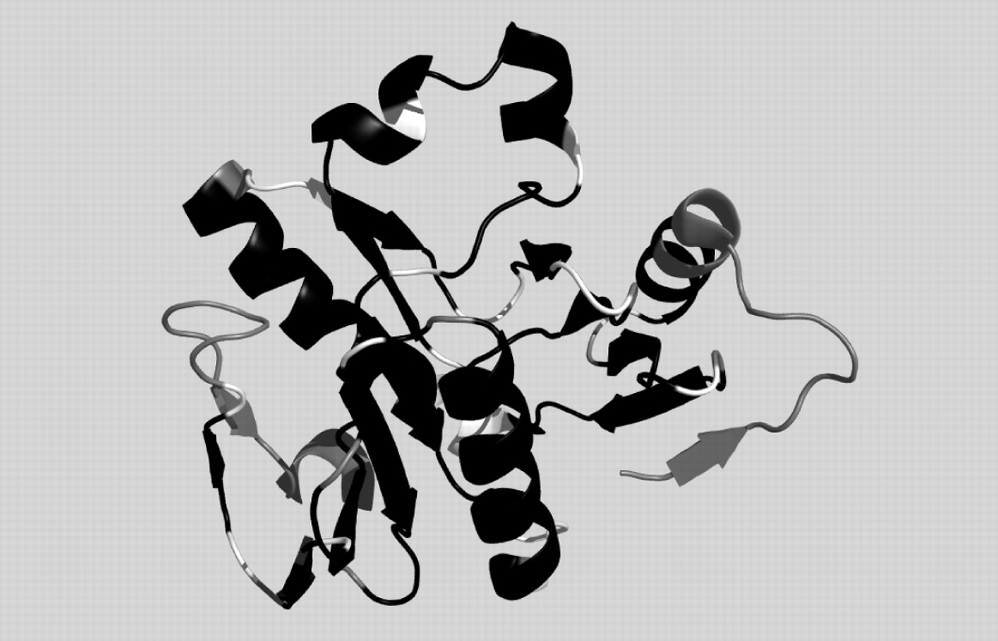
Fig. 7 Prediction for CASP6 target 273 (1wdjA). Black: correct prediction, white: wrong prediction, gray: not ...
Notes:
Fig. 7 Prediction for CASP6 target 273 (1wdjA). Black: correct prediction, white: wrong prediction, gray: not evaluated (chain ends and outliers).
Unless provided in the caption above, the following copyright applies to the content of this slide: © The Author 2006. Published by Oxford University Press. All rights reserved. For Permissions, please email: journals.permissions@oxfordjournals.org

Slide 8
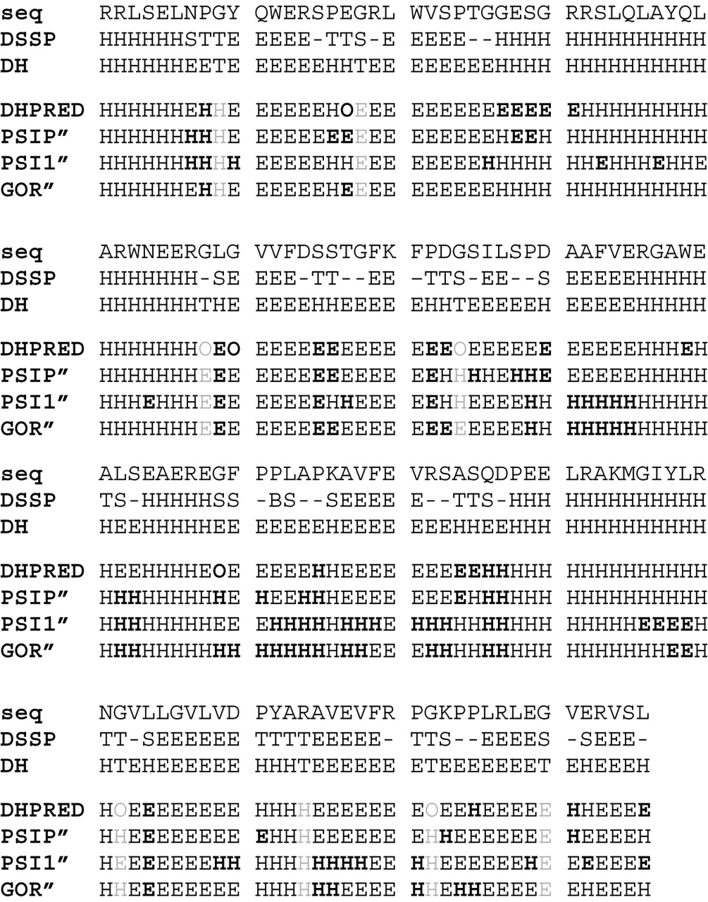
Fig. 8 True dihedral state and predictions for CASP6 target 273 (1wdjA) with different algorithms. Normal font: ...
Notes:
Fig. 8 True dihedral state and predictions for CASP6 target 273 (1wdjA) with different algorithms. Normal font: correct prediction, bold font: wrong prediction, gray: not evaluated (ambiguous or outliers). (Fig. 4. for detailed legend).
Unless provided in the caption above, the following copyright applies to the content of this slide: © The Author 2006. Published by Oxford University Press. All rights reserved. For Permissions, please email: journals.permissions@oxfordjournals.org

