Slide 1
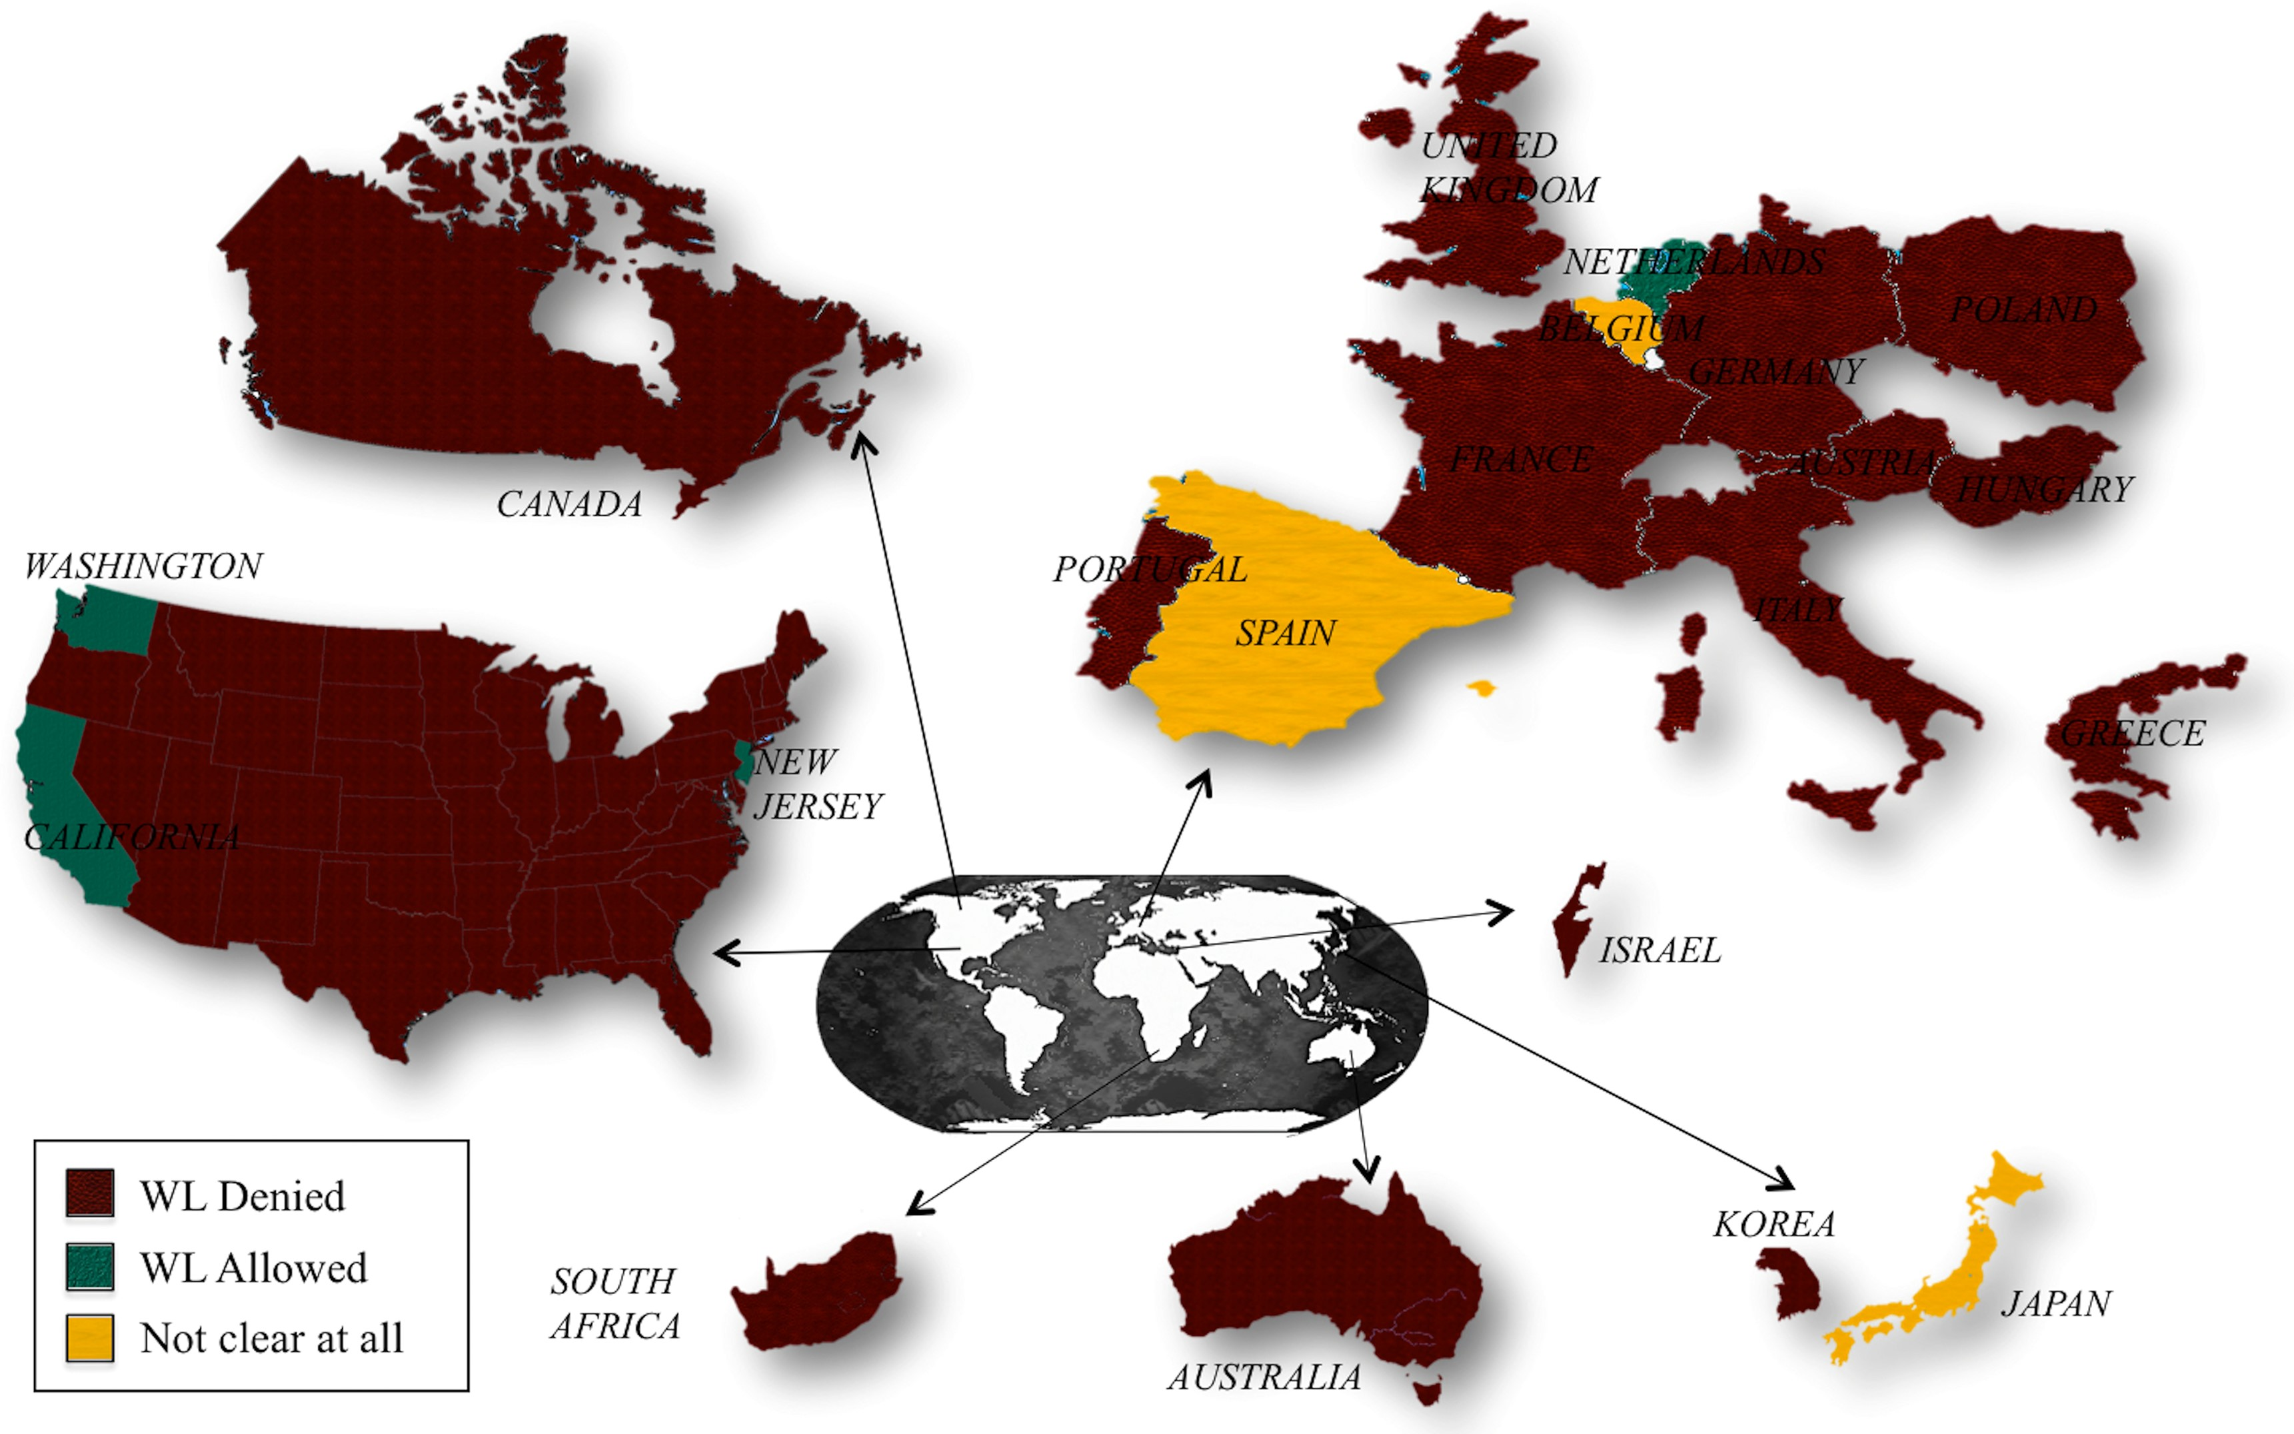
Figure 1 Overview of the countries that accept or reject wrongful life actions.
Notes:
Figure 1 Overview of the countries that accept or reject wrongful life actions.
Unless provided in the caption above, the following copyright applies to the content of this slide: © The Author 2017. Published by Oxford University Press on behalf of the European Society of Human Reproduction and Embryology. All rights reserved. For Permissions, please email: journals.permissions@oup.com

