Slide 1
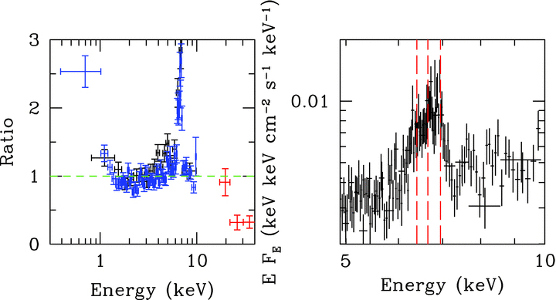
Figure 1 Left: ratio of the XMM–Newton (PN: blue and MOS1: black) and INTEGRAL data (ISGRI: red) to a model of an ...
Notes:
Figure 1 Left: ratio of the XMM–Newton (PN: blue and MOS1: black) and INTEGRAL data (ISGRI: red) to a model of an absorbed power law with a best-fitting index of ∼0.94. There are clear, strong residuals due to iron emission and the presence of a rollover in the spectrum below ∼20 keV. Right: the XMM–Newton data from 5 to 10 keV (unfolded through a power law of Γ= 0 and norm = 1) together with dashed vertical lines, indicating the rest-frame energies for the iron triplet (6.4, 6.65 and 6.95 keV, respectively).
Unless provided in the caption above, the following copyright applies to the content of this slide: © 2011 The Authors Monthly Notices of the Royal Astronomical Society © 2011 RAS

Slide 2
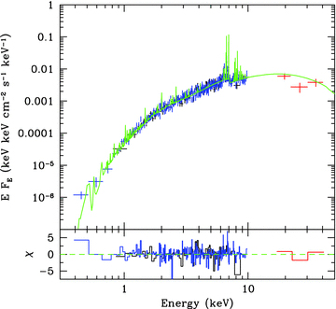
Figure 2 X-ray spectral data from the PN (blue) and MOS1 (black) together with the INTEGRAL ISGRI data (red). The ...
Notes:
Figure 2 X-ray spectral data from the PN (blue) and MOS1 (black) together with the INTEGRAL ISGRI data (red). The best-fitting model comprising a cooling flow, reflection and absorption (see Table 1) is shown in green with residuals to this in the panel below.
Unless provided in the caption above, the following copyright applies to the content of this slide: © 2011 The Authors Monthly Notices of the Royal Astronomical Society © 2011 RAS

Slide 3
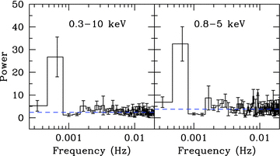
Figure 3 Average PDS extracted from the 0.3–10 keV (left) and 0.8–5 keV (right) light curves binned on 10 s, made from ...
Notes:
Figure 3 Average PDS extracted from the 0.3–10 keV (left) and 0.8–5 keV (right) light curves binned on 10 s, made from five segments of the light curve including the white noise (horizontal dashed line). There is an excess of variance at ∼0.7 mHz which is significant at >3σ in the 0.8–5 keV band. As the power over the remaining observable frequency bins is consistent with the statistical white noise (possibly indicating the source as being stream-fed), this is an acceptable method for determining the significance of this feature.
Unless provided in the caption above, the following copyright applies to the content of this slide: © 2011 The Authors Monthly Notices of the Royal Astronomical Society © 2011 RAS

