Slide 1
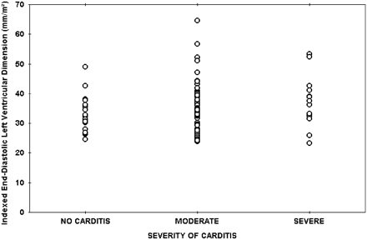
Fig. 1 Distribution of the indexed left ventricular end-diastolic dimension between the three groups
Notes:
Fig. 1 Distribution of the indexed left ventricular end-diastolic dimension between the three groups
Unless provided in the caption above, the following copyright applies to the content of this slide: The European Society of Cardiology

Slide 2
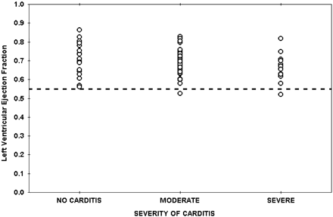
Fig. 2 Distribution of ejection fraction between the three groups.
Notes:
Fig. 2 Distribution of ejection fraction between the three groups.
Unless provided in the caption above, the following copyright applies to the content of this slide: The European Society of Cardiology

Slide 3
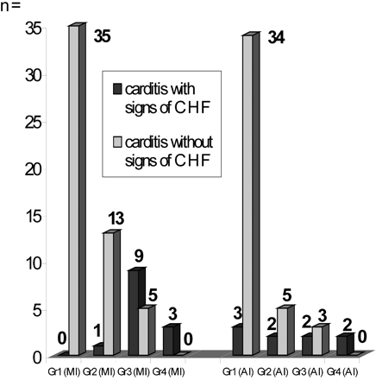
Fig. 3 Distribution of valve regurgitations in the three groups. CHF=congestive heart failure; AI=aortic ...
Notes:
Fig. 3 Distribution of valve regurgitations in the three groups. CHF=congestive heart failure; AI=aortic insufficiency; MI=mitral insufficiency; Gr=regurgitation grade.
Unless provided in the caption above, the following copyright applies to the content of this slide: The European Society of Cardiology

Slide 4
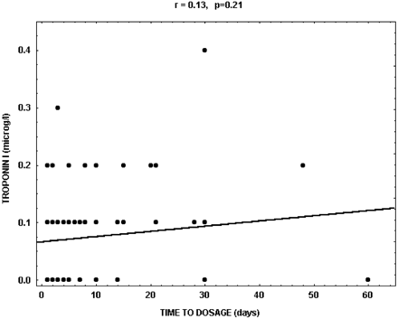
Fig. 4 Correlation between cTnI levels and the time of admittance to the hospital.
Notes:
Fig. 4 Correlation between cTnI levels and the time of admittance to the hospital.
Unless provided in the caption above, the following copyright applies to the content of this slide: The European Society of Cardiology

