Slide 1
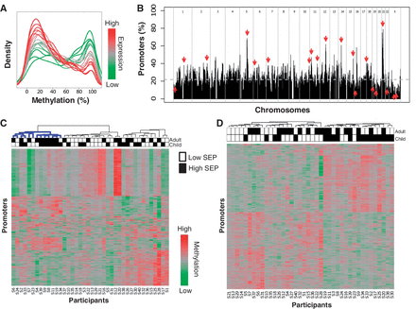
Figure 1 Whole-blood promoter methylation in a variable SEP population. (A) Distributions of promoter methylation ...
Notes:
Figure 1 Whole-blood promoter methylation in a variable SEP population. (A) Distributions of promoter methylation levels by published expression level. Genes are divided into 20 levels by whole-blood expression percentiles (0–5, 5–10, … , 95–100) based on publicly available expression data.50 Shown are the distributions of methylation levels for each expression percentile. The distributions show that genes with low or no expression (represented in green) tend to have highly methylated promoters, whereas genes with high expression (represented in red) tend to have little or no promoter methylation. (B) Distribution of variably methylated promoters. Distribution of variably methylated promoters across the genome shown as percentage of promoters in each region. Downward pointing arrows indicate regions enriched with variably methylated promoters, and upward pointing arrows indicate regions with little variability (FDR < 0.05). The dashed grey line shows the expected percentage of variably methylated promoters. (C) Most variably methylated promoters. Heatmap showing methylation scores of the 500 most variably methylated promoters (rows) across all 40 individuals (columns). Each promoter is represented by its most variable probe. Blackened squares above the columns denote high SEP in childhood or adulthood. The cluster highlighted in blue contains a significant number of high childhood and adulthood SEP individuals (hypergeometric; P ≤ 0.009). Each probe represents a distinct promoter (i.e. for promoters with multiple highly variable probes, only the most variable was included). (D) Differentially methylated promoters associated with childhood SEP. The heatmap shows the methylation scores of the 500 probes most significantly associated with childhood SEP with the following qualifications: each probe satisfied the individual requirements to be called differentially methylated, each belonged to a promoter called differentially methylated, and no pair of probes belonged to the same promoter
Unless provided in the caption above, the following copyright applies to the content of this slide: Published by Oxford University Press on behalf of the International Epidemiological Association © The Author 2011; all rights reserved.

Slide 2
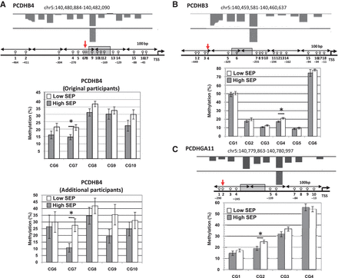
Figure 2 Mapping of the state of methylation of three protocadherin genes by pyrosequencing. Effect size (P-value) for ...
Notes:
Figure 2 Mapping of the state of methylation of three protocadherin genes by pyrosequencing. Effect size (P-value) for three protocadherin promoters were as follows: [effect = log(mean probe intensity in high child SEP/mean probe intensity in low child SEP)] PCDHB4 effect = −0.47, P-value < 0.00114, q-value < 0.015; PCDHB3 effect = −0.34, P-value < 0.013, q-value < 0.023; PCDHGA11 effect = −0.53, P-value < 0.0051, q-value < 0.034. In the figure, the upper panel is a UCSC browser genomic display showing mean DNA methylation differences between high and low childhood SEP and the significant differential probe as detected by microarray analysis (A, B and C). Grey bars correspond to probes more methylated in the low childhood SEP group. The chromosomal location of each analysed region is indicated (hg18: human genome 18 assembly). CpG sites are annotated relative to the transcription start site of each gene. Each circle represents one CpG site. The grey box indicates the probe significantly different as shown by the microarrays data. The bar graphs show the average methylation levels of the CpG sites within the high and low childhood SEP groups as determined by pyrosequencing. Error bars show the SEM (*P < 0.05). (A) Methylation profile of the PCDHB4 promoter in childhood high and low SEP groups. In the PCDHB4 promoter, five CpG sites were analyzed by pyrosequencing (high SEP n = 17, low SEP n = 16). On average, all of the CpG sites have higher methylation in the low SEP group (P = 0.0043, Stouffer) with CG7 showing a significant difference (P = 0.018, t-test). The lower bar graph shows pyrosequencing average methylation levels for the same five CpGs in additional 30 participants (high SEP n = 13, low SEP n = 17). All five CpG sites are more methylated in the low SEP group with CG7 significantly different (P = 0.011, t-test). (B) Methylation profile of the PCDHB3 promoter in childhood high and low SEP groups. In the promoter of the PCDHB3 gene, six CpG sites were analysed by pyrosequencing (high n = 14, low n = 19). Though all CpG sites have higher methylation in the low SEP group, only CG4 is significantly different (P = 0.0049, t-test). (C) Methylation profile of the PCDHGA11 promoter in childhood high and low SEP groups. In the promoter of the PCDHGA11 gene, four CpG sites were analysed by pyrosequencing (high n = 16, low n = 20). CG2 shows significantly higher methylation in the low childhood SEP group (P = 0.010, t-test)
Unless provided in the caption above, the following copyright applies to the content of this slide: Published by Oxford University Press on behalf of the International Epidemiological Association © The Author 2011; all rights reserved.

Slide 3
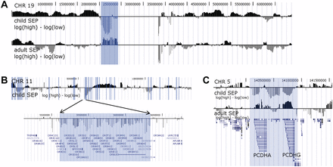
Figure 3 Megabase co-clustering of differential methylation. (A) Co-clustering of differentially methylated promoters ...
Notes:
Figure 3 Megabase co-clustering of differential methylation. (A) Co-clustering of differentially methylated promoters across megabases of DNA. Positive values (black bars) indicate increased methylation in high childhood SEP compared with low childhood SEP and negative values (grey bars) indicate the opposite. With the exception of one region next to the chromosome centromere (highlighted), chromosome 19 promoters are generally more methylated in high childhood SEP than in low childhood SEP. This is in contrast to adulthood SEP where the methylation differences are not significant. (B) Co-clustering of differentially methylated promoters with common function across megabases of DNA. Unlike chromosome 19, chromosome 11 has more directional variation with respect to childhood SEP. We highlight a region of 1 million bases that is consistently more methylated in low childhood SEP and contains about 40 genes, all olfactory receptor genes. Shaded vertical bars identify 500-kb regions of significant difference between childhood SEP groups (FDR ≤ 0.025). (C) Co-clustering of differential methylation with the protocadherins. Shaded is a nearly 1-Mb region containing mainly protocadherins whose promoters are consistently more methylated in low childhood SEP than in high. Most of this region was found to be consistently hypermethylated in breast tumours.53 We observe a similar but much weaker and inverted methylation difference between low and high adulthood SEP
Unless provided in the caption above, the following copyright applies to the content of this slide: Published by Oxford University Press on behalf of the International Epidemiological Association © The Author 2011; all rights reserved.

Slide 4
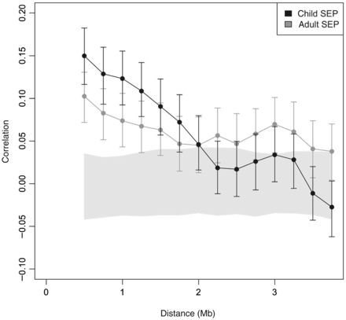
Figure 4 Methylation dependencies across megabases. Shown are correlations of methylation differences from ...
Notes:
Figure 4 Methylation dependencies across megabases. Shown are correlations of methylation differences from 500-kb regions at various distances apart. The solid grey region contains the 95% CI, and error bars contain the 95% CI for correlation values
Unless provided in the caption above, the following copyright applies to the content of this slide: Published by Oxford University Press on behalf of the International Epidemiological Association © The Author 2011; all rights reserved.

