Slide 1
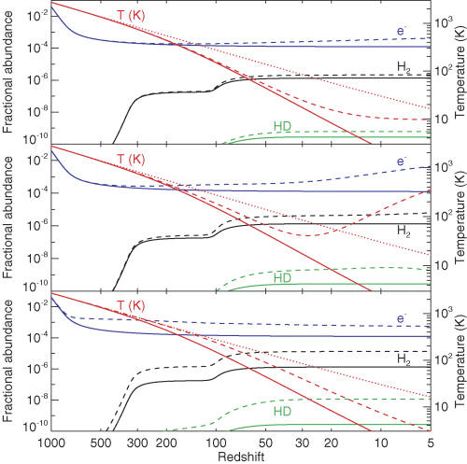
Figure 1 Effects of decaying/annihilating DM on the IGM evolution. Left-hand axis: fractional abundances of free ...
Notes:
Figure 1 Effects of decaying/annihilating DM on the IGM evolution. Left-hand axis: fractional abundances of free electrons (e−), H2 and HD as a function of redshift. Right-hand axis: matter temperature as a function of redshift. Top panel: effect of decaying sterile neutrinos of mass 25 keV (dashed line). Central panel: decaying LDM of mass 10 MeV (dashed line). Bottom panel: annihilating LDM of mass 1 MeV (dashed line). In all the panels the dotted line is the CMB temperature and the solid line represents the thermal and chemical evolution without DM decays/annihilations.
Unless provided in the caption above, the following copyright applies to the content of this slide: © 2007 The Authors. Journal compilation © 2007 RAS

Slide 2
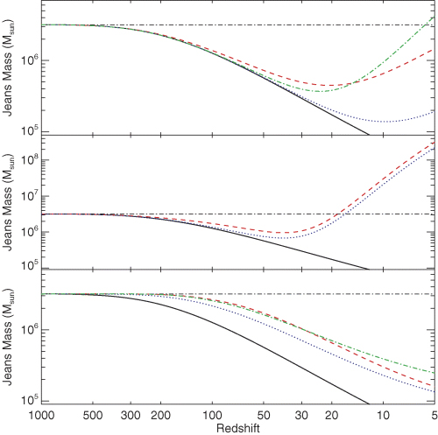
Figure 2 Jeans mass as a function of redshift. Top panel: effect of decaying sterile neutrinos of mass 25 (dashed ...
Notes:
Figure 2 Jeans mass as a function of redshift. Top panel: effect of decaying sterile neutrinos of mass 25 (dashed line), 15 (dotted line) and 4 keV (dot–dashed line). Central panel: decaying LDM of mass 10 (dashed line) and 3 MeV (dotted line). Bottom panel: annihilating LDM of mass 10 (dashed line), 3 (dotted line) and 1 MeV (dot–dashed line). In all the panels the solid line represents the thermal and chemical evolution without DM decays/annihilations. The horizontal dot–dashed line shows the behaviour of the Jeans mass calculated by assuming that the gas temperature is always equal to the CMB temperature.
Unless provided in the caption above, the following copyright applies to the content of this slide: © 2007 The Authors. Journal compilation © 2007 RAS

Slide 3
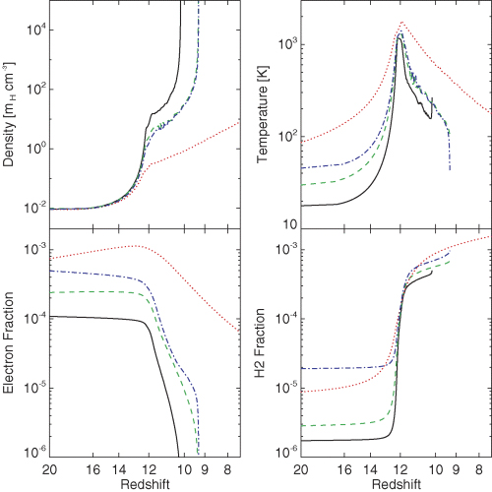
Figure 3 Evolution of the central region of a 6 × 10⁵ M⊙ isothermal halo virializing at ...
Notes:
Figure 3 Evolution of the central region of a 6 × 105 M⊙ isothermal halo virializing at zvir= 12. From left- to right-hand panels and from top to bottom: density, temperature, electron abundance and H2 abundance as function of redshift. The solid line represents the unperturbed case (i.e. without DM decays and annihilations). The dashed, dot–dashed and dotted lines account for the contribution of 25-keV sterile neutrino decays, 1-MeV LDM annihilations and 10-MeV LDM decays, respectively.
Unless provided in the caption above, the following copyright applies to the content of this slide: © 2007 The Authors. Journal compilation © 2007 RAS

Slide 4
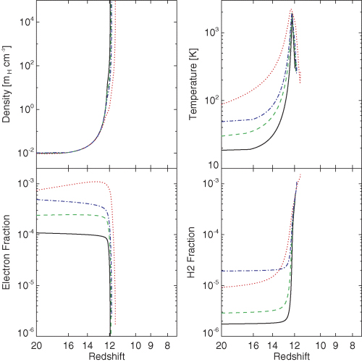
Figure 4 Evolution of the central region of a 2 × 10⁶ M⊙ isothermal halo virializing at ...
Notes:
Figure 4 Evolution of the central region of a 2 × 106 M⊙ isothermal halo virializing at zvir= 12. From left- to right-hand panels and from top to bottom: density, temperature, electron abundance and H2 abundance as function of redshift. The dashed, dot–dashed and dotted lines are the same as in Fig. 3.
Unless provided in the caption above, the following copyright applies to the content of this slide: © 2007 The Authors. Journal compilation © 2007 RAS

Slide 5
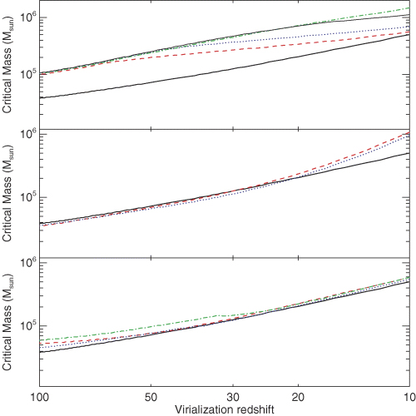
Figure 5 The critical mass as a function of the virialization redshift z_{vir} for isothermal haloes. Top ...
Notes:
Figure 5 The critical mass as a function of the virialization redshift zvir for isothermal haloes. Top panel: effect of decaying sterile neutrinos. Central: decaying LDM. Bottom: annihilating LDM. The lines used in the three panels are the same as in Fig. 2. The thin solid line used in the top panel represents the case of non-decaying WDM (with mass 4 keV).
Unless provided in the caption above, the following copyright applies to the content of this slide: © 2007 The Authors. Journal compilation © 2007 RAS

Slide 6
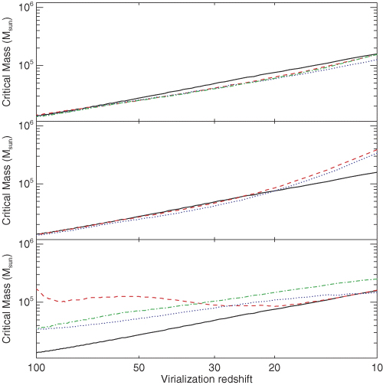
Figure 6 The critical mass as a function of the virialization redshift z_{vir} for NFW haloes. The lines used ...
Notes:
Figure 6 The critical mass as a function of the virialization redshift zvir for NFW haloes. The lines used in the three panels are the same as in Fig. 5.
Unless provided in the caption above, the following copyright applies to the content of this slide: © 2007 The Authors. Journal compilation © 2007 RAS

Slide 7
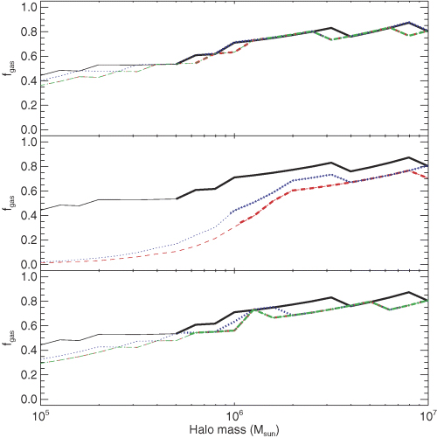
Figure 7 Halo baryonic mass fraction (see definition in equation 22) as a function of the halo mass for a fixed ...
Notes:
Figure 7 Halo baryonic mass fraction (see definition in equation 22) as a function of the halo mass for a fixed virialization redshift (zvir= 10) and for an isothermal DM profile. Top panel: effect of decaying sterile neutrinos. Central panel: decaying LDM. Bottom panel: annihilating LDM. The lines used in the three panels are the same as in Fig. 2. Thick (thin) lines indicate that the halo mass is larger (smaller) than mcrit.
Unless provided in the caption above, the following copyright applies to the content of this slide: © 2007 The Authors. Journal compilation © 2007 RAS

Slide 8
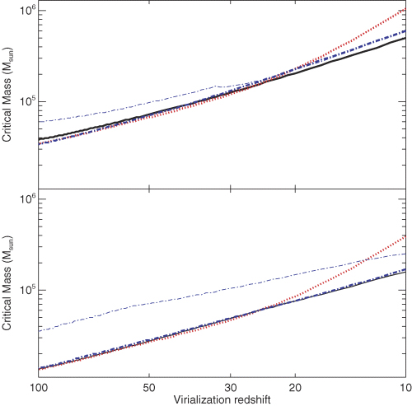
Figure 8 Evolution of m_{crit} as a function of the virialization redshift in the case without DM (solid ...
Notes:
Figure 8 Evolution of mcrit as a function of the virialization redshift in the case without DM (solid lines), with 3-MeV LDM decays (dotted lines) and with 1-MeV LDM annihilations (dot–dashed lines). Thin (thick) lines are with (without) the local contribution of the DM inside the halo. Note that the thin dotted line is completely superimposed to the thick dotted line, because the local contribution of decaying DM is always negligible. Top panel: isothermal haloes. Bottom panel: NFW haloes.
Unless provided in the caption above, the following copyright applies to the content of this slide: © 2007 The Authors. Journal compilation © 2007 RAS

