Slide 1
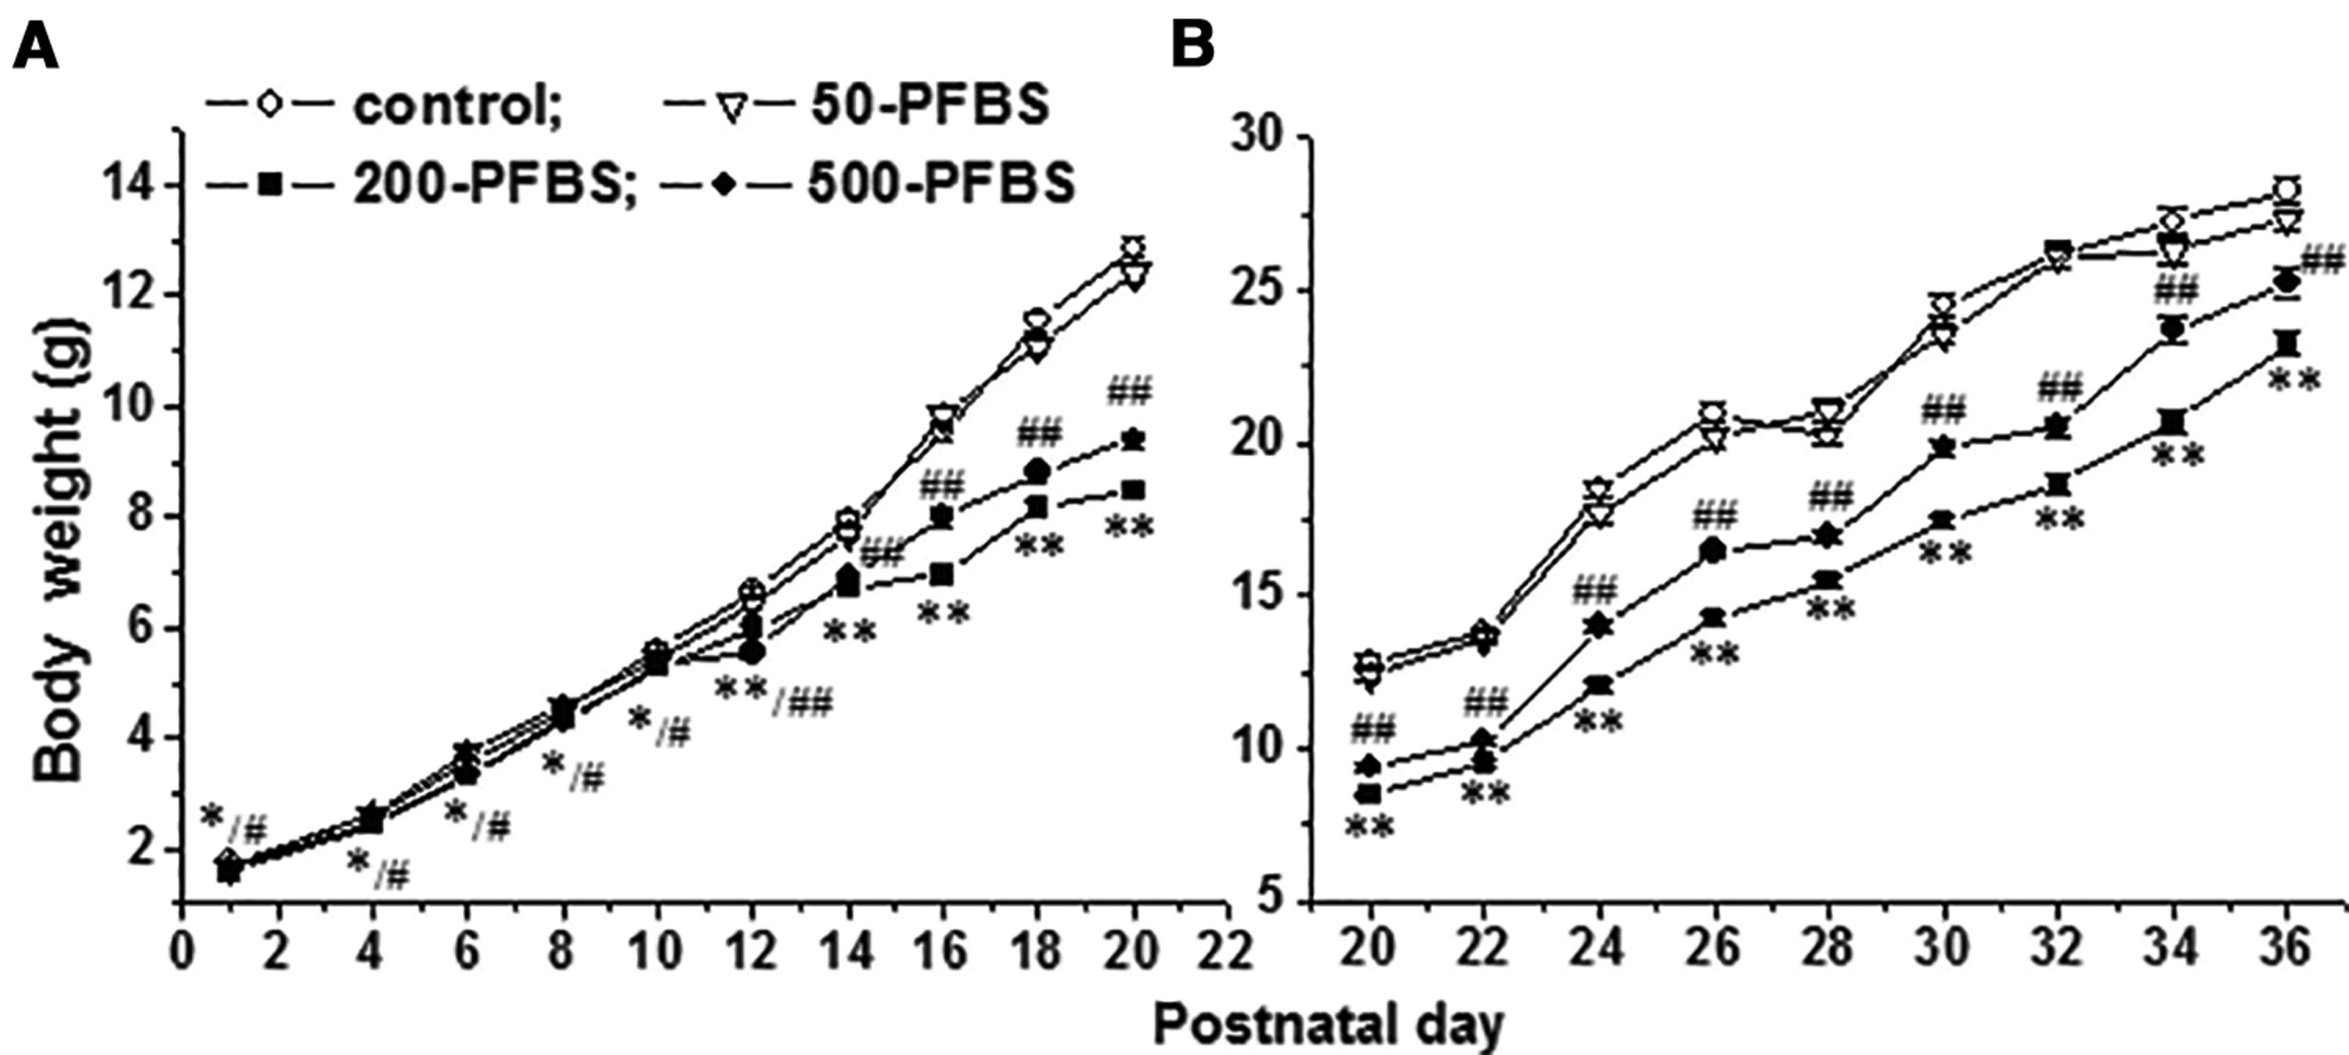
FIG. 1 Influence of prenatal perfluorobutanesulfonate (PFBS) exposure on female offspring growth and development. ...
Notes:
FIG. 1 Influence of prenatal perfluorobutanesulfonate (PFBS) exposure on female offspring growth and development. Growth curves were constructed by plotting the body weights (mean ± SE) of control offspring and PFBS-offspring against postnatal day (PND) 1–20 (A) and PND 20–36 (B). *,#P < 0.05 and **,##P < 0.01 (*,**PFBS 200 mg/kg group; #/## PFBS 500 mg/kg group) versus control offspring (one-way repeated-measures ANOVA).
Unless provided in the caption above, the following copyright applies to the content of this slide: © The Author 2016. Published by Oxford University Press on behalf of the Society of Toxicology. All rights reserved. For Permissions, please e-mail: journals.permissions@oup.com

Slide 2
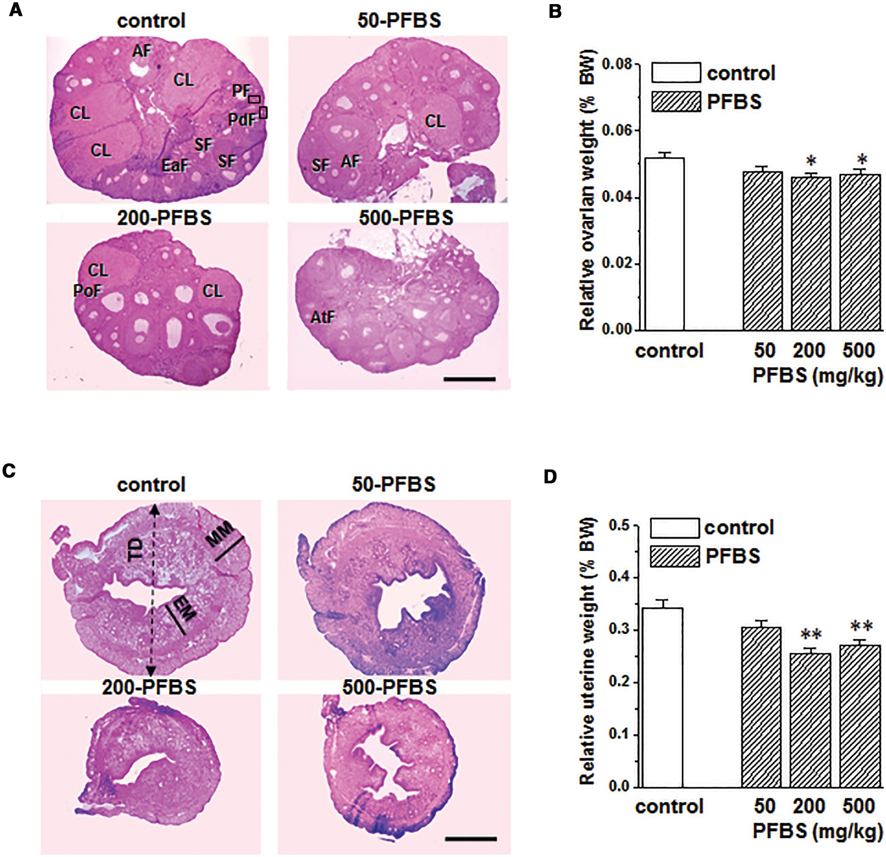
FIG. 2 Influence of prenatal perfluorobutanesulfonate (PFBS) exposure on reproductive organ development. A, ...
Notes:
FIG. 2 Influence of prenatal perfluorobutanesulfonate (PFBS) exposure on reproductive organ development. A, Representative images of ovaries stained with hematoxylin and eosin (HE) in postnatal day (PND) 60 control offspring and PFBS-offspring. Scale bars = 200 μm. B, Bar graph shows the relative weights (%body weight [BW]) of the ovaries. *P < 0.05 versus control offspring (1-way ANOVA). C, Representative images of uteri stained with HE in PND60 control offspring and PFBS-offspring. Scale bars = 100 μm. D, Bar graph shows the relative weights (% BW) of the uteri. *P < 0.05 versus control offspring (1-way ANOVA). Abbreviations: AF: antral follicles; AtF: atretic follicles; CL: corpora lutea; EaF: early antral follicles; EM: endometrium; ; MM: myometrium; PdF: primordial follicles; PF: primary follicles; PoF: preovulatory follicles; SF: secondary follicles; TD: total diameter. Morphological Structure of Ovary and Uterus in PND 60 PFBS (mg/kg)Control50200500Numbers of follicles per ovary Primordial975.5 ± 49.1931.8 ± 42.3800.9 ± 40.5*812.6± 36.7* Primary500.1 ± 29.2531.9 ± 35.1410.5 ± 25.8*398.6 ± 20.4* Secondary321.1 ± 14.1312.0 ± 12.7270.5 ± 11.2*273.3 ± 9.7* Early-antral67.2 ± 1.963.7 ± 2.258.9 ± 2.2*58.7 ± 2.3* Antral42.5 ± 1.743.3 ± 1.636.5 ± 1.9*38.0 ± 1.1* Preovulatory22.3 ± 1.121.2 ± 1.019.0 ± 0.6*19.7 ± 0.5* Corpora lutea5.8 ± 0.36.4 ± 0.24.87 ± 0.2*4.76 ± 0.2*Thickness of uterine (μm) Total diameter654 ± 22.5665 ± 19.6535 ±17.4**515±18.5** Endometrium145 ± 4.9139 ± 4.4125 ± 4.7*123± 4.8* Myometrium71.3 ± 3.269.9 ± 3.756.9 ± 4.1*56.5 ± 3.3*Data are expressed as the mean ± SE. *P < 0.05 and **P < 0.01 versus control mice (1-way ANOVA).
Unless provided in the caption above, the following copyright applies to the content of this slide: © The Author 2016. Published by Oxford University Press on behalf of the Society of Toxicology. All rights reserved. For Permissions, please e-mail: journals.permissions@oup.com

Slide 3
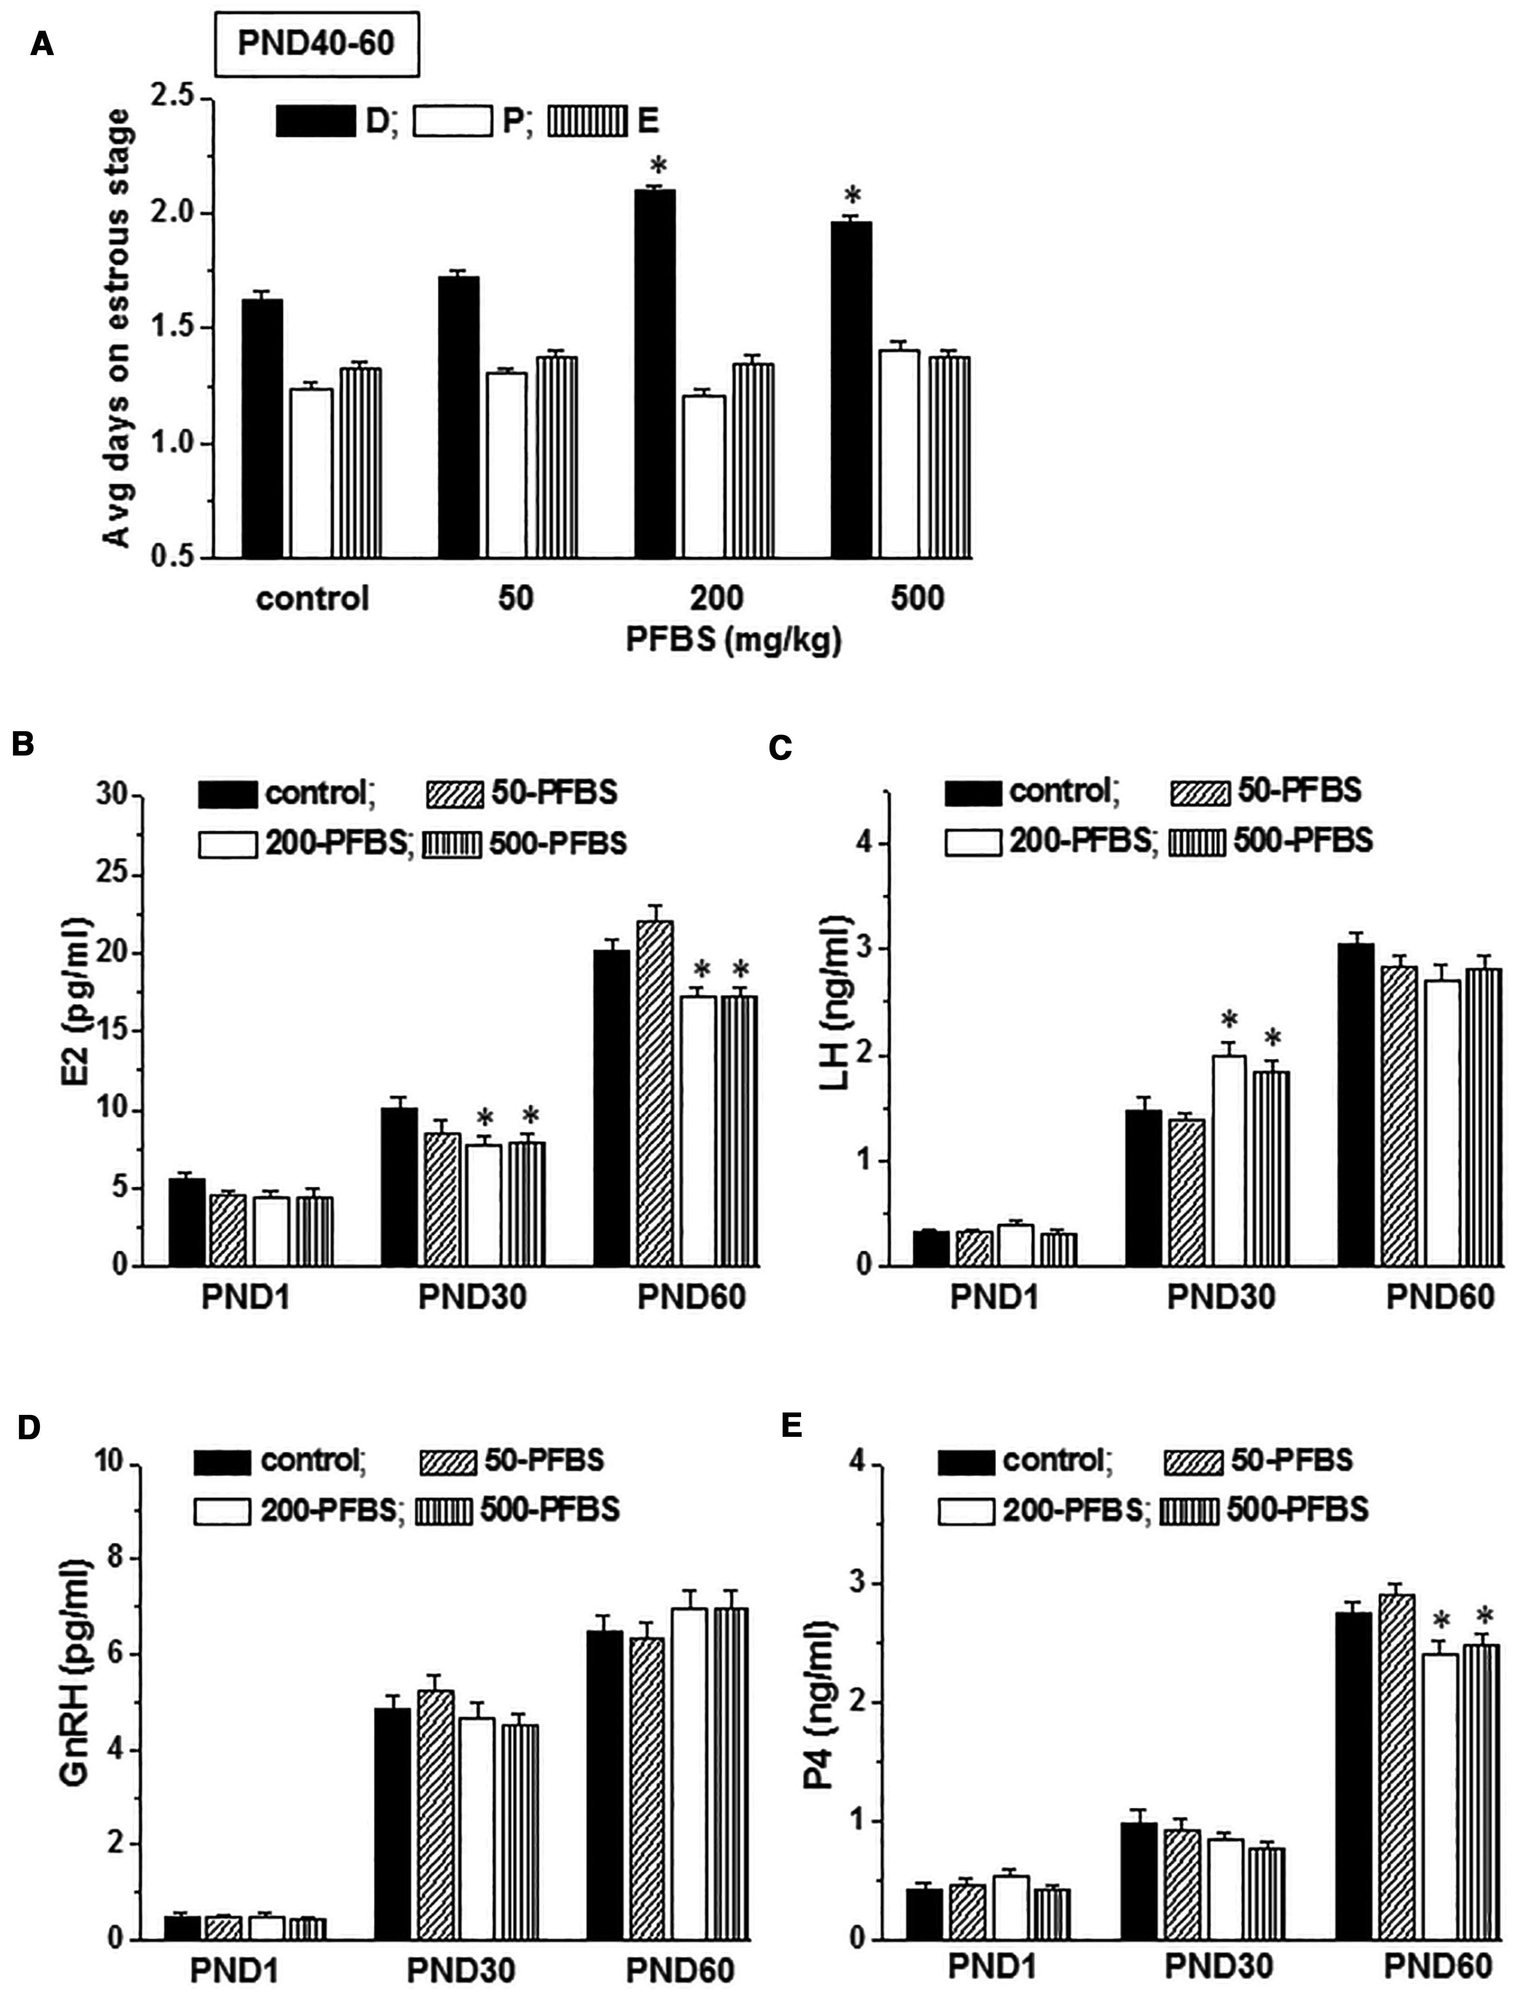
FIG. 3 Influence of prenatal perfluorobutanesulfonate (PFBS) exposure on estrous cycle and ...
Notes:
FIG. 3 Influence of prenatal perfluorobutanesulfonate (PFBS) exposure on estrous cycle and hypothalamic–pituitary–gonadal hormone levels. A, Estrous cycle. Bars indicate the mean days of proestrus (P), estrus (E), and diestrus (D) in postnatal day (PND) 40–60 offspring. *P < 0.05 versus control offspring (1-way ANOVA). Bar graphs show the levels of serum E2 (B), luteinizing hormone (LH) (C), and gonadotropin-releasing hormone (GnRH) in the hypothalamus (D) and P4 (E) in PND1, PND30, and PND60 control offspring and PFBS-offspring. *P < 0.05 versus control offspring (1-way ANOVA).
Unless provided in the caption above, the following copyright applies to the content of this slide: © The Author 2016. Published by Oxford University Press on behalf of the Society of Toxicology. All rights reserved. For Permissions, please e-mail: journals.permissions@oup.com

Slide 4
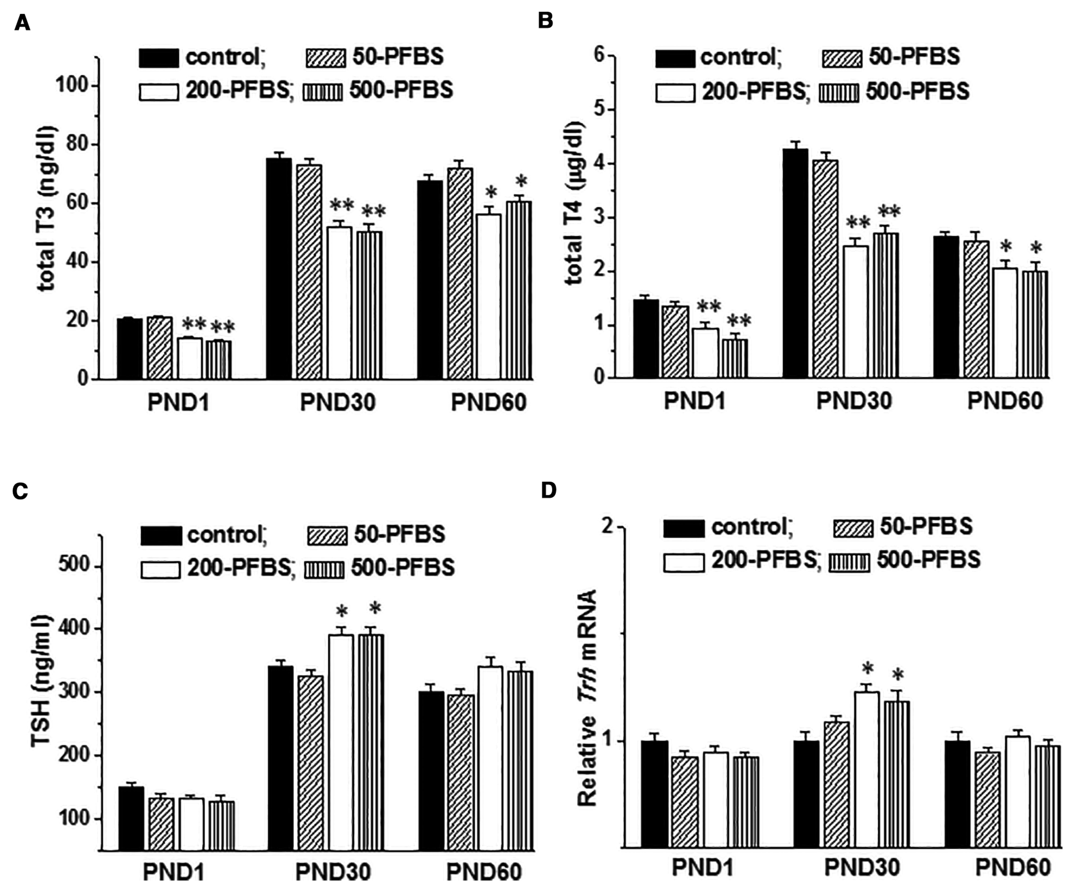
FIG. 4 Influence of prenatal perfluorobutanesulfonate (PFBS) exposure on hypothalamic–pituitary–thyroid hormone ...
Notes:
FIG. 4 Influence of prenatal perfluorobutanesulfonate (PFBS) exposure on hypothalamic–pituitary–thyroid hormone levels. Bar graphs show the levels of serum total 3,3′,5-triiodothyronine (T3) (A), total thyroxine (T4) (B), thyroid-stimulating hormone (TSH) (C) and hypothalamic Trh mRNA (D) in postnatal day (PND) 1, PND30, and PND60 control offspring and PFBS-offspring. *P < 0.05 and **P < 0.01 versus control offspring (1-way ANOVA).
Unless provided in the caption above, the following copyright applies to the content of this slide: © The Author 2016. Published by Oxford University Press on behalf of the Society of Toxicology. All rights reserved. For Permissions, please e-mail: journals.permissions@oup.com

