Slide 1
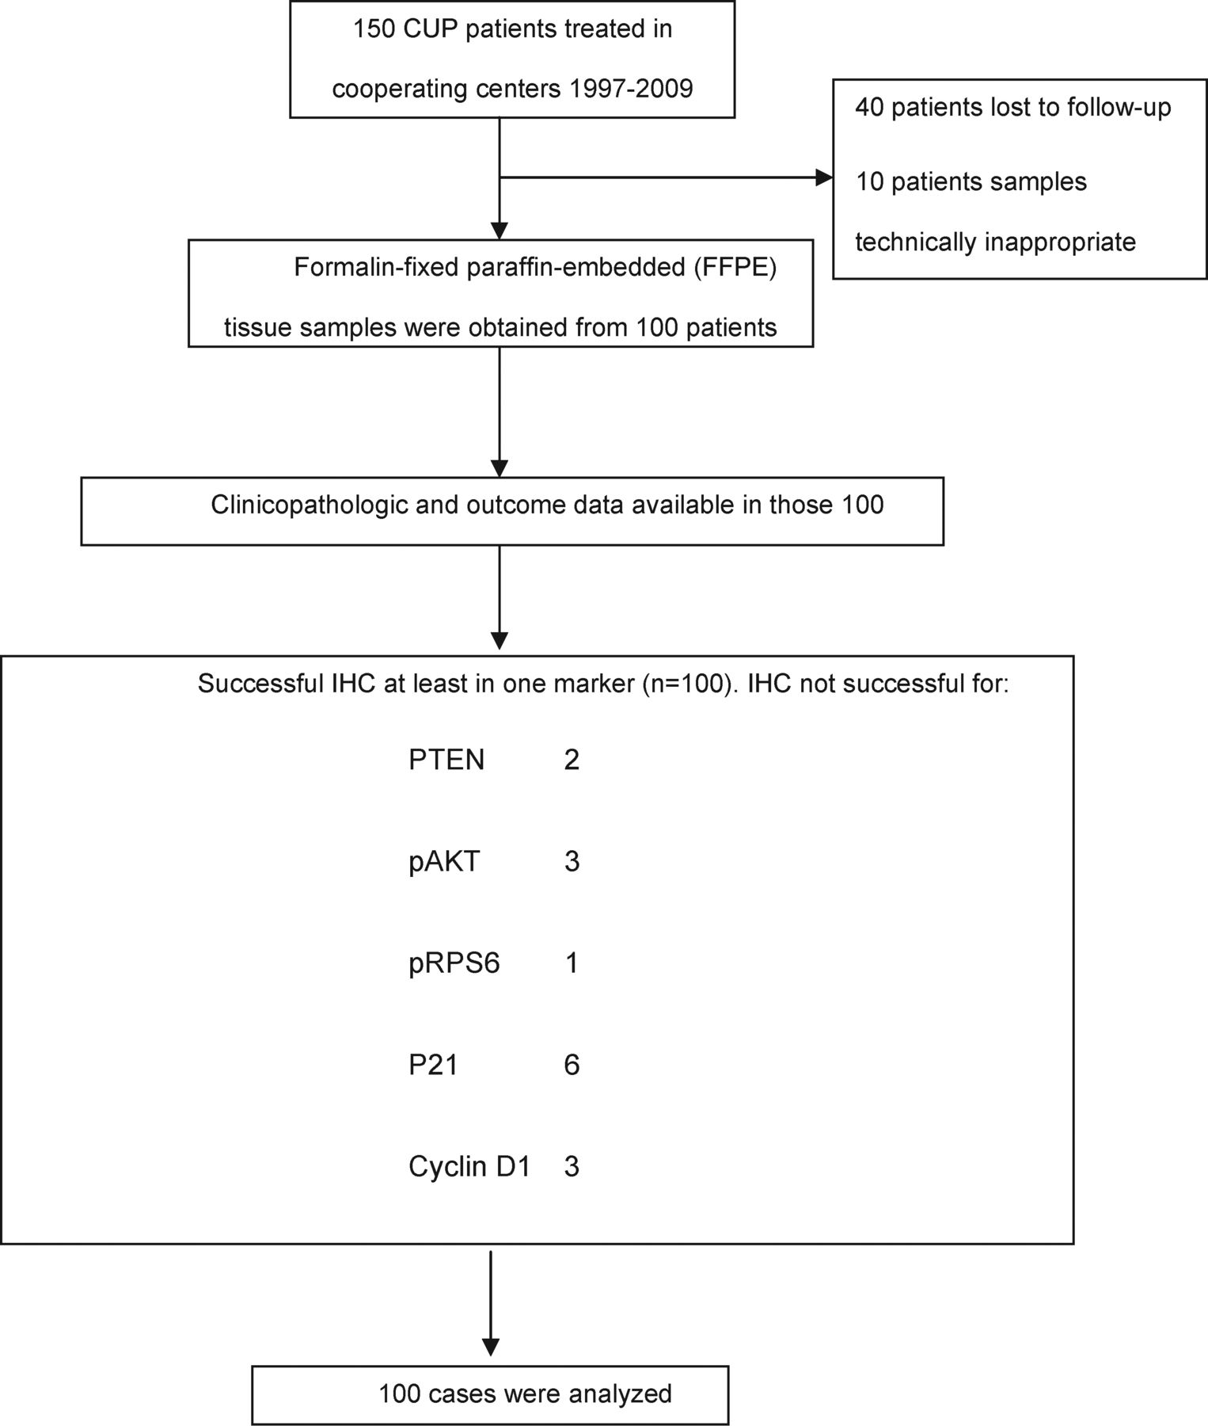
Figure 1. REMARK flow chart.
Notes:
Figure 1. REMARK flow chart.
Unless provided in the caption above, the following copyright applies to the content of this slide: © The Author 2012. Published by Oxford University Press on behalf of the European Society for Medical Oncology. All rights reserved. For permissions, please email: journals.permissions@oup.com

Slide 2
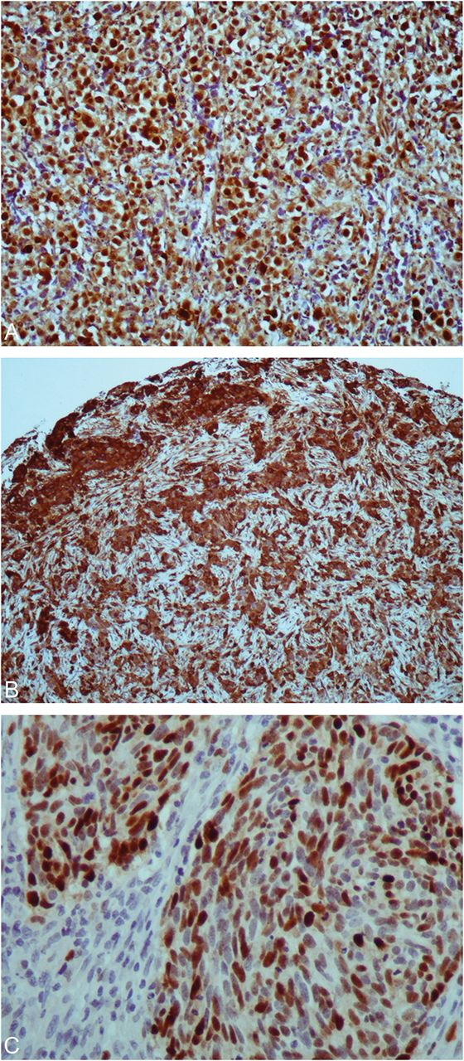
Figure 2. Immunohistochemistry carried out on tissue microarrays. (A) pAKT protein expression (×200); (B) pRPS6 ...
Notes:
Figure 2. Immunohistochemistry carried out on tissue microarrays. (A) pAKT protein expression (×200); (B) pRPS6 expression (×100); (C) p21 expression in tumour nuclei (×400).
Unless provided in the caption above, the following copyright applies to the content of this slide: © The Author 2012. Published by Oxford University Press on behalf of the European Society for Medical Oncology. All rights reserved. For permissions, please email: journals.permissions@oup.com

Slide 3
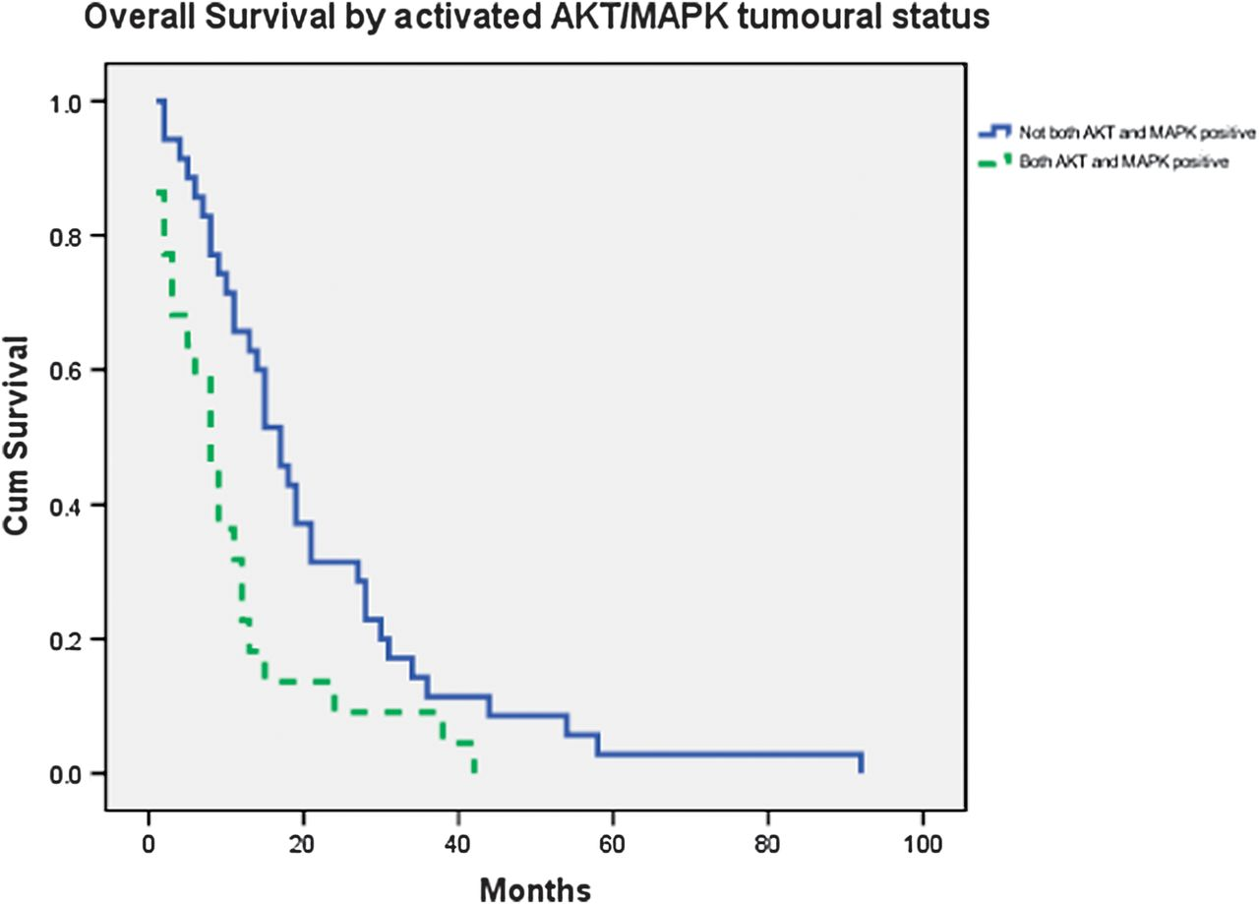
Figure 3. Overall survival of CUP patients by concurrent pAKT and pMAPK IHC expression (8 months [95% CI 5.3–10.7] ...
Notes:
Figure 3. Overall survival of CUP patients by concurrent pAKT and pMAPK IHC expression (8 months [95% CI 5.3–10.7] versus 17 months [95% CI 13.1–20.9]). CI, confidence interval.
Unless provided in the caption above, the following copyright applies to the content of this slide: © The Author 2012. Published by Oxford University Press on behalf of the European Society for Medical Oncology. All rights reserved. For permissions, please email: journals.permissions@oup.com

Slide 4
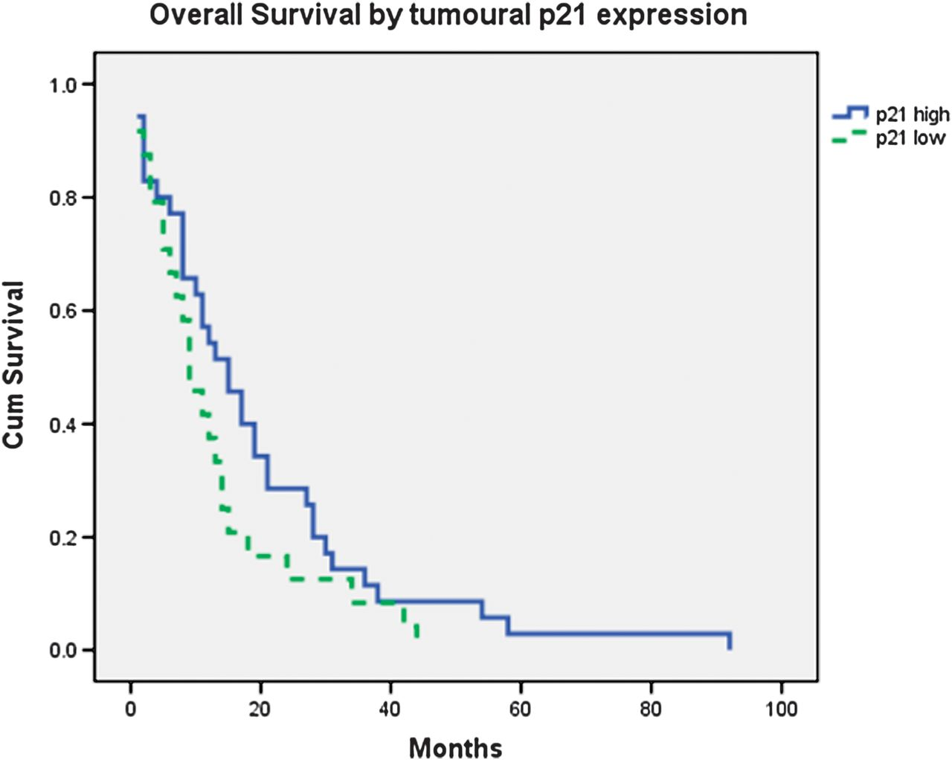
Figure 4. Overall survival of CUP patients by p21 IHC expression (RR = 0.34 [95% CI 0.16–0.73], P = 0.005). CI, ...
Notes:
Figure 4. Overall survival of CUP patients by p21 IHC expression (RR = 0.34 [95% CI 0.16–0.73], P = 0.005). CI, confidence interval.
Unless provided in the caption above, the following copyright applies to the content of this slide: © The Author 2012. Published by Oxford University Press on behalf of the European Society for Medical Oncology. All rights reserved. For permissions, please email: journals.permissions@oup.com

