Slide 1
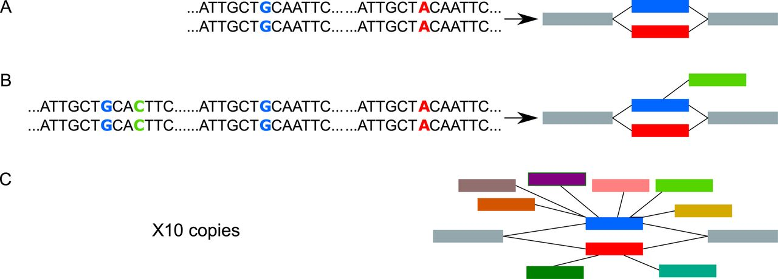
Figure 4. Two inexact repeats give rise to a pattern in the DBG that resembles a SNP (A). Very often, repeats are ...
Notes:
Figure 4. Two inexact repeats give rise to a pattern in the DBG that resembles a SNP (A). Very often, repeats are present in more than two copies (B) and therefore generate branching bubbles. Bubbles with more than five branches (C) are filtered out.
Unless provided in the caption above, the following copyright applies to the content of this slide: © The Author(s) 2016. Published by Oxford University Press on behalf of Nucleic Acids Research.This is an Open Access article distributed under the terms of the Creative Commons Attribution License (http://creativecommons.org/licenses/by-nc/4.0/), which permits non-commercial re-use, distribution, and reproduction in any medium, provided the original work is properly cited. For commercial re-use, please contact journals.permissions@oup.com

Slide 2
Figure 3. Sequencing errors and rare variants generate bubbles in DBGs with very unbalanced path coverage. (A) For ease ...
Notes:
Figure 3. Sequencing errors and rare variants generate bubbles in DBGs with very unbalanced path coverage. (A) For ease of exposition of the concept, we represent here the reads mapping to a reference genome. Applying an absolute cutoff would remove the sequencing error for a poorly expressed gene, but not for a highly expressed gene. (B) Applying a relative cutoff of 5% in the DBG removes one or two edges from the red path and hence prevents this bubble from being found.
Unless provided in the caption above, the following copyright applies to the content of this slide: © The Author(s) 2016. Published by Oxford University Press on behalf of Nucleic Acids Research.This is an Open Access article distributed under the terms of the Creative Commons Attribution License (http://creativecommons.org/licenses/by-nc/4.0/), which permits non-commercial re-use, distribution, and reproduction in any medium, provided the original work is properly cited. For commercial re-use, please contact journals.permissions@oup.com

Slide 3
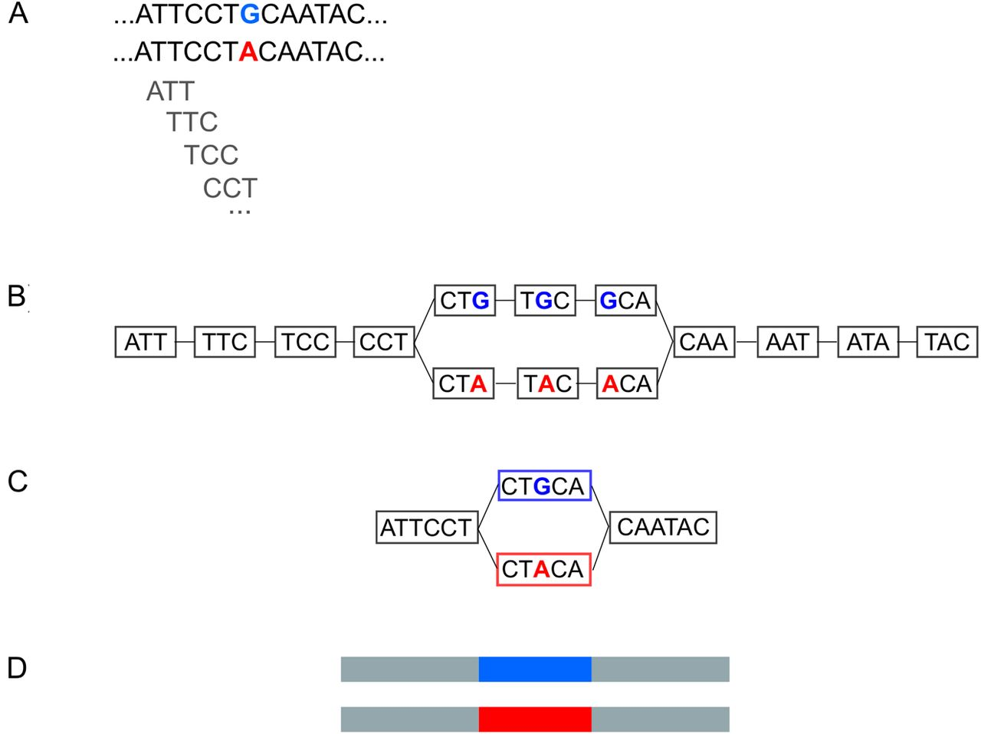
Figure 2. (A) A SNP present in two alleles in the data. (B) The de Bruijn Graph derived from the data. For the sake of ...
Notes:
Figure 2. (A) A SNP present in two alleles in the data. (B) The de Bruijn Graph derived from the data. For the sake of simplicity of exposition, we draw here with k = 3. In practice, k = 41. (C) A compressed de Bruijn graph can be obtained by merging nodes with a single outgoing edge with nodes with a single incoming edge. This compression step is lossless. (D) The two paths in the compressed de Bruijn graph correspond to the two alleles of the SNP.
Unless provided in the caption above, the following copyright applies to the content of this slide: © The Author(s) 2016. Published by Oxford University Press on behalf of Nucleic Acids Research.This is an Open Access article distributed under the terms of the Creative Commons Attribution License (http://creativecommons.org/licenses/by-nc/4.0/), which permits non-commercial re-use, distribution, and reproduction in any medium, provided the original work is properly cited. For commercial re-use, please contact journals.permissions@oup.com

Slide 4
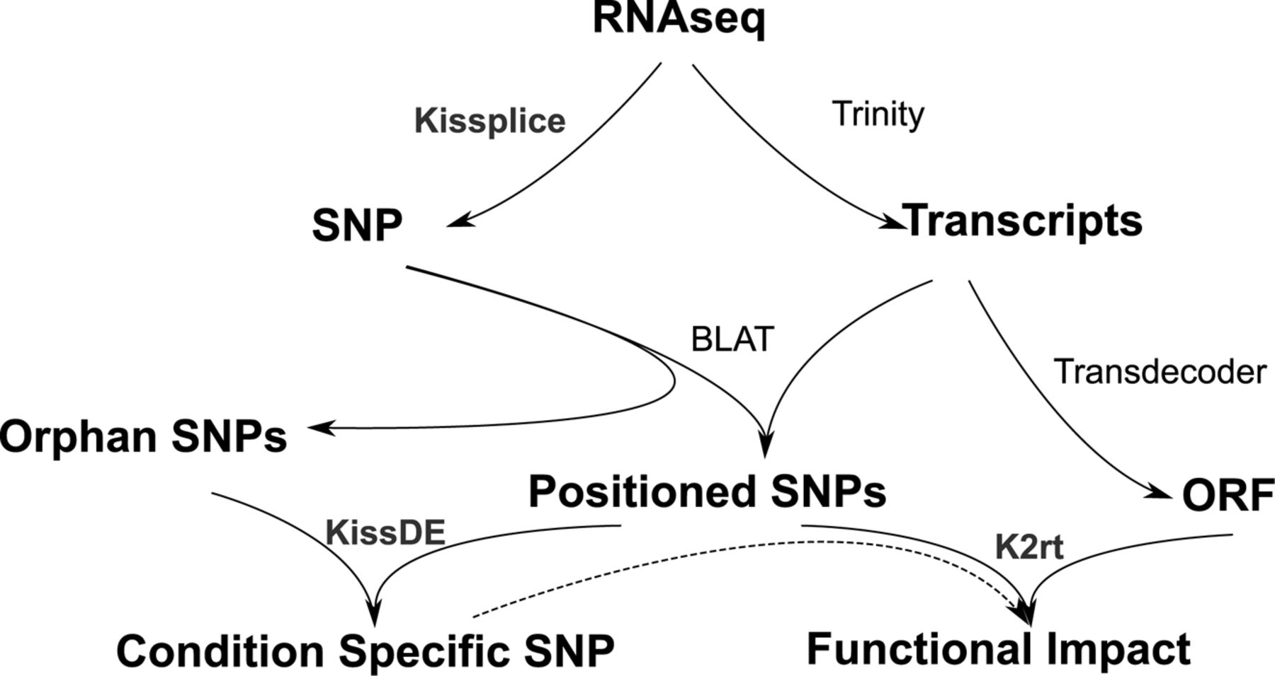
Figure 1. With fasta/fastq input from an RNA-seq experiment, SNPs are found by KisSplice without using a reference. As ...
Notes:
Figure 1. With fasta/fastq input from an RNA-seq experiment, SNPs are found by KisSplice without using a reference. As KisSplice provides only a local context around the SNPs, a reference can be built with Trinity, and SNPs can be positioned on whole transcripts. Some SNPs that do not map on the transcripts of Trinity, called orphan SNPs, are harder to study but can still be of interest. We propose a statistical method, called kissDE, to find condition-specific SNPs (even if they are not positioned) out of all SNPs found. Finally, we can also predict the amino acid change for the positioned SNPs, and intersect these results with condition-specific SNPs using our package KisSplice2RefTranscriptome (K2rt).
Unless provided in the caption above, the following copyright applies to the content of this slide: © The Author(s) 2016. Published by Oxford University Press on behalf of Nucleic Acids Research.This is an Open Access article distributed under the terms of the Creative Commons Attribution License (http://creativecommons.org/licenses/by-nc/4.0/), which permits non-commercial re-use, distribution, and reproduction in any medium, provided the original work is properly cited. For commercial re-use, please contact journals.permissions@oup.com

Slide 5
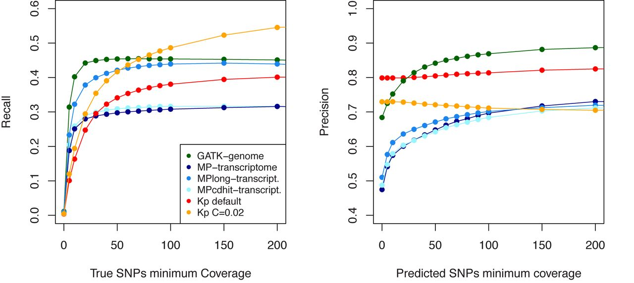
Figure 5. Precision and recall of KisSplice, Gatk-genome, MP-transcriptome and MP-long-trans as a function of the ...
Notes:
Figure 5. Precision and recall of KisSplice, Gatk-genome, MP-transcriptome and MP-long-trans as a function of the expression level of the locus. For the recall, all predictions are taken into account, but the set of true SNPs is restricted to those covered by at least a given number of reads. For the precision, only SNPs supported by at least a given number of reads are taken into account.
Unless provided in the caption above, the following copyright applies to the content of this slide: © The Author(s) 2016. Published by Oxford University Press on behalf of Nucleic Acids Research.This is an Open Access article distributed under the terms of the Creative Commons Attribution License (http://creativecommons.org/licenses/by-nc/4.0/), which permits non-commercial re-use, distribution, and reproduction in any medium, provided the original work is properly cited. For commercial re-use, please contact journals.permissions@oup.com

Slide 6
Figure 6. Difference of allele frequencies (df) Vs Difference of expressed allele frequencies (dfe). (A) All SNPs. (B) ...
Notes:
Figure 6. Difference of allele frequencies (df) Vs Difference of expressed allele frequencies (dfe). (A) All SNPs. (B) Condition-specific SNPs. (C) Conditions-specific SNPs covered by at least 100 reads.
Unless provided in the caption above, the following copyright applies to the content of this slide: © The Author(s) 2016. Published by Oxford University Press on behalf of Nucleic Acids Research.This is an Open Access article distributed under the terms of the Creative Commons Attribution License (http://creativecommons.org/licenses/by-nc/4.0/), which permits non-commercial re-use, distribution, and reproduction in any medium, provided the original work is properly cited. For commercial re-use, please contact journals.permissions@oup.com

Slide 7
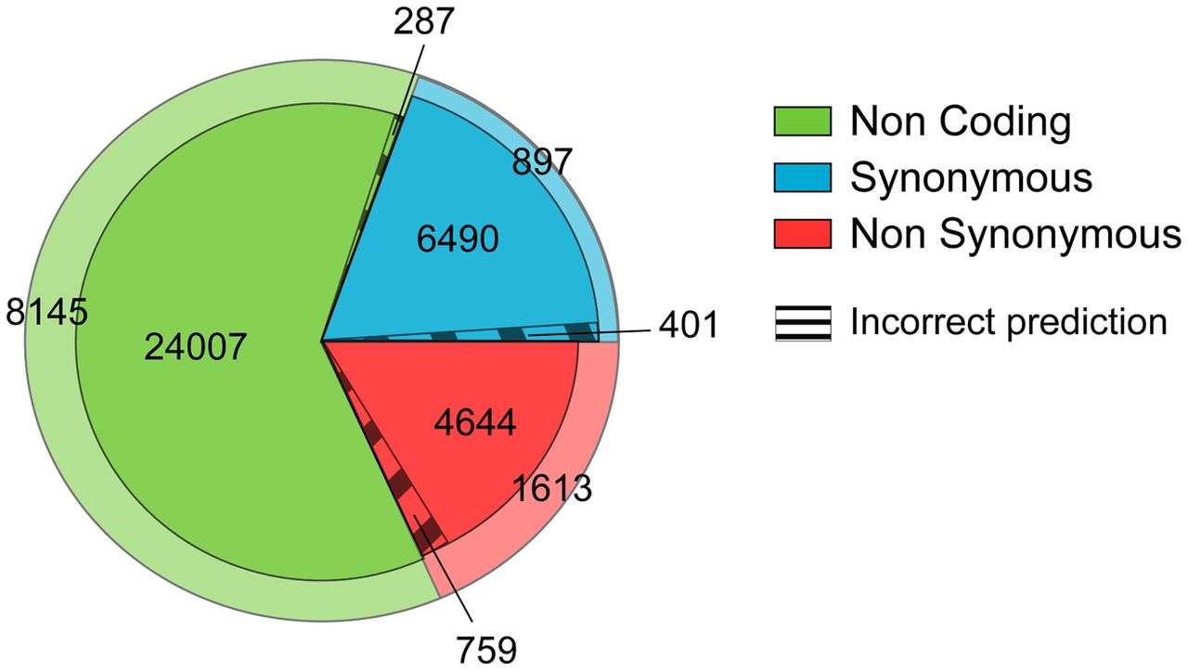
Figure 7. Results of KisSplice2RefTranscriptome The green, red and blue areas correspond respectively to non-coding, ...
Notes:
Figure 7. Results of KisSplice2RefTranscriptome The green, red and blue areas correspond respectively to non-coding, synonymous and non-synonymous SNPs. The dashed area corresponds to errors of our predictions of the impact on the protein sequence. The outer area corresponds to SNPs that are not in dbSNP or for which the prediction cannot be evaluated due to a lack of annotation in dbSNP.
Unless provided in the caption above, the following copyright applies to the content of this slide: © The Author(s) 2016. Published by Oxford University Press on behalf of Nucleic Acids Research.This is an Open Access article distributed under the terms of the Creative Commons Attribution License (http://creativecommons.org/licenses/by-nc/4.0/), which permits non-commercial re-use, distribution, and reproduction in any medium, provided the original work is properly cited. For commercial re-use, please contact journals.permissions@oup.com

Slide 8
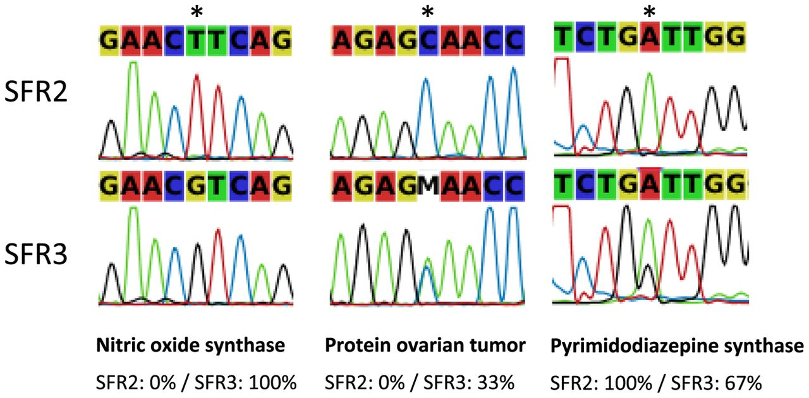
Figure 8. Three examples of SNPs validated by Sanger sequencing. The first is fixed in both the SFR2 and SFR3 lineages. ...
Notes:
Figure 8. Three examples of SNPs validated by Sanger sequencing. The first is fixed in both the SFR2 and SFR3 lineages. The second and third are polymorphic in SFR3 but fixed in SFR2. In the third case, the base caller does not reflect the polymorphism but it can be seen from the chromatogram.
Unless provided in the caption above, the following copyright applies to the content of this slide: © The Author(s) 2016. Published by Oxford University Press on behalf of Nucleic Acids Research.This is an Open Access article distributed under the terms of the Creative Commons Attribution License (http://creativecommons.org/licenses/by-nc/4.0/), which permits non-commercial re-use, distribution, and reproduction in any medium, provided the original work is properly cited. For commercial re-use, please contact journals.permissions@oup.com

