Slide 1
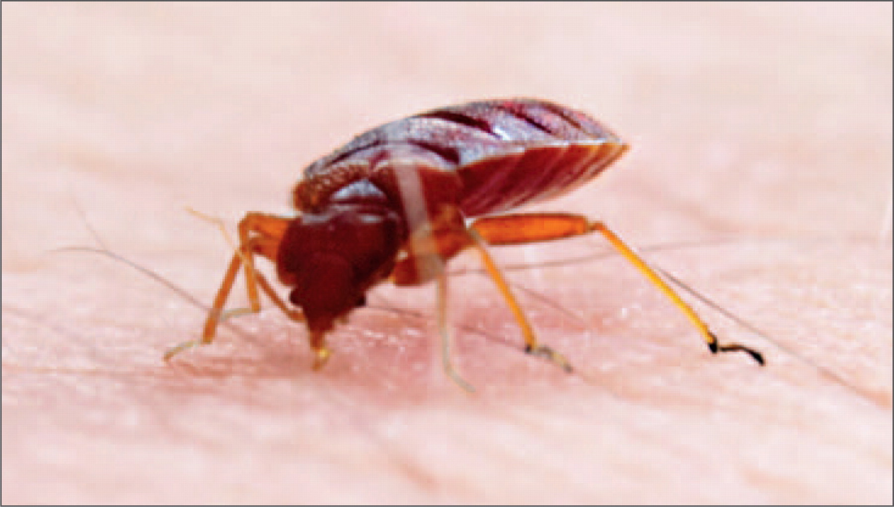
Image 1 Adult bedbug feeding on a human host. Their flat, oval-shaped bodies are reddish brown until they feed, at ...
Notes:
Image 1 Adult bedbug feeding on a human host. Their flat, oval-shaped bodies are reddish brown until they feed, at which point they become reddish and round. Courtesy of http://www.wikimediacommons.org.
Unless provided in the caption above, the following copyright applies to the content of this slide: © American Society of Clinical Pathologists

Slide 2
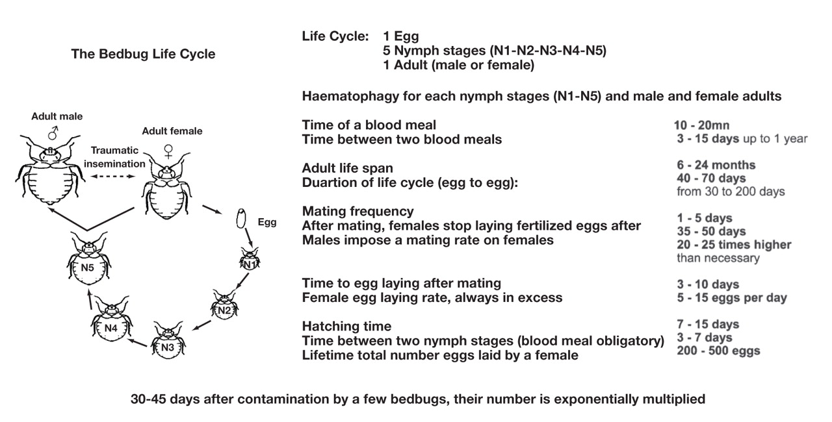
Figure 1 The life cycle of C. lectularius or C. hemipterus. The life cycle of cimicids includes the egg stage, 5 nymph ...
Notes:
Figure 1 The life cycle of C. lectularius or C. hemipterus. The life cycle of cimicids includes the egg stage, 5 nymph stages (N1, N2, N3, N4, and N5), and the adult stage. From Delaunay P et al., 2011.4 Used with permission ©2011.
Unless provided in the caption above, the following copyright applies to the content of this slide: © American Society of Clinical Pathologists

Slide 3
Image 2 Locations where bedbugs hide. Being small but visible, bedbugs often hide in furniture (A, B) and luggage ...
Notes:
Image 2 Locations where bedbugs hide. Being small but visible, bedbugs often hide in furniture (A, B) and luggage (C). From Bedbugs Detroit Extermination and Pest Control Web page. http://www.bedbugsdetroit.com/bed-bugs-news. Accessed June 28, 2011.
Unless provided in the caption above, the following copyright applies to the content of this slide: © American Society of Clinical Pathologists

