Slide 1
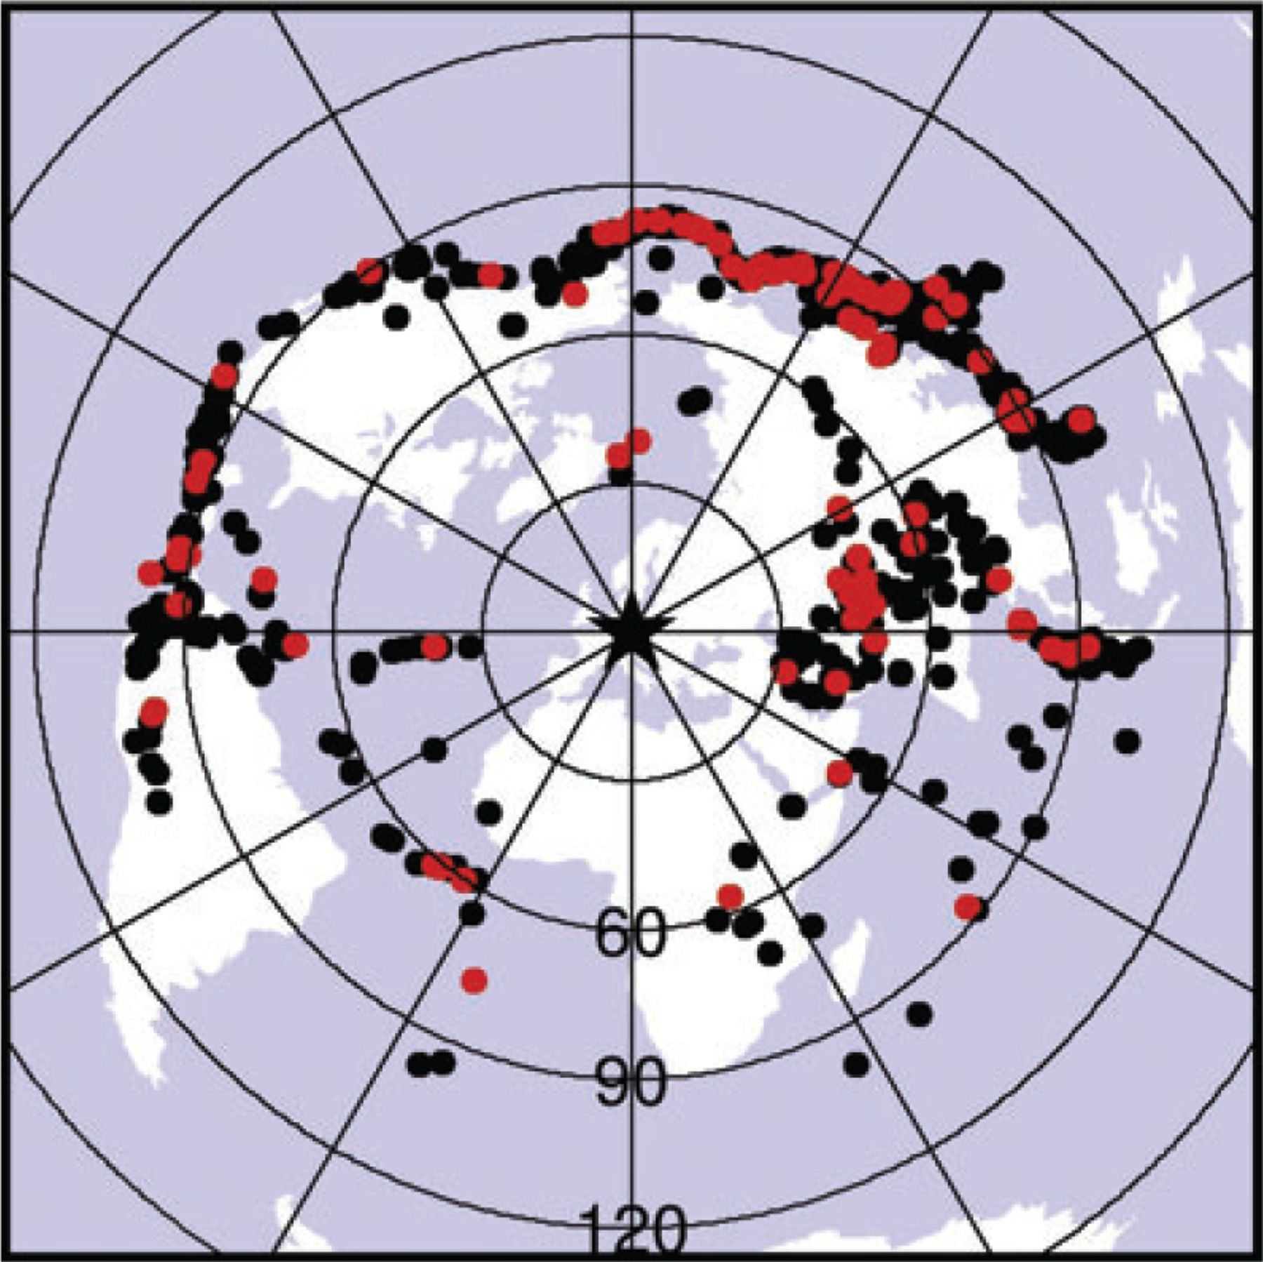
Figure 2 Distribution of teleseismic events used in this study. The black star in the centre marks the location of the ...
Notes:
Figure 2 Distribution of teleseismic events used in this study. The black star in the centre marks the location of the investigation area. Events that occurred within the recording time span of the BOHEMA experiment are shown by red dots. Events that occurred before and after that time span are coloured black and were recorded by permanent stations and/or by stations of the experiment of Geissler et al. (2005). Generally, there is a gap of observations to the south and dominance of observations to the northeast of the study area.
Unless provided in the caption above, the following copyright applies to the content of this slide: © The Authors Geophysical Journal International © 2011 RAS

Slide 2
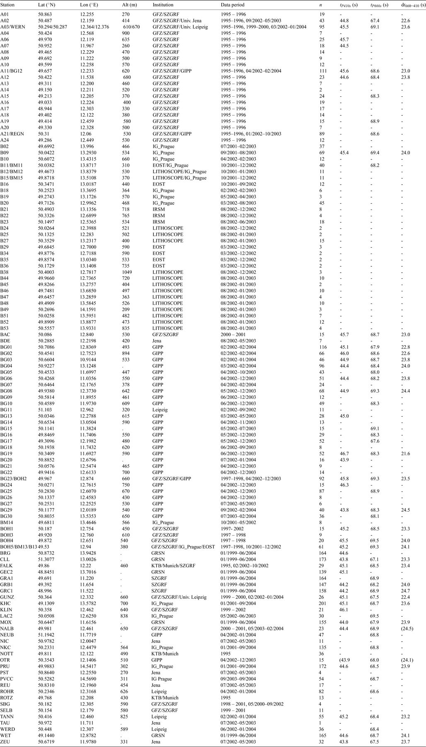
Table 1
Notes:
Table 1
Unless provided in the caption above, the following copyright applies to the content of this slide: © The Authors Geophysical Journal International © 2011 RAS

Slide 3
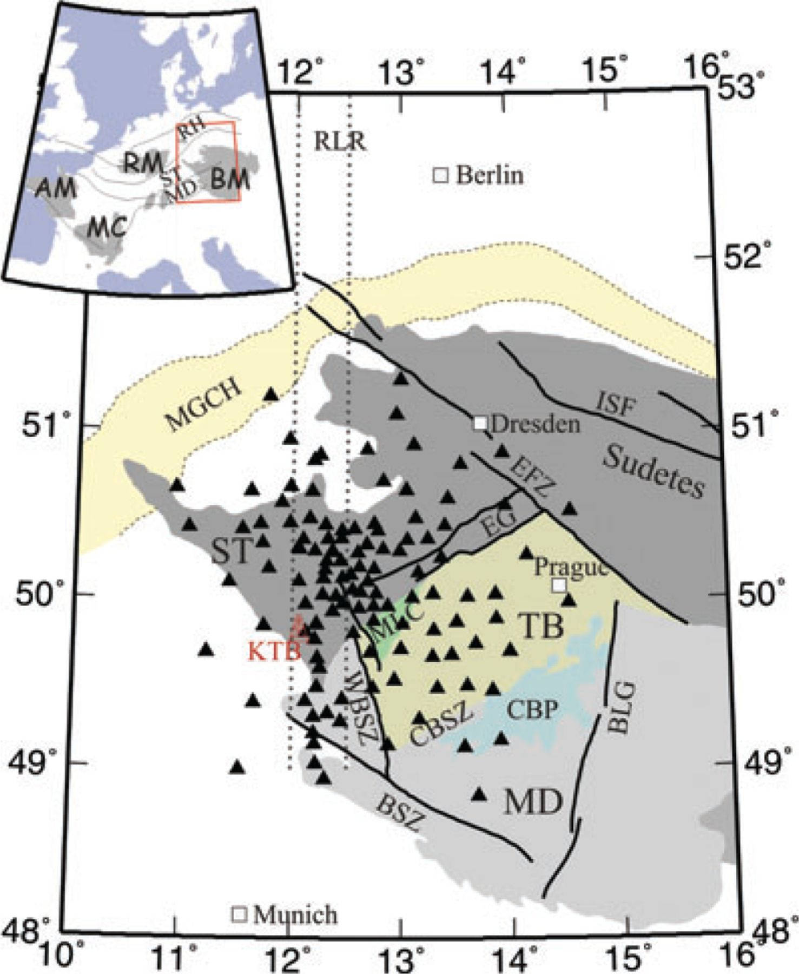
Figure 1 Map of the Bohemian Massif with its major tectonometamorphic units and fault zones (modified after Plomerová ...
Notes:
Figure 1 Map of the Bohemian Massif with its major tectonometamorphic units and fault zones (modified after Plomerová 2007): Mid-German Crystalline High (MGCH); Saxothuringian (ST), Moldanubian (MD) and Teplá-Barrandian (TB) unit; Mariánské Lázne Complex (MLC); Central Bohemian Pluton (CBP); Eger Graben (EG); West Bohemian Shear Zone (WBSZ); Central Bohemian Shear Zone (CBSZ); Bavarian Shear Zone (BSZ); Elbe Fault Zone (EFZ); Blanice Graben (BLG); Intra-Sudetic Fault (ISF); Regensburg-Leipzig-Rostock zone (RLR). KTB is the location of the German Continental Deep Drilling Boreholes. Black triangles show the location of stations of the BOHEMA experiment and of the prestudy by Geissler et al. (2005). Inset: Location of the investigated area within central Europe. AM: Armorican Massif; MC: Massif Central; RM: Rhenish Massif; BM: Bohemian Massif; ST: Saxothuringian unit; MD: Moldanubian unit; RH: Rhenohercynian unit.
Unless provided in the caption above, the following copyright applies to the content of this slide: © The Authors Geophysical Journal International © 2011 RAS

Slide 4
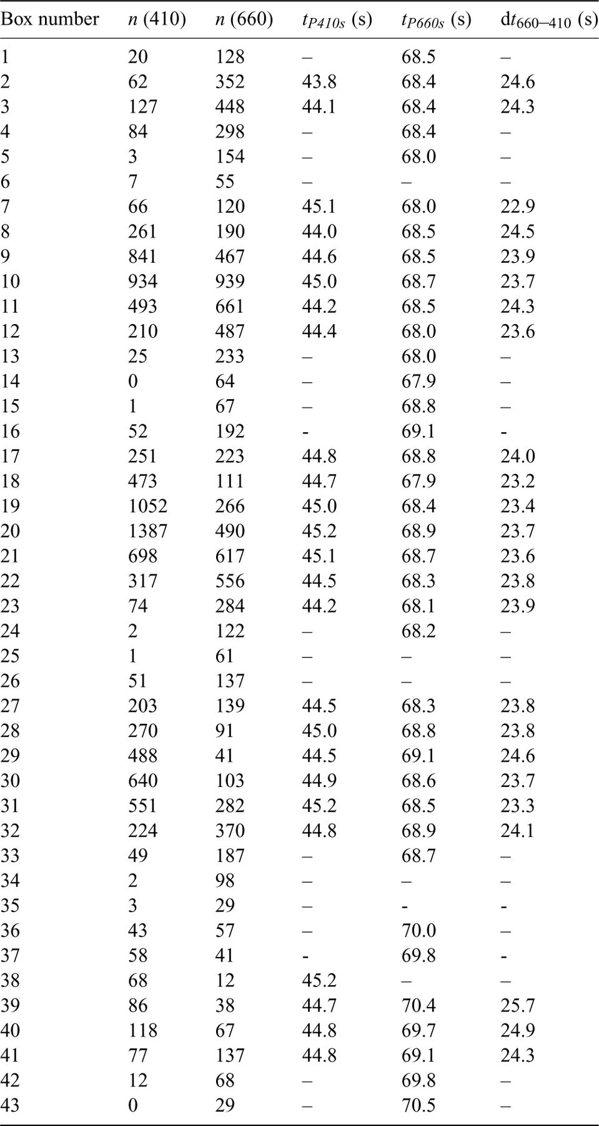
Table 2
Notes:
Table 2
Unless provided in the caption above, the following copyright applies to the content of this slide: © The Authors Geophysical Journal International © 2011 RAS

Slide 5
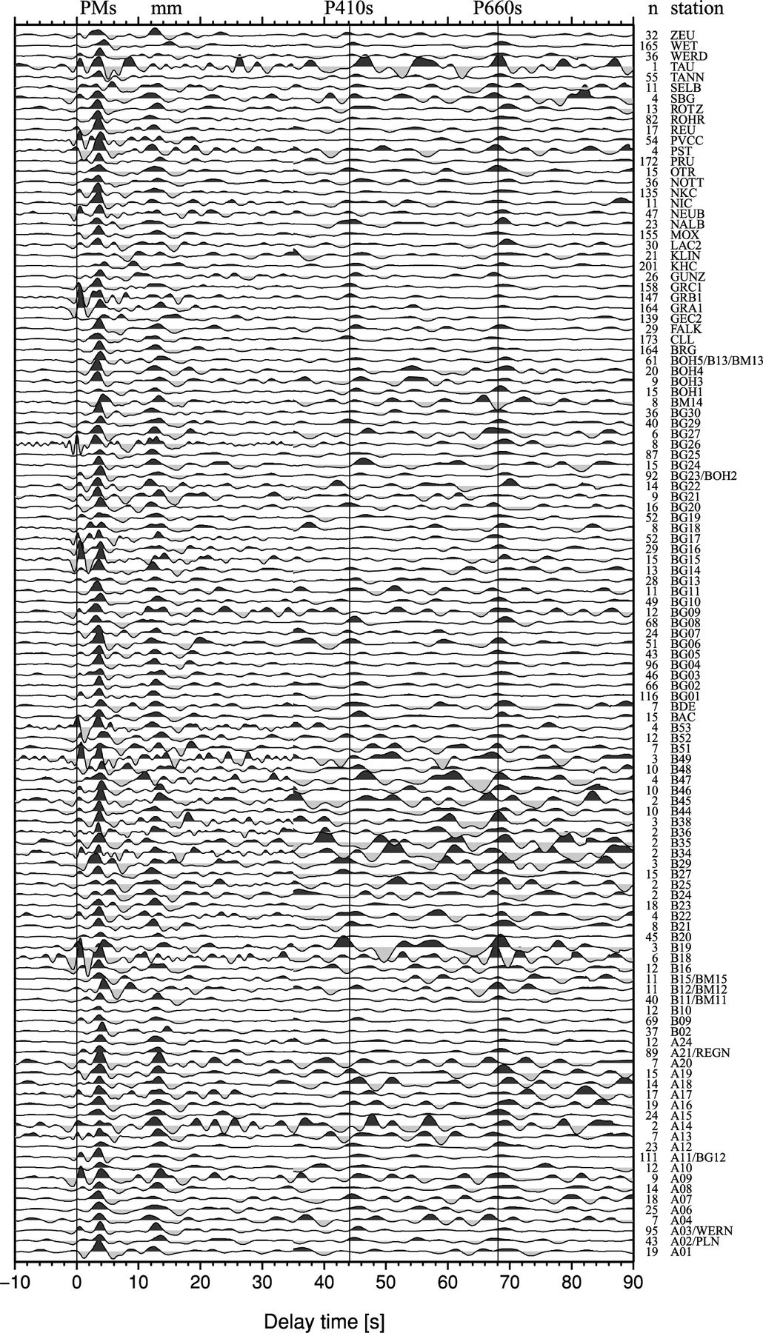
Figure 3 Common station stack traces of all 117 station. The time axis shows the delay time of the phases with respect ...
Notes:
Figure 3 Common station stack traces of all 117 station. The time axis shows the delay time of the phases with respect to the P onset. Stations are sorted alphabetically. n is the number of individual traces stacked (slowness-corrected). Theoretical arrival times of the converted phases from the ‘410’ and ‘660’ according to the IASP91 reference model are marked by thin vertical lines at 44.1 s and 68.1 s, respectively. The traces are filtered with a bandpass of 1-12 s for the time window between -10 s and 35 s delay time. Later than 35 s delay time, a bandpass of 3-20 s was used. The most prominent signals are the P-to-S conversion at the Moho (PMs) and its multiples (mm) at approximately 11 s to 18 s, as well as the P-to-S conversion at the 410 km discontinuity (P410s) and the 660 km discontinuity (P660s).
Unless provided in the caption above, the following copyright applies to the content of this slide: © The Authors Geophysical Journal International © 2011 RAS

Slide 6
Figure 9 (a) Delay times measured for the 410-km discontinuity (see Fig. 8a and Table 2). Only boxes containing at ...
Notes:
Figure 9 (a) Delay times measured for the 410-km discontinuity (see Fig. 8a and Table 2). Only boxes containing at least 20 traces were taken into account. Red colours show longer and blue colours shorter delay times than predicted by the IASP91 reference model (44.1 ± 0.5 s, green), which could correspond to relatively hot and cool temperature, respectively. In hatched boxes, the discontinuity was not covered by at least 20 piercing points, or the signal was unclear. The yellow star marks the centre of the Vogtland/northwest Bohemia swarm earthquake region. (b) Delay times measured for the 660-km discontinuity (see Fig. 8b and Table 2). Only boxes containing at least 20 traces were taken into account. The colour scale is opposite to the scale in Fig. 7 as the 660-km discontinuity has a negative ‘Clapeyron’ slope dP/dT. Blue colours show longer and red colours shorter delay times than predicted by the IASP91 reference model (68.1 ± 0.5 s, green), which could correspond to cool or hot temperatures near the discontinuity, respectively. (c) Difference of the delay times between the P660s and P410s conversions. In the IASP91 reference model, it is predicted to be 24.0 ± 0.5 s. Blue colours indicate a thicker, red colours a thinner mantle transition zone than predicted by IASP91. Coverage with piercing points is not shown because it is different for the two discontinuities within one box (see Fig. 4).
Unless provided in the caption above, the following copyright applies to the content of this slide: © The Authors Geophysical Journal International © 2011 RAS

Slide 7
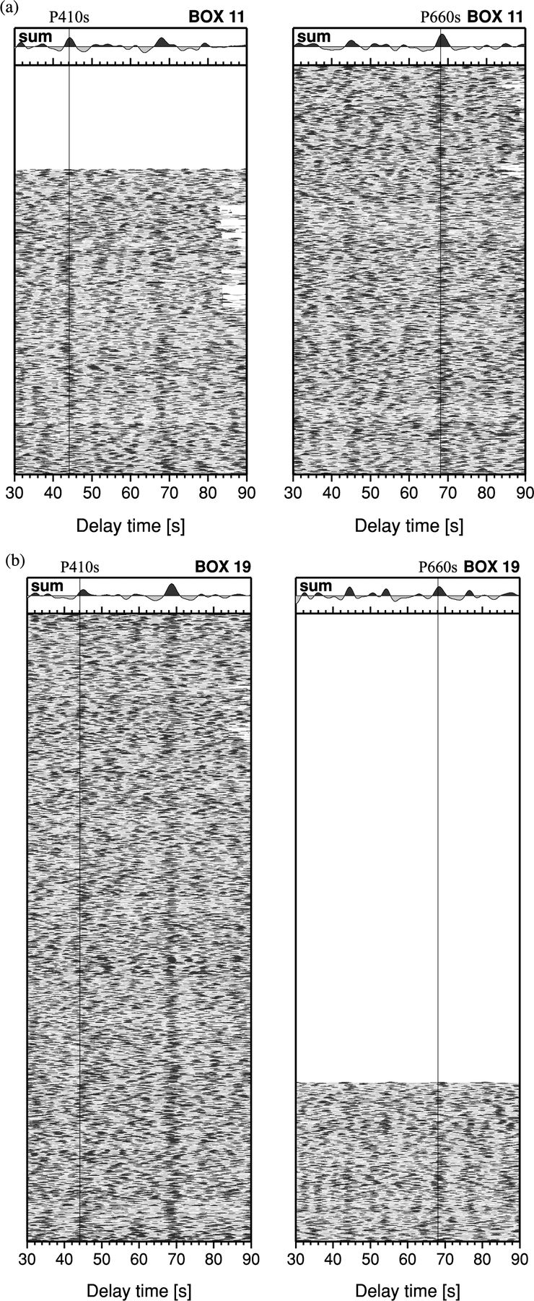
Figure 7 (a) Data example (box 11, see Fig. 4) in the time window between 30 to 90 s after the P onset. Which data the ...
Notes:
Figure 7 (a) Data example (box 11, see Fig. 4) in the time window between 30 to 90 s after the P onset. Which data the box actually contains depends on the considered depth (see piercing points in Fig. 4). Left-hand side: traces were sorted according to piercing points at 410-km depth. Right-hand side: traces were sorted according to piercing points at 660-km depth. Single traces were filtered between 3 and 20 s, moveout-corrected and stacked. On top of the single traces, the sum trace is displayed. The P410s and P660s conversion signals are sometimes weak in the single traces but clear in the sum trace. Thin lines at 44.1 s and 68.1 s give delay times predicted by the reference model IASP91. (b) The same for box 19.
Unless provided in the caption above, the following copyright applies to the content of this slide: © The Authors Geophysical Journal International © 2011 RAS

Slide 8
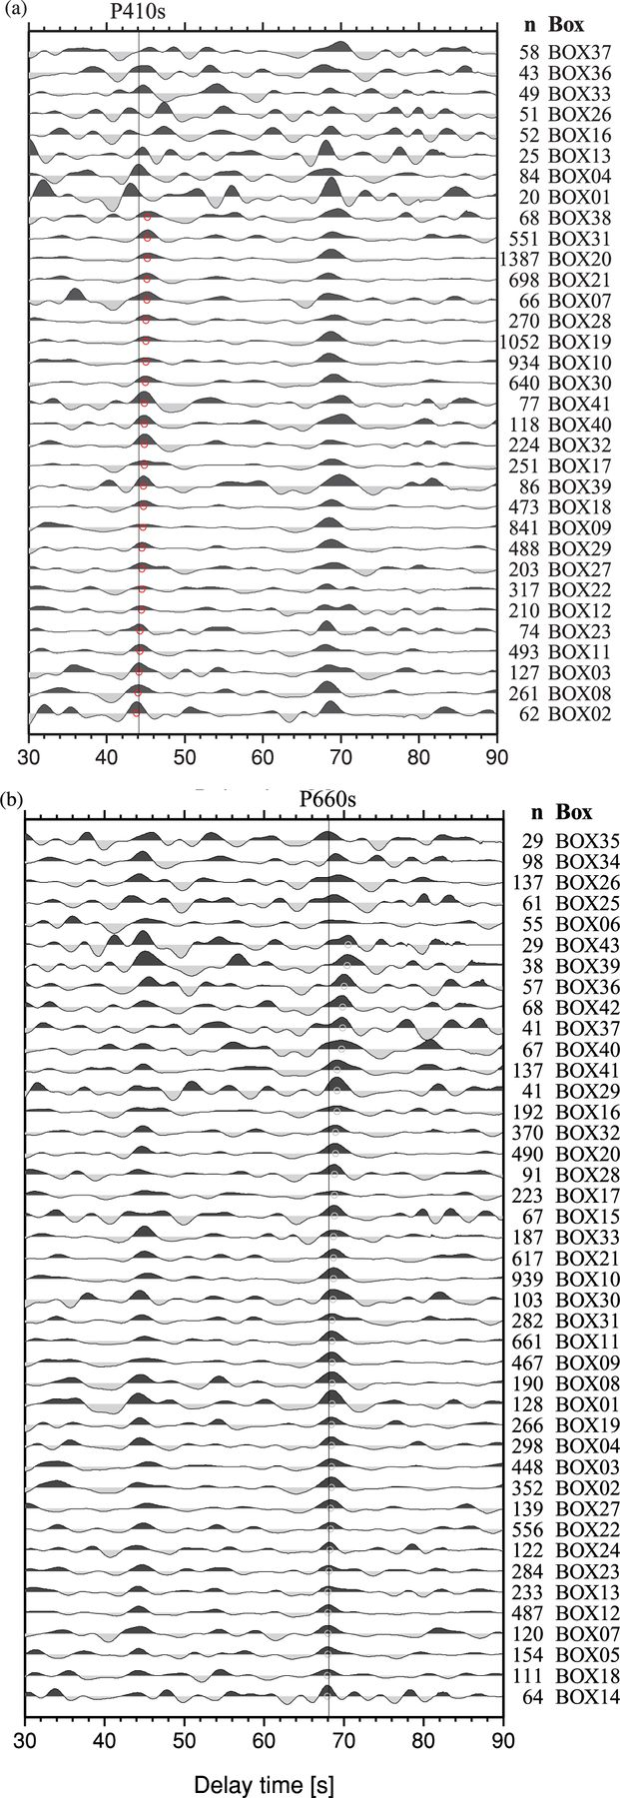
Figure 8 Stacked receiver functions of boxes containing at least 20 traces with piercing points at 410-km depth (a) ...
Notes:
Figure 8 Stacked receiver functions of boxes containing at least 20 traces with piercing points at 410-km depth (a) and 660-km depth (b). The stacked traces are sorted by delay time of P410s and P660s, respectively. The horizontal axis shows the delay time with respect to the P onset. n: number of stacked traces. The single traces were corrected for moveout and filtered between 3 and 20 s before stacking. Thin lines at 44.1 s and 68.1 s mark the delay times of the 410- and 660-km discontinuities according to the IASP91 reference model. Coherent positive arrivals near the delay times predicted by IASP91 are clearly visible for both the ‘410’ and ‘660’. Our measurements of delay times marked by red circles for the ‘410’ and green circles for the ‘660’ (see Table 2). For sum traces with no circle, no clear conversion signal or time pick could be determined.
Unless provided in the caption above, the following copyright applies to the content of this slide: © The Authors Geophysical Journal International © 2011 RAS

Slide 9
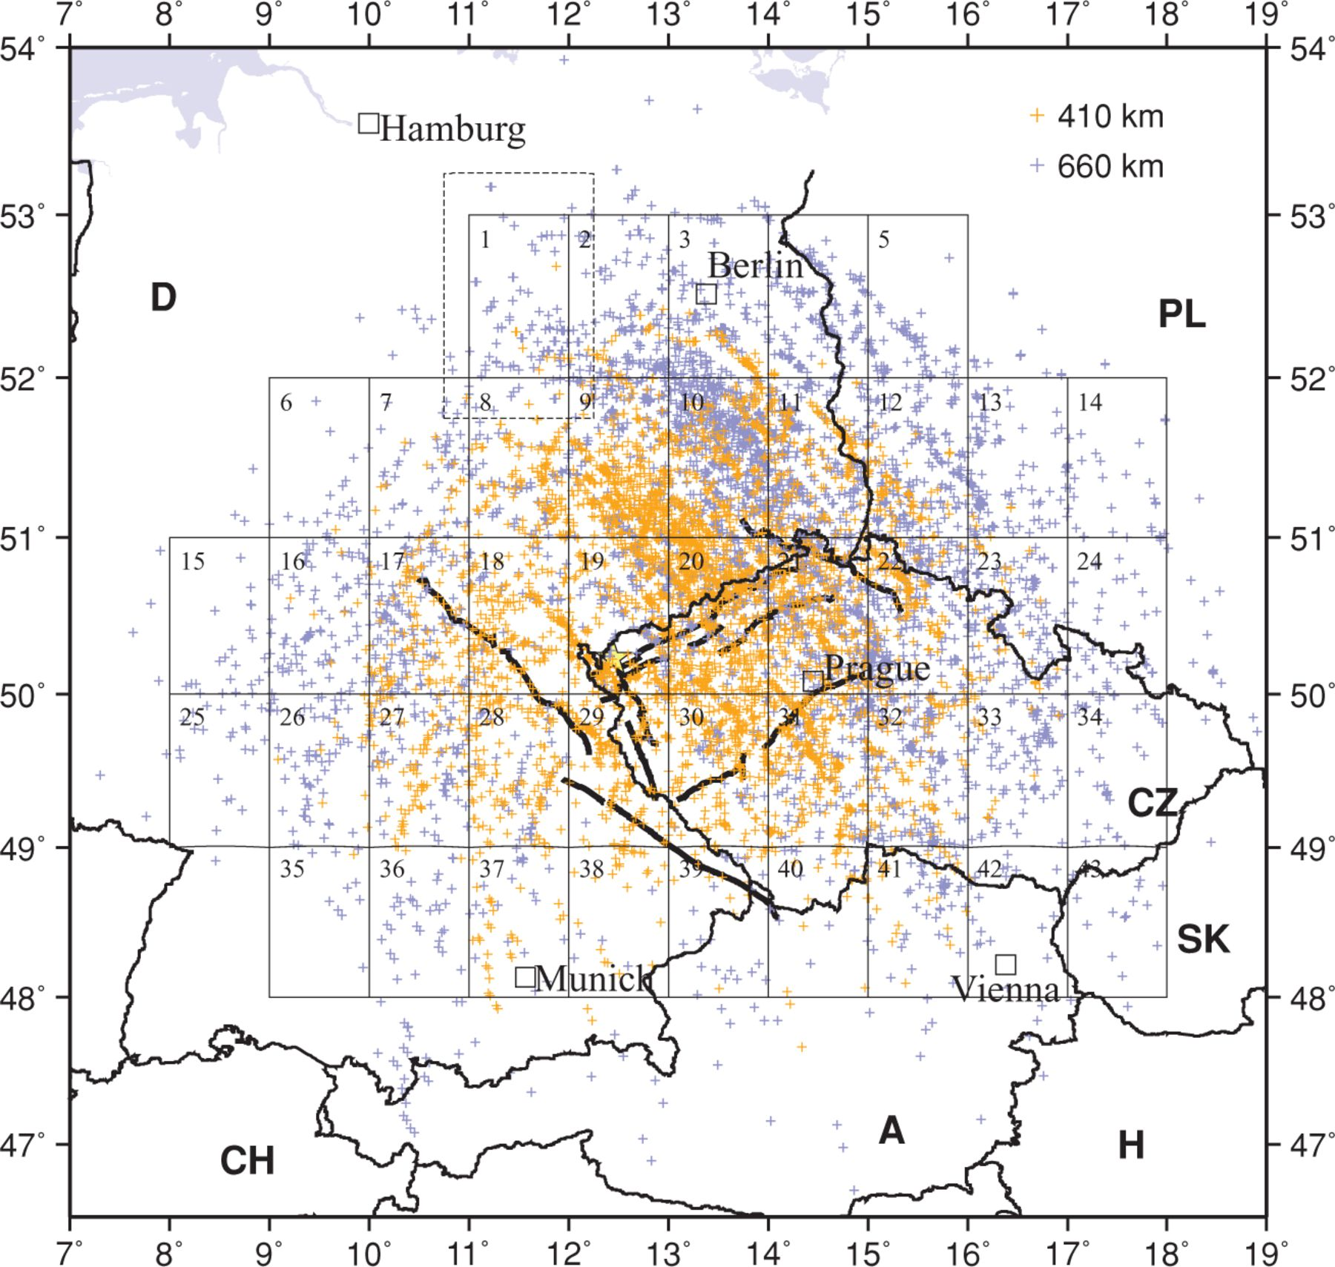
Figure 4 Piercing points of the P-to-S converted phases at interfaces at 410-km (orange) and 660-km depth (blue). The ...
Notes:
Figure 4 Piercing points of the P-to-S converted phases at interfaces at 410-km (orange) and 660-km depth (blue). The piercing points are located 80-170 km and 150-310 km away from the recording station for the 410- and 660-km discontinuity, respectively. For both depth values the same division of the area into boxes of 1°×1° plus a rim of 0.25° (shown only for box 1 by a dashed line) was chosen. Hence, number and location of the piercing points within a specific box are different for interfaces at 410- and 660-km depth.
Unless provided in the caption above, the following copyright applies to the content of this slide: © The Authors Geophysical Journal International © 2011 RAS

Slide 10
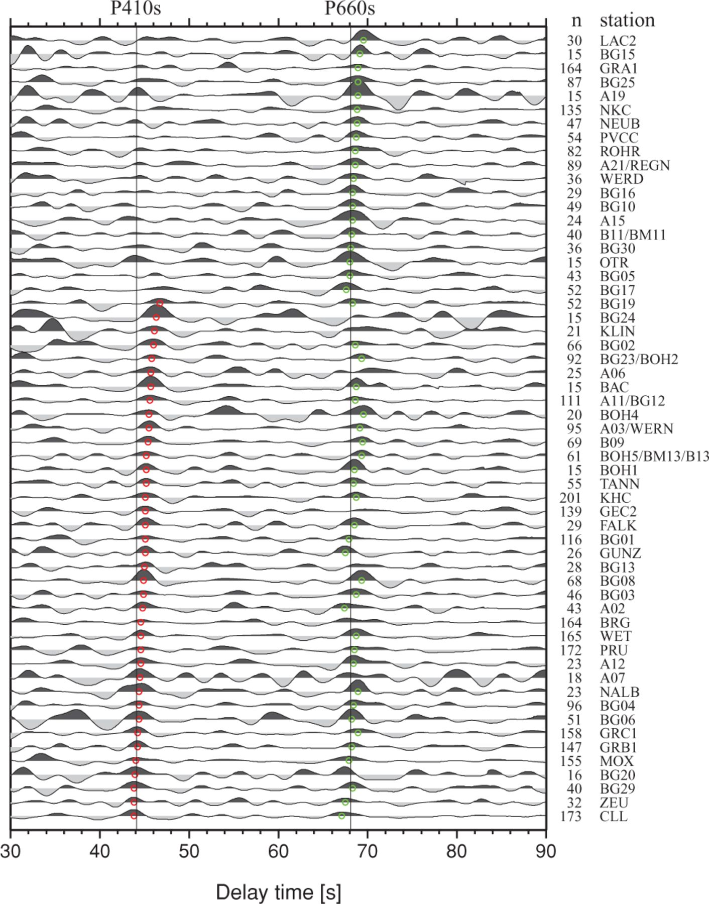
Figure 5 Sum traces at stations that yielded at least 15 high-quality individual receiver function traces. Explanation ...
Notes:
Figure 5 Sum traces at stations that yielded at least 15 high-quality individual receiver function traces. Explanation see Fig. 3. The traces were sorted by the measured delay time of the P410s conversion signal, marked by red circles. The measured delay times of the P660s conversion signal are marked by green circles. For traces with no circle, no clear conversion signal could be determined. Stations showing no clear signal of P410s are randomly distributed over the investigated area.
Unless provided in the caption above, the following copyright applies to the content of this slide: © The Authors Geophysical Journal International © 2011 RAS

Slide 11
Figure 6 (a) Map of the delay time values measured for the P410s conversion signal at each station. One colour ...
Notes:
Figure 6 (a) Map of the delay time values measured for the P410s conversion signal at each station. One colour comprises 1 s. Green colour indicates a value close to the prediction by the IASP91 reference model (44.1 ± 0.5 s). Red shades indicate increased delay time values, corresponding to a deepening of the discontinuity due to increased temperature, or to decreased seismic velocities above the discontinuity. Blue shades indicate smaller delay times, corresponding to an updoming of the ‘410’ due to relatively lower temperature, or to increased seismic velocities above the discontinuity. For grey coloured stations, no value could be determined from the sum trace. The light grey crosses show the distribution of the piercing points at 410-km depth (see Fig. 4). (b) Like Fig. 6(a), but for the discontinuity at 660-km depth. Note that the colour scale is reversed, because for the ‘660’ the Clapeyron slope of the phase transition is also reversed. That means that increased temperature near the discontinuity would lead to updoming of the discontinuity, while lower temperature would lead to a downshift. Green colour indicates a value close to the prediction by the IASP91 reference model (68.1 ± 0.5 s). (c) Like Fig. 6(a), but for the differential time between P660s and P410s. Green colour indicates ‘normal’ thickness as predicted by the IASP91 reference model (24.0 ± 0.5 s). Blue shades indicate increased delay time differences, which correspond to increased thickness of the mantle transition zone due to relatively cool temperature. Red shades indicate smaller delay time differences than in IASP91, corresponding to a thinner mantle transition zone due to relatively high temperature.
Unless provided in the caption above, the following copyright applies to the content of this slide: © The Authors Geophysical Journal International © 2011 RAS

Slide 12
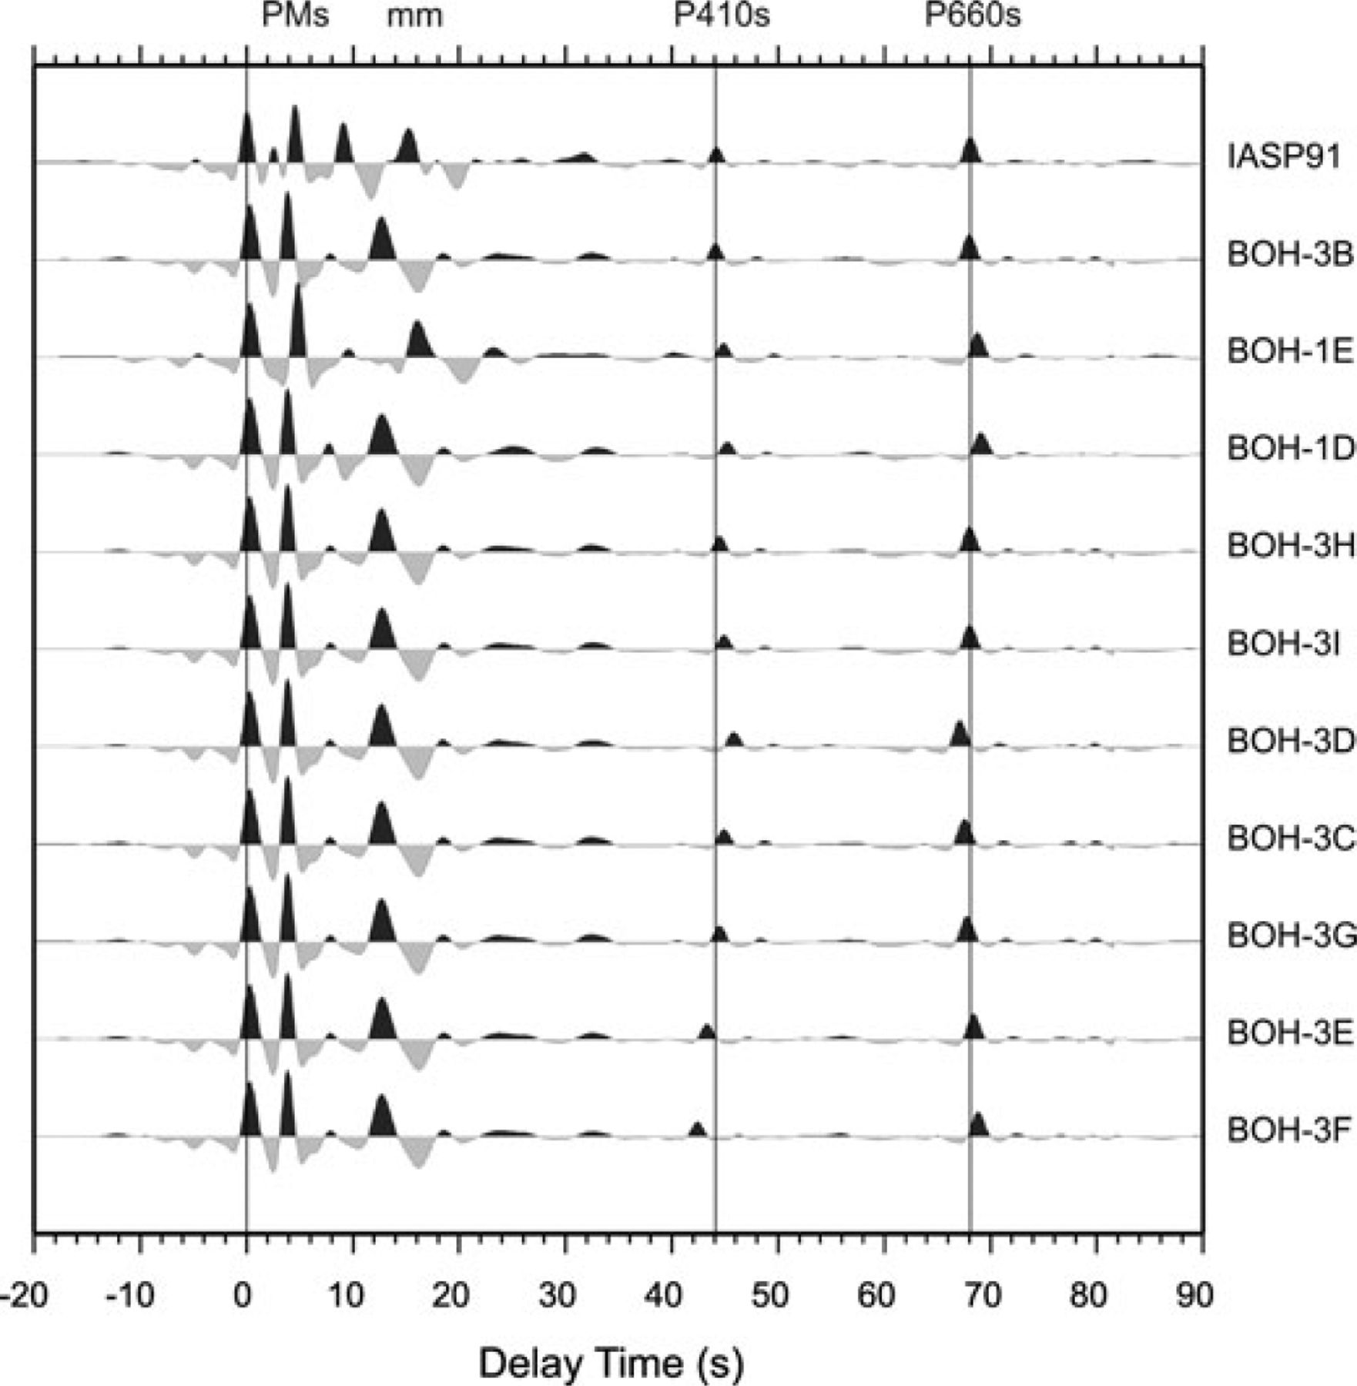
Figure 10 Stacked receiver functions for theoretical seismograms. The arrival times of the MTZ conversions 410 and 660 ...
Notes:
Figure 10 Stacked receiver functions for theoretical seismograms. The arrival times of the MTZ conversions 410 and 660 strongly depend on the velocity model (see Table 3).
Unless provided in the caption above, the following copyright applies to the content of this slide: © The Authors Geophysical Journal International © 2011 RAS

Slide 13
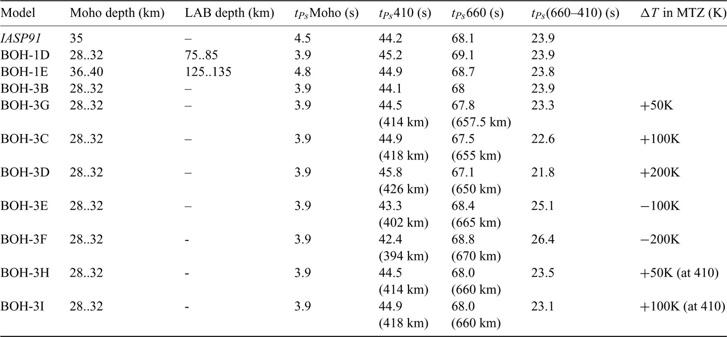
Table 3
Notes:
Table 3
Unless provided in the caption above, the following copyright applies to the content of this slide: © The Authors Geophysical Journal International © 2011 RAS

