Slide 1
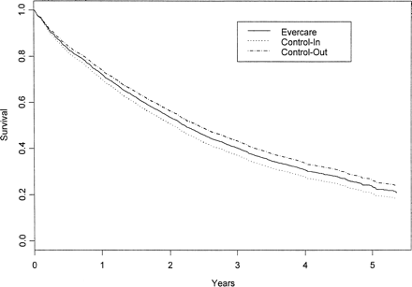
Figure 1. Survival curves
Notes:
Figure 1. Survival curves
Unless provided in the caption above, the following copyright applies to the content of this slide: The Gerontological Society of America

