Slide 1
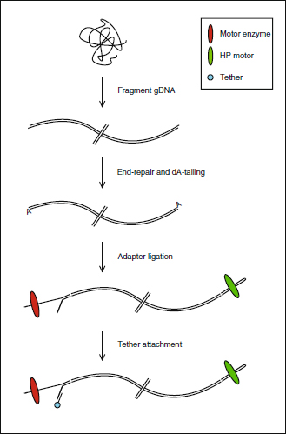
Figure 1 Library preparation schematic for latest version of gDNA sequencing kit (SQK-MAP-003). Figure shows ...
Notes:
Figure 1 Library preparation schematic for latest version of gDNA sequencing kit (SQK-MAP-003). Figure shows attachment sites for each of the two enzymes and tether.
Unless provided in the caption above, the following copyright applies to the content of this slide: Quick et al.; licensee BioMed Central Ltd.This is an Open Access article distributed under the terms of the Creative Commons Attribution License (http://creativecommons.org/licenses/by/4.0), which permits unrestricted use, distribution, and reproduction in any medium, provided the original work is properly credited. The Creative Commons Public Domain Dedication waiver (http://creativecommons.org/publicdomain/zero/1.0/) applies to the data made available in this article, unless otherwise stated.

Slide 2
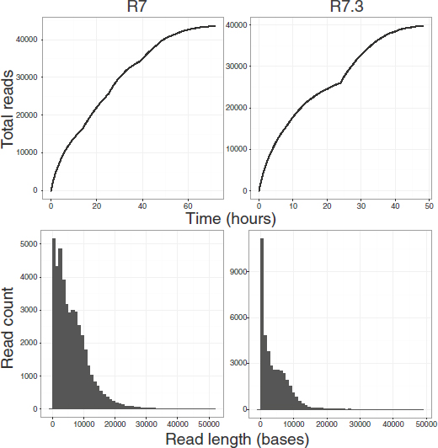
Figure 2 The top row plots demonstrate collector's curves of sequence reads over time measured in hours for the R7 ...
Notes:
Figure 2 The top row plots demonstrate collector's curves of sequence reads over time measured in hours for the R7 (left) and R7.3 (right) run. Visible on the R7 run is a change in rate of read acquisition associated with topping-up the flowcell with additional library at hours 12, 24, 36 and 48. For the R7.3 run, the updated MinKNOW software reselects sequencing wells after 24 hours. The bottom row shows the histogram of read counts for reads shorter than 50,000 bp in length for the R7 (left) and R7.3 (right) run.
Unless provided in the caption above, the following copyright applies to the content of this slide: Quick et al.; licensee BioMed Central Ltd.This is an Open Access article distributed under the terms of the Creative Commons Attribution License (http://creativecommons.org/licenses/by/4.0), which permits unrestricted use, distribution, and reproduction in any medium, provided the original work is properly credited. The Creative Commons Public Domain Dedication waiver (http://creativecommons.org/publicdomain/zero/1.0/) applies to the data made available in this article, unless otherwise stated.

Slide 3
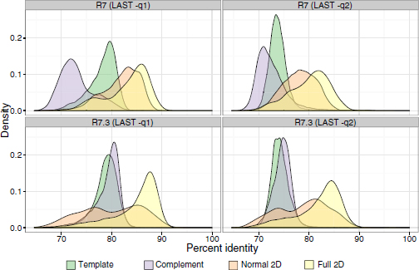
Figure 3 Kernel density plots showing accuracy for R7 and R7.3 chemistries with two different values for the LAST ...
Notes:
Figure 3 Kernel density plots showing accuracy for R7 and R7.3 chemistries with two different values for the LAST substitution penalty score.
Unless provided in the caption above, the following copyright applies to the content of this slide: Quick et al.; licensee BioMed Central Ltd.This is an Open Access article distributed under the terms of the Creative Commons Attribution License (http://creativecommons.org/licenses/by/4.0), which permits unrestricted use, distribution, and reproduction in any medium, provided the original work is properly credited. The Creative Commons Public Domain Dedication waiver (http://creativecommons.org/publicdomain/zero/1.0/) applies to the data made available in this article, unless otherwise stated.

Slide 4
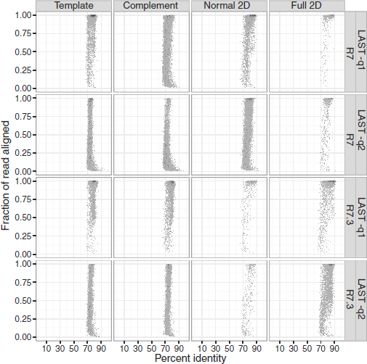
Figure 4 Alignment identity and completeness. Each plot reflects the alignment identity and the proportion of the read ...
Notes:
Figure 4 Alignment identity and completeness. Each plot reflects the alignment identity and the proportion of the read aligned for all 2D reads, as well as the underlying template and complement sequences. The top two panels reflect the alignment results for normal and full 2D reads from the R7 flowcell, and the bottom two panels reflect the R7.3 flowcell. Left panels employ a mismatch penalty of 1 and right panels reflect a mismatch penalty of 2. Overall, the lower mismatch penalty increases the identity and fraction of the read that aligned and this effect is greatest for full 2D reads.
Unless provided in the caption above, the following copyright applies to the content of this slide: Quick et al.; licensee BioMed Central Ltd.This is an Open Access article distributed under the terms of the Creative Commons Attribution License (http://creativecommons.org/licenses/by/4.0), which permits unrestricted use, distribution, and reproduction in any medium, provided the original work is properly credited. The Creative Commons Public Domain Dedication waiver (http://creativecommons.org/publicdomain/zero/1.0/) applies to the data made available in this article, unless otherwise stated.

